Slide 1
STUDENTS GRIEVANCE SYSTEM
ST JOSEPH’S COLLEGE OF ENGINEERING
B.TECH IT - 3RD YEAR
TEAM NAME : BASE64
TEAM MEMBERS:
VENKATESH.K
SRENIVASAN.K.S
SANTHOSH.A
SYED NISHAD.N
VIGNESH.K

Slide 2
STUDENTS GRIEVANCE SYSTEM
Student grievance system is a structural system which helps students to report a complaint or a cause of discomfort caused by their fellow classmates or the staffs of their respective subjects.
This comprises of three logins namely
Student Login
Grievance Cell Member’s Login
Admin Login

Slide 3
STUDENT LOGIN
It helps with the student to report the grievance in the department or of that of college.
It collects information On student details and grievances.
It helps students to check the status of the complaint.
They can view response given by committee members.

Slide 4
GRIEVANCE CELL MEMBER LOGIN
It enable the council members to access the grievances reported by students without the information on the students.
It enables cell members to view reports.
ADMIN LOGIN
Enables the students and the members to change their passwords and maintain the feedbacks submitted by the students.

Slide 5
REACT.JS
Onscreen side of webpages-client-side applications.
JAVASCRIPT
Express.js and node.js(framework) Server-side applications.
1
2
MONGODB
For database and backend.
3

Slide 6
LIMITATIONS OF OTHER EXISTING SYSTEMS
NO QUICK DATA SEARCHING FACILITY FOR INFORMATION
Sorting of grievances based on grievance(categories) and status of complaint is difficult.
NO PROPER MANAGEMENT OF INFORMATION
Which results in difficulty in retrieving, storing and updating data.
REDUNDANCY OF DATA
Once a complaint has been sorted by the cell member,the status of the complaint is not being updated which leads to data redundancy.

Slide 7
SALIENT FEATURES
Students are able to report if they have the same problem by just liking the report submitted by other students.
Graph representation of reports on all fields of grievances.
Admin can access the feedbacks on webapp.
Change of password requested to admin via forms.
Students can able to track the grievance once the complaint has been registered.
Grievance reported by the student is completely anonymous.

Slide 8
PROPOSED SYSTEM
The idea is to automate the entire complaint process.
Grievances can be lodged based on the department level and also based on the categories(i.e., academics, financial, library, accommodation, campus…).
Students can track the grievance once the complaint has been registered.
Cell members are provided with a form where they can give a response regarding the grievance.
Cell Member can track the pending and completed grievances.

Slide 9
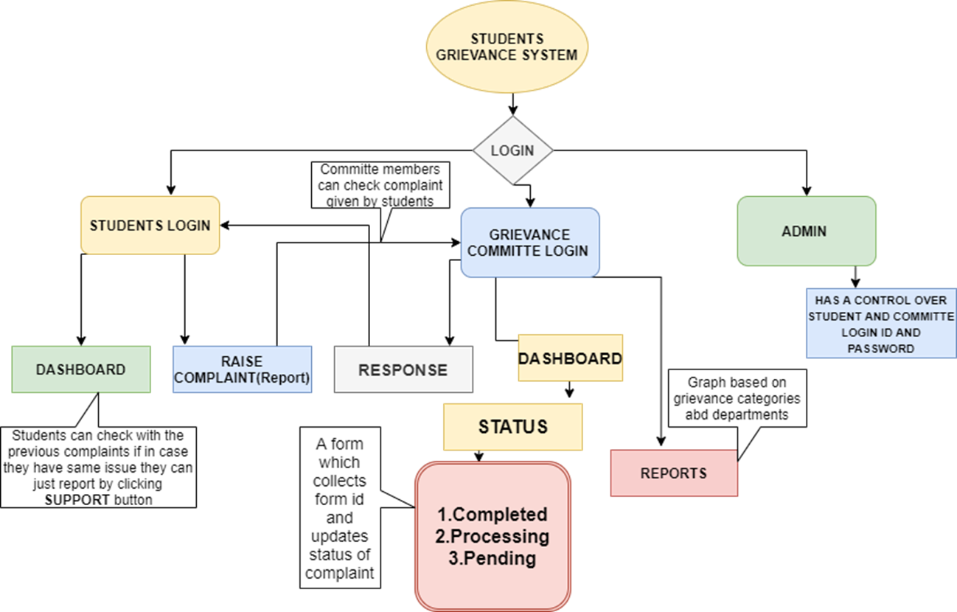

Slide 10
ROADMAP - STUDENT LOGIN:
Students are able to track the status of complaint
Login module
Student can report a new grievance
1
3
5
2
4
A dashboard that displays all the previous posted
grievance details
If a student has same issue which has already been posted ,they can report just by clicking the support button

Slide 11
ROADMAP - GRIEVANCE COMMITTEE MEMBER LOGIN:
Login module
Sort grievances based on categories
Grievance reports
1
3
5
2
4
Action taken on grievance
Viewing grievances

Slide 12
CHALLENGES FACED
Adding Support Function.
Creating Reports Module.
Sorting Function.

Slide 13
REVIEW
The project focuses on developing a typical student grievance system which works and functions for registering student issues.
Thus ,The project ensures a democratic campus environment, acquaints all the faculty and students about their rights, and also provides a qualitative and quantitative development of the college.
The main objective of the complaints management system is to make complaints easier to resolve and to target problem areas. It is used to record, resolve and respond to students complaints.

Slide 14



Thanks!
Any questions?

