Slide 1





















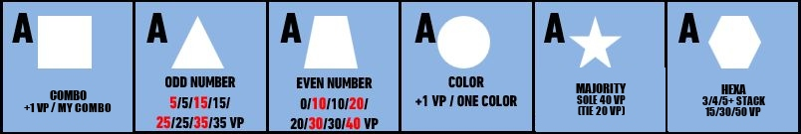
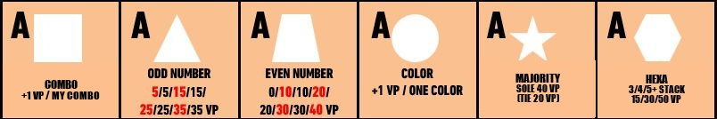
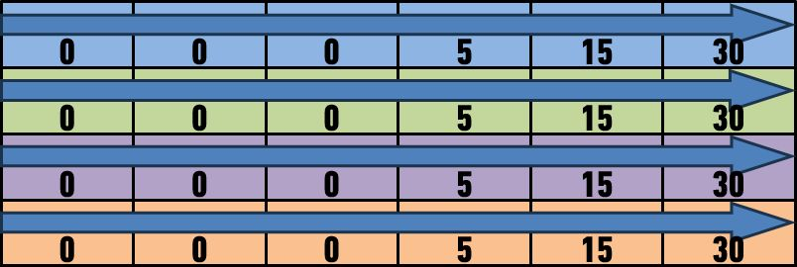


Heaven’s Door
2-4 Players
Ages 8+
30 min
Drafting
Set Collection
Key Selling Points
A beautiful and easy set collection game with unique components
Provides diverse gameplay experiences through various scoring conditions
How to Play
This game allows players to choose scoring conditions as Type A, Type B, or a mix of both, which are decided collectively before starting the game.
A set number of tiles is arranged depending on the number of players.
On each turn, players can take sets of tiles from the revealed ones if they meet the acquisition conditions: tiles with the same color or the same symbol.
Collected tiles are placed in each player's personal space.
Each symbol has different scoring conditions, and scores vary depending on the number of tiles collected for each symbol.
The game ends after all players have completed 10 turns.
When the game ends, the player with the highest total score wins, based on the following:
  Points earned for each symbol
  Collection bonus for acquiring a variety of symbols
  Bonus points for COMBO/DUPLICATE tiles collected
Components | 96 game tiles, 32 personal tiles, 4 personal boards
Game Tile Setup
8 Personal Tiles
Personal Board
8 Personal Tiles
Ikhwan Kwon / (+82)10-5195-8528 / gamedesigner.ikhwan@gmail.com

Slide 2
Heaven’s Door / Brief Game Rule
1. Goal of the game
The player with the highest score at the end of the game wins.
2. Set up
At the start of the game, players can choose the scoring conditions as
Type A, Type B, or a mix of both. The conditions are decided collectively
before the game begins.
Each player takes one personal board and 8 personal tiles.
4-player game: Stack the tiles in three layers:
First layer: 7x6 tiles / Second layer: 6x5 tiles / Third layer: 5x4 tiles
3-player game: Stack the tiles in two layers:
First layer: 7x6 tiles / Second layer: 6x5 tiles
2-player game: Stack the tiles in two layers:
First layer: 6x5 tiles / Second layer: 5x4 tiles
The tiles on the topmost layer must all be placed face-up.
For tiles in other layers, place them randomly face-up or face-down.
3. How to Play
On each turn, players choose two tiles that meet the acquisition conditions,
either matching in color or symbol.
> The chosen tiles must have their front sides visible and at least one edge
exposed to the outside.
The acquired tiles are placed in the order of the symbols collected first.
Each symbol has different scoring conditions. If the scoring condition is
"mixed," players must decide which side of the scoring condition to use
when placing each symbol for the first time.
If two types of symbols are acquired simultaneously, players must decide
which symbol to place in left side.
For each symbol, duplicate colors of tiles cannot be placed.
If 2 tiles with both the same symbol & color are acquired in a single turn:
Place 1 tile in the personal board's scoring area as a normal acquisition.
Place the other tile beneath the [COMBO] tile area.
If the acquired tile is identical to a previously acquired tile, place it beneath
the [DUPLICATE] tile area.
During the game, if a tile placed face-down is revealed, flip it face-up
immediately.
The game ends after 10 turns, when each player has collected 20 tiles.
4. Scoring & Victory
The player with the highest total of the following scores wins:
  Points earned from each symbol's scoring conditions
  Collection points for acquiring various symbols
  Points from tiles collected under the COMBO/DUPLICATE tile areas

Slide 3





Heaven’s Door / Full Rulebook
1. Game Information
2~4 players / 30 min. / 8+
Drafting, Set Collection
2. Components
4 personal boards
32 personal tiles (8x4 tiles)
The personal tiles consist of 6 tiles that display the scoring conditions
for each symbol and 2 tiles that indicate COMBO/DUPLICATE.
The scoring condition tiles are double-sided, with type A and type B,
as shown in the picture below.
96 game tiles
There are 6 symbols, each with 8 colors, and each tile exists in pairs,
resulting in a total of 8 x 6 x 2 = 96 tiles.
There are four personal boards
in the elongated shape shown
in the left picture,
each in a different color.

Slide 4
Heaven’s Door / Full Rulebook
3. Set Up
C
B
At the start of the game, players can choose the scoring conditions as Type A, Type B, or a mix of both. The conditions should be decided collectively before starting the game.
* For the first game, it is recommended to choose either Type A or Type B, and play with the same conditions for all players.
Each player takes one personal board and 8 personal tiles.
4-player game: Stack the tiles in three layers:
First layer: 7x6 tiles / Second layer: 6x5 tiles / Third layer: 5x4 tiles
3-player game: Stack the tiles in two layers:
First layer: 7x6 tiles / Second layer: 6x5 tiles
2-player game: Stack the tiles in two layers:
First layer: 6x5 tiles / Second layer: 5x4 tiles
The tiles on the topmost layer must all be placed face-up.
For the tiles in other layers, place them randomly face-up or face-down.
Next, determine who will play first.

Slide 5
Heaven’s Door / Full Rulebook
4. How to Play
1. The game begins with the first player, and each player, on their turn, selects
2 tiles that meet the acquisition conditions, either matching in color or symbol.
※ Tile Acquisition Conditions: The front side of the tile must be visible,
and one of its edges must be exposed to the outside.
At the start of the game, the tiles marked with a blue box in the picture below
are considered "acquirable tiles.“
Tiles on the 1st layer are not acquirable because their front side is not visible.
For tiles on the 2nd layer, tiles located inside (without exposed edges)
re not acquirable.
2. When acquiring tiles, if it is the first time a symbol is being collected,
the following must be handled based on the game conditions:
If two tiles of the same color are taken and two different symbols are
acquired simultaneously, the player must decide which tile to place
on the left side of their personal board.
If the scoring condition is set to "mixed," the player must decide
which side of the scoring condition (A or B type) to apply for each symbol.
After making these decisions, place the personal tiles on the upper side of the
personal board and the acquired tiles on the lower side of the personal board.
For example, if the player acquires a blue triangle and a hexagon, the tiles are
placed as follows:

Slide 6
Heaven’s Door / Full Rulebook
4. How to Play
3. During the game, if a player acquires two tiles in a single turn that are
completely identical in both color and symbol, this is called a [COMBO].
In this case, one tile is placed on the personal board as a normal tile,
and the other tile is placed under the separate personal tile labeled [COMBO].
Additionally, if a player acquires a tile identical to one they already possess,
the acquired tile is placed under the separate personal tile labeled [DUPLICATE].
So, a tile of the same color can’t be placed on a tile stack for the same symbol.
4. During the game, if the front side of a tile that was previously face-down
becomes visible, the tile is flipped to reveal its front.
For example, as shown with the red tile in the illustration, if the entire surface
becomes exposed, the tile is flipped to display its front side.
5. Once a player finishes their turn, the player to their left takes the next turn.

Slide 7
Heaven’s Door / Full Rulebook
5. Game End & Victory
- Symbol Collection
The game ends when all players have completed 10 turns and collected a total
of 20 tiles. Each symbol's score is calculated based on the following conditions:
- Set Collection
The more types of symbols collected, the higher the bonus points:
1/2/3/4/5/6 types collected: 0/0/0/5/15/30 points.
- COMBO & DUPLICATE
Tiles under the COMBO tile earn 7 points each.
Tiles under the DUPLICATE tile earn 2 points each.
 | TYPE A | TYPE B
Triangle ▲ | Each tile earns 5 points, but scoring increases only for an odd number of tiles collected. The points for tiles are distributed as follows: 5/5/15/15/25/25/35/35 points per tile. | Points are calculated as (number of tiles+1)², but scoring increases only for an odd number of tiles collected. The points for tiles are as follows: 4/4/16/16/36/36/64/64 points per tile.
Trapezoid | Each tile earns 5 points, but scoring increases only for an even number of tiles collected. The points for tiles are distributed as follows: 0/10/10/20/20/30/30/40 points per tile. | Points are calculated as (number of tiles+1)², but scoring increases only for an even number of tiles collected. The points for tiles are as follows: 0/9/9/25/25/49/49/81 points per tile.
Square ■ | For each tile, earn 1 point for every combo the player has achieved. | For each tile, earn 3 points for every duplicate the player has achieved.
Circle ● | For each tile, earn points equal to the number of tiles in the color the player collected the most. | For each tile, earn points equal to the number of tiles stacked in the leftmost 1st column of the tiles the player has acquired.
Star ★ | If a player has acquired the most stars without any ties, the player earns 40 points (20 points each if tied). | If you are not the player who acquired the fewest stars, you earn 25 points.
Hexagon | If a player has acquired 3/4/5+ hexagon tiles, the player earns 15/30/50 points. | If a player isn’t the player who collected the most hexagon tiles, the player earn 6 points per tile.

