Slide 1

GAME DESIGN EXERCISE
Original slides by: Jeremy Gibson Bond
Adapted by: Erel Segal-Halevi
CHAPTER 01

Slide 2
Bartok: A Game Design Exercise
Bartok is played by 3 to 5 players.
A standard deck of playing cards.
  Break into groups of 3-5 players each
  Remove the Jokers from the deck
  Shuffle the cards

Slide 3
Bartok: A Game Design Exercise
Objective
  Be the first person to run out of cards.
Standard Rules:
  Deal 5 cards to each player.
    The remaining cards become a draw pile
  Flip over the top card of the draw pile to start a discard pile.
  The person to the left of the dealer plays first.
  The person to the left of the first player plays second, etc.
  Each player must play a card onto the discard pile, that matches the suit or number of the top card of the discard pile.
  If she can’t, she must draw a card.

Slide 4
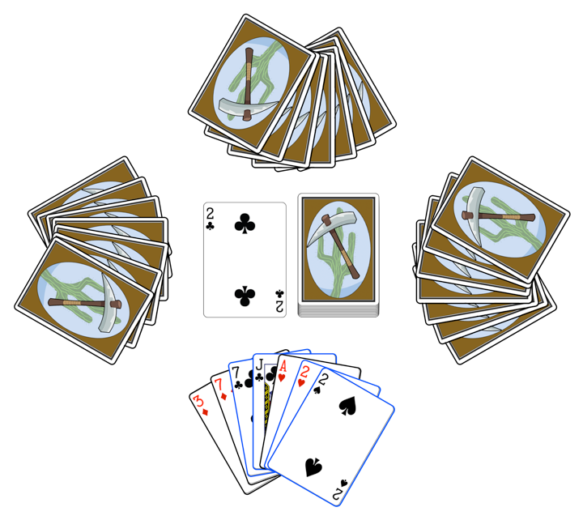
Bartok: A Game Design Exercise
Example
The player can choose to play any one of the cards
highlighted with blue borders (7C, JC, 2H, 2S).

Slide 5
Analysis: Asking the Right Questions
Answer the questions on paper:
  Is the game of the appropriate difficulty -
  Too easy? Too hard? Just right?
  Is the game outcome based more
  on strategy? On chance?
  Are the decisions you make in the game
  meaningful? Interesting?
  Is the game interesting when
  it is not your turn?

Slide 6
Design: Modifying the Rules
Each group should pick a number (1 – 3)
Based on the number, add a rule to the game:
  Rule 1: If a player plays a 2, the person to her left must draw two cards instead of playing.
  Rule 2: If any player has a card that matches the number and color (red or black) of the top card, she may announce "Match card!" and play it out of turn. Play then continues with the player to the left of the one who just played the out-of-turn card. This can lead to players having their turns skipped.
  Rule 3: A player must announce “Last card” when she has only one card left. If someone else calls it first, she must draw two cards (bringing her total number of cards to three).

Slide 7
WATCH OUT FOR PLAYTESTING FLUKES
A strange shuffle or other external force can cause one playtest of the game to be very different from others
You must playtest several times to ensure that you experience an average playtest and not a fluke
However, you must also note any flukes that happen because they can also happen to players

Slide 8
Analysis: Asking the Right Questions
How did the single rule change the game?
Have the answers to your questions changed?
  Is the game of the appropriate difficulty -
  Too easy? Too hard? Just right?
  Is the game outcome based more
  on strategy? On chance?
  Are the decisions you make in the game
  meaningful? Interesting?
  Is the game interesting when
  it is not your turn?
Discuss the changes to these answers
for each of the three rules.

Slide 9
Design: Making Your Own Rules
Each group should pick a number (1 – 3)
Based on the number, change the game rules to attain the following design goal:
  Goal 1: Winning the game requires strategic thinking.
  Goal 2: Winning the game requires speed of arms.
  Goal 3: The game is funny.
Make only a single small change each time.
Test each change in isolation.

Slide 10
Discussion
What game feel was your team seeking?
What rule(s) did your team create?
How well did they work?

