Slide 1

ALPHA ARENA • MERAZ 7.0
Gateway
error
AI-POWERED TRADING STRATEGY
Aditya Kumar • Ujjwal Chandra
OpenLake, IIT Bhilai | 1 November 2026
BUILD • TEST • GENERALIZE

Slide 2

The challenge
Build a strategy that performs on historical market data — then prove it on data it has never seen.
15 years of Yahoo Finance data supplied by the organizers
Choose up to 10 years for training
Final evaluation uses a secret, unseen year or time period
Virtual starting capital: ₹1,00,000
The objective is not just high returns — it is robust performance under unseen conditions.
GATEWAY ERROR • ALPHA ARENA / MERAZ 7.0
02

Slide 3
Our approach
A market-regime signal controls portfolio exposure. We compare equal-weight allocation with a volatility-aware alternative.
01
02
03
04
Market data
→
Regime signal
→
Portfolio weights
→
Evaluation
Historical price series
200-day average + 126-day momentum
Exposure and stock allocation
Return, risk and trading costs
Conceptual workflow based on the strategy descriptions provided; implementation details can be refined after reviewing the repository.
GATEWAY ERROR • ALPHA ARENA / MERAZ 7.0
03

Slide 4
Dataset & evaluation design
DATA
EVALUATION PRINCIPLE
15 years
Out-of-sample
validation
Yahoo Finance historical dataset
TRAINING WINDOW
Up to 10 years
Avoid future-data leakage. Compare strategies under the same capital, data conditions, execution rules and cost assumptions.
Unseen period reserved for final evaluation
GATEWAY ERROR • ALPHA ARENA / MERAZ 7.0
04

Slide 5
Three strategy candidates
STRATEGY 1
STRATEGY 2
STRATEGY 3
Higher-exposure
confirmed trend
Confirmed
market trend
Trend-gated
inverse volatility
50% exposure when the market is above its 200-day average and has positive 126-day momentum; otherwise 30%.
Same market confirmation; 45% exposure in a positive regime and 30% otherwise. Equal weights across stocks.
Same 45% / 30% regime exposure as Strategy 2, with weights allocated inversely to recent 63-day volatility.
Highest reported return: 289.18%
Lowest reported drawdown: −13.48%
Highest reported Sharpe: 1.548
GATEWAY ERROR • ALPHA ARENA / MERAZ 7.0
05

Slide 6
Strategy trade-offs
Candidate | Return | Max drawdown | Calmar | Interpretation
Strategy 1 | 289.18% | −14.98% | 0.993 | Highest return; drawdown just inside 15% limit, Calmar narrowly below 1.
Strategy 2 | 250.97% | −13.48% | 1.014 | Most conservative; lowest drawdown and only Calmar above 1.
Strategy 3 | Not supplied | Not supplied | Not supplied | Highest Sharpe (1.548); highest reported trading costs (6.39%).
Strategy 3's return, drawdown and Calmar values were not included in the supplied strategy notes.
Selection depends on the objective: maximize return, control drawdown, or improve risk-adjusted performance.
GATEWAY ERROR • ALPHA ARENA / MERAZ 7.0
06

Slide 7
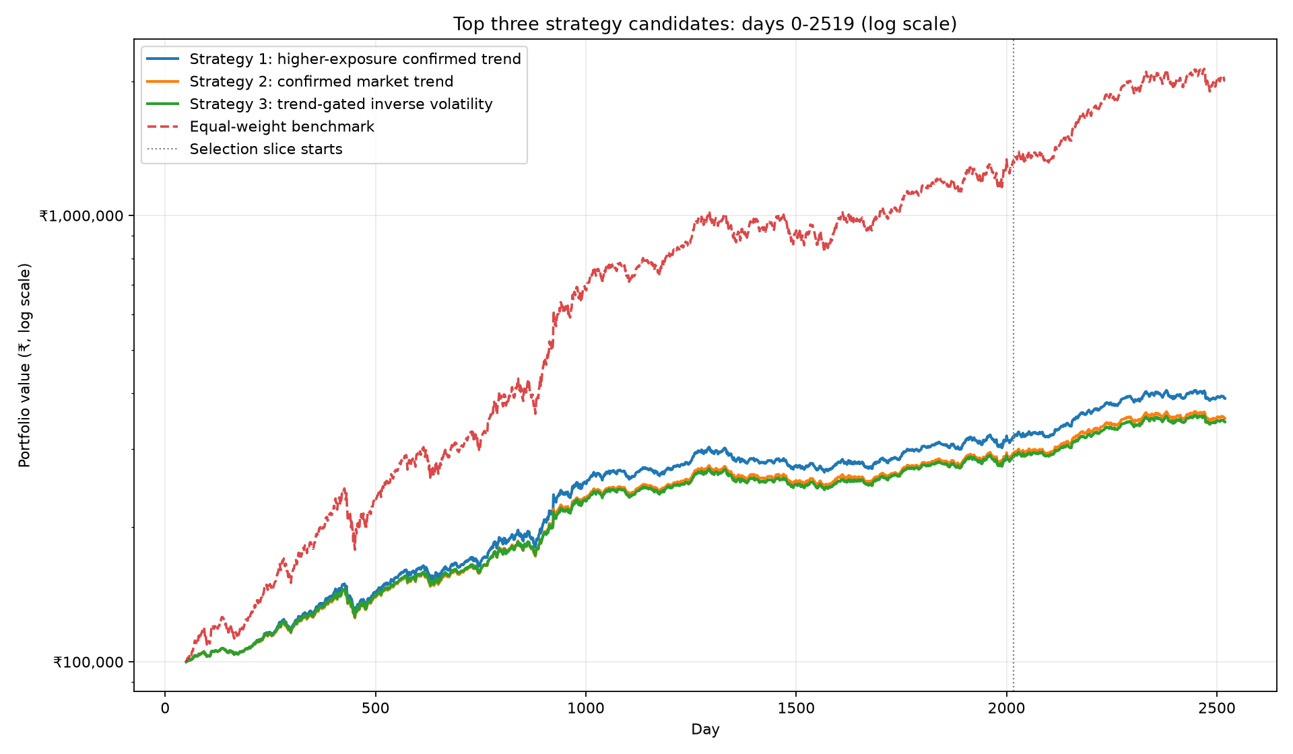
Portfolio growth comparison
Supplied chart: candidate strategies vs equal-weight benchmark; days 0–2519, logarithmic portfolio-value axis.
GATEWAY ERROR • ALPHA ARENA / MERAZ 7.0
07

Slide 8
Reported performance metrics
Metric | Strategy 1 | Strategy 2 | Strategy 3
Return | 21.90% | 19.83% | 19.29%
Sharpe ratio | 1.476 | 1.487 | 1.498
Calmar ratio | 1.996 | 2.006 | 2.002
Maximum drawdown | −5.22% | −4.72% | −4.60%
Trading accuracy | 51.37% | 51.37% | 51.37%
Costs paid | 0.42% | 0.32% | 1.12%
Average exposure | 48.02% | 43.51% | 43.51%
Source: metric table supplied by the team.
GATEWAY ERROR • ALPHA ARENA / MERAZ 7.0
08

Slide 9
What the results suggest
01
Return leadership
Strategy 1 leads the supplied strategy-note return comparison.
02
Risk control
Strategy 2 reports the lowest drawdown and Calmar above 1.
03
Risk-adjusted profile
Strategy 3 reports the highest Sharpe in the strategy notes, but also the highest costs.
No single candidate dominates every objective; the preferred strategy depends on the scoring priorities.
GATEWAY ERROR • ALPHA ARENA / MERAZ 7.0
09

Slide 10
Data note before final submission
Two return figures are present in the supplied material.
STRATEGY NOTES
METRICS TABLE
289.18% • 250.97%
21.90% • 19.83% • 19.29%
Strategy 1 and Strategy 2 returns
Strategy 1, 2 and 3 return values
These may represent different definitions or evaluation windows. They are shown separately and should be reconciled before presenting them as directly comparable.
GATEWAY ERROR • ALPHA ARENA / MERAZ 7.0
10

Slide 11
Conclusion
A regime-aware portfolio can adapt its exposure to market conditions.
Trend confirmation is the common signal across all three candidates
Exposure sizing changes the return–risk trade-off
Inverse-volatility weighting prioritizes lower-volatility stocks
Out-of-sample robustness matters more than training performance alone
GATEWAY ERROR • ALPHA ARENA / MERAZ 7.0
11

Slide 12
GATEWAY
ERROR
Thank you.
Aditya Kumar • Ujjwal Chandra
Alpha Arena | MERAZ 7.0 | OpenLake, IIT Bhilai
GATEWAY ERROR • ALPHA ARENA / MERAZ 7.0
12

