Slide 1

Scalable Game Development
William Roberts
Senior Game Engineer
Schell Games – www.schellgames.com
Notes:
Good afternoon, my name is William Roberts. I am a senior game engineer at Schell Games. Building large applications with Unity can often be troublesome. Today I am going to discuss the process we use to alleviate a number of common issues.

Slide 2
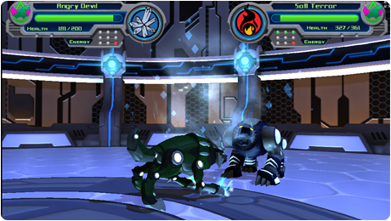



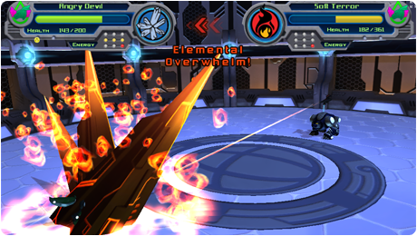
Notes:
The process and framework I am about to discuss was originally developed for *Mechatars. We wanted to build a an extendable framework that can be quickly applied to new projects. More recently, the framework was used to get our Innercube puzzle game off the ground and running.
*Mechatars is a blended reality game that exists both online and in toy robot form. (www.mechatars.com)

Slide 3
The Monolithic Project
Takes an extremely long time to import assets.
Editor becomes unstable as the project size grows.
Notes:
We found that having an single Unity project created an variety of problems when building large scale projects. A large number of assets being added or modified caused the Unity editor to take an extremely long time to import assets. Sometimes it would take us an hour or more to load up an project.
Additionally, the Unity Editor tends to become unstable as the project size grows. If the editor crashes during the import process, the asset database will become in an corrupted state. Therefore, the asset database will need rebuilt from scratch when the project is reloaded. Thus taking even longer for Unity to load the project.
The majority of our projects involve a large number of assets being created. Therefore, coming up with a process for handling this scenario was ideal.

Slide 4
Scalable Game Development
Unity Projects
Art Pipeline
Code
Build Tools
Notes:
There is a better approach to building large scale unity projects.
Split the project into many Unity projects.
Export art assets in a format that can be natively ingested by Unity without the help of third party software (ie: Maya, 3DS Max, etc).
Build the source code as .NET DLL’s.
Create a custom toolset for quickly building and deploying the project.
I am now going to break down and explain each of these four pillars.

Slide 5
Unity Project Structure
Unity Projects
Notes:
Let’s start by discussing how we setup the Unity projects.

Slide 6
Typical Directory structure
Unity
Entry Point Project
Project A
Project B
Project etc...
Code
DLL Library Project A
DLL Library Project B
DLL Library Project etc...
BuildTools
Notes:
Our typical project directory looks similar to this. All of the Unity projects are placed into their own directory. None of the source code is stored within the projects. Instead, we create a separate directory that contains the entire code base. This directory also contains the Visual Studio projects and solutions needed to build the code base.

Slide 7
'Entry Point' Project
A single scene with a “main” game object.
All of the DLL’s needed to run and build the game.
A minimal amount of assets in the “Resources” directory.
Notes:
We have a single “main” project that we use as the entry point to the application. This project is super simple. Thus allowing us to quickly rebuild and deploy deploy code only changes. Typically it takes around 1-2 minutes to build the project.
Normally we have a single scene with a main game object to get everything up and running. This game object has a single script attached that starts downloading asset bundles. It also controls the initial flow of the application.
The project contains the dll’s needed to run and build the game. I will discuss dll’s more in depth during the code pillar of this presentation.
A minimal amount of assets are stored in the project. Typically these resources are just prefabs for our loading and error screens. Since all of the scenes and assets are asset bundles, we need a few assets to gracefully handle the loading of resources during startup. We keep the number of assets minimal to ensure the project opens and builds as quick as possible.

Slide 8
Content Projects
Content is split into multiple Unity projects.
Each project contains a copy of the dll's.
Similar assets are grouped together.
All assets are packaged into asset bundles.
Easy to rebuild portions of the project.
Notes:
Assets are divided up into a series of Unity projects. Each project contains a copy of the DLL’s.
Tip - Make sure to keep all of the DLL meta files in sync across multiple Unity projects. Otherwise you will not be able to move assets between projects.
We attempt to smartly group assets together. For instance, all of the scenes and assets dealing with arctic environments are grouped into a single Unity project. While assets for the dessert environments reside in their own project.
All of the assets are packaged into asset bundles using an helper tool that we developed.
Splitting the projects up this way makes it easy to rebuild a portion of the application. For instance, we can easily rebuild the arctic environment without needing to load the desert environment. Loading the project is significantly quicker, and we can guarantee that Unity does not touch resources we don’t currently care about.

Slide 9
Art Pipeline
Unity Projects
Art Pipeline
Notes:
Next we are going to discuss the art pipeline.

Slide 10
Art Pipeline - Pros
  Only artists need copies of 3rd party art tools installed.
  Faster import times.
  Asset Database becomes corrupted less frequently.
Notes:
Originally we had tried to use the Unity art pipeline as it was intended. However, we ran into an variety of problems when dealing with 3D model assets.
At Schell Games we currently use Maya for the majority of our modeling needs. The problem is that Maya is really expensive to purchase. We typically only buy full licenses for our 3D artists and a handful of floating licenses for the tech team. We found that Unity does not handle Maya floating licenses very gracefully. If all of the floating licenses are in use, the Editor and Maya will become in a hung state. This was not very ideal for us.
Therefore, we made the decision to export all 3D assets from Maya into a format that Unity could easily ingest.
Only 3D artists need to have an copy of Maya installed on their systems. Programmers and Designers only need Unity.
3D assets import much quicker. No longer need to wait for Maya to slowly start up.
The asset database becomes corrupted less frequently.

Slide 11
Art Pipeline - Cons
  Goes against the standard Unity work flow.
  Causes some extra work for the 3D artists.
Notes:
This work flow does have a few cons for the art team. It goes against the standard unity workflow. Because of this, there is some extra work for the art team. Each time they modify an 3D asset, they must be sure to export the asset to the correct location.
We feel that the pros of the process outweigh the cons.

Slide 12
Code Projects
Unity Projects
Art Pipeline
Code
Notes:
Now the moment you have been waiting for, the code section! ☺

Slide 13
Project Code Base - Pros
  Reusable core framework that can be shared between projects.
  Ability to use namespaces.
  Custom compiler preprocessor.
  Easily obfuscate code using professional tools.
Notes:
The entire code base was completely moved out of the Unity projects. This allows our developers to easily build the code base with either Visual Studio or MonoDevelop. Note that we choose to build our application with c-sharp to make this process easier.
Since the codebase is modular, it is relatively easy to setup a automated process to copy the DLL’s into the Unity projects.
Normally you are not allowed to place MonoBehaviours and other special Unity class objects within a namespace. However, if the code is placed within a .NET assembly, Unity will allow the use of namespaces.
Because we now have complete control over the code build process, we can use custom compiler preprocessor symbols. This makes it easily to strip debug code and tools from release builds.
Lastly we gain the capability to use professional toolsets for obfuscating the codebase.
Tip: The conditional attribute can be useful for removing debug code from release builds.
ie: [Conditional("DEBUG")]
public void RenderDebugStuff()
{
// Do debug stuff here…
}

Slide 14
Project Code Base - Cons
  Some of the Unity API methods no longer work as expected.
  MonoBehaviour visibility in inspector can become broken in certain scenarios.
  Editor cannot display source code documentation.
  May not play nice with certain export options (ie: Export to Flash).
Notes:
The biggest disadvantage of this approach is that some of the API will no longer work as expected. For instance, variations of GetComponent(...) that expect a string parameter will always return a null value.
Monobehaviour visibility within the Unity Editor becomes broken if a base class is located in a DLL and then inherited by an object that is located inside of a second DLL.
The Unity Editor will automatically display documentation for public MonoBehaviour variables. Because the code is built as an DLL, the editor is no longer able to parse the source code for comments.

Slide 15
Code Build Process
  Programmer selects “Build Solution” within the development studio of their choice.
  A special tool is executed to copy the projects output if the build was successful.
  Each assembly and debug database is automatically copied into each Unity project.
Notes:
Because Unity was no longer builds the code base, we wanted to make the process as seamless as possible. A small tool was developed to help copy the DLL’s into each of the Unity projects. This helps make the process of deploying dlls painless.
To start the process, a programmer selects “Build Solution” within the development studio of their choice.
If the build completed without any errors, the IDE will execute the build tool.
This will cause each assembly and debug database (mdb) to be copied into each Unity project.
Note that we separate our client code and editor code into separate DLL’s. This is because editor DLL’s must be copied into an special subdirectory named “Editor” (just like normal editor scripts). We specially tag the editor DLL’s so that the copy tool can identify them. The tool will automatically copy all tagged DLL’s into the “Editor” directory for us.

Slide 16
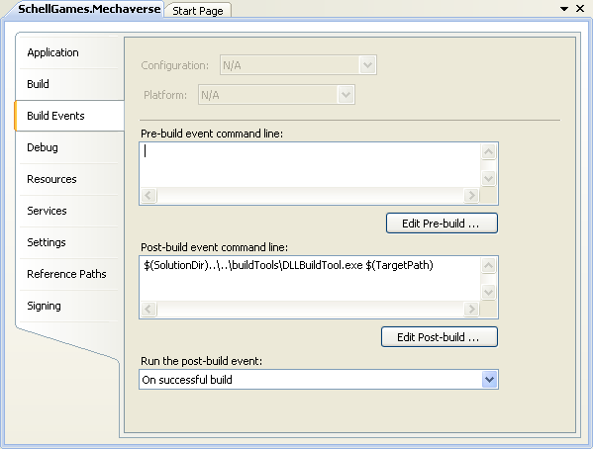
IDE Differences
  Build Events are not the same as Custom Commands.
  Visual Studio
  Build Events are essentially bat files that can be executed before or after a build.
Notes:
Both MonoDevelop and Visual Studio have the capability to execute commands during the build process. We use this mechanism to trigger our DLL copy tool.
Unfortunately both Visual Studio and MonoDevelop handle the commands differently.
Visual Studio has what is known as build events. You can think of build events as bat files that are executed before or after the build. In our case, we use the post-build event to execute our dll copy tool.

Slide 17
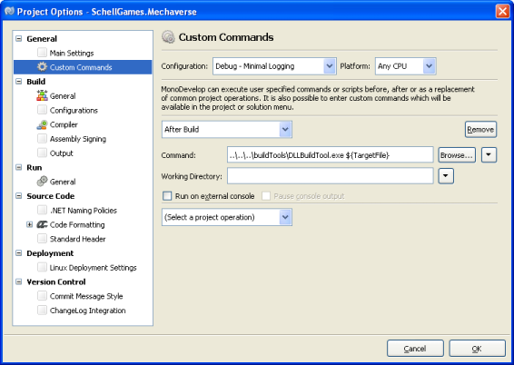
IDE Differences
  MonoDevelop Custom Commands are single commands that are executed before or after a build.
Notes:
MonoDevelop has what is known as custom commands.
Custom commands are single commands that will execute before or after a build. It is possible to specify multiple commands. However, they can only be executed in a linear fashion. Therefore, you may need to execute a bat file if there is a need for complex logic. We avoided the issue by having our complex logic housed within an actual program (the dll copy tool). This allowed us to keep both our Visual Studio build events and MonoDevelop custom commands similar.

Slide 18
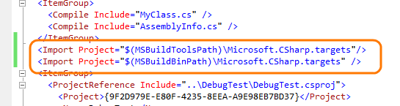
IDE Differences
  Both MonoDevelop and Visual Studio will attempt to insert the same target import using a different Environment Variable into the C# project file.
Notes:
You may want to setup your c-sharp projects for both MonoDevelop and Visual studio. In this case, you will discover that both MonoDevelop and Visual Studio will improperly insert their own version of the c-sharp target import into the project file.
The target should not be imported twice. You will notice that Visual Studio spits out warnings about the problem. You can easily correct the issue by manually editing the project file in notepad. Just find the extra import element and delete it to resolve the build warning.

Slide 19
Debug Databases
  The program database (PDB) file is an proprietary format developed by Microsoft.
  The mono team decided to create their own format (MDB).
  We need to generate MDB files in order to debug our assemblies.
Notes:
It is still possible to use the Unity debugger with external DLL’s. Although it does take a bit of setup work.
The program database (PDB) file is an proprietary format developed by Microsoft for storing program debugging and build state information. Since the PDB format is not open source the mono team decided to create their own format (MDB). Because of this, we must use MonoDevelop to generate the debug symbols.

Slide 20
Debugging External Assemblies
OSX
  MonoDevelop is setup out of the box.
Windows - 2 ways to make this work:
  Download and install the official Mono SDK (Easiest way)
  Modify the MonoDevelop configuration files to point to Unity’s Mono directory.
Notes:
Out of the box, the OSX version of MonoDevelop is setup to target Mono as the runtime. Therefore, we do not need to change any settings.
The Windows version of MonoDevelop is setup to use the Microsoft .NET Framework by default. In order to build the mono debug database files, we must configure the IDE to target the mono runtime.
There are two methods for doing this:
The easiest way is to download and install the official mono SDK.
The second method involves editing MonoDevelop’s configuration files to point at Unity’s Mono directory.

Slide 21
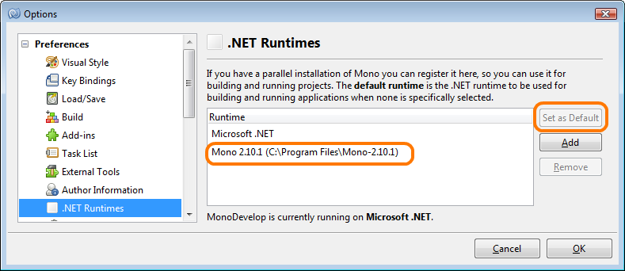
The Easy Way
  Grab a copy of the Mono SDK from the official website. I would recommend using v2.6.1.
  http://mono-project.com/OldReleases
  Launch MonoDevelop and navigate to the
  “Tools->Preferences” menu.
Notes:
First grab a copy of the Mono SDK from the official website. I would recommend using the same version of Mono that the Unity team built against (v2.6.1)
After installing the SDK, launch MonoDevelop and navigate to the preferences menu. Find the .NET Runtime options and set the default to the Mono runtime we installed.
Full Instructions:
Grab a copy of the Mono SDK from the official website. I would recommend using the same version of Mono that the Unity team built against (v2.6.1).
http://mono-project.com/OldReleases
Install the SDK with the default settings.
Launch Monodevelop and navigate to the
“Tools->Preferences” menu.
Select "Preferences->.NET Runtimes" from the left hand tree view.
Finally select "Mono 2.6.1" and click the "Set as Default" button.

Slide 22

The Slightly Harder Way
Navigate to MonoDevelop configuration directory:
Windows XP:
C:\Documents and Settings\{UserName}\Application Data\MonoDevelop-Unity
Windows Vista & 7:
C:\Users\{UserName}\Application Data\MonoDevelop-Unity
Create a new file in the directory named
mono-runtimes.xml and copy the following XML into it:
Note: If your Unity installation directory is non standard, you will need to change the path to reflect your own installation.
Notes:
And now I will walk you through the harder method. This method involves editing the MonoDevelop configuration files. We must manually do this because of a bug in the version of MonoDevelop that is bundled with Unity (v3.3 & v3.4). The “Add” button in the .NET Runtime options does not function correctly. However, we can work around the problem until it is addressed.
First make sure to close all running instances of MonoDevelop MonoDevelop automatically saves changes to it’s configuration files. Therefore, it may nuke our manual changes if it is running.
Navigate to the MonoDevelop configuration directory and create a new file named “mono-runtimes.xml”. The directory will differ based on the operating system you are running. Next enter the XML that is displayed on this slide. Note that you may need to change the path if you installed Unity in a non default location.
For Reference:
<RuntimeCollection>
<MonoRuntimeInfo prefix="C:\Program Files\Unity\Editor\Data\Mono”/>
</RuntimeCollection>

Slide 23

The Slightly Harder Way
Open the "MonoDevelopProperties.xml" file and locate the "MonoDevelop.Ide.DefaultTargetRuntime" property.
Change the value to be "Mono Unknown".
Save the changes to the file.
Notes:
Now we must open the “MonoDevelopProperties.xml” and locate the DefaultTargetRuntime. Change the current value to be “Mono Unknown” and proceed to save your changes.
For reference:
<Property key="MonoDevelop.Ide.DefaultTargetRuntime" value="Mono Unknown"/>

Slide 24
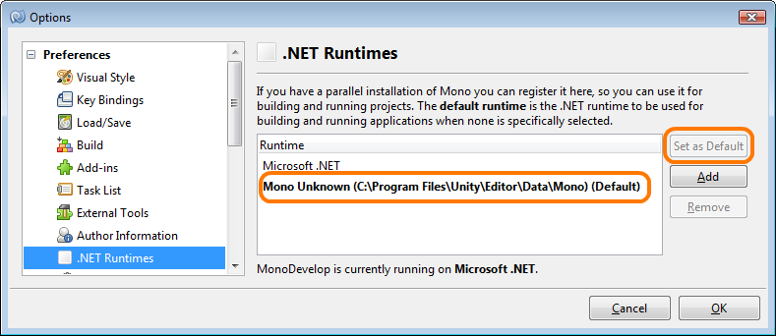
The Slightly Harder Way
Notes:
If everything went well, the Unity Mono runtime should be set as the default the next time you start MonoDevelop.
* You can open the options dialog via the main menu (Tools->Preferences). Note that the menu item is named “Preferences” while the dialog is named “Options”.

Slide 25
Debugging Projects
  Open the Unity Project you wish to debug.
  Open MonoDevelop and load the Solution file for the .NET Library Projects.
  In the MonoDevelop IDE Select
  "Run->Attach To Process".
Notes:
Now we are ready to begin debugging. Lets quickly walk through the process for attaching the debugger to Unity.
If you have more then one Visual Studio project, I would recommend keeping them under the same Solution.

Slide 26
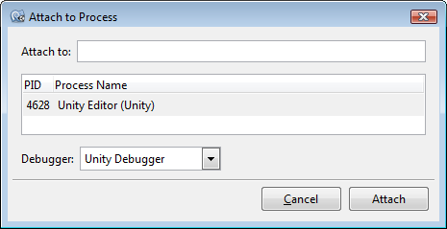
Debugging Projects
Select the Unity Editor process and click the "Attach" button.
Set breakpoints in your code.
Finally click the "Play" button in the Unity editor!

Slide 27
Build Tools
Unity Projects
Art Pipeline
Code
Build Tools
Notes:
The last piece of the puzzle is our build tool suite.

Slide 28
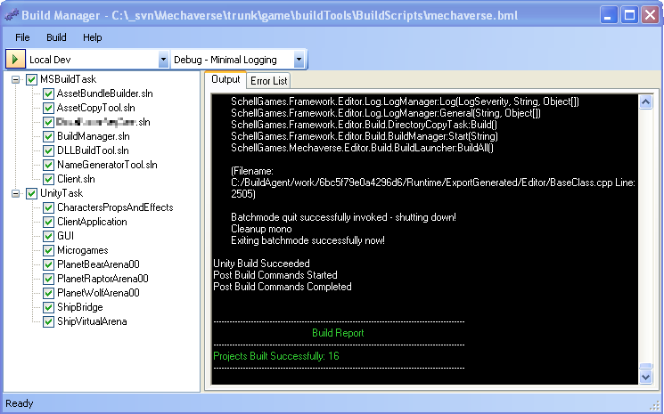
Build Manager
Notes:
To make the build process easy, we built an tool for automating the build process.

Slide 29
Build Manager
  Built on top of Microsoft .NET Framework.
  Utilizes the MSBuild API to build Visual Studio solutions and projects.
  Launches Unity in command line mode to build each projects asset bundles.
  Monitors the Unity Editor log file for changes and displays it in real time.
  Features an XML script file that allows us to customize the build process. Pre-build and post-build commands can be issued.
Notes:
We choose to build the tool on top of the Microsoft .NET Framework because Mono was missing features we wanted to use. Namely portions of the MSBuild API are not finished yet.
Build Manager utilizes the MSBuild API in order to build the Visual Studio projects. Because MSBuild is bundled with the .NET Framework, any machine that has .NET installed can build the source code. There is no need to have the design and art teams install Visual Studio or MonoDevelop.
Build Manager launches a Unity process to build each of the Unity projects. We start the editor in command line mode to keep it from continually stealing mouse focus. This allows team members to do other tasks while waiting for the project to build. The application monitors the Unity Editors log file similar to a tail application. All events written to the log are automatically redirected to the applications output textbox.
We found that Unity was not always importing new assets properly the first time an project has been opened (while running in batch mode). To work around the issue, each project is opened once to allow the importing of the assets. We then close and reopen the same project before beginning to build.
Lastly, the tool has an XML based script interface. It allows us to easily setup the build process for new projects. We can specify both pre-build and post-build commands to do tasks such as copying files to an new location after the build completes.

Slide 30
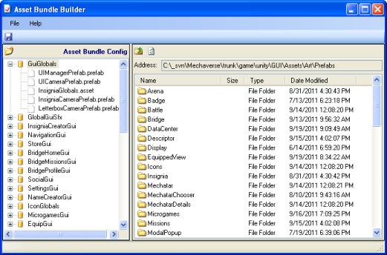
Asset Bundle Builder
Notes:
The asset bundle build tool allows us to define asset bundles. It features a drag and drop interface to make setting up bundles intuitive for the end users.

Slide 31
Thanks!
William Roberts
roberts@schellgames.com
http://www.williamroberts.net

