Slide 1

Custom Build Processes with Unity3D
William Roberts
Senior Game Engineer
Schell Games LLC

Slide 2
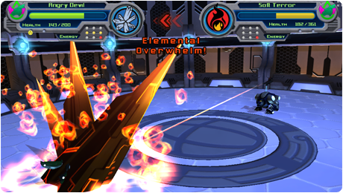



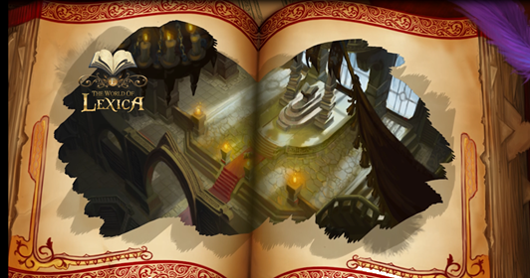
Schell Games
Notes:
Schell Games has worked on a number of Unity3D games. Innercube is available on the Ouya, Kindle, Google Chrome, and Google Play stores .
For more information about The World of Lexica, see http://www.usatoday.com/story/tech/gaming/2013/06/18/lexica-game-classic-books/2431337/

Slide 3
Overview
Extending the Code Build Process
Automating the Building of Unity3D Projects
Demonstration
Conclusion

Slide 4
Extending the Code Build Process

Slide 5
Project Structure
Code is separate from the Unity3D projects.
During compilation, the outputted assemblies are copied into each Unity Project.
Unity Project 1
Assembly
Unity Project 2
Etc...

Slide 6
Benefits of Approach
Code can easily be reused across many projects.
Greater control over what code makes it into a build.

Slide 7
Cons of Approach
Source code changes will not be automatically detected and rebuilt by the editor.
Extra layer of complexity.

Slide 8
Several Ways To Copy Output
Visual Studio Post Build Events
MonoDevelop Custom Commands
MSBuild Built-in Tasks
MSBuild Custom Tasks
To name a few common options...

Slide 9
Visual Studio Post Build Events
Builds Events are essentially Windows BAT files that are executed before and after builds.
By default, MonoDevelop will not execute them out of the box.
MonoDevelop support can be enabled by toggling the "Compile projects using MSBuild / XBuild" option.

Slide 10
Visual Studio Post Build Events
Pros
Can easily invoke commands and external applications before and after a build.
Cons
Not cross platform independent.
  Mono treats the Build Events as shell scripts on OSX and batch scripts on Windows.
Does not provide good feedback within the IDE about errors and script issues.

Slide 11
MonoDevelop Custom Commands
Pros
Capable of functioning cross platform.
Cons
Commands are only executed by MonoDevelop. Visual Studio, MSBuild and XBuild will ignore them.
Does not provide good feedback in the IDE about errors and script issues.

Slide 12
MSBuild Built-in Tasks
Visual Studio projects (ie: vbproj, csproj, etc) are just XML files. Also known as MSBuild projects.
It is possible to edit the file in a text editor to insert custom logic.
MSBuild has two targets defined that allow you to insert custom logic before or after the code builds.
Notes:
Additional reference about the BeforeBuild and AfterBuild targets: http://msdn.microsoft.com/en-us/library/ms171462.aspx

Slide 13
MSBuild Built-in Tasks
MSBuild provides a number of built-in helper tasks, such as the Copy task.
  Complete Task List:
  http://msdn.microsoft.com/en-us/library/7z253716.aspx
MonoDevelop supports most of the built-in tasks out of the box. However, you must manually enable MSBuild support via the Options dialog.

Slide 14
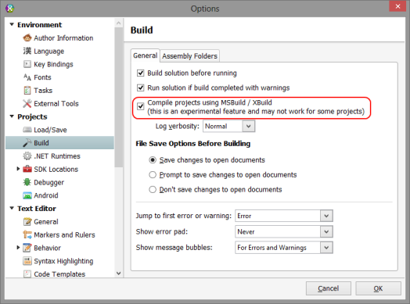
MSBuild Built-in Tasks
In MonoDevelop, navigate to Tools->Options to display the options dialog.
Notes:
This applies to Xamarin Studio as well.

Slide 15
MSBuild Built-in Tasks
Pros
xbuild automatically handles the conversion of relative Windows file paths to Unix style paths.
Consistent behavior across platforms.
Cons
May not have the functionality needed out of the box.

Slide 16
MSBuild Custom Tasks
While the built-in tasks will get you most of the way there. You may want to further customize the copy process.
  For instance, we may want to detect and copy editor assemblies to a directory named “editor”.
To give us greater flexibility, we can create our own custom tasks.

Slide 17

MSBuild Custom Tasks
To start, we need to create a new Visual Studio class library project.
Note that the project’s Target Framework must be set to .NET 2.0 in order for the task to work with Mono’s XBuild.
You will need to reference the following MSBuild assemblies:

Slide 18
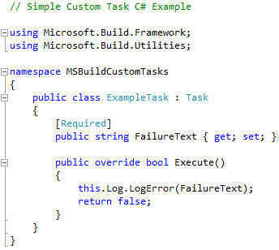
MSBuild Custom Tasks
The below example illustrates a custom task that logs an error message to the IDE.

Slide 19
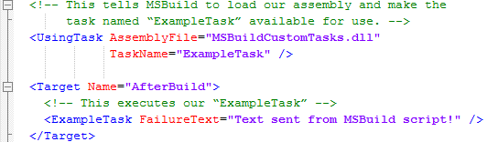
MSBuild Custom Tasks
Next we must insert several XML elements into the Visual Studio project file that utilize our custom task.
The “UsingTask” element loads the assembly containing the task and makes the task available for use.

Slide 20
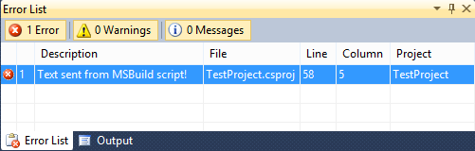
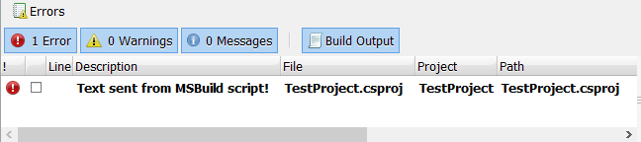
MSBuild Custom Tasks
Custom Task Output in Visual Studio
Custom Task Output in MonoDevelop

Slide 21
MSBuild Custom Task Ideas
Utilize Mono.Cecil for loading and inspecting an assembly prior to copying it.
  Ensure an assemblies meta file contains the same GUID across Unity projects.
  Generate mono debug database (MDB) files when running under Visual Studio
  Determine if an assembly references the UnityEditor assembly.
  Scan assemblies for potential runtime issues on iOS.
Utilize Mono.Cecil to inject special debug code.
  Automatically insert profiling code based on the current build settings.
Notes:
Meta Files
When creating an Visual Studio project, Visual Studio will typically insert an file named AssemblyInfo.cs within the Properties directory. If you open this file, you will notice that it inserts an System.Runtime.InteropServices.GuidAttribute attribute with a unique ID into this file. It is possible during the copy process to extract the GUID and use it as the meta files GUID.
MDB
Mono.Cecil has an helper library that is capable of converting Microsoft PDB files to Mono MDB files. It is possible to determine if the code is currently executing under the Microsoft .NET Framework or Mono. This allows you to add a post process that converts PDB’s to MDB’s when building in Microsoft MSBuild or Visual Studio.
UnityEditor.dll
During the copy process it is useful to automate copying Editor assemblies into the “Editor” directory. One way to do this is by inspecting the assembly for a Reference to UnityEditor. This can be accomplished is by physically loading the DLL using the System.Reflection.Assembly class. However, this approach is not recommended due to the assembly being physically loaded into the applications domain. A better approach is to utilize Mono.Cecil to inspect the contents of the assembly.

Slide 22
Extending the Code Build Process
Automating the Building of Unity3D Projects

Slide 23
Many Ways to Automate the Build Process.
A few options...
Custom Command line application
Custom GUI Application
  There are many issues with the Mono Windows Forms API.
  It should be avoided if the application is to run on both Windows and OSX.
  Utilizing Gtk# is recommended for cross platform UI.
Integrate directly into a third party application such as Cruise Control .Net.

Slide 24
Building Code With MSBuild
Two ways to build Visual Studio projects:
  MSBuild.exe (Windows) and xbuild.exe (Mono) provide a way to build projects from the command line.
  Microsoft.Build.BuildEngine provides an API for programmatically building projects.
Mono currently only has support for MSBuild 2.0 & 3.5.

Slide 25
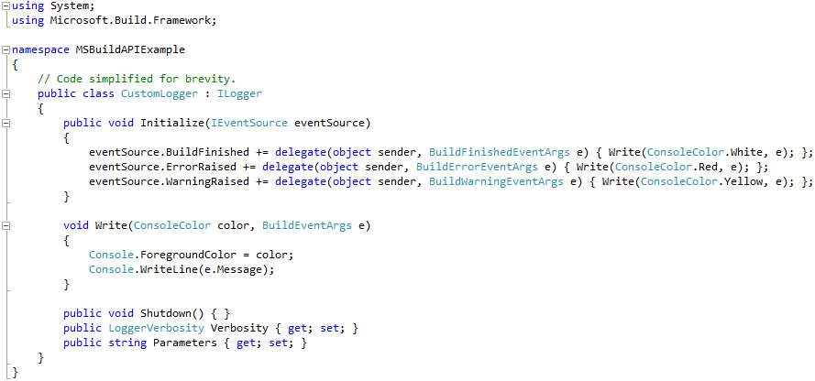
Building Code With MSBuild
To customize log output, we must implement Ilogger.

Slide 26
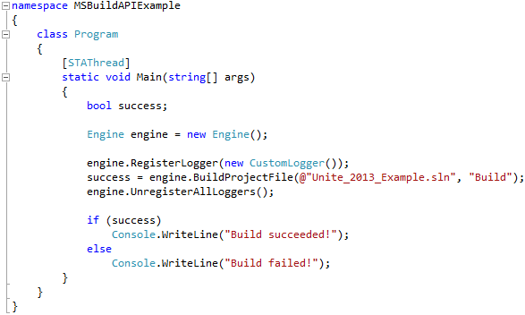
Building Code With MSBuild
To build the code, we will create an Engine instance and register our custom logger (CustomLogger).

Slide 27
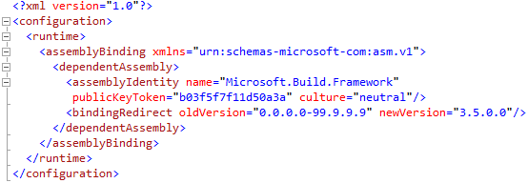
Building Code With MSBuild
If we are using MSBuild 3.5, we must add an assembly binding for Microsoft.Build.Framework to the applications app.config file.
Notes:
For more information about why this is important with MSBuild 3.5, refer to the following blog post: http://blogs.microsoft.co.il/blogs/idof/archive/2008/11/24/what-does-entity-framework-has-to-do-with-msbuild.aspx

Slide 28
Launching Unity
System.Diagnostics.Process can be used to programmatically launch the Unity Editor on both Windows and OSX.
Unity has a number of command line arguments that can be used to aid with automating the Editor.
  http://docs.unity3d.com/Documentation/Manual/CommandLineArguments.html

Slide 29
Launching Unity
-batchmode tells the editor to run without a visible user interface.
-quit tells the editor to exit once it has finished processing commands.
-projectPath is the full path to the project the editor should load.
-executeMethod instructs the editor to execute the specified parameterless static method after it loads the project. Note, this code must exist in the project being opened.

Slide 30
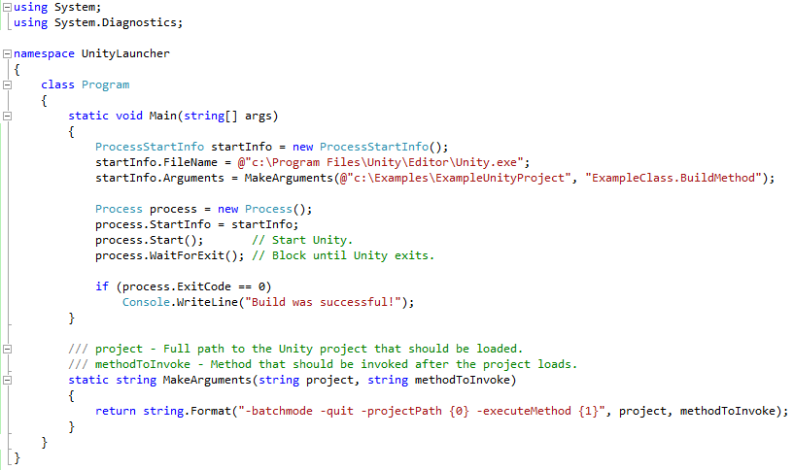
Launching Unity

Slide 31
Passing Arguments to Unity
It is possible to pass your own arguments to the Unity Editor.
Unity will ignore any arguments that it does not understand.
Both System.Environment.CommandLine and System.Environment.GetCommandLineArgs() can be utilized within the Editor to retrieve the command line.

Slide 32
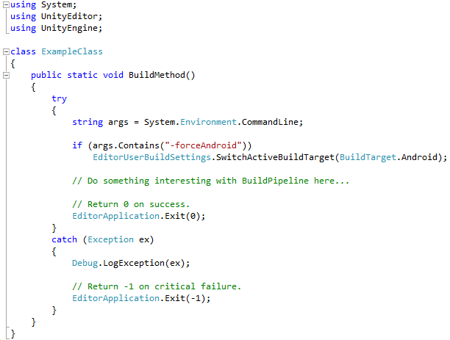
Passing Arguments to Unity

Slide 33
Inter-process Communication
It is possible to use inter-process communication to send data between the two applications.
Useful for displaying the progress of the build within the launcher application.

Slide 34
Inter-process Communication
Many different ways to achieve this:
Named Pipes
  System.IO.Pipes not fully implemented on OSX
  Should be avoided for cross platform reasons.
File I/O
Sockets

Slide 35
Extending the Code Build Process
Automating the Building of Unity3D Projects
Demonstration

Slide 36
Extending the Code Build Process
Automating the Building of Unity3D Projects
Demonstration
Conclusion

Slide 37


Schell Games Unite 2013 Presentations
Empowering Content Creators
Ryan Hipple
August 28th, 2013
Ballroom B 16:30-17:00

Slide 38
Thanks!
Slides and examples available at:
http://www.williamroberts.net/publications.php
William Roberts
e-mail: roberts@schellgames.com
website: http://www.williamroberts.net

