Slide 1
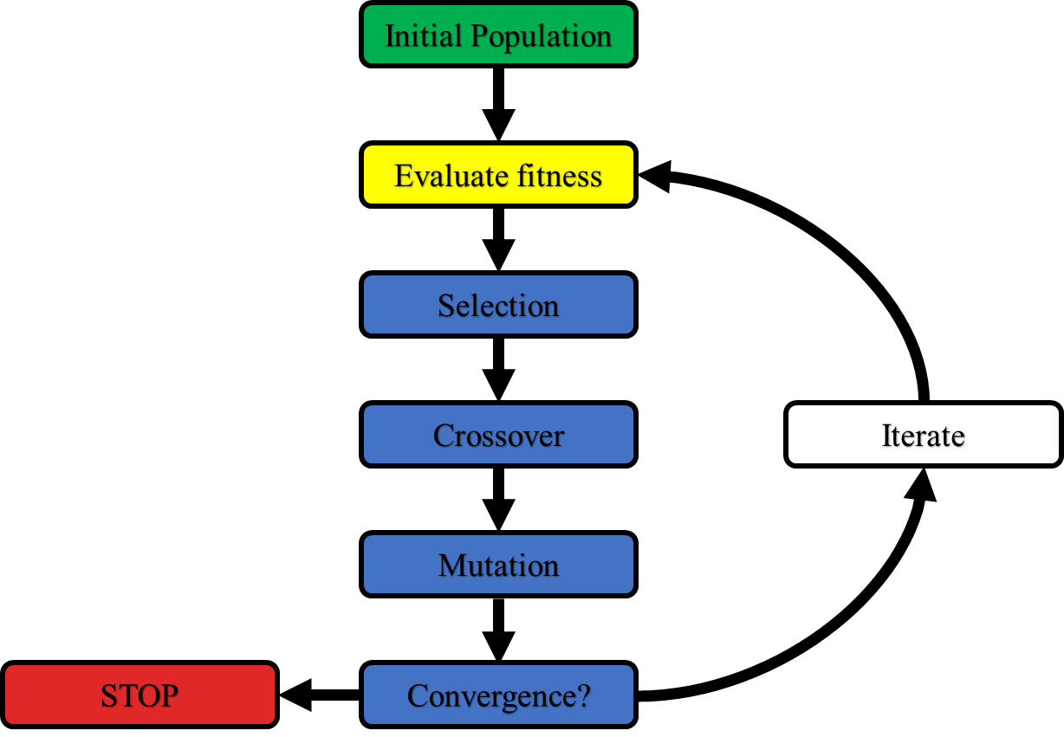

Genetic algorithms: An introduction and a Python example
Garrett Meek

Slide 2
Genetic algorithms
Parent
Initial Population
Evaluate fitness
.91
.90
.91
.98
.95
.95
.92
.90
.97
.96
Selection
“Fittest” members
Offspring
Crossover
Iterate
Mutation
STOP
Convergence?

Slide 3
What are these algorithms good for? Optimization problems:

Slide 4
What are these algorithms good for? Optimization problems:

Slide 5
What are these algorithms good for? Optimization problems:

Slide 6
Genetic algorithms for optimization problems

Slide 7
Genetic algorithms
=
=
Initial Population

Slide 8
Genetic algorithms
=
=
Initial Population

Slide 9
A simple and general Python genetic algorithm
This code (and this presentation) are available here:
https://github.com/gameekmd/GA_python.git
and on Gollum (for Brooks group members):
/home/gameek/GA/python/

Slide 10
Fitness function

Slide 11
Genetic algorithm implementation tips
A volume of work shows:
Genetic algorithms perform optimally for moderate population sizes (5-10)
Mutation and crossover rates minimally impact performance (in comparison with population size)
Convergence is fast, so we can efficiently optimize large numbers of genes (40-50 maximum)

