Slide 1

US Food Import: Visualized
Asa Bejraputra (70591374)
Data Visualization Studies Summer Semester 2025 University of Europe for Applied Sciences

Slide 2
Introduction
The U.S. Food Imports data product is an annually published statistical summary of the value and volume of food imports coming into the United States.
This data set provides import values of edible products (food and beverages) entering U.S. ports and the products’ origin of shipment. Data are from the U.S. Department of Commerce, Bureau of the Census. Food and beverage import values are compiled by calendar year into food groups, corresponding to major commodities or level of processing.
You could see the source page and datasets here.

Slide 3
Dataset Questions
1. What are the 5 largest Category of U.S. food imports by amount in the last 25 years, and their Commodities?
2. Who are the US's biggest food exporters?
3. What kind of commodities which US imported the most from Canada in the last 5 years?
4. How's the change of trend of food imports from each category by their value over time?
5. Who is the biggest exporters of US's beverages, and what kind of beverages that US imported from them?
6. Who is the biggest exporters of US's fruits, and what kind of fruits that US imported from them?
7. Who is the biggest exporters of US's fishes, and what kind of fishes that US imported from them?
8. How is the import demand of the product shift over last 25 years?
9. How is the price of each Food Category fluctuating for the last 25 years?
10. How is the price of each kind of commodities correlates with each other for the last 25 years?
Click the link to jump right to the questions.

Slide 4
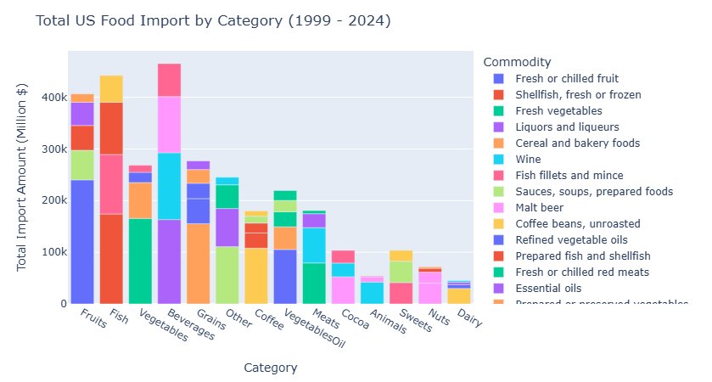
1. What are the 5 largest Category of U.S. food imports by amount in the last 25 years, and their Commodities?
For the last 25 years, we could see that US spend their money for importing the Beverages the most. Then followed by Fishes and Fruits, respectively.
<< Back to Questions

Slide 5
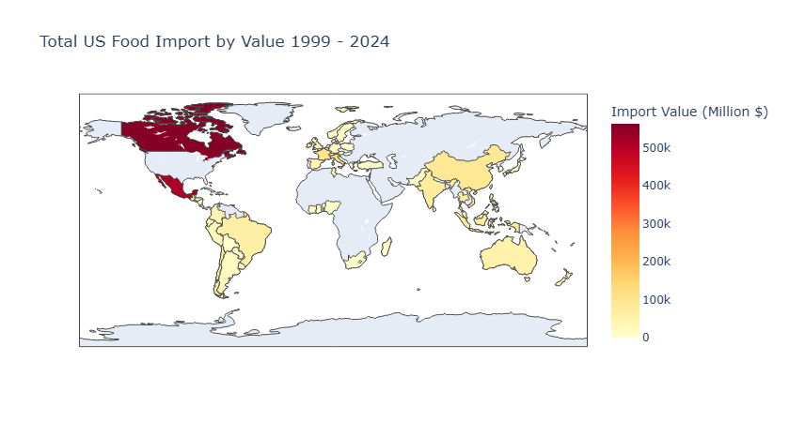
2. Who are the US's biggest food exporters?
Obviously, there're numbers of trade partner which US imports the foods from. However, around two-third of their foods imports was made with their close neighbors e.g. Canada and Mexico.
<< Back to Questions

Slide 6
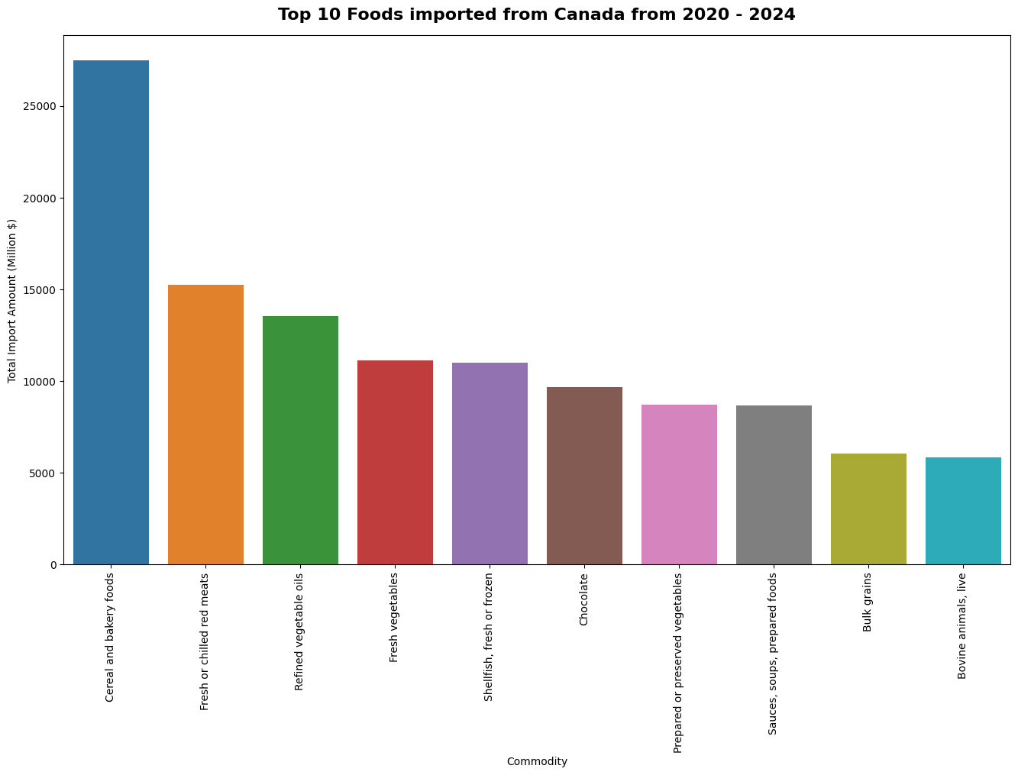
3. What kind of commodities which US imported the most from Canada in the last 5 years?
Well then, when we found out that Canada is the U.S. biggest food exporters. What they actually sold for the last 5 years?
Then, speaking of Canada, the U.S. is a major importer of their Cereal, Bakery, and Red Meats.
<< Back to Questions

Slide 7
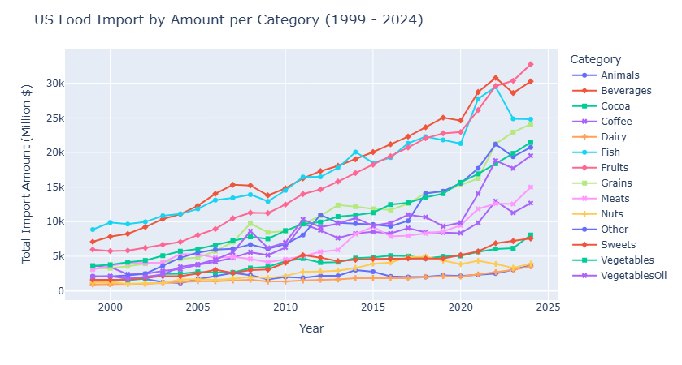
4. How's the change of trend of food imports from each category by their value over time?
When we take a look on the changes in Import Value for the last 25 years. We could see that Beverages is the main items which U.S. import from the outside until the last 2 years which the top position goes to Fruits.
<< Back to Questions

Slide 8
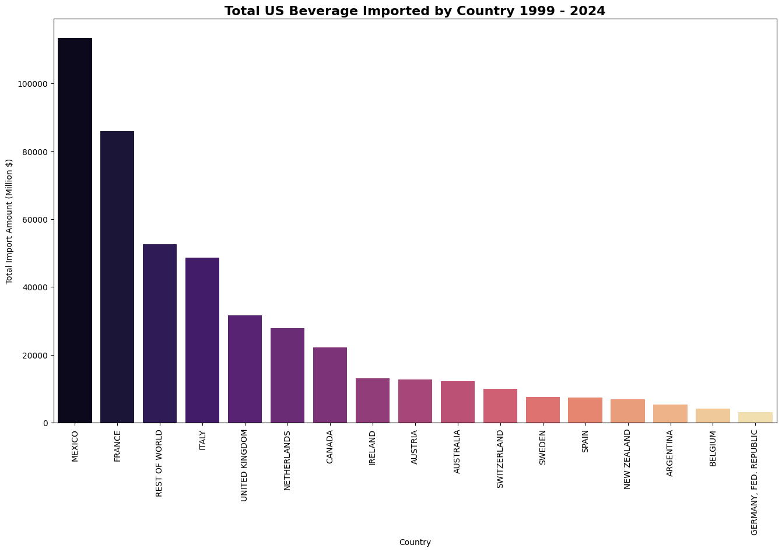
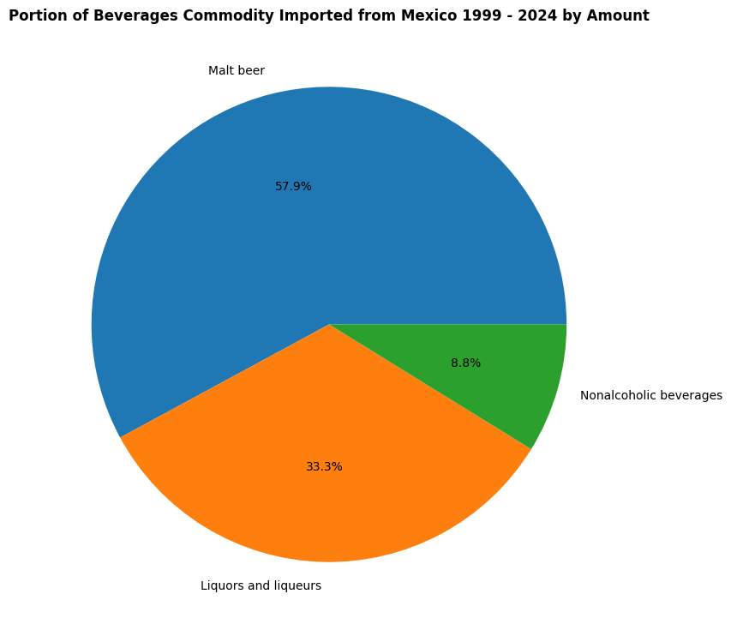
5. Who is the biggest exporters of US's beverages, and what kind of beverages that US imported from them?
When we take a look into Beverages imports for the last 25 years, we found that Mexico is U.S. main exporters. The U.S. mostly bought Malt Beer, Liqour, and Non-Alcoholoc Beverages from them.
<< Back to Questions

Slide 9
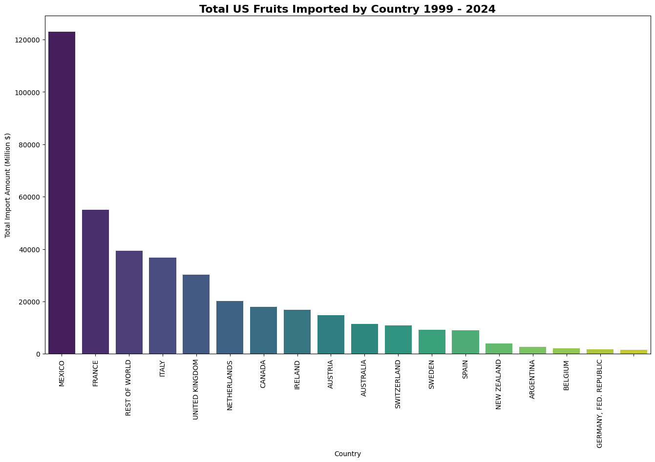
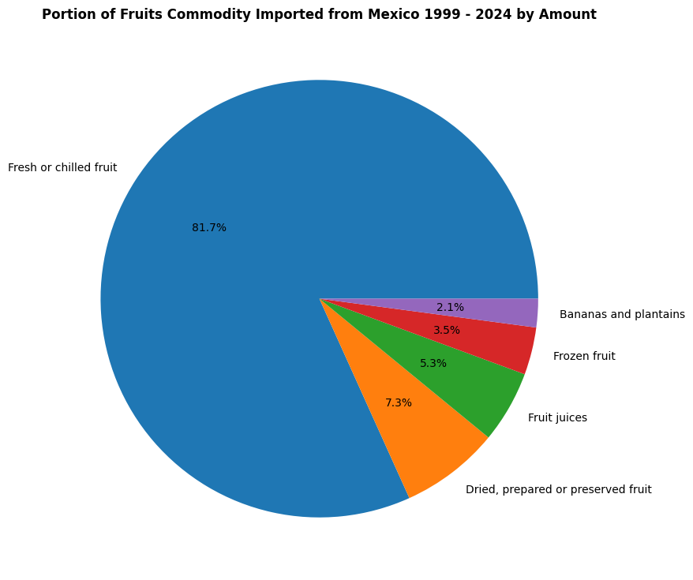
6. Who is the biggest exporters of US's fruits, and what kind of fruits that US imported from them?
In terms of imported fruits, Mexico is still their biggest trade partner in Fruits. Most of them are Fresh and Chilled Fruit, which their values is more than other kind of fruits combined.
<< Back to Questions

Slide 10
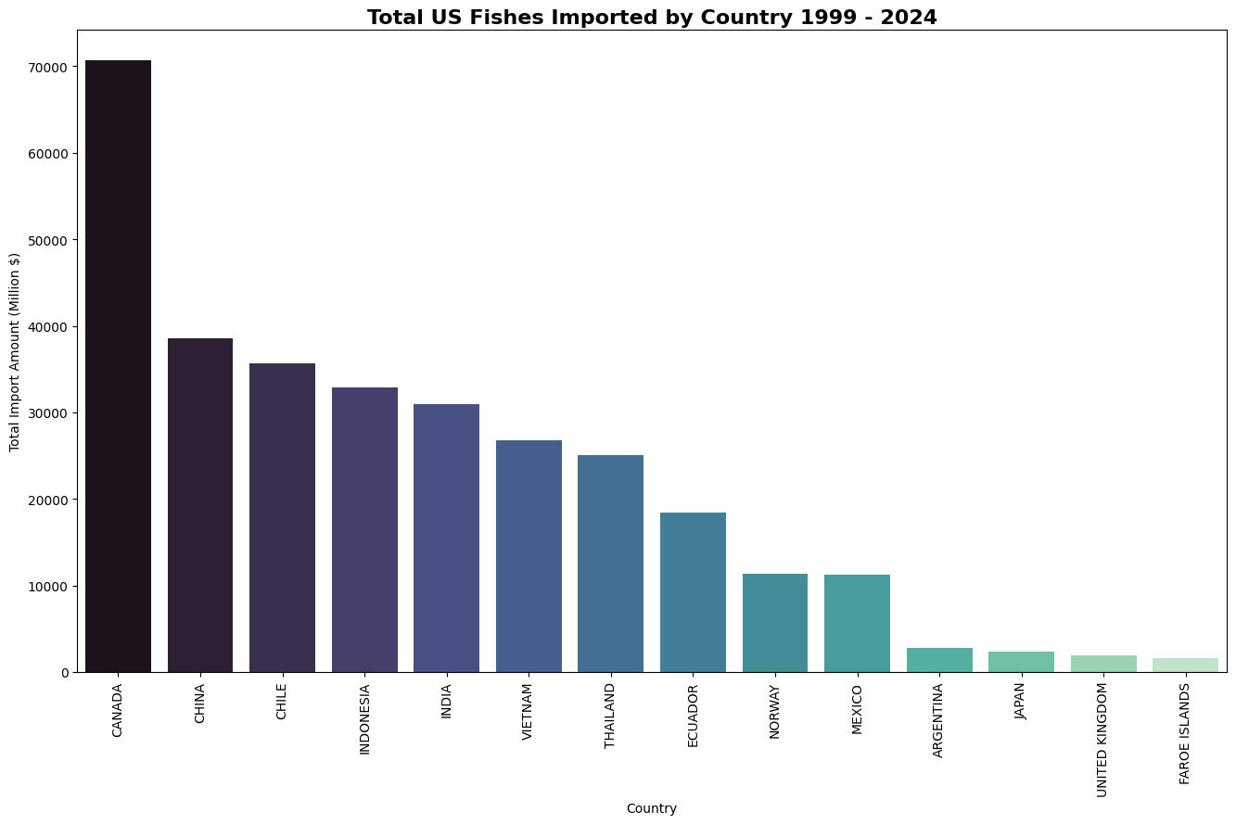
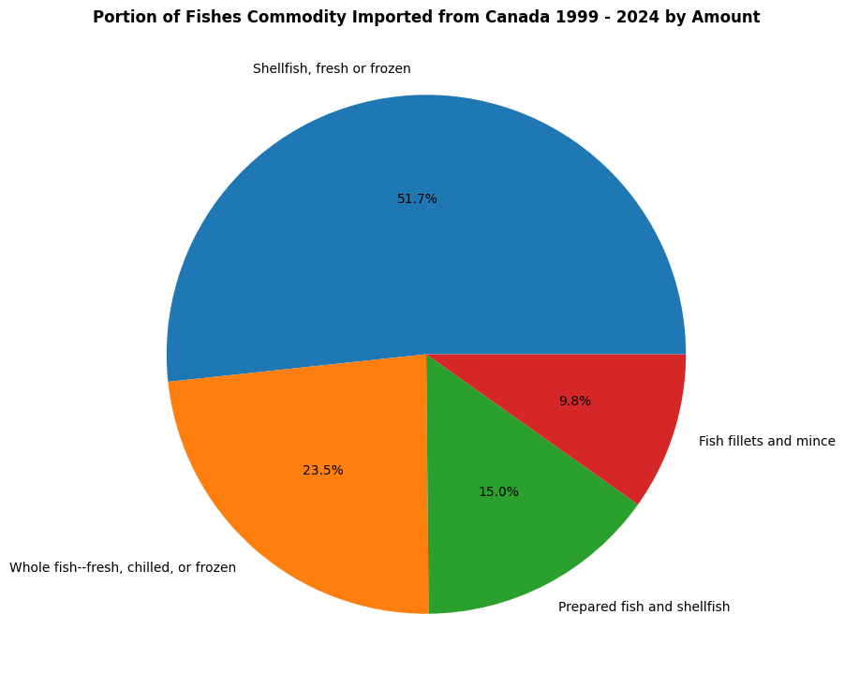
7. Who is the biggest exporters of US's fishes, and what kind of fishes that US imported from them?
In terms of Fishes import, Canada is their main exporters here. Majority of their exports are Fresh or Frozen Shellfish.
<< Back to Questions

Slide 11
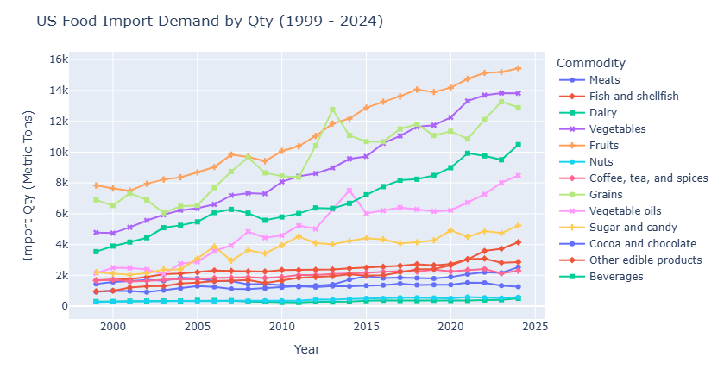
8. How is the import demand of the product shift over last 25 years?
Then, we take a look of the Import Quantity for the last 25 years, we found that there're only some kind of Foods which the import quantity grows e.g. Fruits, Vegetables, Grains, Beverages, and Vegetable Oils, while demands of other kind of foods is grow a bit slower.
<< Back to Questions

Slide 12
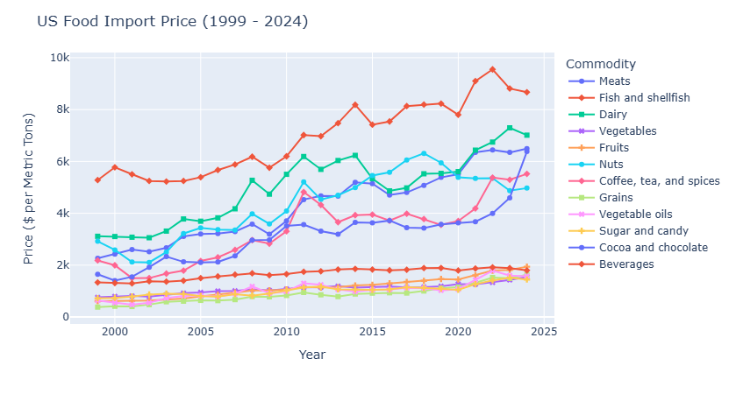
9. How is the price of each Food Category fluctuating for the last 25 years?
In terms of Price, we found that price of fishes is noticeably more expensive than the other kind of imported foods. Moreover, their rate of price inflation is noticeably faster than everyone here. This could explain that why Import Value of Fishes is getting higher for the last 25 years while their demand doesn't change that much.
<< Back to Questions

Slide 13
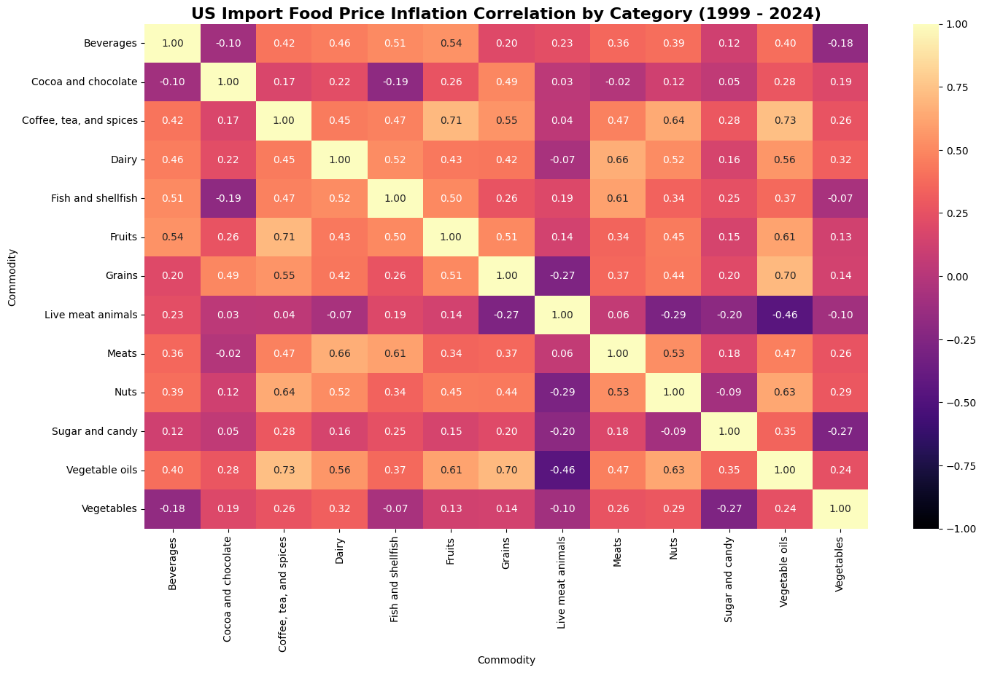
10. How is the price of each kind of commodities correlates with each other for the last 25 years?
Then, we compared the price inflation over the years of each kind of Foods compared to each other. For example, we could see the patterns with strong correlation as follows:
Fruits' price are positively correlated with Coffe, Tea, and Spices.
Meats' price are positively correlated with Dairy, and Fishes.
Nuts' price are positively correlated with Coffee, Tea, and Spices.
Vegetable Oils are positively correlated with Coffee, Tea, Spices, and Grains.
But most of them are positively correlated between each other.
<< Back to Questions

Slide 14
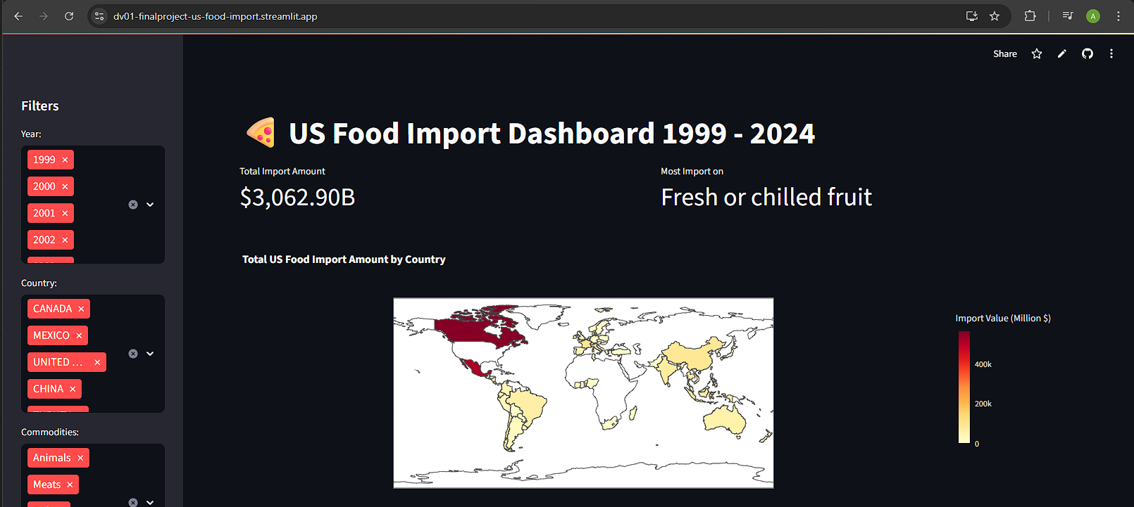
Showcase: Streamlit Dashboard
Link: https://dv01-finalproject-us-food-import.streamlit.app/

Slide 15

Conclusions
U.S. imports foods from overseas by Billions of Dollars a year and still gradually growing. Mostly from their own neighbors, obviously. However, this is also the opportunities for entrepreneurs to know the market size so they could make the good forecast for marketize their products.

