Slide 1
TapPrints: Your Finger Taps Have Fingerprints
Presented by: Tom Staley

Slide 2
About
Paper by
Emiliano Miluzzo
Alexander Varshavsky
Suhrid Balakrishnan
Romit Roy Choudhury
Originally presented at MobiSys2012, June 27, 2012

Slide 3
Introduction
Determining location of screen taps using accelerometer and gyroscopes
Could lead to attackers using this info to track inputs
“TapPrints- a framework for inferring location of taps on mobile devices”

Slide 4
Current State of Sensors
Mobile sensors becoming more powerful
Many types of data: patient monitoring, localization, context-awareness, etc.
Rumored that insurance companies are trying to use dietary patterns to determine cost and coverage of policies

Slide 5
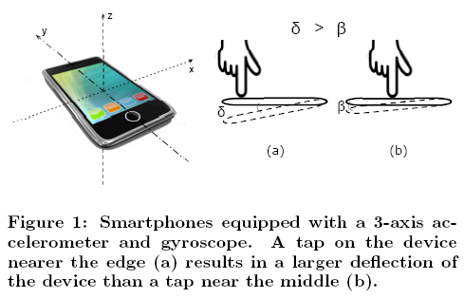
Using Gyroscopes

Slide 6
TapPrints
Implemented on Google Nexus S, Apple iPhone 4, Samsung Galaxy Tab 10.1
Over 40,000 taps collected from 10 users over 4 weeks
80-90% accuracy, enough to guess a password

Slide 7
How Data Could be Used
Attackers can improve odds by:
Applying a spellchecker to guess unknown words
Narrowing search to email addresses in contact list if the email application is running
Data can be protected by:
Using a rubber case to absorb motions
Switching to swiping-based keyboards

Slide 8
Is this a Threat?
Attacks could be disguised as any app available on the market
Only sensor that requires permission is location
Accelerometer and gyroscope largely ignored due to gaming

Slide 9
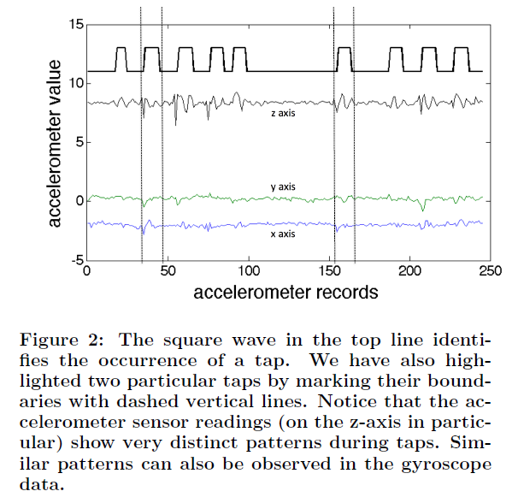
How to Differentiate Taps

Slide 10
Recognizing Taps
TapPrints has to be trained to recognize taps
Different methods:
k-Nearest Neighbor
Multinomial Logistic Regression
Support Vector Machines
Random Forests
Bagged Decision Trees
Combine all methods at end to get best results

Slide 11
Collecting Data
Used four methods:
Icon Taps
Sequential Letters
Pangrams
Repeated Pangrams

Slide 12
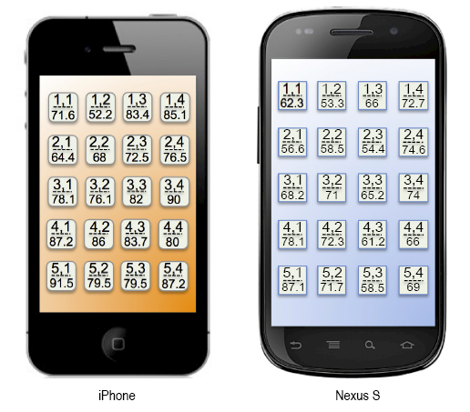
Icon Taps
Averages:
iPhone- 78.7%
Nexus- 67.1%
Random guess is only 5%

Slide 13
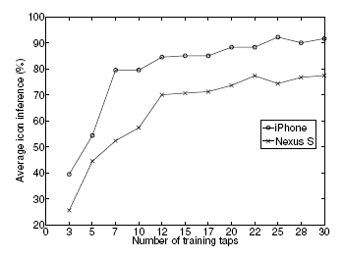
Repetitions
Stabilizes at 20 taps/icon
70% accuracy reached at 12 taps
Attackers could disguise as a game
Could also pre-train to recognize other users’ taps

Slide 14
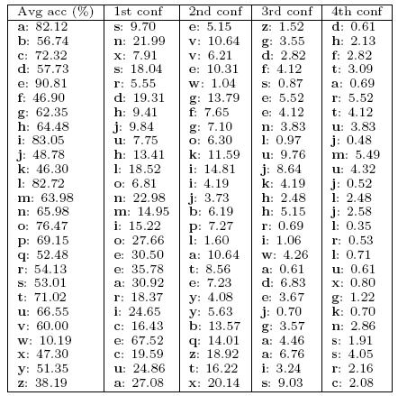
Letter Tapping
Harder than icon taps because letters are smaller and have less separation
Average prediction is 65.11% after training using pangrams
Random guess is only 3.8%

Slide 15
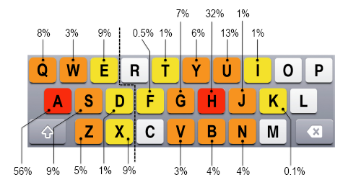
Letter Confusion
Mostly limited to surrounding letters
Could be used in a dictionary search to guess words
Some letters better than others, e.g. E vs. W

Slide 16
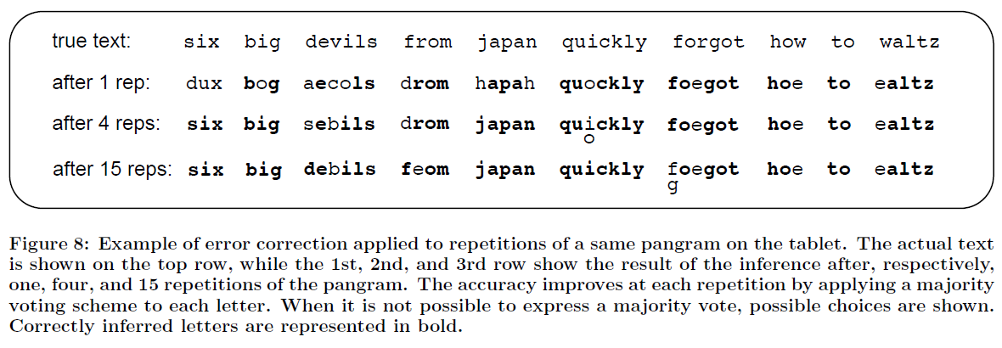
Example of Pangram

Slide 17
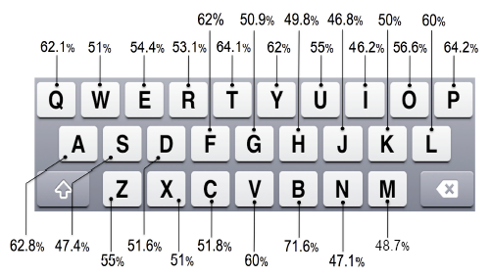
Sequential Letters

Slide 18
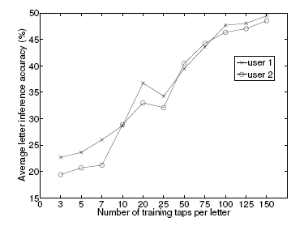
Letter Repetition
More repetitions required because of smaller areas
150 taps to reach 50%

Slide 19
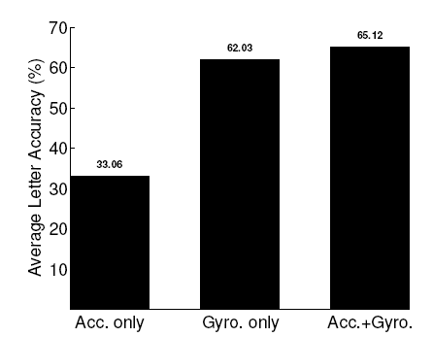
Sensor Efficacy

Slide 20
Possible Solutions
Pause sensors when typing
Agreements with developers to hold them accountable
Have users grant permission to use sensors
Rubber cases to absorb motion
Swiping-based keyboards

Slide 21
Conclusion
Attackers can use software to track user input
TapPrints is just an early implementation
In future, software will be much more powerful

Slide 22
Bibliography
Miluzzo, Emiliano, Alexander Varshavsky, Suhrid Balakrishnan, and Romit Roy Choudhury. "Tapprints: Your Finger Taps Have Fingerprints." MobiSys '12 Proceedings of the 10th International Conference on Mobile Systems, Applications, and Services. MobiSys 2012, United Kingdom, Low Wood Bay, Lake District. New York: ACM, 2012. 323-36. Print.

