Slide 1



Embedded Systems: GPIO

Slide 2
Today
Embedded board
Data sheets
Toolchain
GPIO

Slide 3
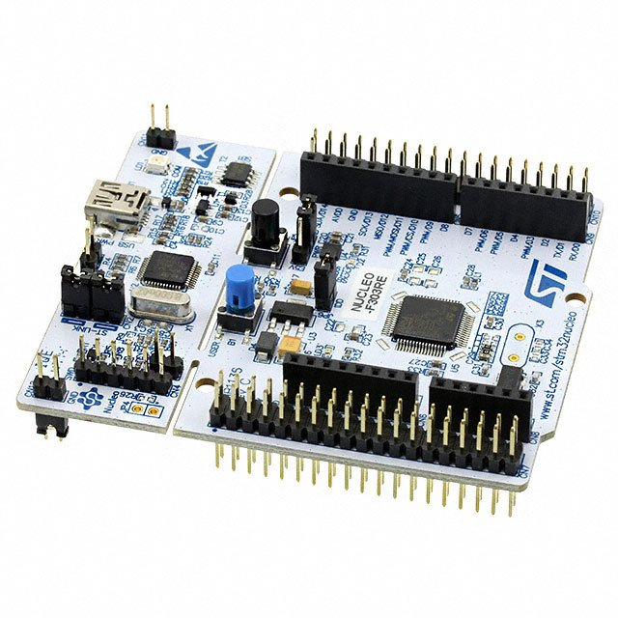
Embedded board used in this course
MCU: STM32F303RE Cortex M4
System clock 72 MHz
Harvard architecture
32 bit data and address bus
Powerful instruction set including DSP instructions
512 KB Flash
80 KB SRAM
51 GPIO pins
10 timers(1x32 bit and 9x16 bit)
On-board ST-LINK/V2-1 debugger/programmer
3.3 V, some pins are 5 V tolerant
GPIO can sink or source 20 mA max.
Shields available (e.g. Wifi shield)
NUCLEO-F303RE

Slide 4
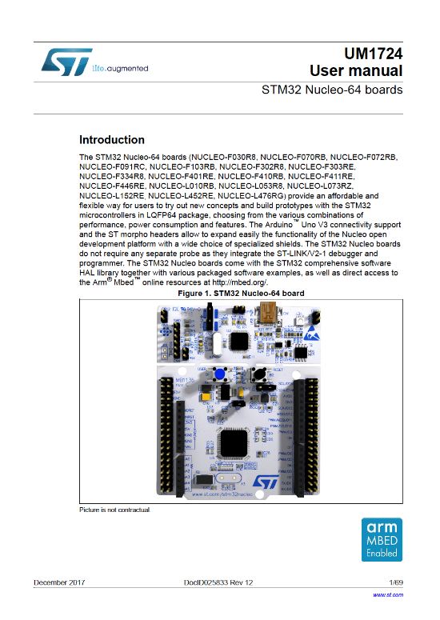
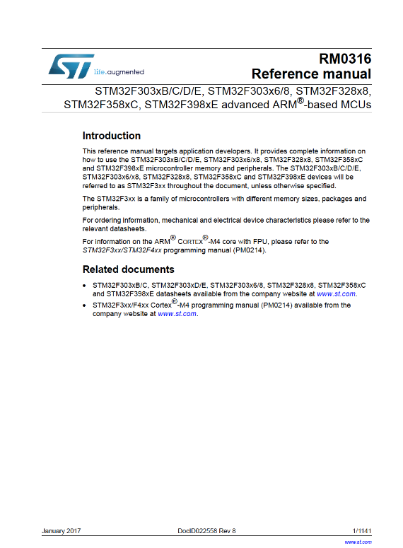
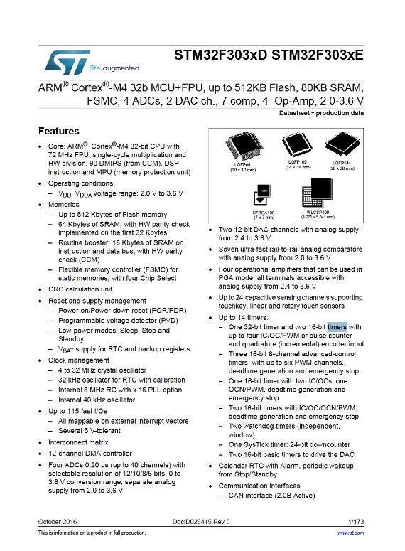
Data sheets
user manual
reference manual
device datasheet
Notes:
You will need the following datasheets:
User manual - for general usage of the board
Reference manual - for application developers. This one you will use the most.
Device datasheet – about the characteristics of the device, like voltages, currents but also alternate function mappings.

Slide 5
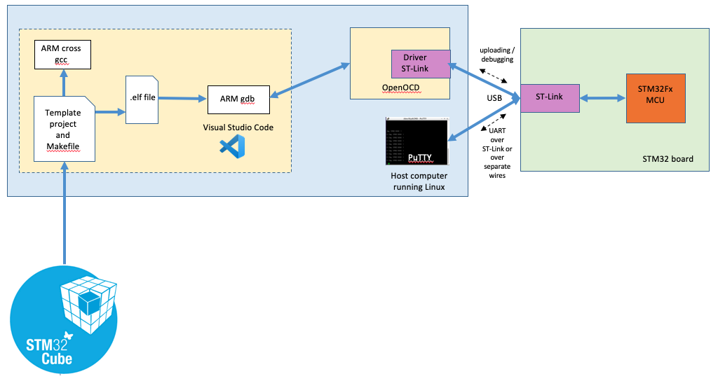
Toolchain
Notes:
See the STM32 toolchain document for a description of the toolchain.

Slide 6
Libraries: three levels
Example code:
set GPIO port A pin 0 to output and make it high
HAL
GPIO_InitStruct.Mode = GPIO_MODE_OUTPUT_PP;
HAL_GPIO_WritePin(GPIOA, GPIO_PIN_0, GPIO_PIN_SET);
Low Level Library
LL_GPIO_SetPinOutputType(GPIOA, LL_GPIO_PIN_0,LL_GPIO_OUTPUT_PUSHPULL); LL_GPIO_SetOutputPin(GPIOA, LL_GPIO_PIN_0);
CMSIS
GPIOA->MODER |= GPIO_MODER_MODER0_0;
GPIOA->ODR |= GPIO_ODR_0;
This we are going to use,
requires using the reference manual
Notes:
The template project generated by the STM32CubeMX applications supports three libraries, from low level to high level:
CMSIS (Cortex Microcontroller Software Interface Standard) These are mainly register definitions for direct register access. The register descriptions can be found in the reference manual. The CMSIS device header file stm32f303xe.h (for NUCLEO-F303RE) contain the definitions to use in your code.
Low Level Library (follow up of the Standard Peripherals Library) Low level functions on top of the register definitions. Makes use of CMSIS. The LL offers low-level APIs at registers level, with better optimization but less portability. They require deep knowledge of the MCU and peripherals specifications.
HAL Portable higher level library, also makes use of CMSIS The HAL offers high-level and feature-oriented APIs, with a high-portability level. They hide the MCU and peripheral peripheral complexity from the end-user.
In this course we will mainly use the CMSIS library when it concerns GPIO, interrupts, timers and so on. You can use HAL functions like HAL_UART_Transmit() and HAL_GetTick().
Note: There is also a Board Support Package (BSP) which contains drivers for hardware outside the MCU like the LED, buttons, SD card, LCD (if available). This BSP is not part of the code generated by STM32CubeMX but is available in the STM32CubeMX installation firmware repository. The BSP code makes use of the HAL functions. The boards used in this course do not contain much specific hardware so we do not use the BSP.

Slide 7
Why CMSIS? Some good reasons!
Maximum control and performance
You will learn much more on the MCU architecture (learning goal)
You will learn how to read the MCU data sheets (learning goal)
You will get to know if HAL / device driver programming is your ‘cup of tea’

Slide 8
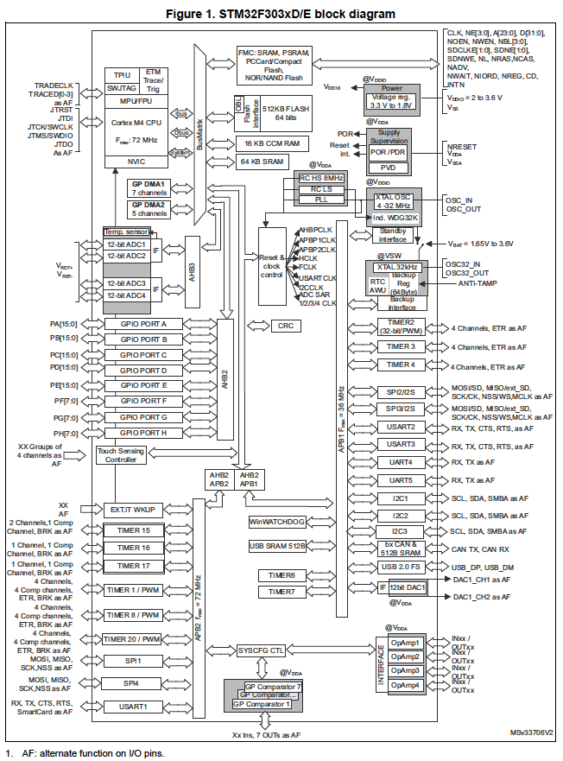
GPIO - overview
Notes:
Block diagram is of STM32F303xD/E MCU

Slide 9
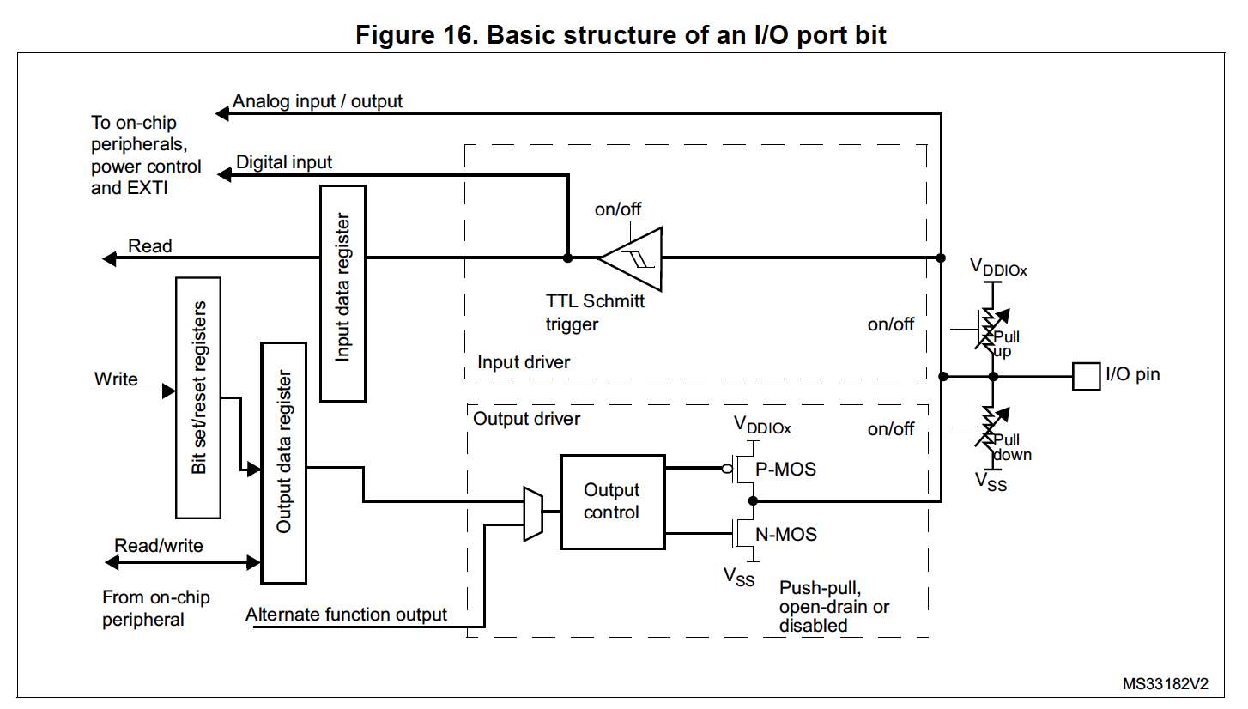
GPIO - basic structure
Notes:
This picture comes out of the reference manual.
Note that:
One I/O pin can be configured as input or output.
One pin can have multiple (alternate) functions, for example timer input. When configured as digital input, a pull up or pull down resistor can be enabled.
Discuss in class:
What is the purpose of a pull up or pull down resistor?

Slide 10
GPIO – output configuration
To do GPIO output you typically need to:
Set mode register (GPIOx_MODER) To set input, output, alternate function or analog
Set output type register (GPIOx_OTYPER) To set push-pull or open drain
Set output data register (GPIOx_ODR) To write to output port
Alternatively, set bit set reset register (GPIOx _BSRR) To write to a single output pin

Slide 11
GPIO – input configuration
To do GPIO input you typically need to:
Set mode register (GPIOx_MODER) To set input, output, alternate function or analog
Set pull-up/pull-down register (GPIOx_PUPDR) To set none, pull-up or pull-down
Read input data register (GPIOx_IDR) To read an input port

Slide 12
GPIO - code examples
Set GPIO port A pin * to output and make it high
GPIOA->MODER = (GPIOA->MODER & ~GPIO_MODER_MODER*) | (0b** << GPIO_MODER_MODER*_Pos); // set pin PA* to output. GPIOA->OTYPER &= ~GPIO_OTYPER_OT_*; // set pin PA* to output type to push-pull
GPIOA->ODR |= GPIO_ODR_*; // set pin PA* to high
Read GPIO port A pin *
GPIOA->MODER = (GPIOA->MODER & ~GPIO_MODER_MODER*) | (0b** << GPIO_MODER_MODER*_Pos); // set pin PA* to input. GPIOA->PUPDR = (GPIOA->PUPDR & ~GPIO_PUPDR_PUPDR*) |
(0b** << GPIO_PUPDR_PUPDR*_Pos); // set pin PA* pull-up/pull-down to pull-up
if ((GPIOA->IDR & GPIO_IDR_*) == 0) // Test for pin PA* being low
{
...
}
Discussion:
Why the complicated settings of the registers?
See https://en.wikipedia.org/wiki/Mask_(computing)
Notes:
For * fill in the right values, see reference manual.
GPIOA struct is defined in CMSIS header file.
Notes:
Important note
When adding code like GPIO configuration or using the USART, make sure to place this code after the call to MX_GPIO_Init() and MX_USART2_UART_Init().

Slide 13
GPIO - connection examples
output
input
STM32 board
STM32 board
220 Ω
3.3V
PA0
PA0
LED
internal pull-up
button
GND
GND
PA0 output in push-pull mode
PA0 input in pull-up mode
Notes: - voltage level 3.3V, some pins are 5V tolerant - max. sink or source current 20 mA

Slide 14
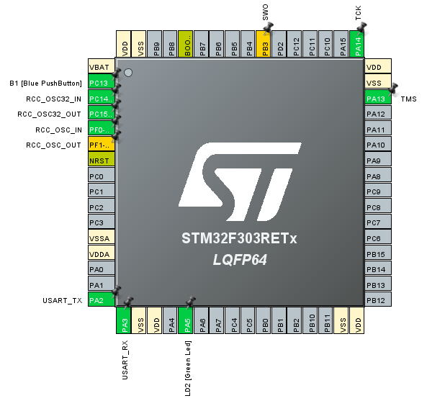
Watch out: pins already in use!
Notes:
Using STM32CubeIDE one can see which pins are already in use in the default configuration.
WATCH OUT: pin PA2, PA3, PA13 and PA14 are already programmed to connect to USART2_TX and USART2_RX and ST-LINK respectively. When accidently overwriting the PA2 / PA3 / PA13 / PA14 settings this can leave the board ‘bricked’. In this case pushing the reset button on the board while powering up might help. This will force the board entering the bootloader again after which a new program can be uploaded.

Slide 15
References
https://deepbluembedded.com/stm32-arm-programming-tutorials/
https://embedded-lab.com/blog/stm32-tutorials/
https://www.keil.com/pack/doc/CMSIS/General/html/index.html
https://community.arm.com/arm-community-blogs/b/architectures-and-processors-blog/posts/how-much-stack-memory-do-i-need-for-my-arm-cortex--m-applications

