Slide 1



Embedded Systems: RTOS

Slide 2
Today
CMSIS and RTOS
FreeRTOS and memory usage
FreeRTOS and tasks
Main flow
Tasks and interrupts
Communication between tasks

Slide 3
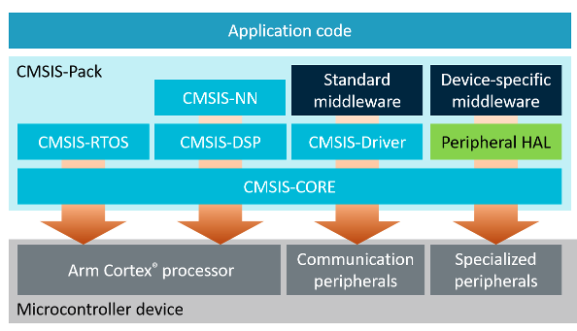
CMSIS structure
From https://arm-software.github.io/CMSIS_5/General/html/index.html
Notes:
CMSIS stands for Cortex Microcontroller Software Interface Standard.
From https://arm-software.github.io/CMSIS_5/General/html/index.html:
The CMSIS is a vendor-independent hardware abstraction layer for microcontrollers that are based on Arm® Cortex® processors.

Slide 4
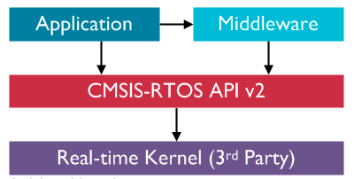
CMSIS-RTOS
Note:
In this course as Real-time Kernel FreeRTOS is used.
From https://www.keil.com/pack/doc/CMSIS/RTOS2/html/genRTOS2IF.html
Notes:
In this course we use the CMSIS-RTOS API v2, see https://arm-software.github.io/CMSIS-FreeRTOS/General/html/index.html.
The Real-time Kernel we use in this course is FreeRTOS.
You can access FreeRTOS through the native FreeRTOS API.
However, when porting to another RTOS (Real Time Operating System) this has a big impact on the application code.
Therefore a generic API for RTOSes is created so the application does not have to be changed when another Real-time Kernel is used.
This can be compared to POSIX (Portable Operating System Interface) for Unix like operating systems.
From https://www.keil.com/pack/doc/CMSIS/RTOS2/html/genRTOS2IF.html:
CMSIS-RTOS2 is a generic API that is agnostic of the underlying RTOS kernel. Application programmers call CMSIS-RTOS2 API functions in the user code to ensure maximum portability from one RTOS to another.
Notes:
Not all CMSIS-RTOS API functions are supported by FreeRTOS, for example osThreadJoin() and osMutexGetName() are not supported, see https://arm-software.github.io/CMSIS-FreeRTOS/General/html/functionOverview.html.

Slide 5

FreeRTOS features
FreeRTOS offers:
Threads
Mutexes
Semaphores
Software timers
Basic memory management
InterTask communication with queues
Libraries for TCP/IP stack, IoT, CLI etc.
FreeRTOS does not offer:
POSIX compliant API.
FreeRTOS kernel does not support I/O, so no virtual file system, network stack, device drivers.
https://arm-software.github.io/CMSIS_5/RTOS2/html/index.html is your starting point for programming RTOS!

Slide 6
FreeRTOS memory footprint
For a very basic configuration (just to get the idea)
RAM < 500 bytes
ROM < 10 KBytes
Note:
FreeRTOS is ideal for small MCU’s!
From https://www.freertos.org/FAQMem.html

Slide 7
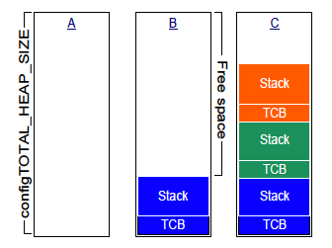
FreeRTOS memory usage
Discussion:
What happens if a task ends?
Note:
Beware of words and bytes!
Very important note:
When using FreeRTOS, do not use the main stack, so make all variables in main() static. See Speaker Notes for details!
From https://freertos.org/Documentation/161204_Mastering_the_FreeRTOS_Real_Time_Kernel-A_Hands-On_Tutorial_Guide.pdf
Notes:
Notes
When running FreeRTOS on a board like the NUCLEO-F303RE one has to be aware of the memory layout and usage. The configTOTAL_HEAP_SIZE is the heap on which memory can be allocated dynamically. It is used for allocate memory for the tasks (threads) created, including the stack!
In case many tasks have to be created it might be needed to increase configTOTAL_HEAP_SIZE in FreeRTOSConfig.h.
In case an interrupt handler uses much memory it might be needed to increase configMINIMAL_STACK_SIZE in FreeRTOSConfig.h. This is the stack size of the Idle task which is reused by FreeRTOS as the stack for interrupt handlers after osKernelStart().
In case a task uses much memory it might be needed to increase its stack_size attribute in const osThreadAttr_t defaultTask_attributes.
One can use xPortGetFreeHeapSize() to get the free heapsize.
In FreeRTOSConfig.h the configMINIMAL_STACK_SIZE and configTOTAL_HEAP_SIZE are defined. The configMINIMAL_STACK_SIZE is in words (1 word = 4 bytes) while the configTOTAL_HEAP_SIZE is in bytes.
With the default task stack size of 128 words, for each new task 624 bytes are allocated from the heap for the stack (512 bytes) and the Task Control Block (TCB) (112 bytes).
When library functions like sprint(), snprintf() are required to be reentrant (to be able to use them from multiple tasks), configUSE_NEWLIB_REENTRANT in FreeRTOSConfig.h must be set to 1. In this case a newlib reent structure will be allocated for each created task, which will increase the allocated stack for each task. Only do this when it is really required!
If needed you can increase the configTOTAL_HEAP_SIZE to 10000 and the stack_size attribute in const osThreadAttr_t to 256 or 512.
VERY IMPORTANT NOTE: When using FreeRTOS it is very important to make all variables in main() static so they will be on the heap and not on the stack. Otherwise these variables might be overwritten during an ISR and possibly the HardFault_Handler() will be called. This because after osKernelStart(), main will not be entered anymore and the main stack is reused as the ISR stack. See https://www.freertos.org/FreeRTOS_Support_Forum_Archive/January_2015/freertos_Main_stack_pointer_reset_when_starting_the_scheduler_e5a776c1j.html.

Slide 8
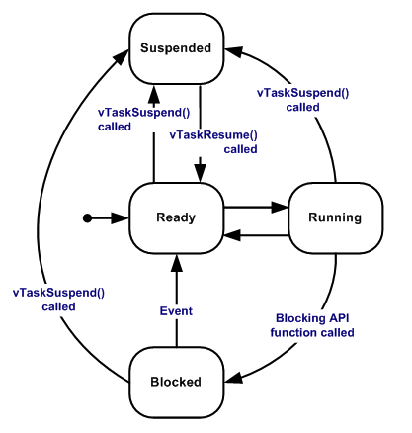
FreeRTOS tasks - states
New task is created using osThreadNew()
Round Robin preemptive scheduling is used (see next slide)
From https://www.freertos.org/RTOS-task-states.html
Notes:
Discuss the different task states as described at https://www.freertos.org/RTOS-task-states.html.

Slide 9
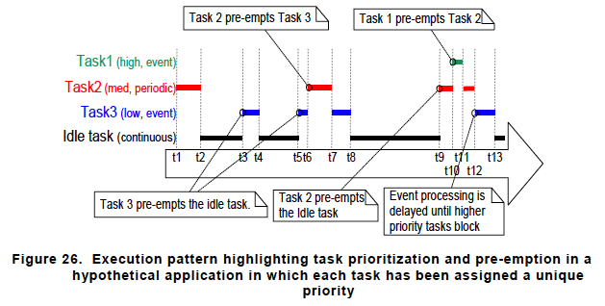
FreeRTOS tasks - scheduling
Note:
Add a small delay like ‘osDelay(1)’ in every task loop to give other tasks (like the Idle task) the opportunity to run!
Discussion:
What makes FreeRTOS a Real-time OS? Is Linux also a Real-time OS?
From https://freertos.org/Documentation/161204_Mastering_the_FreeRTOS_Real_Time_Kernel-A_Hands-On_Tutorial_Guide.pdf
Notes:
Discuss the picture as described in https://freertos.org/Documentation/161204_Mastering_the_FreeRTOS_Real_Time_Kernel-A_Hands-On_Tutorial_Guide.pdf
The default FreeRTOS setting is ‘Fixed Priority Pre-emptive Scheduling with Time Slicing’. Meaning by default configUSE_PREEMPTION and configUSE_TIME_SLICING are set to ‘1’.
From https://www.freertos.org/Documentation/161204_Mastering_the_FreeRTOS_Real_Time_Kernel-A_Hands-On_Tutorial_Guide.pdf:
Time slicing is used to share processing time between tasks of equal priority, even when the tasks do not explicitly yield or enter the Blocked state. Scheduling algorithms described as using ‘Time Slicing’ will select a new task to enter the Running state at the end of each time slice if there are other Ready state tasks that have the same priority as the Running task. A time slice is equal to the time between two RTOS tick interrupts.
Note:
It can happen that a task does not seem to be scheduled properly due to other higher priority tasks. It makes sense to include an ‘osDelay(1)’ (wait for 1 ms) in every task loop to give other lower priority tasks the opportunity to run. A good example of such a task is the Idle task, which runs on the lowest priority, but is responsible for freeing memory, see https://www.freertos.org/RTOS-idle-task.html.

Slide 10
FreeRTOS – main flow (CMSIS-RTOS2)
#include "cmsis_os.h"
…
osKernelInitialize();
…
defaultTaskHandle = osThreadNew(StartDefaultTask, &argument, &defaultTask_attributes);
…
osKernelStart();
/* We should never get here as control is now taken by the scheduler */
Notes:
osThreadNew() can be called before osKernelStart() (as in this example) but also after osKernelStart() from a task context.
Often a task runs a for(;;) loop, but if a task ends, use osThreadExit() to free resources, otherwise other tasks will not run anymore!
Notes:
Notes
The task function of osThreadNew() needs to be a function with ‘C’ linkage an takes one void* parameter. If you want a C++ class member function to act as the task, you need to wrap it with a wrapper that looks something like: void taskfun(void* parm) { static_cast<classname *>(parm)->memberfun() }

Slide 11
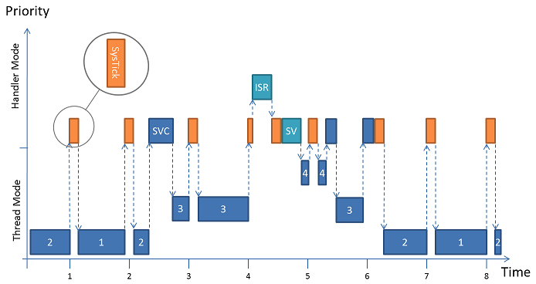
FreeRTOS tasks and interrupts
Note:
Tasks will only run when there are no ISRs running, so the lowest priority interrupt will interrupt the highest priority task, and there is no way for a task to pre-empt an ISR.
From https://www.keil.com/pack/doc/CMSIS/RTOS2/html/theory_of_operation.html and From https://freertos.org/Documentation/161204_Mastering_the_FreeRTOS_Real_Time_Kernel-A_Hands-On_Tutorial_Guide.pdf
Notes:
Discuss the picture as described in https://www.keil.com/pack/doc/CMSIS/RTOS2/html/theory_of_operation.html:
The scheduler combines priority and round-robin based context switches. The example depicted in the image above contains four threads (1, 2, 3, and 4). Threads 1 and 2 share the same priority, thread 3 has a higher one and thread 4 the highest (osThreadAttr_t::priority). As long as threads 3 and 4 are blocked the scheduler switches between thread 1 and 2 on a time-slice basis (round-robin).
Notes on Calling CMSIS-RTOS2 functions from interrupt context:
Some CMSIS-RTOS2 functions can be called from interrupt context, like functions handling semaphores, message queues and memory allocation. This is only allowed when the timeout is set to 0.
In addition the interrupt priority must be equal or lower than configMAX_SYSCALL_INTERRUPT_PRIORITY defined in FreeRTOSConfig.h. This can be accomplished by using the CMSIS function ‘void NVIC_SetPriority(IRQn_Type IRQn, uint32_t priority)’ for the particular interrupt. Note that a lower priority value means a higher interrupt priority.
Functions handling mutexes cannot be called from interrupt context.

Slide 12
Communication / synchronisation between tasks
Memory pools
Message queues
Semaphores
Mutexes (not from ISR)
Discussion:
What is the purpose of each of these communication / synchronization techniques?
From https://arm-software.github.io/CMSIS_5/RTOS2/html/rtos_api2.html#rtos_api2_functions
Notes:
Notes:
Memory pools and message queues are thread safe.
See https://www.keil.com/pack/doc/cmsis/RTOS2/html/group__CMSIS__RTOS__Message.html for information on message queues.

Slide 13
And last but not least: UI task HAL_UART_Transmit() and HAL_UART_Receive()
Typically you want a separate UI task doing serial input and output.
When HAL_UART_Transmit() and HAL_UART_Receive() with large buffers are used in a separate task there are some attention points:
HAL_UART_Transmit() and HAL_UART_Receive() are blocking functions, although HAL_UART_Receive() can be used with timeout set to 0.
Do not use from interrupt handler, only for debugging!
Make sure your stack and heap size are large enough.
The UART hardware can only store one character, so when the the UI task is not running an overrun error can occur. See next slide.
There are also interrupt and DMA versions of HAL_UART_Transmit() and HAL_UART_Receive().
Note:
Use xPortGetFreeHeapSize() and uxTaskGetStackHighWaterMark(TaskHandle_t xTask) to check the free heap size (bytes) and the free stack size (words).
See Speaker Notes for more details!
Notes:
Notes
If a hardfault error occurs like divide by zero, bus error the HardFault_Handler defined in stm32f3xx_tt.c will be called. Use the Debug Console and GDB commands to reveal the cause of the error. Relevant GDB commands (see also https://sourceware.org/gdb/current/onlinedocs/gdb/):
Backtrace to see the stack trace of previously called functions.
x 0xE000ED2C or print/x *(uint32_t *) 0xE000ED2C to see the contents of the HardFault Status Register (HFSR).
p pxCurrentTCB->pcTaskName to get current taskname.
p pxCurrentTCB->pxTopOfStack to get the top of the stack.
p pxCurrentTCB->pxStack to get the lowest stack address. Subtract this from pxTopOfStack to get the used stack size in bytes. If this comes near the .stack_size attribute current task, increase the stack size.
watch *0x20003dd8 to break when the contents of address 0x20003dd8 is being written. This comes in handy when there is a suspicion that memory is being overwritten when it shouldn’t.
See https://interrupt.memfault.com/blog/cortex-m-fault-debug and http://fixbugfix.blogspot.com/2016/01/how-to-debug-stack-corruption-on.html
It is possible to set up the vApplicationStackOverflowHook() function to be called when a stack overflow occurs. In main.cpp this would be like: // The function below is called when a stack overflow occurs and // '#define configCHECK_FOR_STACK_OVERFLOW 1' is added to FreeRTOSConfig,h. // Set a breakpoint in this function to check for stack overflow and to determine which task caused it. extern "C" void vApplicationStackOverflowHook(xTaskHandle *pxTask, signed char *pcTaskName) { GPIOA->ODR |= (1 << 5); // GPIO pin PA5 on (onboard green LED). } See also https://www.freertos.org/Stacks-and-stack-overflow-checking.html
The stack that was used by main() before the scheduler is started is re-used as the stack used by interrupts.

Slide 14
UI task Code example (adapt to your needs)
char txBuf[80];
snprintf(txBuf, 80, "In UI thread, sensorValue: %d\n", sensorValue);
HAL_UART_Transmit(&huart2, (uint8_t *)txBuf, strlen(txBuf), HAL_MAX_DELAY);
uint8_t rxChar;
HAL_StatusTypeDef status;
USART2->ICR |= USART_ICR_ORECF; // Clear the overrun error bit.
// Set timeout to 0 so it will not block,
// just read one character if available.
status = HAL_UART_Receive(&huart2, &rxChar, 1, 0);
if (status == HAL_OK) // No HAL_TIMEOUT, so a character is read.
{
...
}
Note:
See Speaker Notes for details!
Notes:
Notes
Do not use HAL_UART_Transmit() simultaneously in multiple tasks as HAL_UART_Transmit() is not thread-safe. Chances are there will be no or corrupted output.
It is advised to use snprintf() i.s.o. sprint() when printing variables. This because when printing out uninitialized values or erroneous values, they might become very large, like 41 characters for a float and 311 characters for a double. This might be more than the buffer size allocated. This can lead to memory corruption causing HardFault_Handler() to be called.
Calling sprintf() or snprintf() with formatting from a task or interrupt handler uses large amounts of stack. From https://www.freertos.org/FAQHelp.html: Tasks that make calls to any string formatting functions are likely to require a lot of stack – particularly when using the GCC compiler. Such tasks are particularly prone to stack overflow.
Because the UART has a receive data register (USART_RDR) of effectively one byte an overrun error occurs when data is received before the previous data is read out of the USART_RDR register. This typically happens when new data is received when code execution is outside HAL_UART_Receive(), e.g. in another thread. An overrun error then occurs which will set the ORE bit in the UART interrupt and status register USART_ISR. If this bit is not reset no new data can be received. This above inevitably will happen when using the blocking HAL_UART_Receive() call and will also happen when using HAL_UART_Receive_IT() when higher priority interrupts will prevent the UART callback function to be called. Therefore below we clear the overrun error bit to make sure receiving characters will continue. This means it can happen that typed characters are lost when typing fast. Also take care of using CR + LF ('\r' + '\n') as end of line in the terminal emulator because the second character, in this case '\n' will be lost.
See https://stm32.programmingpedia.net/en/tutorial/9707/uart-universal-asynchronous-receiver-transmitter-serial-communication for an example of asynchronous serial communication.
See https://stm32f4-discovery.net/2017/07/stm32-tutorial-efficiently-receive-uart-data-using-dma/ for receiving UART data using DMA.

Slide 15
Checklist
Increase configTOTAL_HEAP_SIZE in FreeRTOSConfig.h to 10000
Set stack_size attribute in const osThreadAttr_t defaultTask_attributes to 128 * 4
Set configUSE_NEWLIB_REENTRANT in FreeRTOSConfig.h to 0
Only use library calls like sprint and snprintf from one thread
Only use USART communication from one UI thread. Other threads can send their output to be printed to the UI thread using a message queue.
Put a delay like osDelay(1) in every task loop
Use osThreadExit() when exiting a thread
If you follow this checklist RTOS should not give you too much trouble!
Notes:
.

Slide 16
References
https://deepbluembedded.com/stm32-arm-programming-tutorials/
https://embedded-lab.com/blog/stm32-tutorials/
https://www.keil.com/pack/doc/CMSIS/General/html/index.html
https://community.arm.com/arm-community-blogs/b/architectures-and-processors-blog/posts/how-much-stack-memory-do-i-need-for-my-arm-cortex--m-applications

