Slide 1



Embedded Systems: Low Power

Slide 2
Today
Power and Energy
Block diagram
Power modes
Code example
Challenge

Slide 3
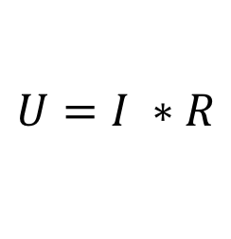
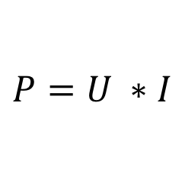
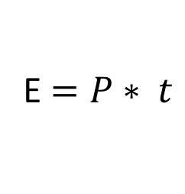
Power and Energy
$$U=I ∗R$$
$$P=U ∗I$$
E $=P∗ t$
Notes:
Discuss in class:
What is the meaning of these equations and what are the units?
How would you measure the energy consumption of an embedded board?
Note that the NUCLEO-F303RE boards is equipped with an Idd jumper meant to measure the power consumption of the MCU.

Slide 4
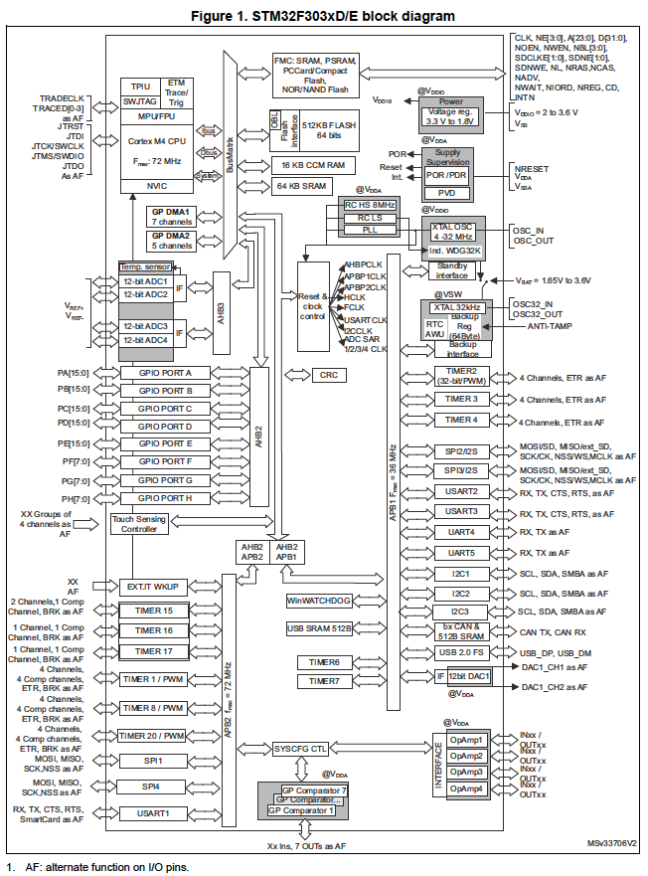
Power management - overview
Notes:
Block diagram is of STM32F303xD/E MCU

Slide 5

Power domains - block diagram
Notes:
In this picture from the reference manual it can be seen that the STM32F303xD/E MCU (used on the NUCLEO-F303RE board) has multiple power domains.
Discuss in class:
Can you name 2 reasons why multiple power domains are used? (the answer is in the ‘Power Control (PWR)’ chapter of the reference manual).

Slide 6
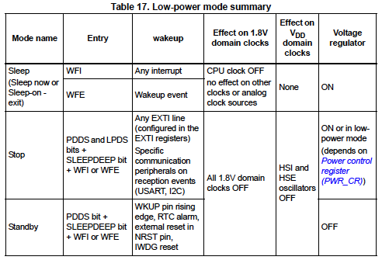
Low Power modes
Notes:
This table from the reference manual shows the available low power modes.
There is also a Run mode (not in the table). This is the standard mode when the CPU is running. In this mode the power can still be reduced by lowering the system clocks by programming the prescaler registers.
Discuss or exercise in class:
For each of the modes in the table, discuss:
The amount of power saving (which mode saves the most energy?)
Will your code still run?
Will interrupts still occur?
Will timers still run?
What happens to the I/O pins?
Will you be able to print debug messages via semihosting or UART?
Some answers are in the table, others in the ‘Power Control (PWR)’ chapter of the reference manual.

Slide 7
MCU sleep code example
Put MCU to sleep every iteration
while (true)
{
activity1();
activity2();
activity3();
__WFI();
}
Note:
In the standard code generated by STM3CubeMX a timer clock is configured which generates a timer interrupt every ms. This will also wake the MCU from sleep mode!
Challenge: How to check if the above code works?
Notes:
In this example the MCU is put to sleep every iteration and woken up by an interrupt.
Side note: The __WFI() instruction (Wait For Interrupt) is used to enter the sleep mode. It is defined in ‘cmsis_gcc.h’ as ‘__ASM volatile ("wfi");’
Challenge: How can you check that the __WFI() instruction works as expected? (there are at least two ways)
Note:
In the standard code generated by STM3CubeMX a timer clock is configured which generates a timer interrupt every ms. This will also wake the MCU from sleep mode!
In this case a __WFI() instruction in the main loop will only be effective when it is called more often than once every 1 ms.

Slide 8
References
https://deepbluembedded.com/stm32-arm-programming-tutorials/
https://embedded-lab.com/blog/stm32-tutorials/
https://www.keil.com/pack/doc/CMSIS/General/html/index.html
https://community.arm.com/arm-community-blogs/b/architectures-and-processors-blog/posts/how-much-stack-memory-do-i-need-for-my-arm-cortex--m-applications

