Slide 1



Embedded Systems: Watchdog

Slide 2
Today
Why do we need a watchdog?
Watchdog principle
Block diagram
Code example

Slide 3

Why do we need a watchdog?
Notes:
Picture is of the Mars Exploration Rover.
Discuss in class:
What can go wrong with the software executed in the Mars Exploration Rover and is there a way to deal with this?

Slide 4
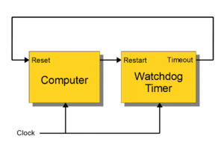
Watchdog principle
while (true)
{
activity1();
activity2();
activity3();
restart_watchdog();
}
Notes:
Discuss in class:
From this slide can you explain how a watchdog works?
Source of the picture: https://en.wikipedia.org/wiki/Watchdog_timer

Slide 5
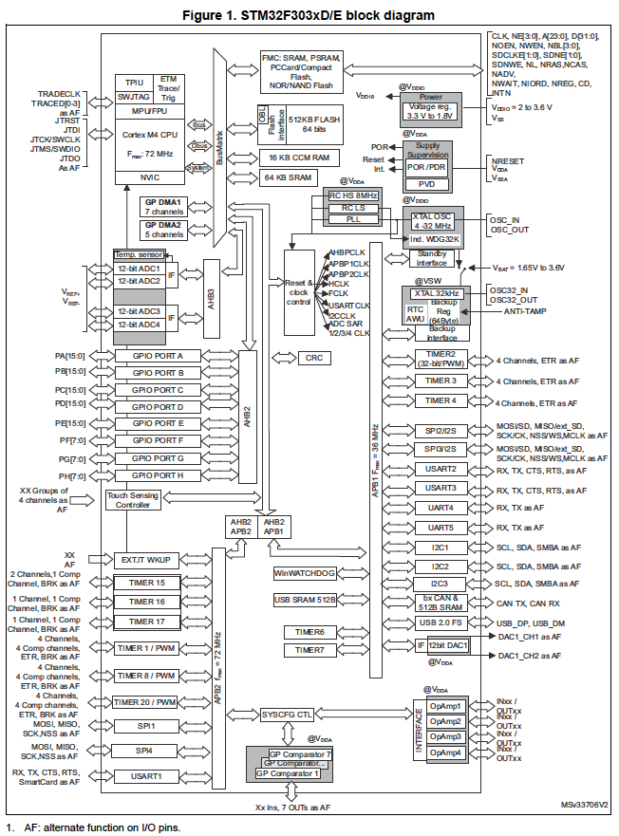
Watchdog - overview
Notes:
Block diagram is of STM32F303xD/E MCU.
The MCU contains two watchdogs
Independent watchdog (IWDG) The independent watchdog is a basic watchdog system that you can find on almost any microcontroller. This watchdog system detects software failures where the software stops being responsive. It works by letting a counter run towards a pre-set timeout value, and software that periodically resets the counter. If your software no longer resets the counter, it will reach the timeout value and trigger a system reset. Example: timeout value is 100ms, so you must reset the watchdog timer within 100ms else the system will reset.
System window watchdog (WWDG) The window watchdog is in basis the same as the independent watchdog, but can also detect software failures where the software runs too fast (e.g.: some tasks are skipped). It works the same as the independent watchdog, but has a time window within which the watchdog must be reset. Reset too early or too late: your system will reset. Effectively this is an independent watchdog with additional minimal counter value that must be reached. Example: timeout window is 80-100ms, so you must reset the watchdog timer after 80ms and before 100ms else the system will reset.
The remainder of the presentation will focus on the IWDG watchdog.

Slide 6
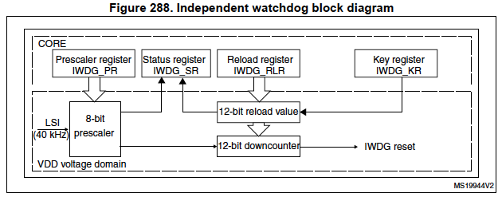
Independent watchdog (IWDG)
Notes:
Block diagram of the independent watchdog (IWDG).
IWDG main features:
Free-running downcounter
Clocked from an independent RC oscillator (can operate in Standby and Stop modes)
Conditional Reset
Reset (if watchdog activated) when the downcounter value becomes lower than 0x000

Slide 7
Watchdog - code example
Initialize and start the IWDG watchdog
IWDG->KR = 0x****; // Enable write to PR, RLR.
IWDG->PR = <prescaler value>; // Init prescaler.
IWDG->RLR = <reload value>; // Init reload register.
IWDG->KR = 0x****; // Reload the watchdog.
IWDG->KR = 0x****; // Start the watchdog.
Main loop
while(true)
{
activity1();
activity2();
activity3();
IWDG->KR = 0x****; // Reload the watchdog.
}
Note:
For * fill in the right values, see reference manual.
Notes:
In this example the IWDG watchdog is initialized and started.
A similar example can be found in the reference manual code examples.
The <prescaler value> and <reload value> have to be calculated to obtain a suitable watchdog timeout value.
For the STM32F0Discovery and the NUCLEO-F303RE boards the IWDG watchdog clock (before the prescaler) is 40 kHz.
Discuss in class:
What could be the need for the first write to the key register: IWDG->KR = 0x****; // Enable write to PR, RLR ?
How can you calculate the prescaler and reload value given a required watchdog timeout value?

