Slide 1
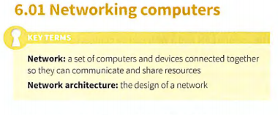
NETWORK

Slide 2
Network
The first instance of computer s being linked togethe r was in
1969 with the Advanced Research Projects Agency Netwo rk
(ARPANET). Universities connected com puters together
with the intention of being able to communicate and share
resources. This network was the predecessor to the internet
Networking computers has a number of advantages and
disadvantages.
The advantages of networking computers w ill mostly
outweigh the disadvantages . This is why we choose to
network computers together.

Slide 3
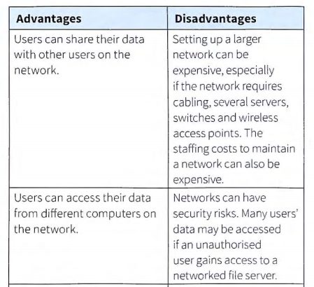
NETWORK

Slide 4
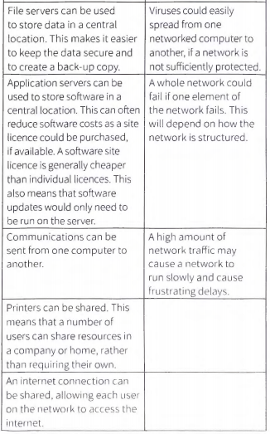
NETWORK

Slide 5
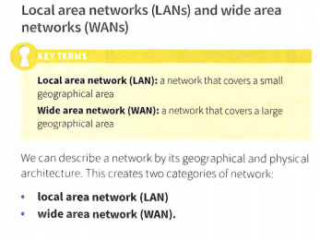
Network

Slide 6
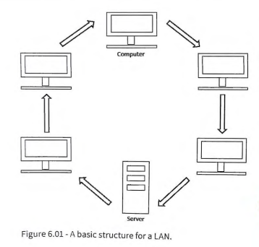
NETWORK

Slide 7
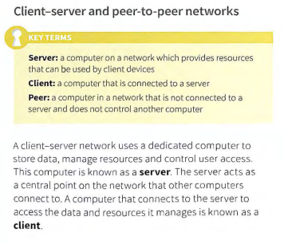
NETWORK

Slide 8
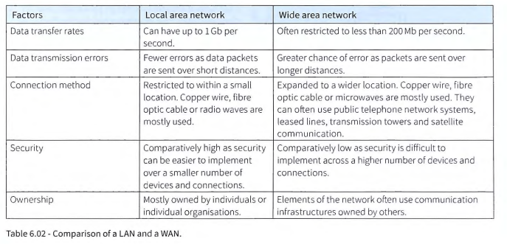
NETWORK

Slide 9
Network servers handle a variety of functions,
including :
Storing a database of usernames and passwords to control user access
Data storage security assigning levels of access that determi ne what resources a user may access
Monitoring network traffic
Hosting of shared application s
Managing an internet connectio n
Schedu ling and running back-ups
Email services
Printingjobs on network printer s
Domain name services.
A client- server network will usually have at least one server and several clients. A network may have more than on e server, each one dedicated to handl ing a specific function . For example, one server may hand le user access, whil e another may handle data storage. This ohen occurs in larger network s where a server has to service many client s at the same tin, e. Spreading the load across several servers helps to keep the network running efficiently

Slide 10
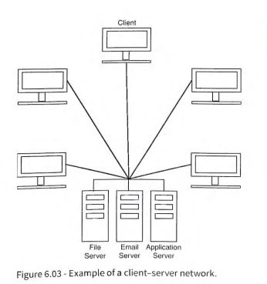
Network

Slide 11
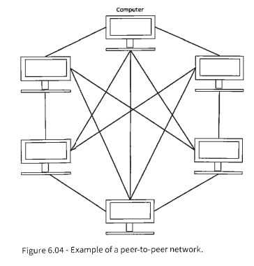
NETWORK

Slide 12
NETWORK
On a peer-to-peer network, users store data on their own computer, but may allow other users access to it. Alternatively, they may choose to keep their data private.
Indivi dual peers may provide resources that others do not. For example, a peer may have a printer attached to it and other peers may print to that printer.
Table 6.03 shows a comparison of the architecture of a
client-server and a peer-to-peer network

Slide 13
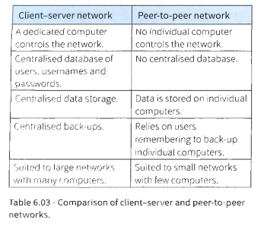
NETWORK

Slide 14
NETWORK
Each type of archi tectu re has it s advantages and disadvantages. Peer-to-p eer netw orks are often cheaper to install and maintain than client- server networ ks. Client-server net works can be expensive to purchase and often req uire trai ned staff to maintain
them .

Slide 15
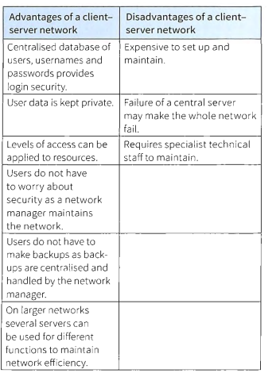
NETWORK

Slide 16
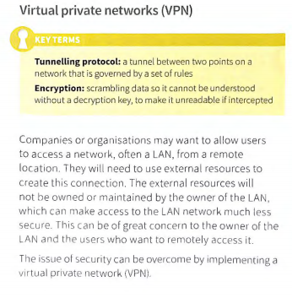
NETWORK

Slide 17
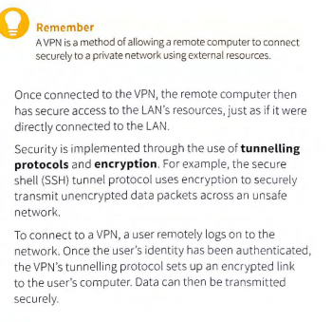
NETWORK

Slide 18
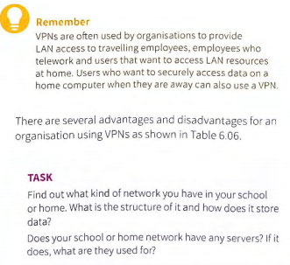
NETWORK

