Slide 1
GAMER INC.
PRESENTS

Slide 2
MOTIVATIONAL QUOTES

Slide 3
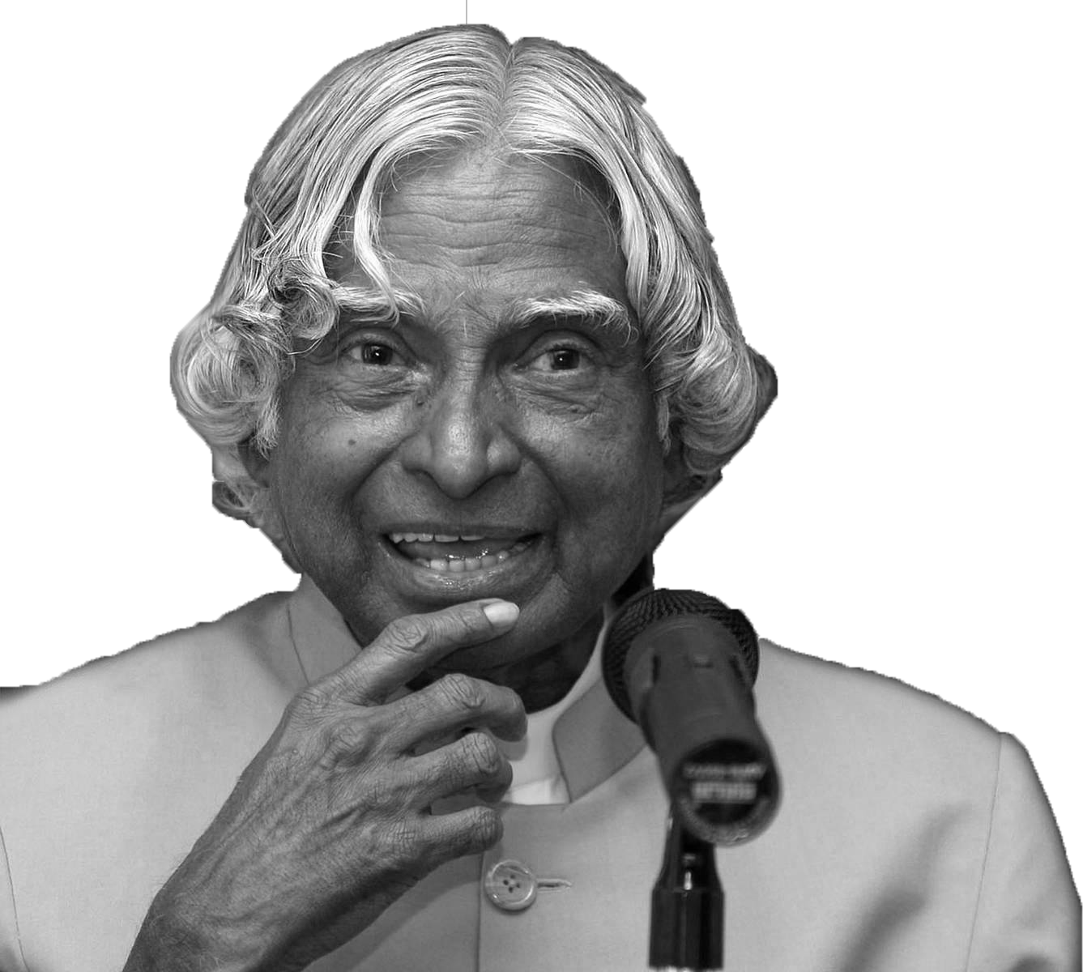
DR. APJ ABDUL KALAM
YESTERDAY WAS PAST
TOMORROW WILL BE FUTURE
TODAY IS WHAT WE HAVE
THAT’S WHY IT IS CALLED AS PRESENT

Slide 4
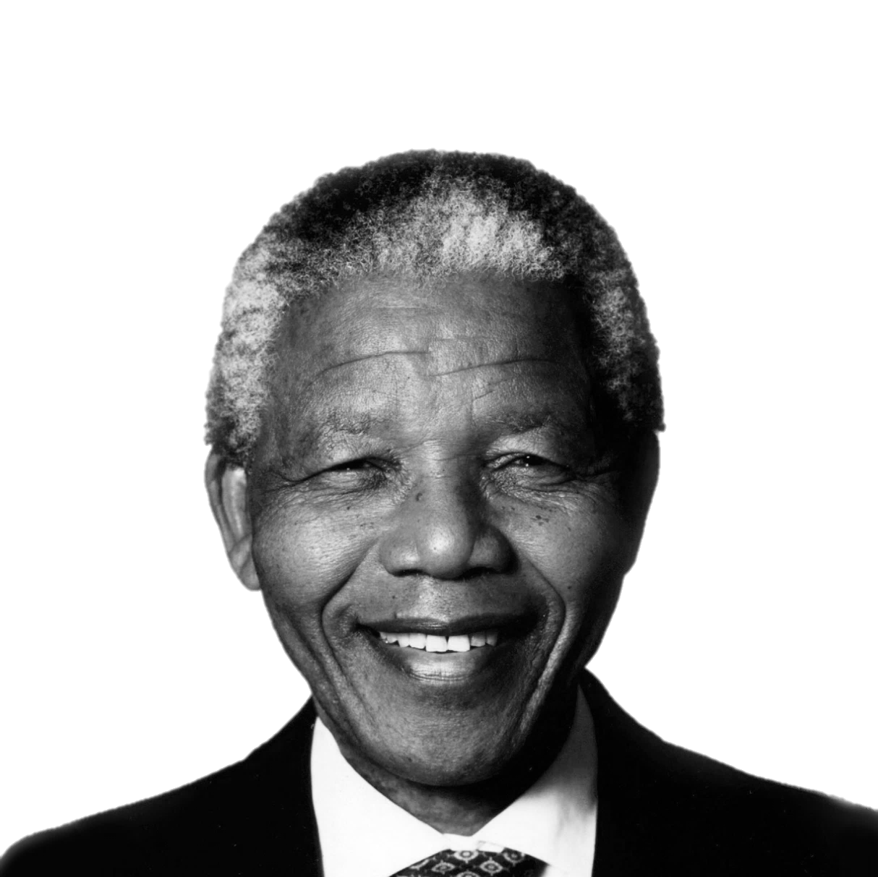
NELSON MANDELA
EDUCATION IS THE MOST POWERFUL WEAPON WHICH YOU CAN USE TO CHANGE THE WORLD

Slide 5
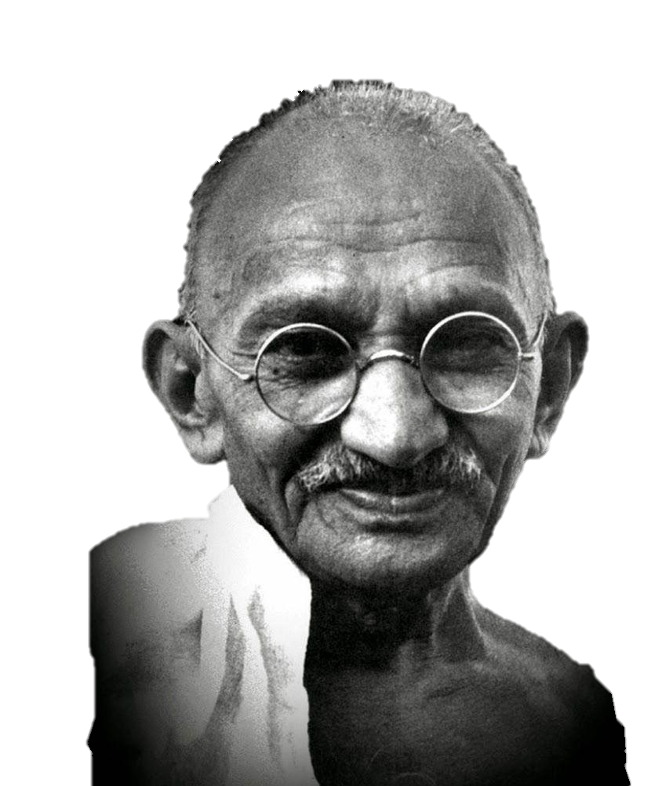
MAHATMA GANDHI
THE FUTURE DEPENDS ON WHAT WE DO IN THE PRESENT

Slide 6

STEVE JOBS
YOUR TIME IS LIMITED, SO DON’T WASTE IT LIVING SOMEONE ELSE’S LIFE

Slide 7
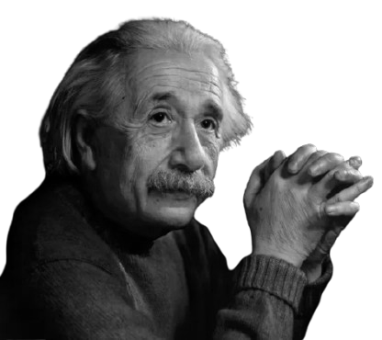
ALBERT EINSTEIN
ANYONE WHO HAS NEVER MADE A MISTAKE HAS NEVER TRIED ANYTHING NEW

Slide 8


S P I D E R M A N
WITH GREAT POWERS, COMES GREAT RESPONSIBILITIES

Slide 9

IRON MAN
SOMETIMES YOU
GOTTO RUN BEFORE
YOU CAN WALK

Slide 10
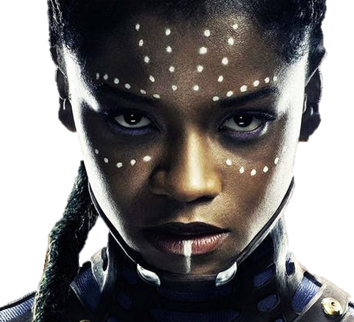
SHURI
JUST BECAUSE SOMETHING WORKS DOESN’T MEAN IT CAN’T BE IMPROVED

Slide 11
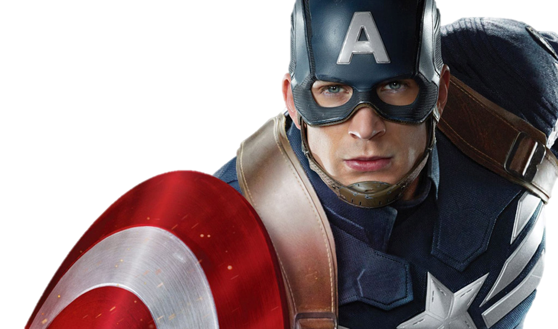
CAPTAIN AMERICA
I CAN DO THIS ALL DAY!
WHY CAN’T YOU?

Slide 12
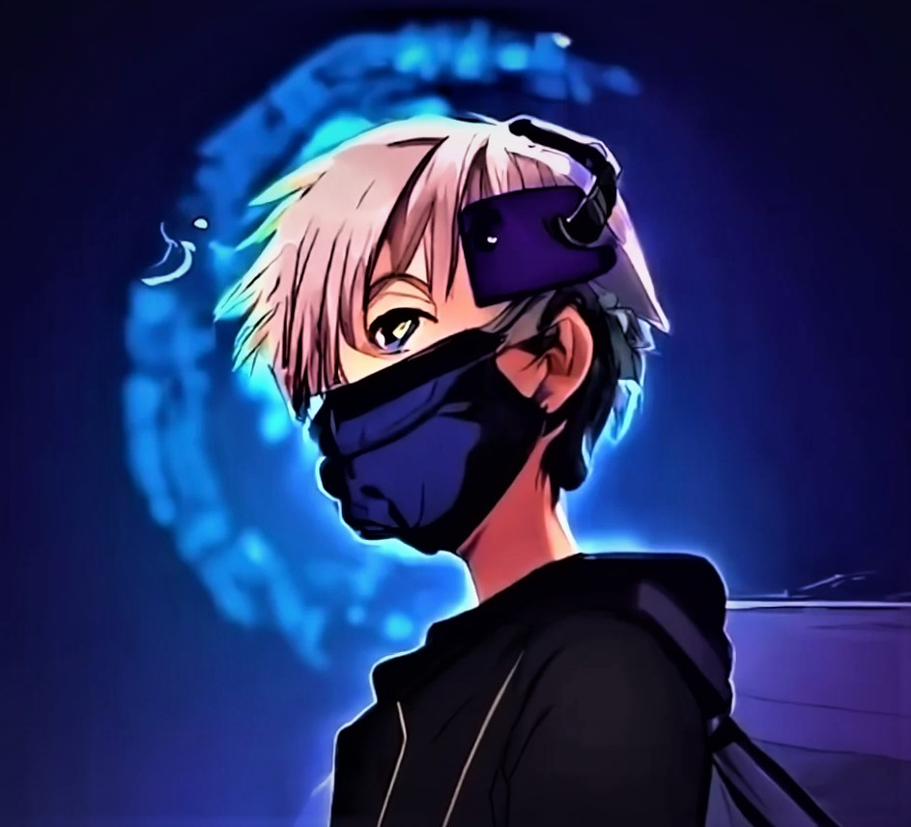
AAYAN ABDULLAH
WORK HARD IN
SILENCE
LET YOUR SUCCESS
MAKE SOME
NOISE

Slide 13
T
H
A
N
K
S
© Gamer Inc. 2026
NAME : AAYAN ABDULLAH
CLASS : IX B
EX. ROLL : 9B2
Get the project only on www.gamerinc.me

