Slide 1
JAVA · SWING · COMPUTER GRAPHICS
Interactive Ray Tracing Engine
A Java renderer that simulates light — reflection, refraction and shadows — across spheres, cubes and pyramids, exported as photorealistic PNG output.
Course Project · Computer Graphics

Slide 2
Introduction
A ray tracing engine simulates the physical behavior of light: rays are cast from a virtual camera through every pixel and traced through a 3D scene to calculate realistic reflections, refractions and shadows. This project implements an interactive ray tracer in pure Java that renders multiple primitives in real time and exports the result as a PNG.
HOW IT WORKS
1
2
3
4
Ray Generation
Intersection Test
Shading & Shadows
Reflect & Refract
A ray is cast from the camera through every screen pixel using perspective projection.
Each ray is tested against every sphere, cube, pyramid and the floor to find the closest hit.
Lambertian lighting plus a shadow ray decide how lit or shadowed the hit point is.
Recursive rays add mirror reflection and Snell's-law refraction, up to 4 bounces deep.
1

Slide 3
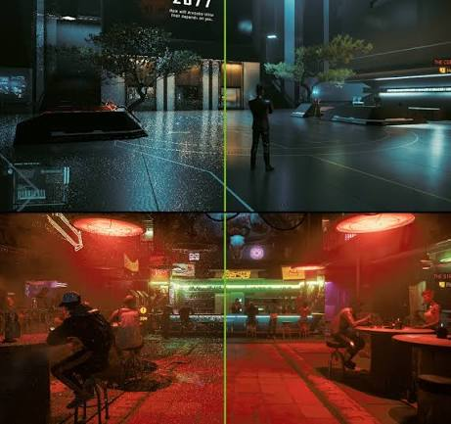
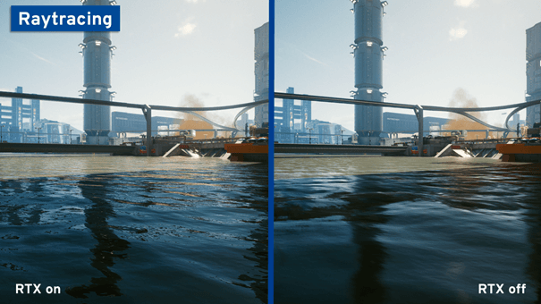
Ray Tracing: Before vs. After
Cyberpunk 2077 — lighting, shadows & reflections
Real-time ray-traced reflections demo
4

Slide 4
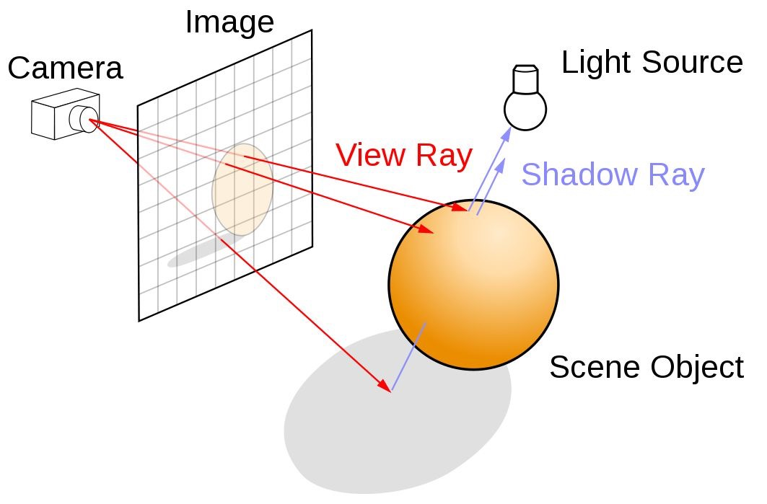
Technical Approach
RENDER PIPELINE
Camera rays.
Each pixel's ray is built from the camera basis (forward × world-up) and the pixel's normalized screen coordinates.
Primitive intersection.
Sphere → quadratic formula. Cube → slab (min/max) method. Pyramid → Möller–Trumbore ray-triangle test on 6 faces. Plane → algebraic ray-plane solve.
Local shading.
A shadow ray toward the light decides occlusion; Lambertian diffuse = max(0, N·L) scales the surface color.
Recursive bounces.
Mirror reflection (R = D − 2(D·N)N) and Snell's-law refraction (with total-internal-reflection fallback) recurse up to MAX_DEPTH = 4.
Parallel execution.
Pixel rows render concurrently with Java's IntStream.parallel(), using every CPU core.
3

Slide 5
System Architecture
CLASS DESIGN (OBJECT-ORIENTED JAVA)
Vector3
Ray
x, y, z + add / sub / dot / cross / normalize
origin + normalized direction
SceneObject (abstract)
center · color · reflectivity · transparency · ior
Sphere
Cube
Pyramid
Plane
Quadratic ray–sphere hit test
Slab (min / max) method
6-face Möller–Trumbore
Checkerboard floor
Scene.closestHit() + trace() — the recursive rendering engine
Finds the nearest hit · casts a shadow ray · recurses for mirror reflection and Snell's-law refraction, up to MAX_DEPTH = 4 bounces
5

Slide 6
Key Features
Beyond a static renderer, the project ships as an interactive Swing "studio": scenes are built, lit and explored live, with every frame re-traced in real time as you work.
INTERACTIVE TOOLING
1
2
3
4
Drag, Drop & Edit
360° Orbit Camera
Ray-Path Demo Mode
Multithreaded Rendering
Spawn spheres, cubes or pyramids from the palette; drag any object in 3D and tweak its color and transparency live.
Hold middle-click (or Alt+drag) to orbit the camera in full spherical coordinates, CAD-style, around the scene.
Visualizes 8 real camera rays bouncing off a solid sphere and refracting through a glass sphere, overlaid in 3D.
Pixel rows render in parallel across every CPU core, with adaptive resolution while dragging for a smooth live preview.
6

Slide 7
Real-World Applications
WHERE RAY TRACING IS USED TODAY
1
Gaming & Real-Time Graphics
2
Film & Animation (VFX)
Hardware ray tracing now reaches mainstream PC gaming.
Path-traced global illumination is standard in feature animation.
138 games + 72 apps support RT; 83% of RTX 40-series owners enable it. — NVIDIA / Tom's Hardware
Pixar's RenderMan moved to full path tracing (RIS) in 2014; Coco (2017) used 8M+ light sources. — VFX Voice
3
Architecture & Product Design
4
Medical Imaging
Photorealistic previews before anything is physically built.
"Cinematic Rendering" path-traces CT/MRI scan volumes.
Ray-traced renderers (V-Ray, Unreal, Chaos) are now standard for client-ready archviz walkthroughs.
Used clinically for CT angiography and surgical planning with lifelike 3D anatomy. — radiology literature
2

Slide 8
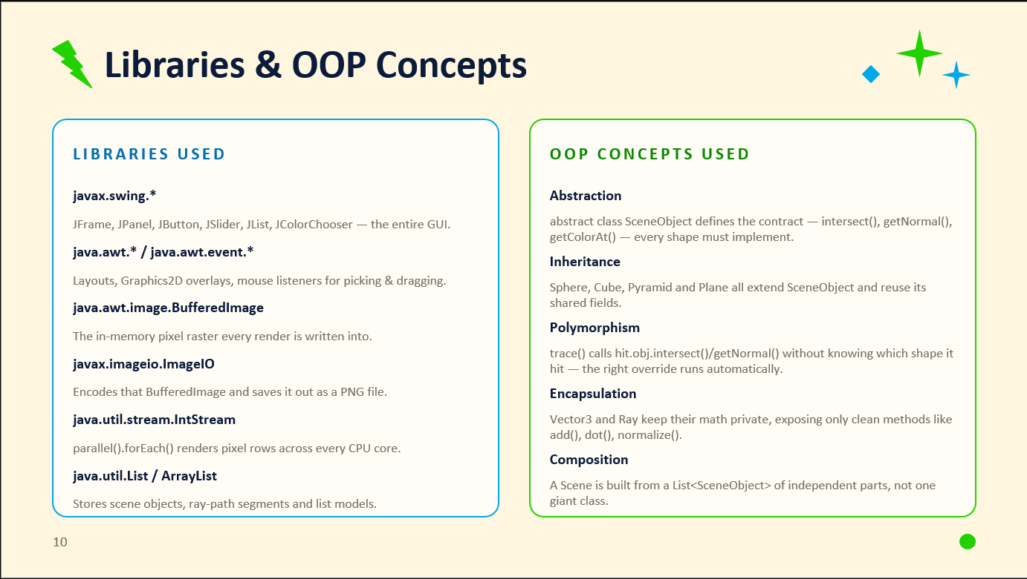

Slide 9
Code Walkthrough: Core Math
class Vector3 {
double x, y, z;
Vector3 sub(Vector3 v) {
return new Vector3(x-v.x, y-v.y, z-v.z);
}
double dot(Vector3 v) {
return x*v.x + y*v.y + z*v.z;
}
Vector3 normalize() {
double len = Math.sqrt(dot(this));
return len > 0 ?
new Vector3(x/len, y/len, z/len) : this;
}
}
// Sphere-ray intersection (quadratic formula)
double intersect(Ray ray) {
Vector3 oc = ray.origin.sub(center);
double b = oc.dot(ray.direction);
double c = oc.dot(oc) - radius * radius;
double disc = b * b - c;
if (disc < 0) return -1;
double t = -b - Math.sqrt(disc);
return t > 0.001 ? t : -b + Math.sqrt(disc);
}
WHAT THIS DOES
• Vector3 is the project's entire 3D math toolkit: every position, direction and RGB color is one of these.
• dot() and sub() implement the standard vector algebra used throughout the renderer.
• normalize() rescales a vector to unit length so lighting · reflection math stays correct.
• Sphere.intersect() solves |O + tD − C|² = r² for t — a textbook quadratic. A negative discriminant means the ray misses; otherwise the nearest positive root is the hit distance.
8

Slide 10
Code Walkthrough: Ray Tracing Engine
static Vector3 trace(Ray ray, List<SceneObject> objs,
Vector3 light, int depth, int maxDepth) {
if (depth > maxDepth) return new Vector3(0,0,0);
HitRecord hit = findClosestHit(ray, objs);
if (hit.obj == null) return skyColor(ray);
Vector3 p = ray.origin.add(ray.direction.mult(hit.t));
Vector3 n = hit.obj.getNormal(p);
Vector3 toLight = light.sub(p).normalize();
// shadow ray toward the light
Ray shadowRay = new Ray(p.add(n.mult(0.001)), toLight);
boolean inShadow = findClosestHit(shadowRay, objs).obj != null;
double diffuse = inShadow ? 0.2
: 0.2 + Math.max(0, n.dot(toLight)) * 0.8;
Vector3 color = baseColor(hit).mult(diffuse);
if (hit.obj.reflectivity > 0) { // reflection
Vector3 r = ray.direction.sub(
n.mult(2 * ray.direction.dot(n)));
Vector3 refl = trace(new Ray(p.add(n.mult(0.001)), r),
objs, light, depth+1, maxDepth);
color = color.mult(1-hit.obj.reflectivity)
.add(refl.mult(hit.obj.reflectivity));
}
// refraction follows the same pattern via Snell's law
return color;
}
WHAT THIS DOES
• trace() is the heart of the renderer — called once per pixel, then recursively for every bounce.
• depth / maxDepth caps the recursion (4 bounces) so reflections and refractions can't run forever.
• A shadow ray toward the light checks occlusion before adding Lambertian diffuse light.
• Reflective surfaces recurse with the mirrored direction R = D − 2(D·N)N, blending the bounced color in by the surface's reflectivity.
• Transparent surfaces do the same with a refracted ray — this is what produces the glass sphere's bending light.
9

Slide 11
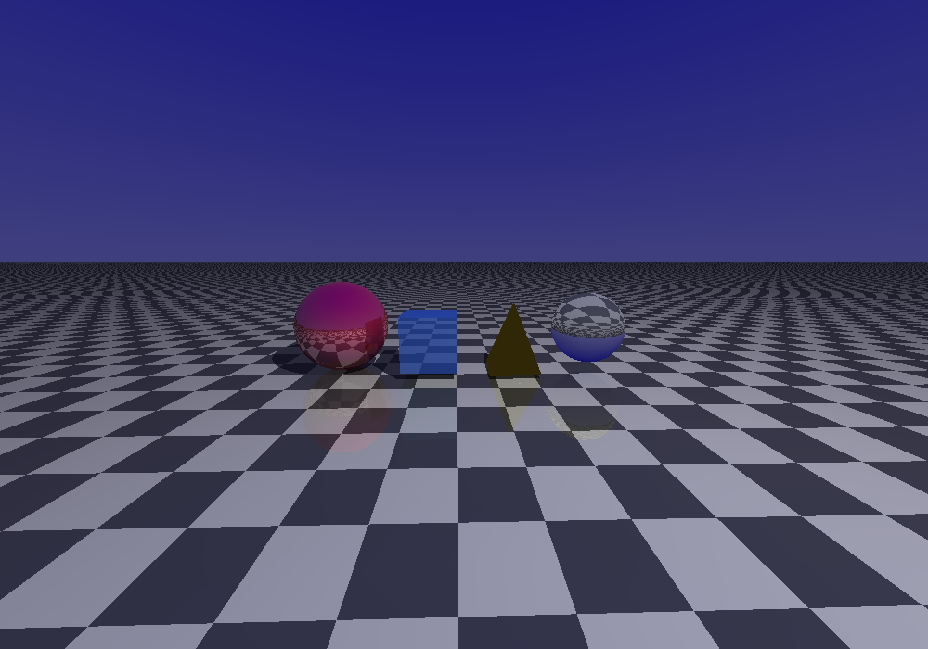
Sample Render Output
Rendered directly by the project's own trace() engine — sphere, cube, pyramid and a refractive glass sphere on a checkered floor, exported as a PNG.
7

Slide 12
Thank You
Questions & Discussion
Interactive Ray Tracing Engine · Java

