Slide 1
T6: Making the most of cis-regulatory annotations for genome-scale analysis
A practical day for moving from epigenomic evidence to reusable regulatory annotation workflows.
ECCB 2026 Tutorial
03/09/2026

Slide 2


Feedback survey
We appreciate your honest feedback – they help us improve our courses for future participants!
Click here to complete the feedback survey.

Slide 3
Citing the resources
Follow the ENCODE citation guidelines
Follow the IGV citation guidelines
Ensembl Regulation pre-print:
Ilsley, G.R., Branco Lins, P.R., Merino, G.A., Urbina-Gómez, D., Harrison, P.W., 2026. Ensembl’s regulatory annotation for human, mouse, livestock, and aquaculture species. https://doi.org/10.21203/rs.3.rs-8007521/v1
Cite Ensembl’s most recent paper: Yates AD, Austine-Orimoloye O, Azov AG, et al. Ensembl 2026. Nucleic Acids Research. 2025 Nov;gkaf1239. DOI: 10.1093/nar/gkaf1239. PMID: 41296548.

Slide 4
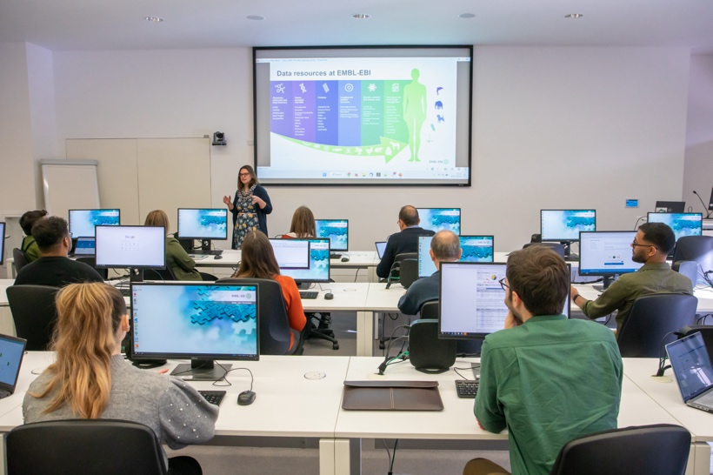
Hosting an Ensembl-specific training course
Browser course One-day course on the Ensembl browser, aimed at wet-lab scientists.
Train-the-trainer course One-day course on delivering bioinformatics training and teaching your own Ensembl browser course.
Visit the Ensembl Training website or email us for more information.
We can teach an Ensembl course at any institute for free (plus trainers’ expenses in high-income countries).
https://training.ensembl.org/hosting
Notes:
You can also host your own Ensembl training course by inviting an Ensembl colleague to deliver Ensembl training at your institute. We can deliver these courses both remotely or in-person. You can find more information on the Ensembl Training website, or by emailing us directly at helpdesk@ensembl.org

Slide 5
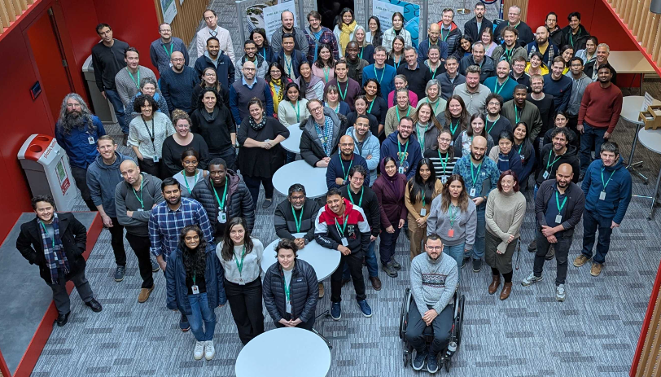










Acknowledgements and funding
Funded by Wellcome
Funded by the European Union
Horizon 2020
Horizon Europe Programme
We would like to acknowledge the National Genome Research Institute (NHGRI) for funding the following grants supporting the creation of the human pangenome reference: U41HG010972, U01HG010971, U01HG013760, U01HG013755, U01HG013748, U01HG013744, R01HG011274, and the Human Pangenome Reference Consortium (BioProject ID: PRJNA730823) as well as 2U24HG007497-09 which supports the creation of HGSVC resources

Slide 6

Training materials
Ensembl training materials are protected by a CC BY licence
If you use these materials in teaching or training, please cite the repository https://gitlab.ebi.ac.uk/ensembl-regulation/ECCB-2026-T6 and acknowledge the ECCB 2026 Tutorial

