Slide 1
player strategies

Slide 2
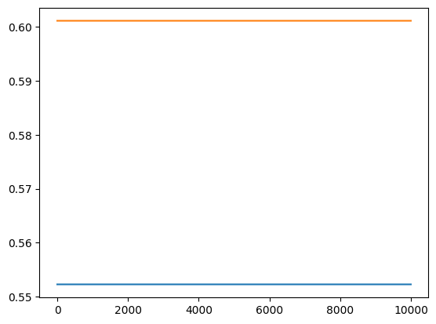
start at C,C - SGD

Slide 3
start at C,C - PCGD

Slide 4
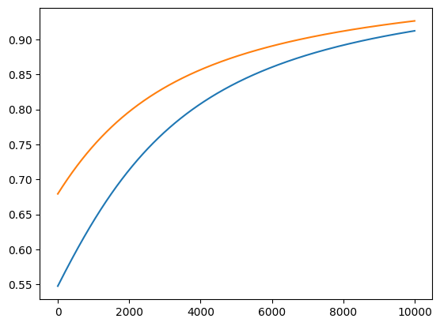
start at C,B - SGD

Slide 5
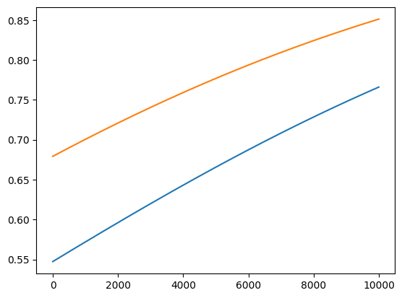
start at C,B - PCGD

Slide 6
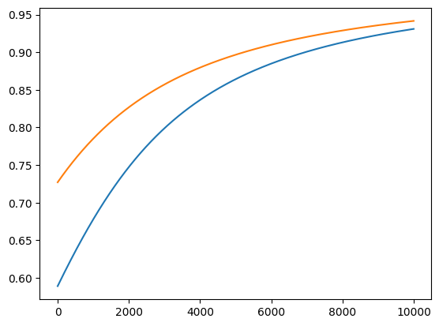
start at B,B - CGD

Slide 7
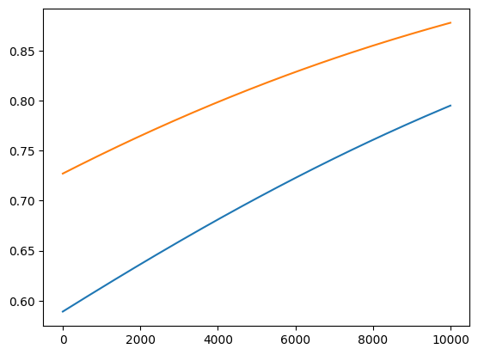
start at B,B - PCGD

