Slide 1

Shri Ramswaroop Memorial University,Barabanki Topic: Adventure Works Power BI Dashboard Analysis Report
Presented By: Gaurav Singh Presented to: Rohit sir
Roll no: 202310101150222
B.Tech cs(ds+ai)-58

Slide 2
Introduction
This report presents a detailed overview of the Adventure Works Power BI dashboard. It covers sales, budget, and variance performance, customer insights, and regional analysis. Data from multiple tables was modeled into a star schema for efficient reporting.

Slide 3
Data Sources and Preparation
The dashboard is powered by the following datasets:
- Sales: Contains order, product, and amount details.
- Budget: Includes planned sales values by product and month.
- Customer: Demographic and geographic details.
- Product: Product attributes and categories.
- Calendar: Enables time intelligence.
- Territories: Country and region information.
Data was cleaned and transformed using Power Query before modeling.

Slide 4
Data Model and Relationships
A star schema model was created to optimize performance:
- 'Sales' table at the center connected to dimension tables like Product, Customer, and Calendar.
- 'Budget' linked to Product and Calendar.
- 'Territories' provides regional mapping.
Relationships are one-to-many, ensuring accurate cross-filtering.

Slide 5
Key DAX Measures
DAX (Data Analysis Expressions) was used to calculate:
- Total Sales = SUM(Sales[SalesAmount])
- Total Budget = SUM(Budget[Value])
- Variance = [Total Sales] - [Total Budget]
- Variance% = DIVIDE([Variance], [Total Budget])
These measures power the KPI visuals and variance analysis.

Slide 6
Dashboard Overview
The Power BI dashboard provides a top-down performance snapshot:
- KPIs for Sales, Budget, Variance, and Variance%.
- Visuals: Bar, line, and table charts.
- Interactivity with filters and drill-through options.
- Q&A feature for natural language queries.

Slide 7
Sales vs Budget by Category
The comparison highlights performance differences across categories:
- Clothing and Bikes lead in both sales and budget achievement.
- Accessories show budget underperformance.
This visualization helps identify strong and weak-performing segments.

Slide 8
Sales and Budget by Month
The line chart tracks monthly performance trends:
- Sales show consistent growth through the year.
- Budget remains steady, with peaks during promotional months.
- The final quarter indicates increased sales momentum.

Slide 9
Variance and Performance Insights
Variance visuals reveal:
- 2023 showed positive variance, suggesting sales exceeded budget.
- Categories like Bikes achieved high variance%.
These insights support performance evaluation and future planning.

Slide 10
Top Customers and Regions
Analysis of customer-level data reveals:
- Top 10 customers account for a major share of revenue.
- High sales concentration in California, New York, and England.
This assists in identifying key clients and geographic opportunities.

Slide 11
Regional and State-wise Sales
Regional distribution analysis shows:
- Strongest markets in North America and Europe.
- Opportunities for expansion in underperforming regions.
- Potential for targeted marketing campaigns in low-sales zones.

Slide 12
Customer Segmentation
Customers were segmented based on sales volume and location:
- High-value customers: Top 20% generating 80% of sales.
- Medium-value customers: Regular buyers with moderate contribution.
- Low-value customers: Potential targets for upselling strategies.

Slide 13
Forecasting and Trends
Using Power BI’s forecasting tools:
- Sales growth expected to continue into next fiscal year.
- Seasonal trends show peaks during mid-year months.
- Suggests optimizing inventory and promotions accordingly.

Slide 14
Technical Implementation in Power BI
Key Power BI features used:
- Power Query for data transformation.
- DAX for dynamic calculations.
- Model view for relationship setup.
- Interactive visuals and bookmarks for navigation.
- Export and sharing through Power BI Service.

Slide 15
Strategic Insights & Recommendations
Insights:
- Sales performance exceeds budget expectations overall.
- Strong regional markets can be leveraged for expansion.
Recommendations:
- Reallocate budget based on sales variance.
- Invest in customer retention and targeted campaigns.
- Continue dashboard enhancements for real-time analysis.

Slide 16
Conclusion
The Adventure Works Power BI Dashboard delivers a holistic view of sales and budget performance. With its analytical capabilities, it enables data-driven decision-making, improved budgeting accuracy, and strategic business planning for future growth.

Slide 17
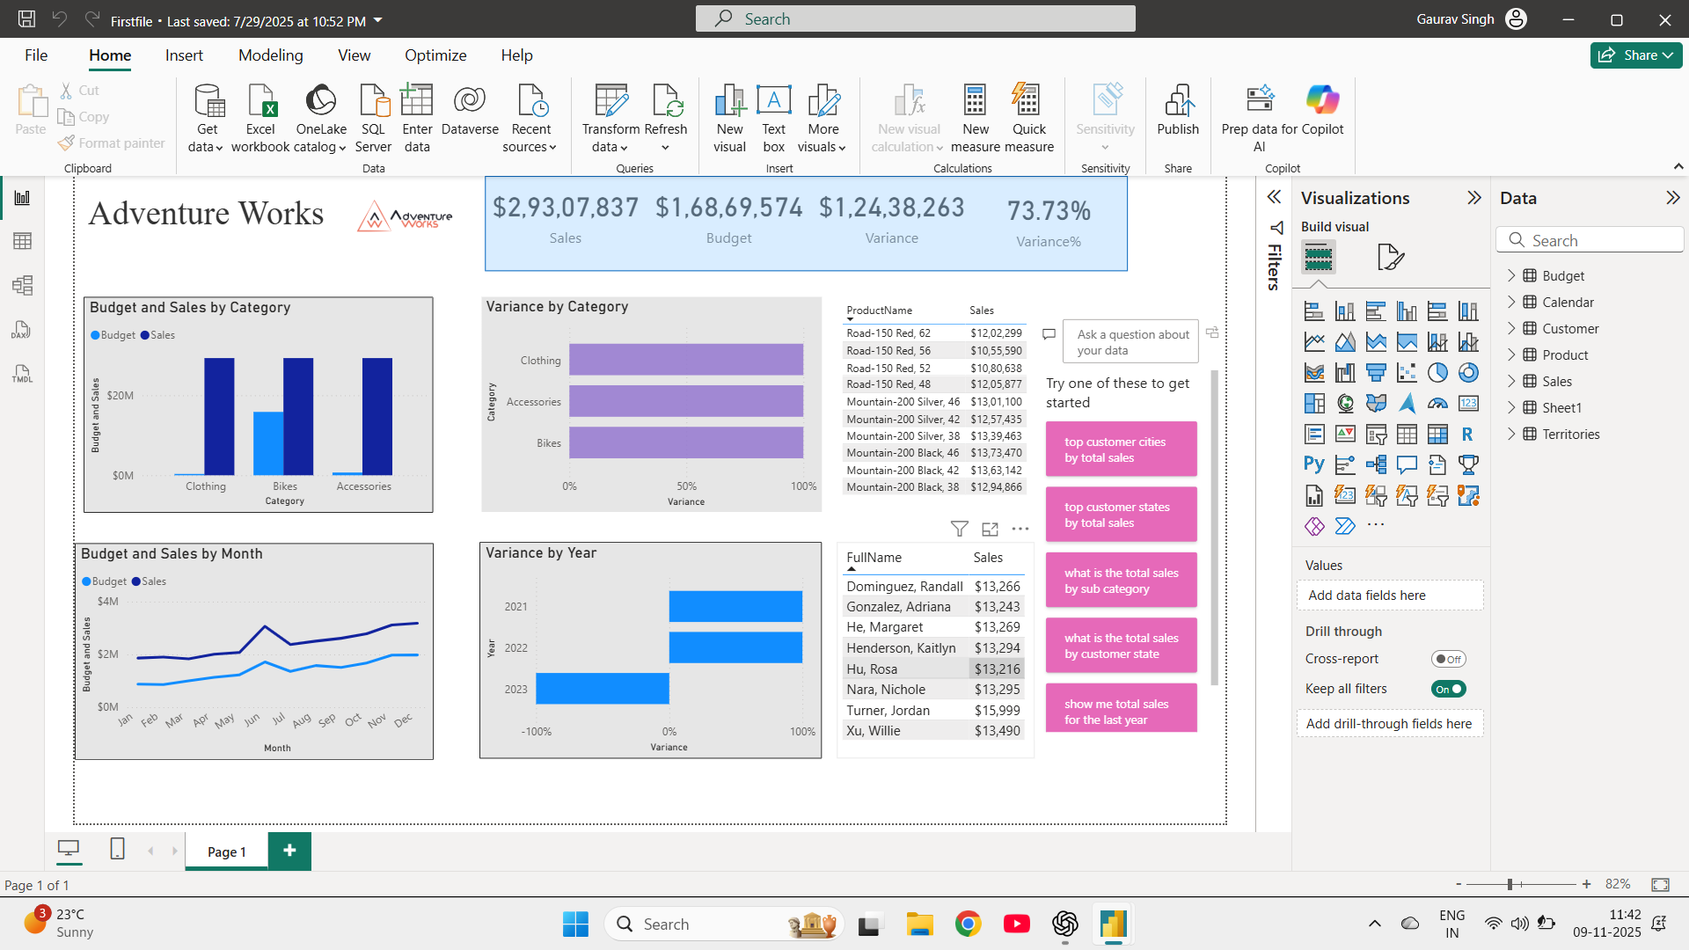
Final dashboard view

