Slide 1



Poetry Genre Identification- A Comparitive Analysis of Embedding Models and Classifiers
BL.EN.U4AIE22019 – GAMIDI ROHAN BL.EN.U4AIE22057 – SNEHA SARAGADAM BL.EN.U4AIE22060 – T SRI SURYA MANIDEEP

Slide 2
Introduction
Importance of Poetry in Literature:
Reflects complex human emotions and narratives.
Captures cultural and historical contexts.
Vital for literary education and scholarly research
Challenges in Manual Classification:
Requires expertise in various poetic forms.
Time-consuming and labor-intensive process.
Subjective interpretations can lead to inconsistencies.
Need for Automated Systems:
Streamlines the categorization process.
Enhances accessibility for researchers, educators, and enthusiasts.
Facilitates large-scale analysis and discovery of patterns in poetry.

Slide 3
Objective
Automate Poetry Classification:
Develop a system capable of categorizing poems into various genres accurately and efficiently.
Evaluate Model Performance:
Assess the effectiveness of different pre-trained language models, including GPT-2, BERT, and RoBERTa, in poetry classification.
Enhance Accessibility and Education:
Improve access to poetry resources for students, scholars, and enthusiasts.
Foster deeper understanding and appreciation of diverse poetic forms and genres.

Slide 4
Literature Survey
[1] Marathi Poem Classification using Machine Learning
[2] Adapting GPT, GPT-2, and BERT Language Models for Speech Recognition
[3]Poem classification using machine learning approach.
Problem Statements:
[1] | [2] | [3]
The primary challenge lies in effectively categorizing Marathi poems based on sentiment due to contextual nuances and dynamic word meanings shaped by poets' interpretations. The system faces complexities in discerning ambiguous poems and relies on users possessing a certain level of proficiency in Marathi for accurate classification. The overarching objective is to elevate poet reputation through precise poem analyses and classifications, prioritizing enhanced system accuracy and scalability. | Despite significant advancements in machine learning and natural language processing, the task of poetry classification remains under-explored and challenging. Poetry, with its diverse forms and rich linguistic features, poses unique challenges for automated classification due to its inherent complexity, variability in structure, and use of figurative language. Traditional methods of poetry classification are labor-intensive, requiring extensive expertise and manual effort, which limits scalability and accessibility. | The study focuses on enhancing automatic speech recognition (ASR) systems by exploring bidirectional recurrent neural network language models. The goal is to improve word error rate (WER) performance by investigating the effectiveness of different LM architectures, such as GPT, GPT-2, and BERT, and their combinations. The research aims to propose efficient methods for calculating language prior probabilities in bidirectional LMs and evaluate their impact on ASR tasks, ultimately aiming to achieve significant WER reductions on both development and evaluation sets.

Slide 5
Implementation Details:
[1] | [2] | [3]
Implementation involves preprocessing Marathi poems by removing stop words and categorizing words using a designated dataset. Support Vector Machine (SVM) algorithm is utilized for classification, with tfidf computed for each sentiment category for accurate sentiment analysis. System architecture facilitates seamless search functionalities, enabling exploration of poems based on poet names or sentiments. Particularly beneficial for users with limited Marathi language proficiency, enhancing accessibility and usability. | Utilized RapidMiner5, an open-source data mining package, to model and implement the classifiers: K-Nearest Neighbor (KNN), Naïve Bayesian (NB), and Support Vector Machine (SVM). Converted text to lowercase, tokenized poems into individual words, removed stop words, and applied stemming using WordNet to transform poems into term-document vectors representing the weight of terms. Employed the Term Frequency-Inverse Document Frequency (tf-idf) weighting scheme to calculate the weight of each term in the documents. Applied the Gain Ratio (GR) method to rank and reduce features, selecting the top 20% of ranked features for further processing. Trained and evaluated the KNN, NB, and SVM classifiers on the preprocessed and feature-reduced dataset, measuring performance primarily through accuracy, with SVM achieving the highest accuracy of 93.25%. | Achieved a 2.0% absolute WER reduction on AEval through fine-tuning the 24-block GPT-2 model. Utilized Covariance Matrix Adaptation Evolution Strategy (CMA-ES) to optimize LM score scaling factors, minimizing WER on development sets. Explored context lengths from 20 to 180 tokens for GPT fine-tuning, influencing LM performance. Combined GPT, GPT-2, and BERT models to further reduce WER on ADev and AEval sets. Improved LM performance by refining right context quality using reference transcriptions instead of 1-best hypotheses, suggesting potential future enhancements.

Slide 6
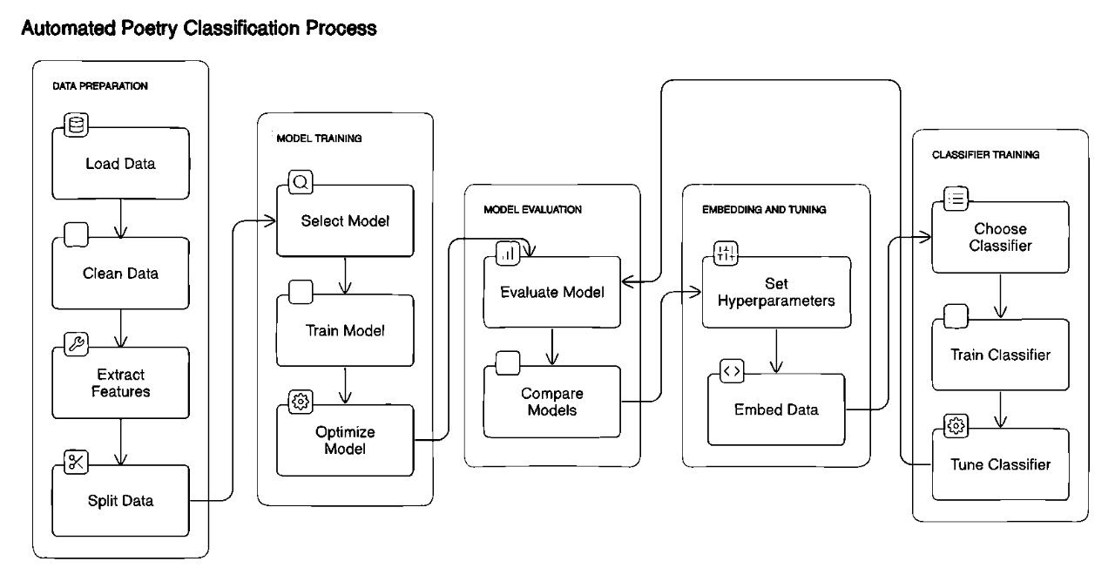
Methodology
Architectural Diagram:
Fig 1- Architectural Diagram of our Project

Slide 7
Data Pre-Processing:
Dataset Source and Preparation:
Obtaining data from Kaggle
Cleaning and preprocessing to ensure data integrity
Tokenization and Sequence Padding:
Transforming poetry samples into tokens
Applying sequence padding for uniform input dimensions
Manual Review by Literature Professor:
Validating dataset accuracy and quality

Slide 8
Model Training:
Training Process:
Using pre-trained language models on diverse poetry forms
Extracting embedding vectors for each poem
Data Splitting:
Dividing data into training and testing sets (80% training, 20% testing)
Model Selection and Optimization:
Selecting classifiers (MLP, Naive Bayes, SVM) and optimizing hyperparameters

Slide 9
Hyperparameter Tuning:
Objective:
To optimize model performance by finding the best set of hyperparameters.
To enhance the accuracy, precision, recall, and F1-score of our classification models.
Randomized Search:
Application:
Utilized for models with large hyperparameter spaces to speed up the tuning process.
Ensured a balance between computational cost and finding near-optimal hyperparameters.

Slide 10
Cross-Validation for Hyperparameter Tuning:
Integration with K-Fold Cross Validation:
Combined hyperparameter tuning with K-Fold Cross Validation to ensure robust and reliable evaluation.
Each hyperparameter set was evaluated across all folds, and the average performance was used to select the best set.
Hyperparameters Tuned:
Embedding Models (GPT-2, BERT, RoBERTa):
Learning rate, batch size, number of training epochs.
Classifiers:
Naive Bayes: Smoothing parameter.
SVM: Kernel type, regularization parameter (C).
Decision Tree: Maximum depth, minimum samples split.
Random Forest: Number of trees, maximum features.
AdaBoost: Number of estimators, learning rate.
XGBoost: Number of estimators, learning rate, max depth.
CatBoost: Learning rate, depth, iterations.

Slide 11
Reasons to choose our Embedding Models:
GPT-2 (Generative Pre-Trained Transformer 2):
Known for its strong generative capabilities and ability to capture contextual nuances.
Effective in understanding and generating complex textual structures, making it suitable for poetry analysis.
BERT (Bidirectional Encoder Representations from Transformers):
Utilizes bidirectional context, allowing it to understand the meaning of words based on their surroundings.
Excels in tasks requiring deep semantic understanding and has shown state-of-the-art performance in various NLP tasks.
RoBERTa (Robustly Optimized BERT Pre-Training Approach):
An optimized version of BERT, with improvements in training methodology.
Enhanced performance in terms of accuracy and efficiency, making it a robust choice for text classification tasks.

Slide 12
Model Evaluation with K-Fold Cross Validation:
Embedding Models:
Applied K-Fold Cross Validation to evaluate the embeddings from GPT-2, BERT, and RoBERTa.
Ensured that the embeddings captured consistent semantic features across folds.
Classification Models:
Evaluated classifiers such as Naive Bayes, SVM, Decision Tree, Random Forest, AdaBoost, XGBoost, and CatBoost.
Fine-tuned hyperparameters based on cross-validation results to optimize performance.
Purpose:
To ensure robust evaluation and mitigate overfitting.
To provide a comprehensive assessment of model performance across different subsets of the data.

Slide 13
Reasons to choose our Classification Models:
Naive Bayes:
Simple and fast classifier, often serving as a strong baseline for text classification tasks.
Performs well with a large number of features, typical in text data.
Support Vector Machine (SVM):
Known for its effectiveness in high-dimensional spaces.
Strong performance in text classification tasks due to its ability to find optimal hyperplanes for classification.
Decision Tree:
Intuitive model that provides clear insights into the decision-making process.
Effective for understanding and visualizing feature importance.

Slide 14
Random Forest:
Ensemble method that improves classification accuracy by averaging multiple decision trees.
Reduces overfitting and enhances model robustness.
AdaBoost:
Boosting algorithm that combines weak classifiers to create a strong classifier.
Effective in improving the accuracy of models with complex data.
XGBoost:
Gradient boosting algorithm known for its high performance and speed.
Frequently achieves top results in machine learning competitions.
CatBoost:
Gradient boosting algorithm that handles categorical features efficiently.
Provides robust performance with less parameter tuning.

Slide 15
Utilizing ELI5 for Model Interpretation:
Importance in Our Project:
Transparency:
Enhances transparency by making the decision-making process of our models understandable.
Ensures that stakeholders can trust and verify the results produced by the models.
Model Debugging:
Identifies potential issues or biases in the model.
Provides insights into why certain classifications were made, helping to refine and improve the model.
Application in Poetry Classification:
Feature Importance:
Analyzed the importance of different features (words, phrases, structures) in classifying poetry into genres.
Visualized which parts of the poems contributed most to the model's predictions.

Slide 16
Model Insights:
Provided explanations for specific predictions, allowing us to understand the model's behavior on individual poems.
Helped in comparing how different models (GPT-2, BERT, RoBERTa) interpret and classify the same poem.
Validation:
Used ELI5 to validate that the models were learning relevant features and not relying on irrelevant data.
Ensured that the model's predictions were aligned with literary characteristics of each poetry genre.
Benefits:
Improved Model Trust:
Built confidence in the model by providing clear and interpretable explanations for its decisions.
Facilitated communication of model results to non-technical stakeholders, such as literature professors.
Enhanced Model Refinement:
Guided the iterative process of model refinement by highlighting areas where the model performed well or poorly.
Allowed for targeted adjustments and improvements based on the interpretability insights provided by ELI5.

Slide 17
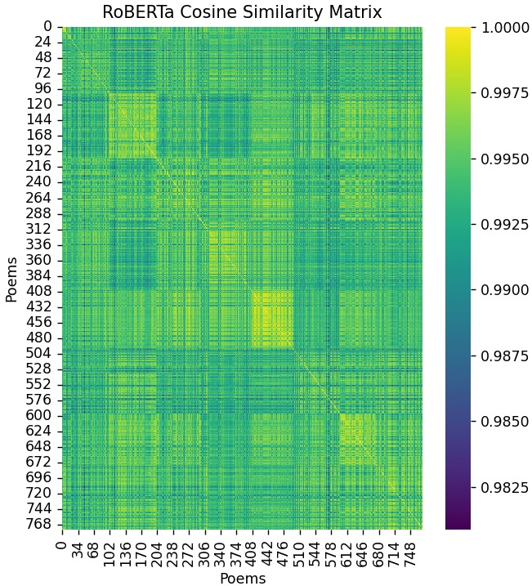
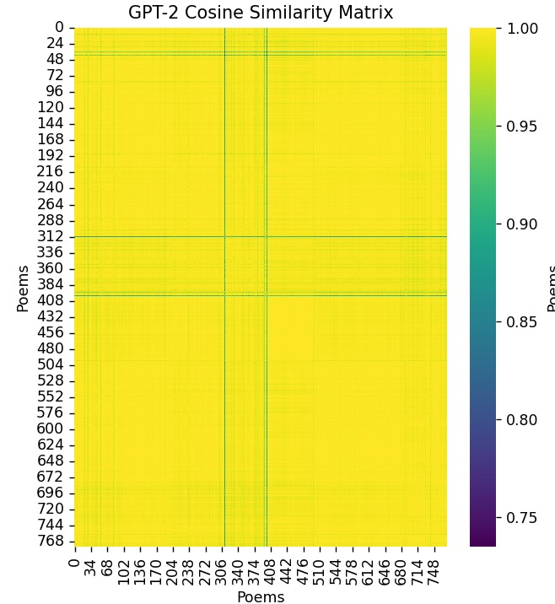
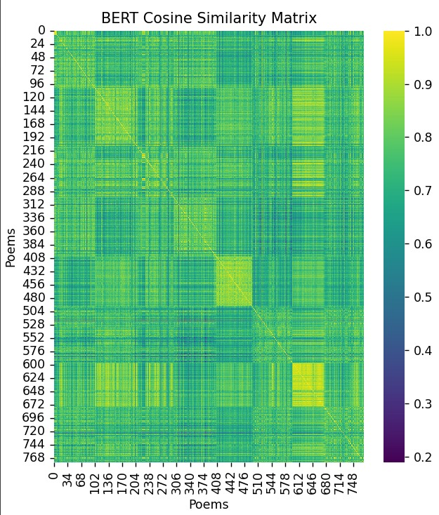
Results
Cosine Similarity Heatmap:
Fig 2- Cosine Similarity Heatmap of all Embedding Models used
Notes:
The cosine similarity heatmaps generated from GPT-2, RoBERTa, and BERT embeddings provide a visual represen- tation of semantic relationships within poems. These insights guide the selection of the most appropriate model for specific poetry analysis tasks.

Slide 18
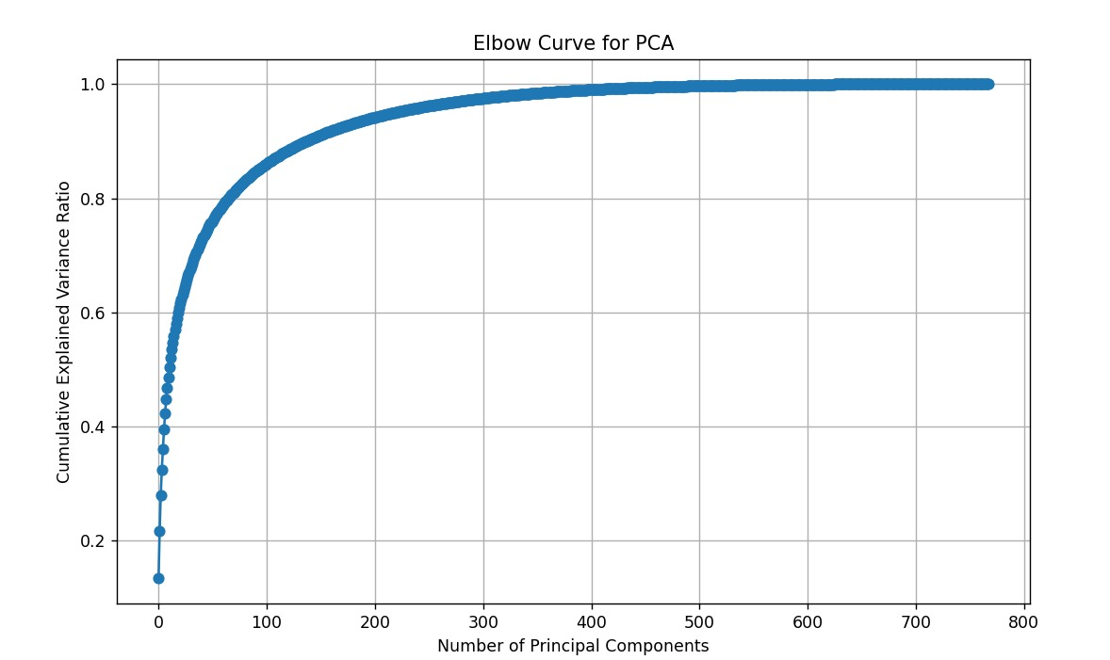
Fig 3 – Elbow Curve of PCA

Slide 19
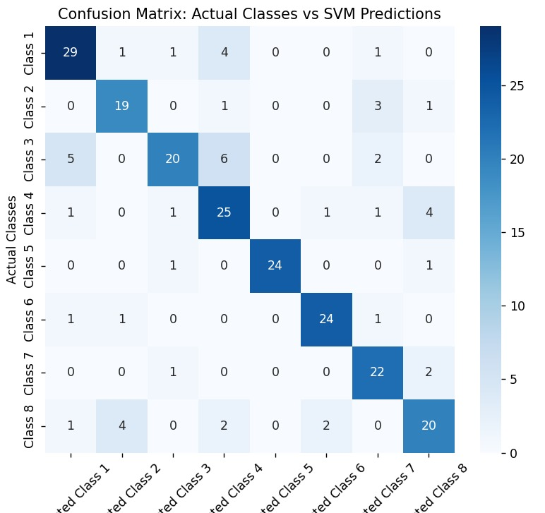
Confusion Matrix of SVM on Roberta:
Train Accuracy: 0.92
Test Accuracy: 0.79

Slide 20
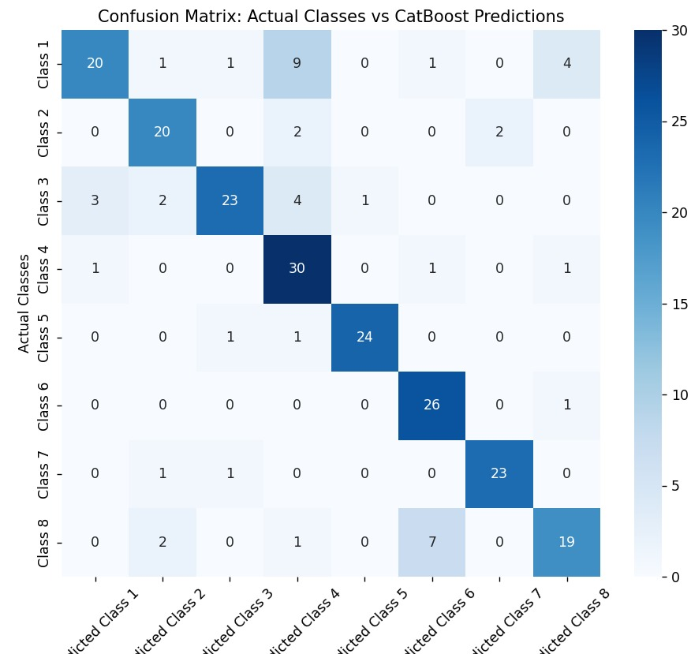
Confusion Matrix of CatBoost on Bert:
Train Accuracy: 1.00
Test Accuracy: 0.79

Slide 21
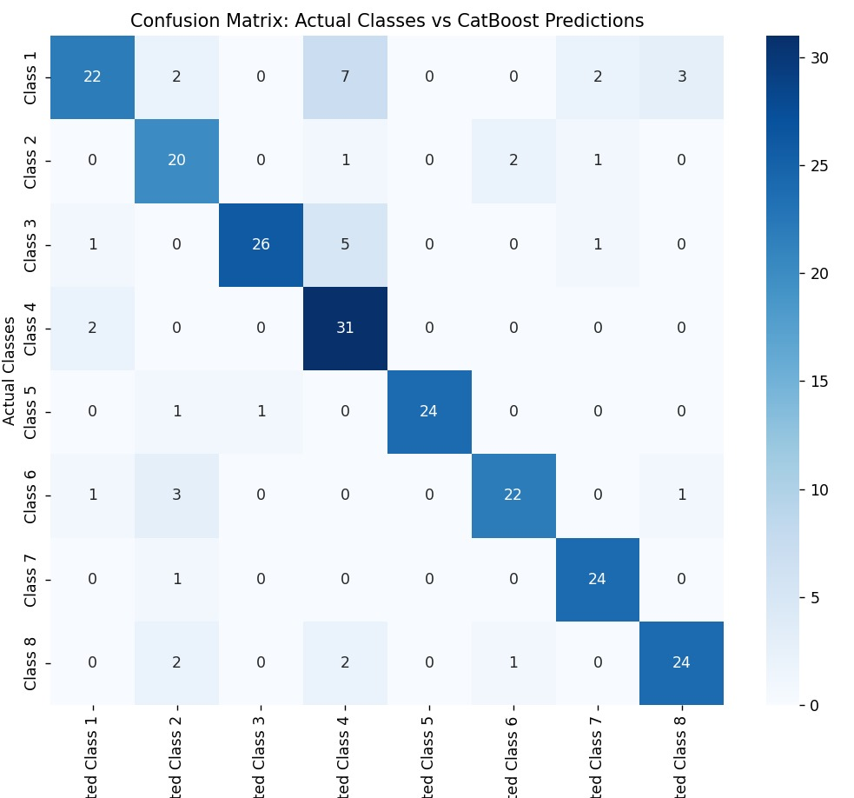
Confusion Matrix of Catboost on GPT2:
Train Accuracy: 1.00
Test Accuracy: 0.83

Slide 22
Future Scope
Expanding the Dataset:
Include a broader range of poetry genres to enhance model generalization.
Incorporate multilingual datasets to support poetry analysis in various languages.
Refining Model Architectures:
Fine-tune hyperparameters and explore different model architectures for improved performance.
Investigate ensemble methods to combine the strengths of multiple models.
Exploring Advanced Techniques:
Implement advanced techniques such as attention mechanisms or transfer learning to enhance model understanding of poetic nuances.
Investigate the use of generative models for poetry generation and style transfer.

Slide 23
Conclusion
Significance of the Project:
Streamlining the categorization process for poetry, facilitating research and educational initiatives.
Demonstrating the potential of advanced natural language processing techniques in literary analysis.
Key Takeaways:
Successful development of an automated poetry classification system using pre-trained language models.
Comparative analysis of GPT-2, BERT, and RoBERTa models for poetry classification.
Contribution to enhancing accessibility and educational resources in the field of literature.

