Slide 1
Case Study
MySQL vs Mongo DB

Slide 2
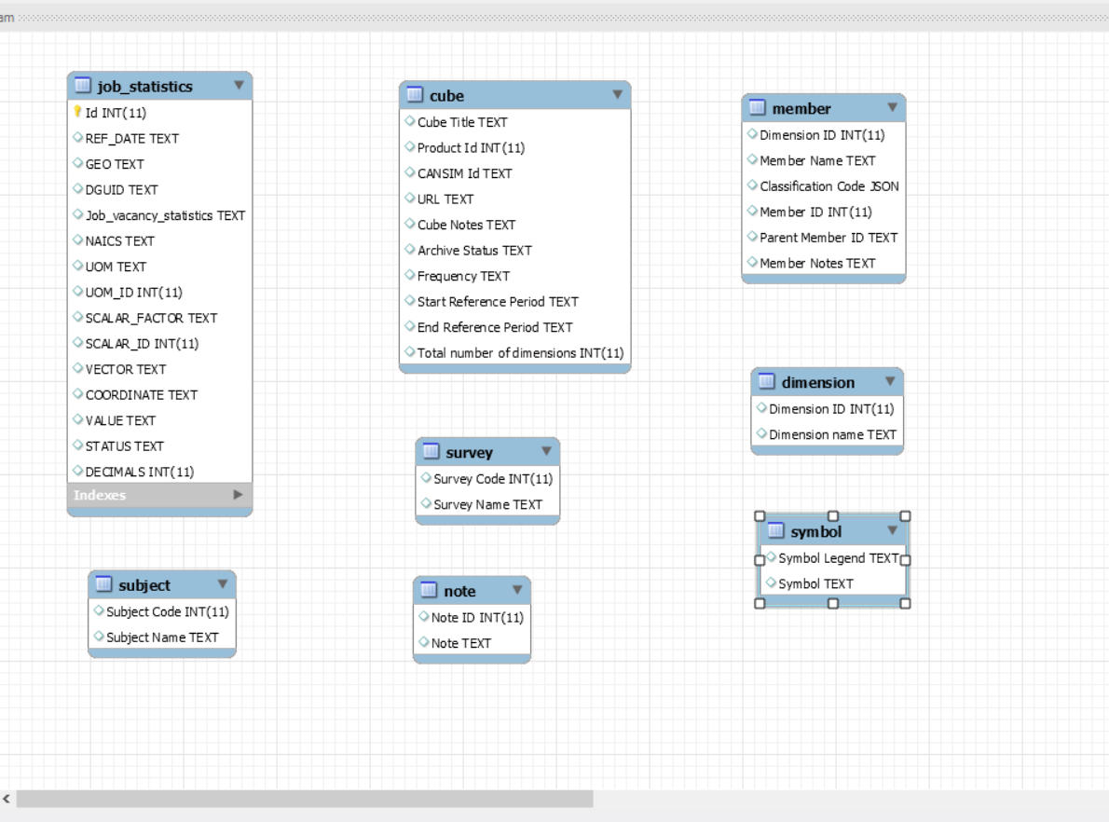
Initial Data Model

Slide 3
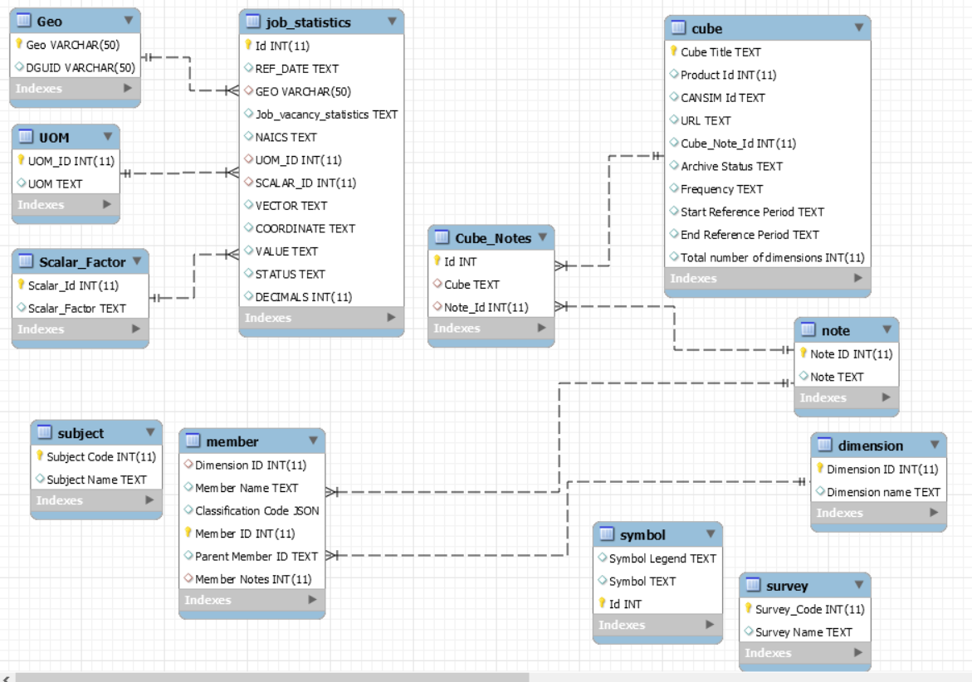
Final Data Model

Slide 4
Comparison

Slide 5
Comparison

Slide 6
Thank You
Vamsi Gamidi
B00834696

