Slide 1
Accident and Vehicle Rollover Detection System
Using Arduino, MPU9250 (Accelerometer + Gyroscope) and GPS
Gamini M

Slide 2
Introduction
Road accidents cause major injuries and fatalities worldwide.
Quick accident detection can help provide faster emergency response.
This project detects vehicle accidents and rollovers automatically.
The MPU9250 sensor measures acceleration and rotation to detect abnormal motion.

Slide 3
Problem Statement
Many accidents are not reported immediately after they occur.
Emergency services may take longer to reach the accident location.
Manual reporting depends on witnesses or drivers.
An automated system can quickly detect accidents and provide location information.

Slide 4
Objectives
Detect vehicle accidents using accelerometer data.
Detect vehicle rollover using gyroscope tilt angles.
Provide real-time location using GPS module.
Generate alerts using buzzer and LED.

Slide 5
Components Used
Arduino UNO
MPU9250 Sensor (Accelerometer + Gyroscope)
GPS Module
Buzzer
LED Indicator
Power Supply

Slide 6
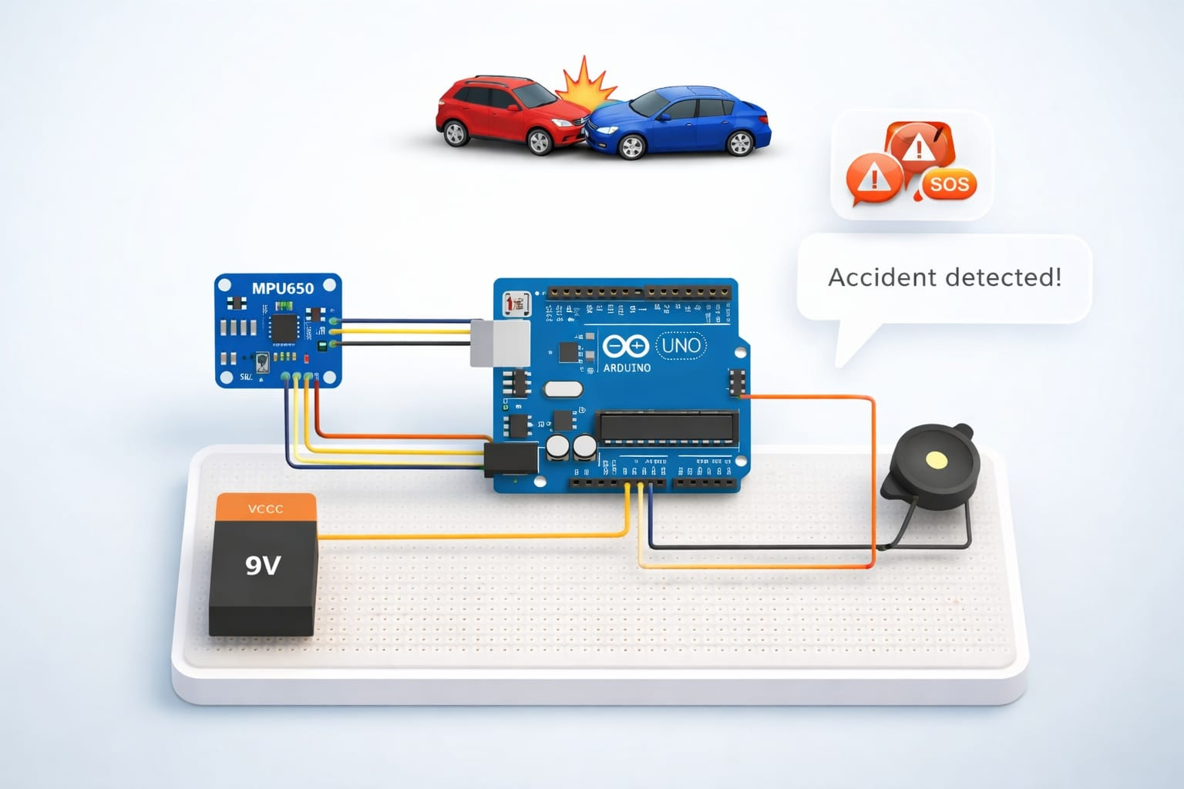
WORKING ARCHITECTURE OF THE PROPOSED SYSTEM
MPU9250
Accelerometer + Gyroscope
Arduino UNO
Processing
Accident / Rollover Detection
GPS Module
Location
Buzzer + LED Alert
Serial Monitor

Slide 7
Working Principle
The MPU9250 sensor continuously measures acceleration and angular motion.
Arduino calculates total acceleration and vehicle tilt angles.
If acceleration exceeds threshold, an accident is detected.
If roll or pitch exceeds 60°, rollover is detected.
GPS module provides the exact location of the accident.

Slide 8
Output
When an accident or rollover occurs, buzzer and LED are activated.
GPS location is printed on the serial monitor.
A Google Maps link is generated using the coordinates.

Slide 9
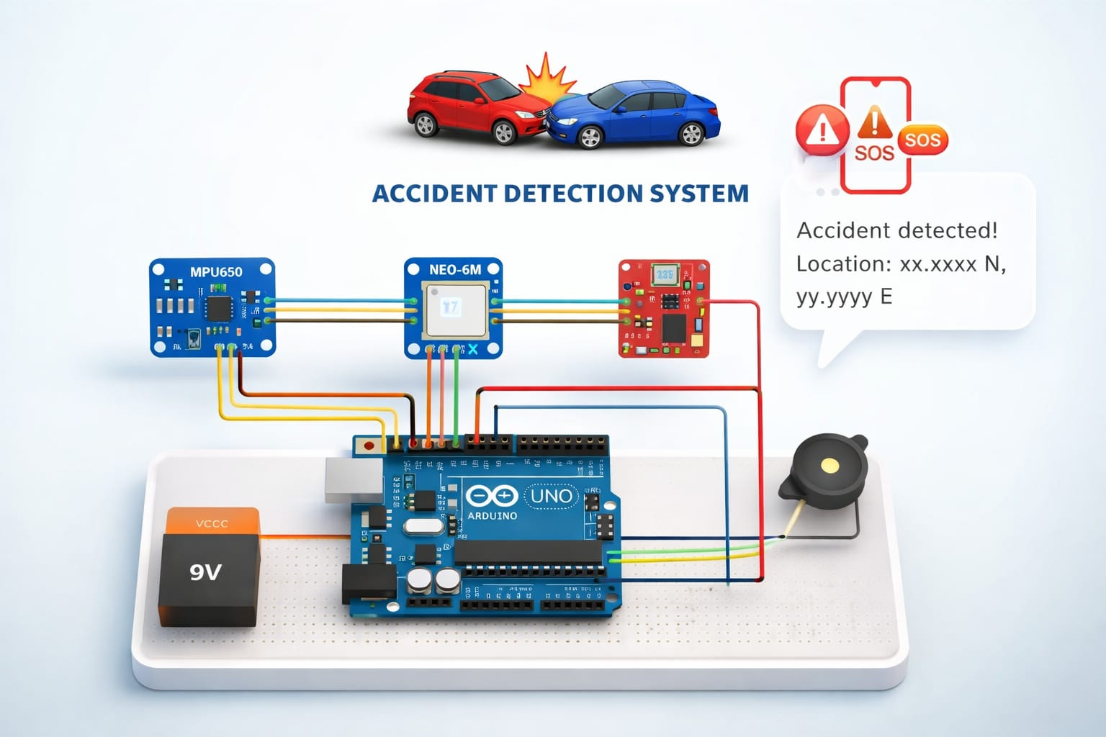
Future Enhancement
A GSM module can be integrated in future.
It will automatically send SMS alerts with location to emergency contacts.

Slide 10
Main Detection Logic (Code Snippet)
totalAcc = sqrt(AccX*AccX + AccY*AccY + AccZ*AccZ);
roll = atan2(AccY, AccZ) * 180 / PI;
pitch = atan2(-AccX, sqrt(AccY*AccY + AccZ*AccZ)) * 180 / PI;
if(totalAcc > accidentThreshold)
{
Serial.println("ACCIDENT DETECTED");
triggerAlert();
}
if(abs(roll) > rolloverAngle || abs(pitch) > rolloverAngle)
{
Serial.println("VEHICLE ROLLOVER DETECTED");
triggerAlert();
}

Slide 11
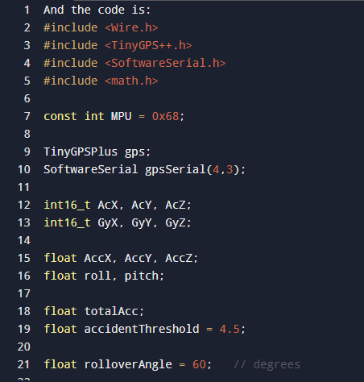
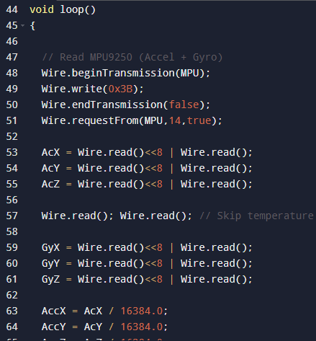
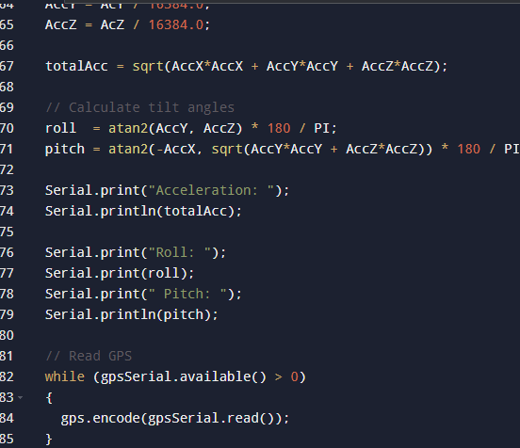
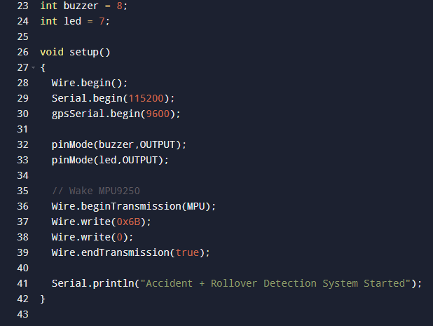

Slide 12
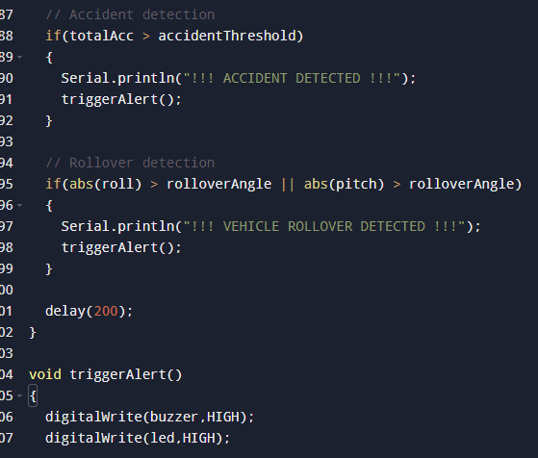
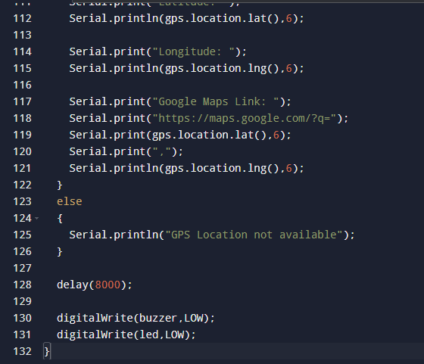
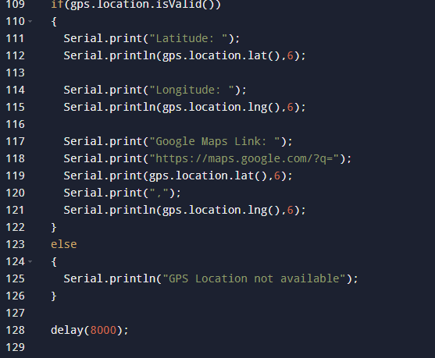

Slide 13
Conclusion
The system detects both collisions and vehicle rollovers.
It provides location information using GPS.
This technology can help reduce emergency response time and improve road safety.

Slide 14
Thank You

