Slide 1
Descend Below the Crypts
Pitch Date: October 19 , 2019
Release Date: February 9, 2020
Team Lead: Vince McKeown

Slide 2
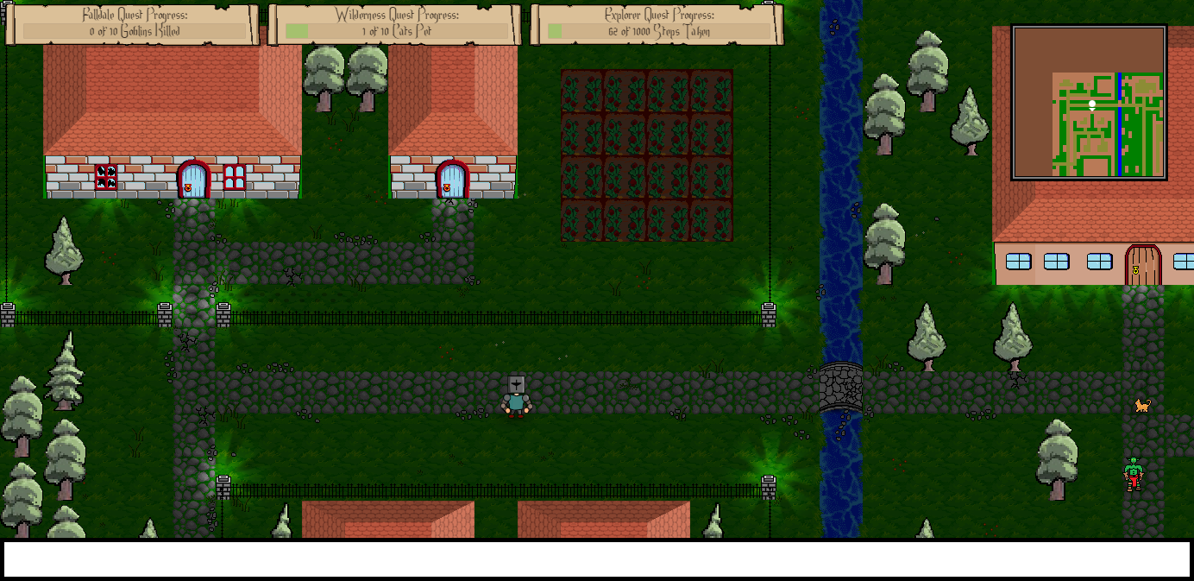
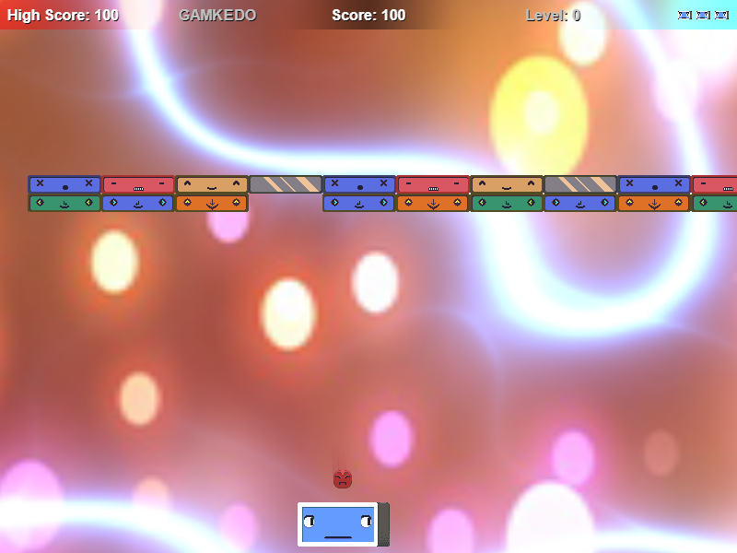
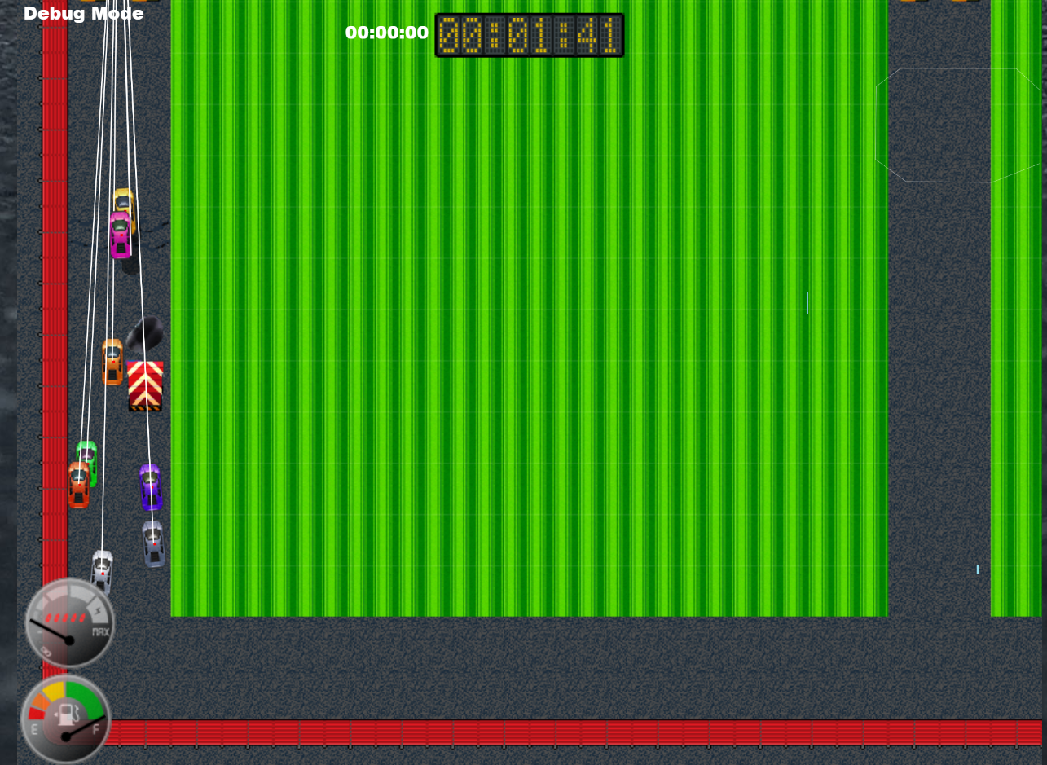

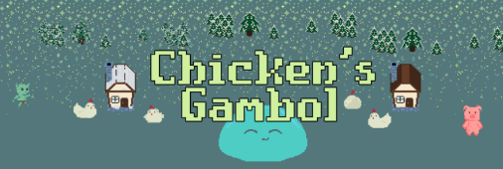

Prior Club Experience
Falldale
Ballrog
Little Racers
Game Changer
Art for grass, dirt, house and buildings (including damaged and destroyed states), goblin sprite integration
Ground enemy sprite
Debug coding, player inputs,
refactoring, reset function,
Audio code, pause, mute, animation
Logic for Sprite Sheet

Slide 3
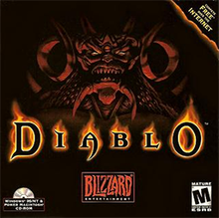
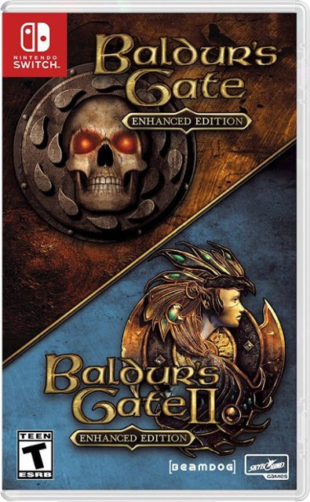
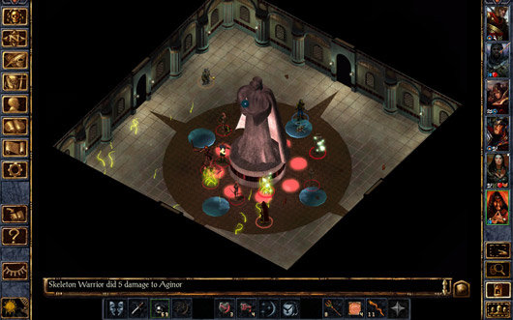
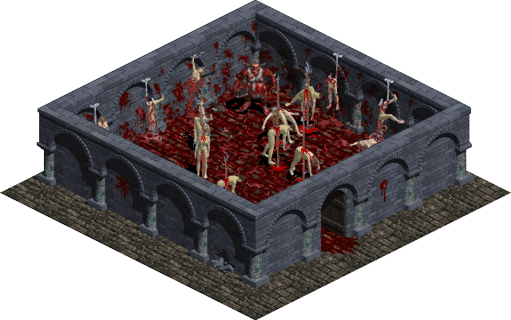
Related Games

Slide 4
Demo
Cutover to Game

Slide 5
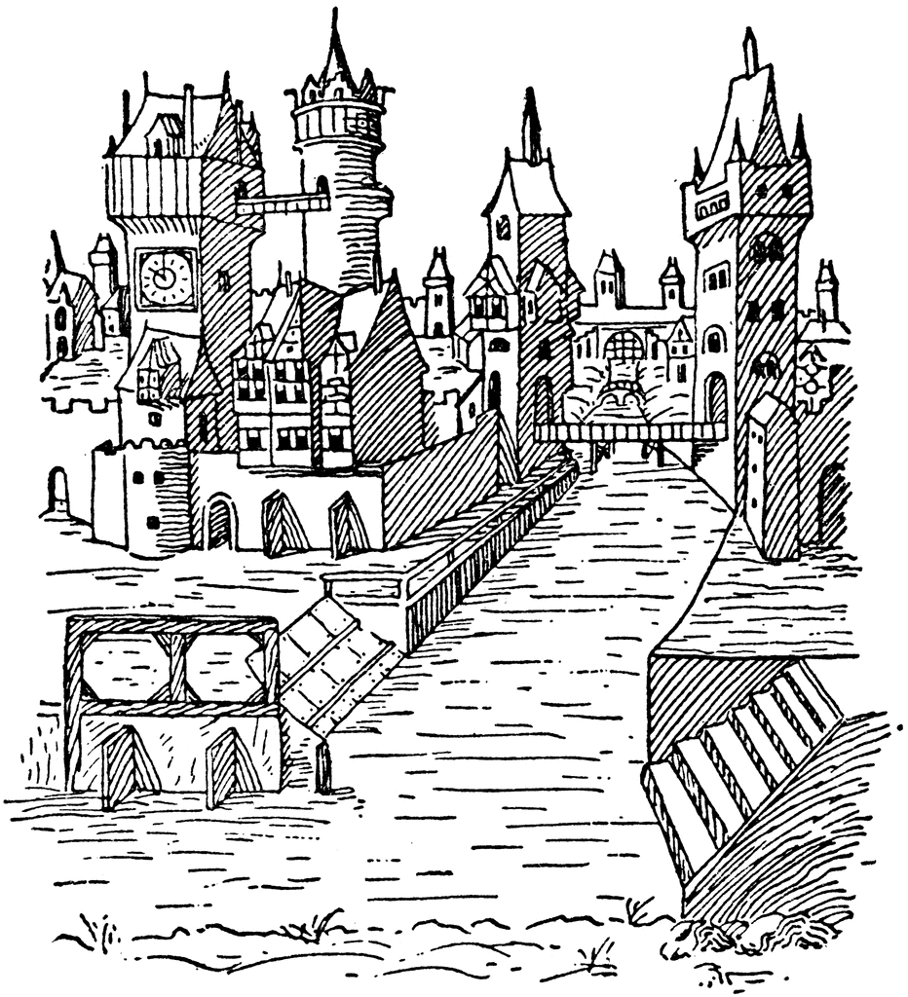
Vision
Town
Town’s underground
Goblins, Orcs
Orc Boss
Crypts
Skeletons, Zombies
Crypts
Skeletons, Zombies
Skeleton King
Cave
Goblins, Orcs, Spiders, and Rats
Cave
Goblins, Orcs, Spiders, and Rats
Necromantic Wizard

Slide 6
Schedule
Cutover to Trello

Slide 7
Roles
Art:
Character Art: Skeletons, Zombies, Big Bosses
Environmental Art: Sewers, Crypts, and Cave art
Sounds:
Creepy Dungeon Sounds
Creative Voices

Slide 8
Roles
Code:
Tiled!
Artificial Intelligence.

Slide 9
Questions?
Who would like to take on this adventure with me?

