Slide 1
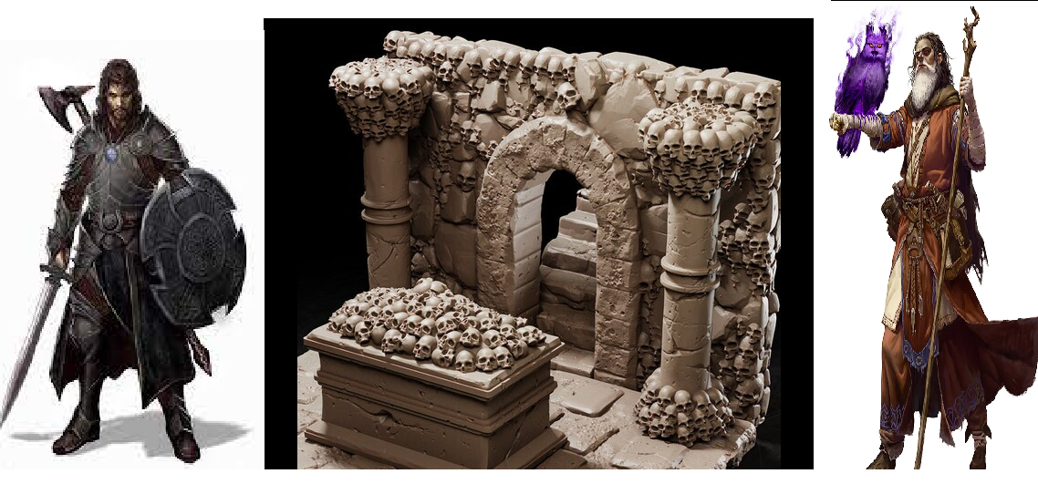
Underground Tactics
Pitch Date: April 7, 2024 Pitch!
Release Date: July 28, 2024 1 Commit
Team Lead: Vince McKeown 1 Contributor
1
2
3
4
5
6
7
8
9
10
11
12
13
14
15
16

Slide 2
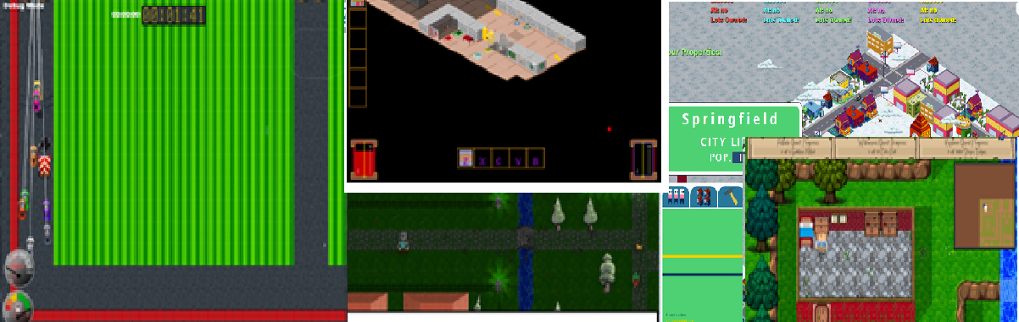
Projects I lead
Falldale
Descend Below the Crypts
Night of the Lich
Falldale Extended Edition
Little Racers
Springfield Property Manager
The Adventures of Salvatore

Slide 3
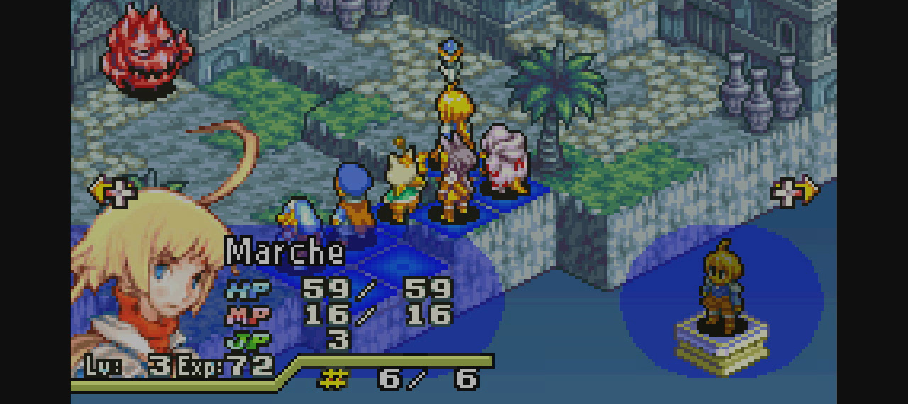
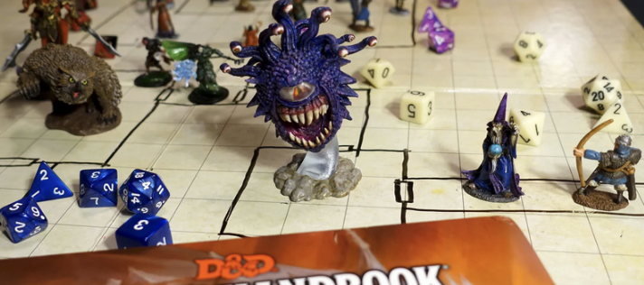
Inspiration for Underground Tactics
Descent Below the Crypt
The Adventures of Salvatore
Dungeons and Dragons (Rules)
Final Fantasy Tactics
Throneless

Slide 4
Demonstration of prototype

Slide 5
The Vision of Underground Tactics
An adventure of slaying goblins and bugbears in a castle, and skeletons and wizards in the catacombs.
Improved monster AI for combat.
Finding fun items while exploring.
Coins, and potions.
A good story along the way.
A lure into the underground.
Creating D&D combat and quests… but on the computer ☺
Keeping it fun

Slide 6
The Project Plan
Weeks 1–4
Weeks 9-12
Weeks 13-16
Systems
Combat
Inventory
Weeks 5–8
Pathfinding
Enemies
Monsters
Level
Puzzles
Player
Level Design
Placement
Puzzles
Refinement
Testing
Storyline
Difficulty

Slide 7
Where to jump in?
Coding
Help generating an inventory system
Unique tactics for monsters
Animation
Walking, dying, attacking goblins, crossbowman, and wizard
Music
Medieval Background
Sounds
Narrating story – Character Voices
Sound effects for attacking, blocking, and being hurt.

Slide 8
Join us in Channel!
Channel is Team-js-underground-tactics

