Slide 1
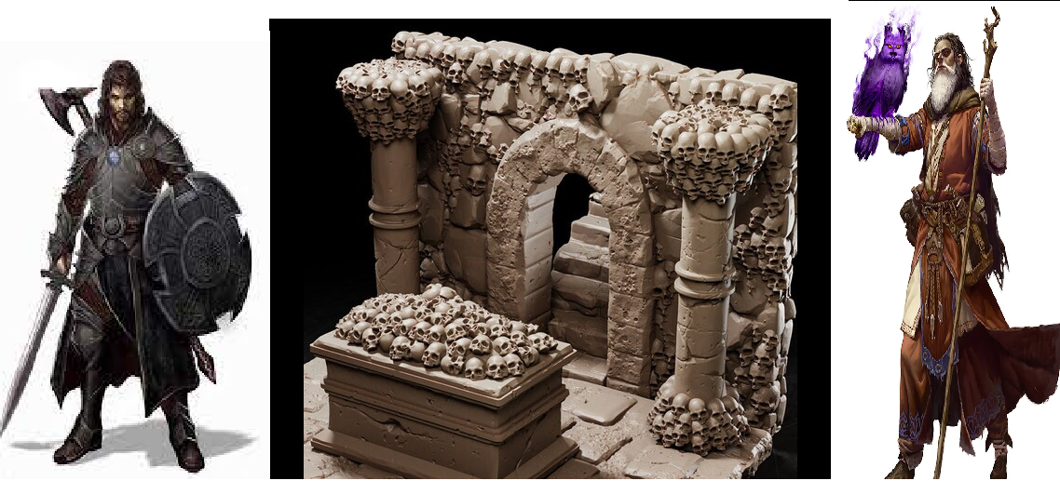
The Adventure of Salvatore
Pitch Date: 10/22/2023 Update 10/22/2023
Release Date: 2/4/2023 1 Commit
Team Lead: Vince McKeown 1 Contributor
1
2
3
4
5
6
7
8
9
10
11
12
13
14
15
16

Slide 2
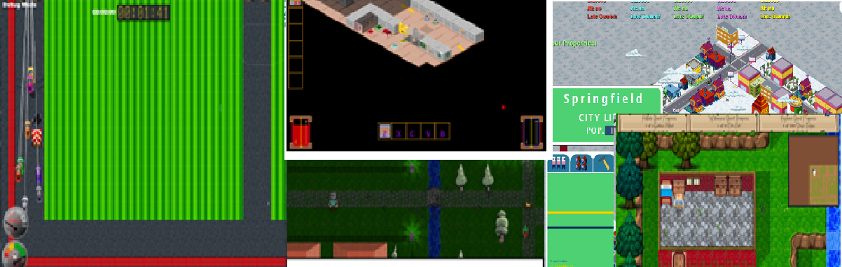
My Gaming Experience
Falldale
Descend Below the Crypts
Night of the Litch
Falldale Extended Edition
Little Racers
Springfield Property Manager

Slide 3
Inspiration for The Adventure of Salvatore

Slide 4
Demonstration of prototype

Slide 5
The Vision of The Adventure of Salvatore

Slide 6
The Project Plan

Slide 7
Where to jump in?

