Slide 1
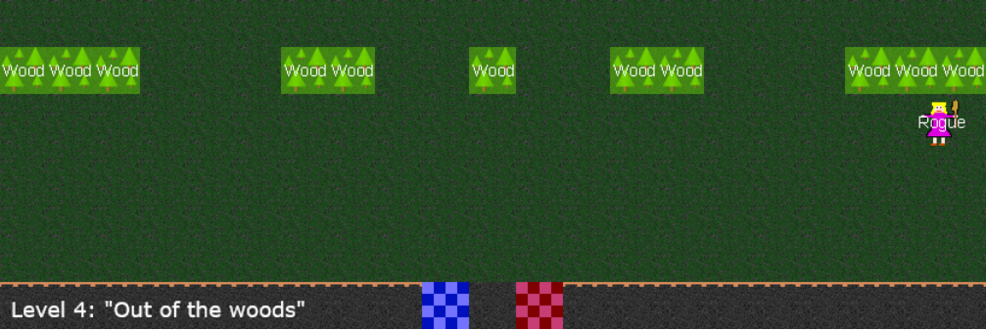



15
40
50
80
60
30
10
Level end and scoring
100
100

