Slide 1
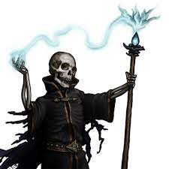
The Night of the Liche
Pitch Date: 12/18/2022
Release Date: 4/9/2023
Team Lead: Vince McKeown

Slide 2
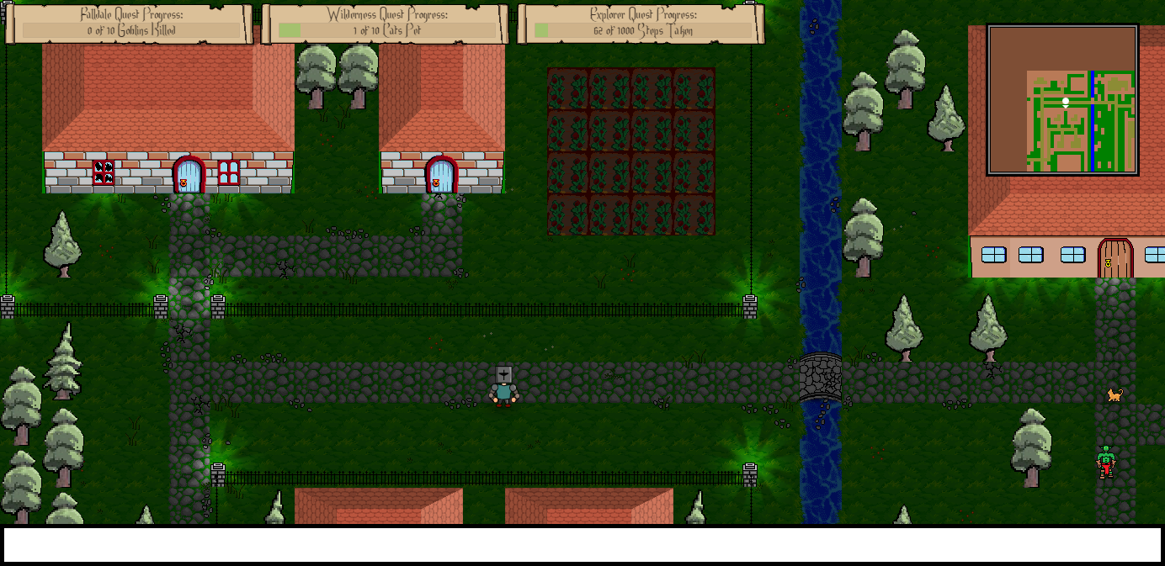
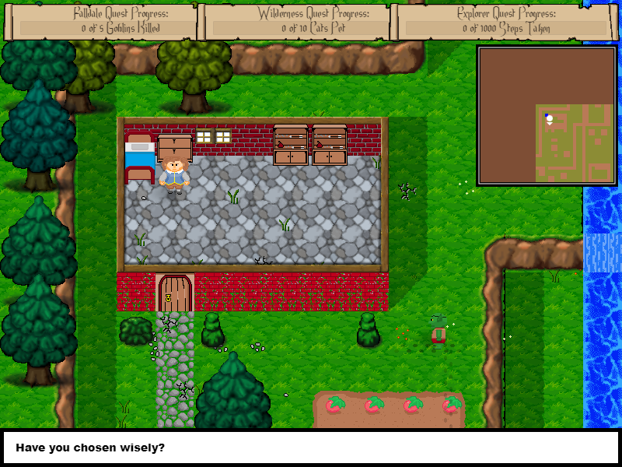
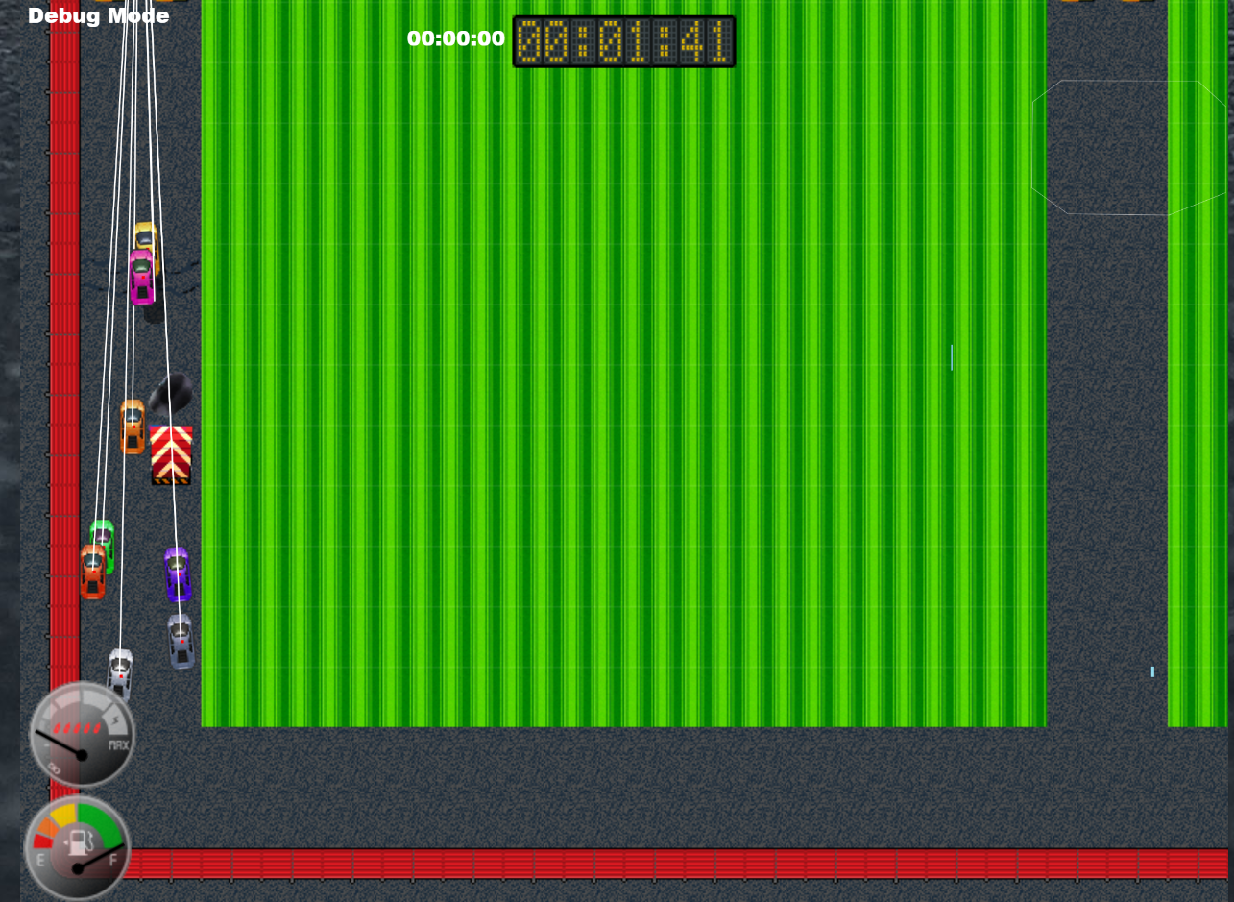
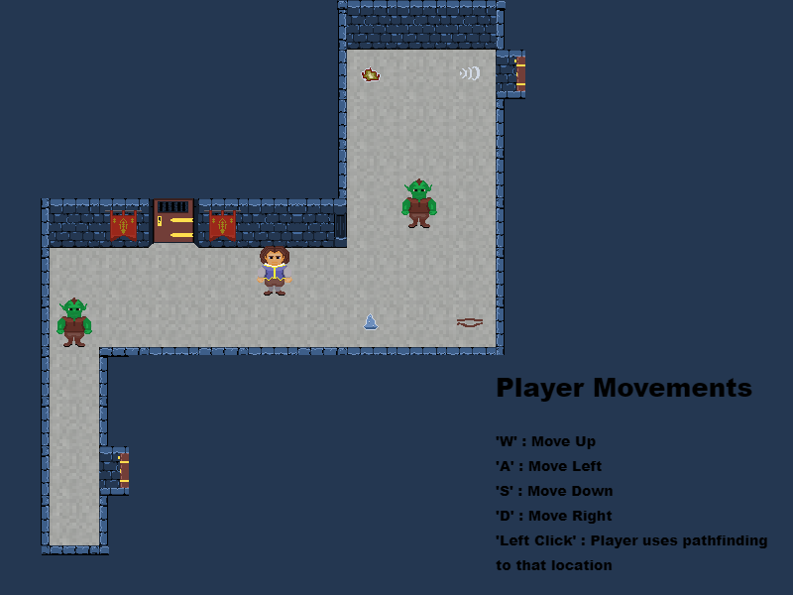
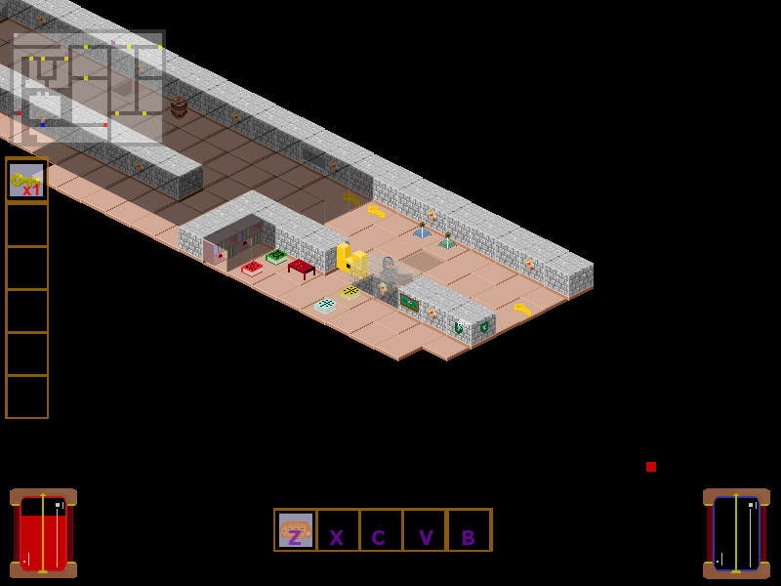
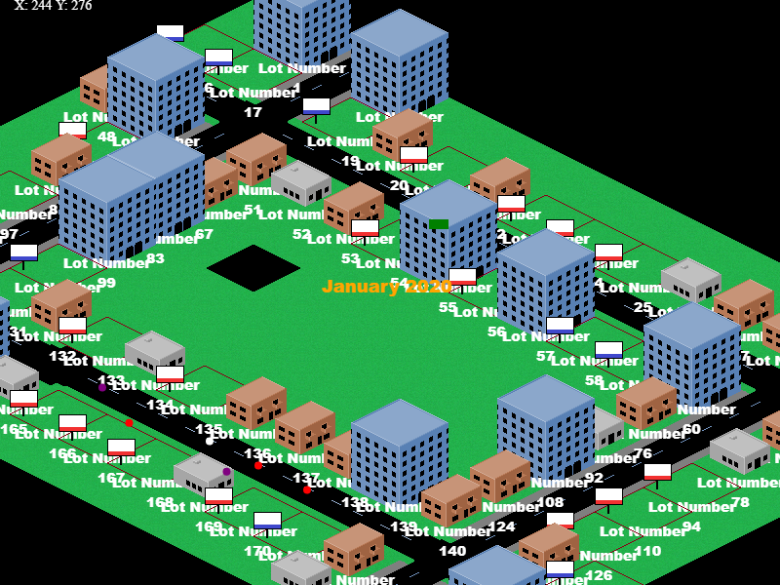
Prior Club Experience
Falldale
Falldale Enhanced Edition
Little Racers
Escape from Cell Block 60
Descend Below the Crypts
Springfield Property Manager

Slide 3
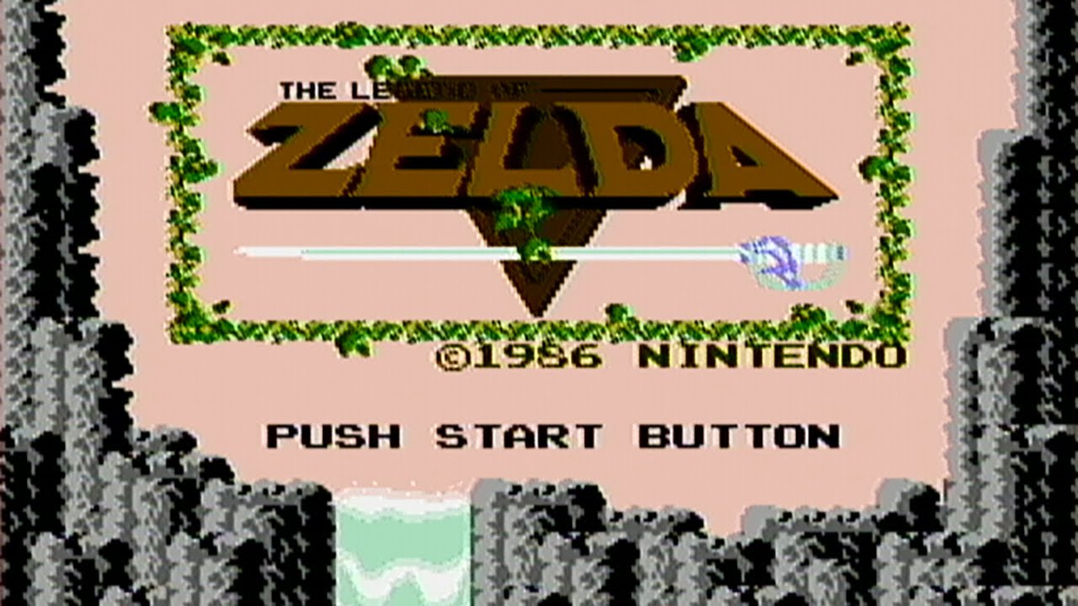
Related Games

Slide 4
Demo
Cutover to Game

Slide 5
Vision
A top down RPG with a short interesting quests. Quest 1 is to investigate and resolve the supply chain issues. Quest 2 is vanquish the lich king.
Good combat system consisting of good enemy AI mix between melee and range attacks. Enemy and Player can miss each other.
A system of collecting plants and herbs to create potions.

Slide 6
Schedule
Cutover to Trello

Slide 7
Roles
Art:
Monsters
Findable objects
Sounds:
Character sounds
Background Music
Code:
Artificial Intelligence for enemies
Tile Editor

Slide 8
Questions?
Who would like to take on this adventure with me?

