Slide 1
WEEK 5 - CONTRIBUTIONS!
33+ commits! – Focus on player control and feel, health, death.
Axphin – jump attack animation, level 1 layout updates, more tiles, health pickup animation, ceiling & deadzone collision boxes, attack collision box tweaks, alien guard now requires two hits
H – refactoring and cleanup, camera, collisions, crouch attack working, implementing deadzone, and lots of fixes, posted itch.io demo!
McFunkypants – Enemy mech code refactoring
Gonzalo – FSM help for ducking left and right states, jumping, etc
THANK YOU TO ALL CONTRIBUTORS!

Slide 2
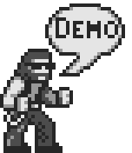
WEEK 5
SHOW ME THE DEMO!

Slide 3
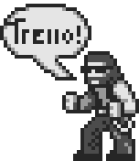
WEEK 5
TRELLO!

Slide 4
FOCUS FOR NEXT WEEK
Enemies and enemy attacks (melee, projectiles, jumping)
Enemy knockback and death
Finish Level 1 layout and tile set
Level 1 miniboss fight (enemy mech)
Extra Life power up (art, code, sound effect)
Level 1 to Level 2 transition
Trello Warm Up Tasks!
Join Team Xeno Jackers!

Slide 5
THANK YOU!!!
QUESTIONS or FEEDBACK?

