Slide 1



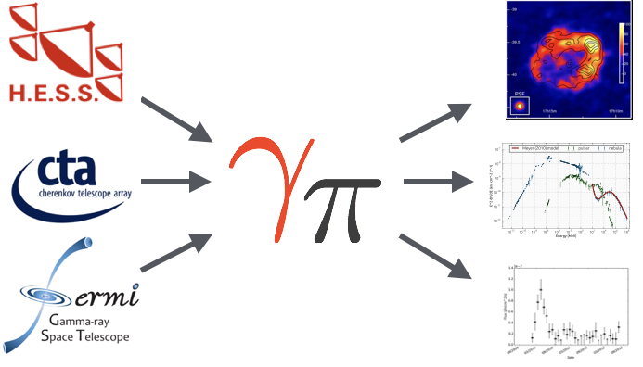
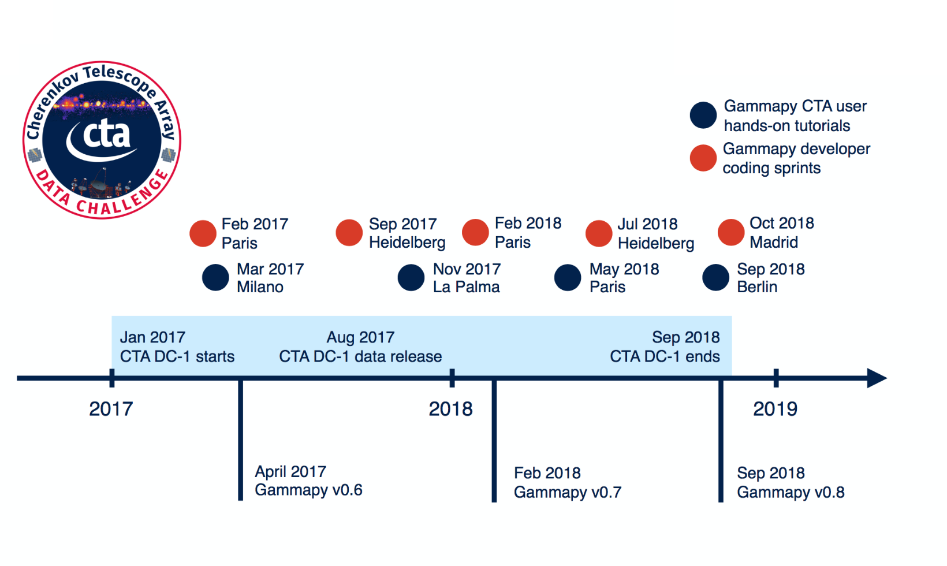
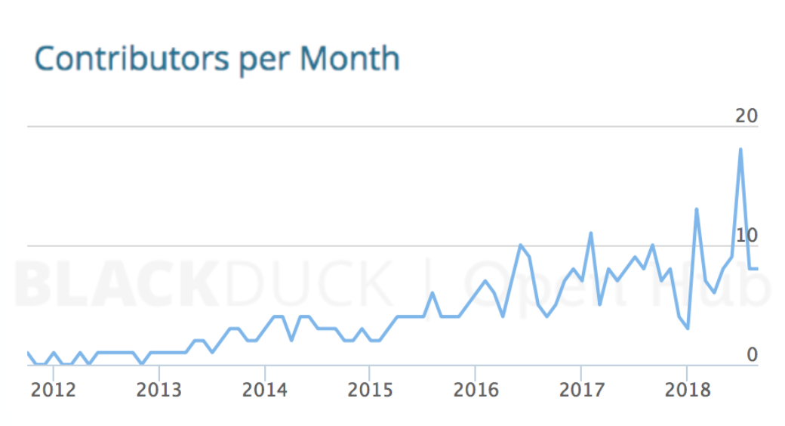


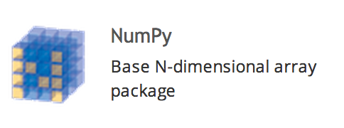




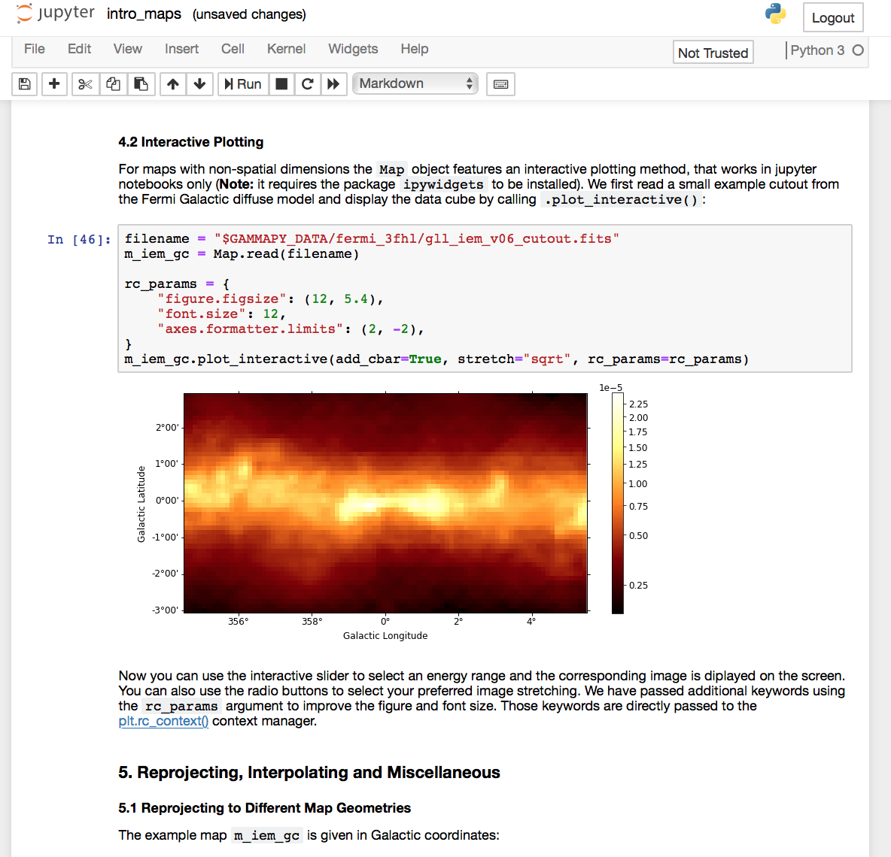
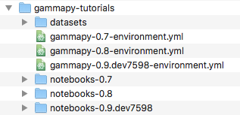










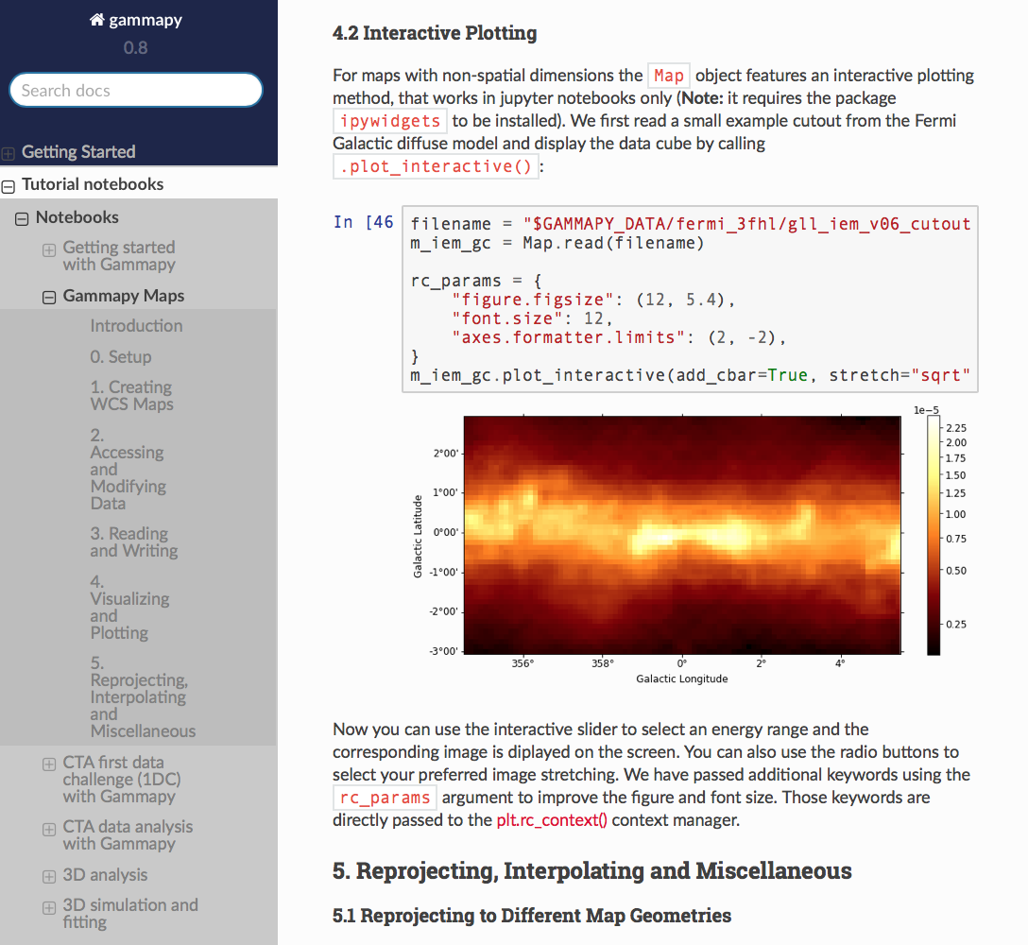
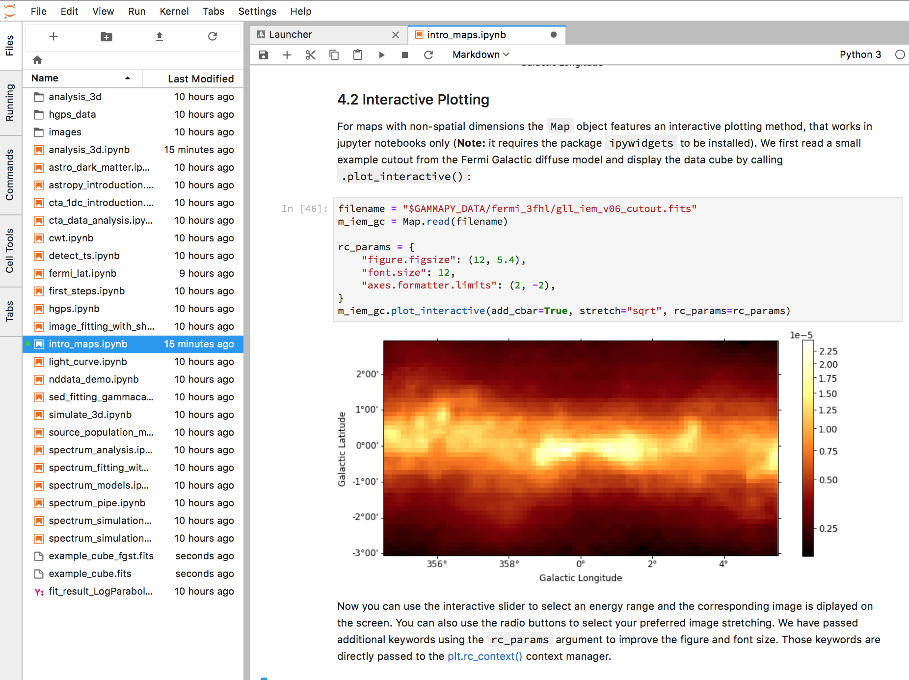




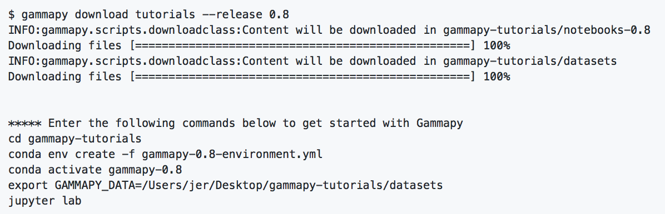
Versioned executable user documentation
for in-development science tools
A Python package for gamma-ray astronomy
Catherine Boisson¹, José Enrique Ruiz², Christoph Deil³, Axel Donath³ and Bruno Khelifi⁴ for the Gammapy team.
¹ LUTH - Observatoire de Paris, ² Instituto de Astrofísica de Andalucía - CSIC, ³ Max-Planck-Institut für Kernphysik, ⁴ APC - AstroParticule et Cosmologie, Université Paris Diderot.
Abstract
One key aspect of software development is feedback from users. This community is not always aware of the developments undertaken in the code base, neither they use the tools and practices followed by the developers to deal with a non-stable software in continuous evolution. Gammapy provides its beta-tester user community with versioned reproducible environments and executable documentation, in the form of tutorials that are versioned coupled with the code base. We believe this set-up greatly improves the user experience for a software in prototyping phase, as well as provides a good workflow for developers to deliver versioned and up-to-date documentation.
What is Gammapy?
A software in development
The rise in the contributor and user base together with a high development activity, hinders user feedback from not always up-to-date versions. There’s a need for reproducible environments versioned coupled with the code base.
A Python package for gamma-ray astronomy. A prototype for the Cherenkov Telescope Array (CTA) science tools.
https://www.openhub.net/p/gammapy
gammapy jupyter run
Set-up
Tutorials integration: tutorials in the form of Jupyter notebooks are integrated into the software documentation with Sphinx + nbsphinx extension.
Executable on-line: the documentation provides links to myBinder platform, where tutorials can be executed in the cloud using a versioned kernel provided by a Dockerfile.
Version-coupling: the base-code, the tutorials and the Dockerfile are stored in the same Github versioned repository.
Authoring and review: seamless code review for the tutorials with gammapy jupyter using diff comparisons in pull requests is possible, since the notebooks only store markdown and code cells with no outputs.
Regression tests: tutorials execute in Travis Continuous Integration system, checking that their output cells do not throw any errors.
Reproducibility: deterministic environments are defined for each version of the software in the form of conda configuration files, with pinned version numbers for each dependency package.
Shipping: gammapy download command allows to retrieve versioned tutorials, composed of Jupyter notebooks, the datasets needed and the conda configuration file to build the environment.
Maintainability: for each versioned environment we define its requirements, which tutorials to provide and where to fetch them with centralized index lookup files.
https://github.com/gammapy/gammapy
https://docs.gammapy.org
https://gammapy.org
gammapy jupyter test
gammapy jupyter strip
Datasets
gammapy download
Lookup files
make docs
Command Line Tools
gammapy download provides users with the means to retrieve any tutorials-related asset for a specific version, whereas gammapy jupyter provides developers with a tool to work with notebooks in a seamless workflow for the development/review/publish process of the versioned executable tutorials.
Poster presented at ADASS XXVIII, College Park, MD, 2018 - contact: jer@iaa.es

