Slide 1


Modern C++ Course
Gammasoft

Slide 2

Who am I ?
Gammasoft
Gammasoft aims to make c++ fun again.
About
Gammasoft is the nickname of Yves Fiumefreddo.
More than thirty years of passion for high technology especially in development (c++, c#, objective-c, ...).
Object-oriented programming is more than a mindset.
more info see my GitHub : https://github.com/gammasoft71
Gammasoft
Modern C++ Course

Slide 3
Outline
Introduction
Language Basics
Object Oriented Programming (OOP)
Core Modern C++
Modern C++ Expert
Advanced Programming
Gammasoft
Modern C++ Course

Slide 4
Outline
Introduction
Language Basics
Object Oriented Programming (OOP)
Core Modern C++
Modern C++ Expert
Advanced Programming
Gammasoft
Modern C++ Course

Slide 5
Outline
Introduction
Language Basics
Object Oriented Programming (OOP)
Core Modern C++
Modern C++ Expert
Advanced Programming
Gammasoft
Modern C++ Course

Slide 6
Language Basics
Language Basics
Gammasoft
Modern C++ Course
Hello World
Core syntax and types
Arrays and Pointers
Scopes / namespaces
Class and enum types
References
Functions
Operators
Control structures
Headers and interfaces
auto keyword
inline keyword
Assertions

Slide 7
Language Basics
Language Basics
Gammasoft
Modern C++ Course
Hello World
Core syntax and types
Arrays and Pointers
Scopes / namespaces
Class and enum types
References
Functions
Operators
Control structures
Headers and interfaces
auto keyword
inline keyword
Assertions

Slide 8
The first classic application
C++98
Language Basics | Hello World
Gammasoft
Modern C++ Course

Slide 9
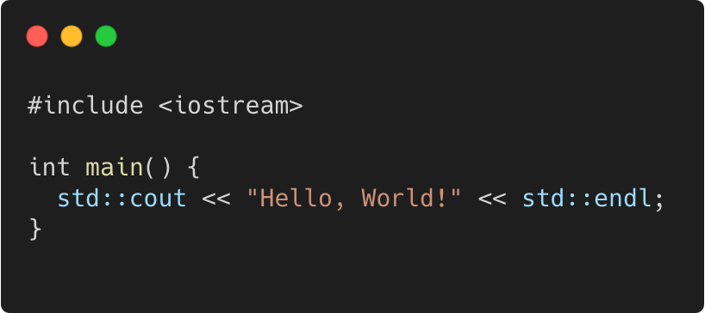
The first classic application
C++98
Language Basics | Hello World
program.cpp
Gammasoft
Modern C++ Course

Slide 10
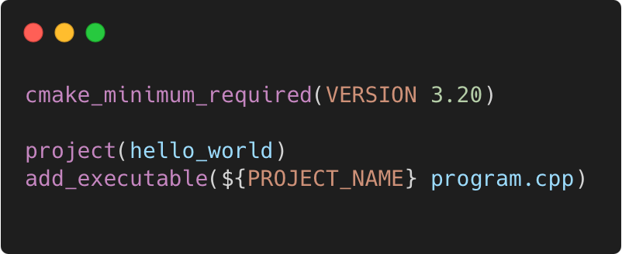
The first classic application
C++98
Language Basics | Hello World
program.cpp
CMakeLists.txt
Gammasoft
Modern C++ Course

Slide 11
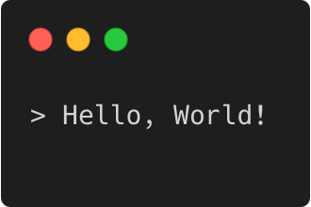
The first classic application
C++98
Language Basics | Hello World
program.cpp
CMakeLists.txt
Output
Gammasoft
Modern C++ Course

Slide 12
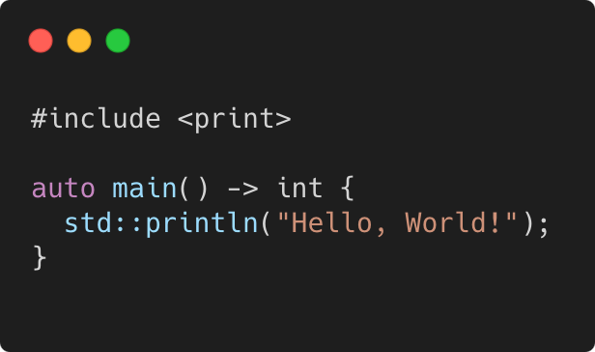
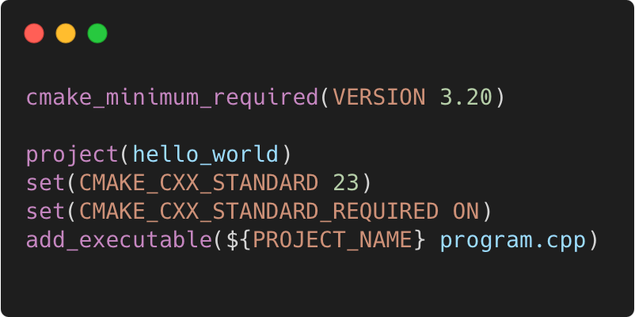
The first classic application
C++23
Language Basics | Hello World
program.cpp
CMakeLists.txt
Output
Gammasoft
Modern C++ Course

Slide 13
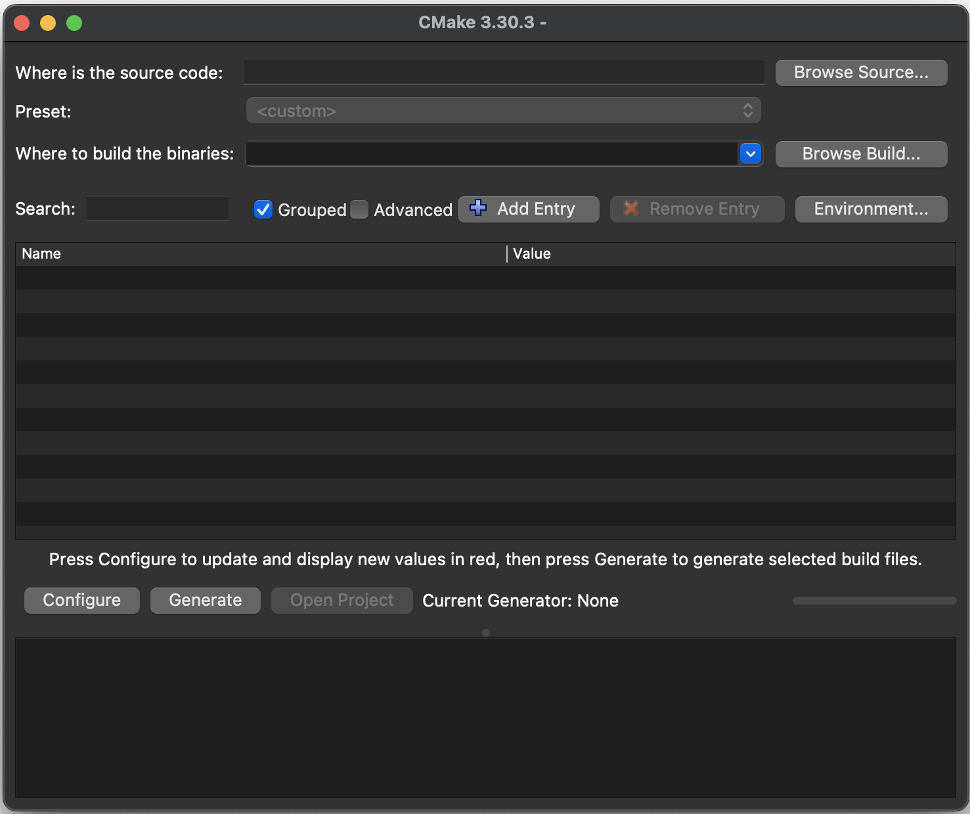
Execute with CMake GUI
Language Basics | Hello World
Open the CMake GUI application
Click on "Browse Sources..." button and select the "Hello world" folder.
Copy the path from "Where is the source code:", past it in the "Where to build the binaries:" and add "/build".
Click on "Configure" button and select the generator.
Click on "Generate" button to generate the project.
Finally, click on “Open project” button.
Gammasoft
Modern C++ Course

Slide 14
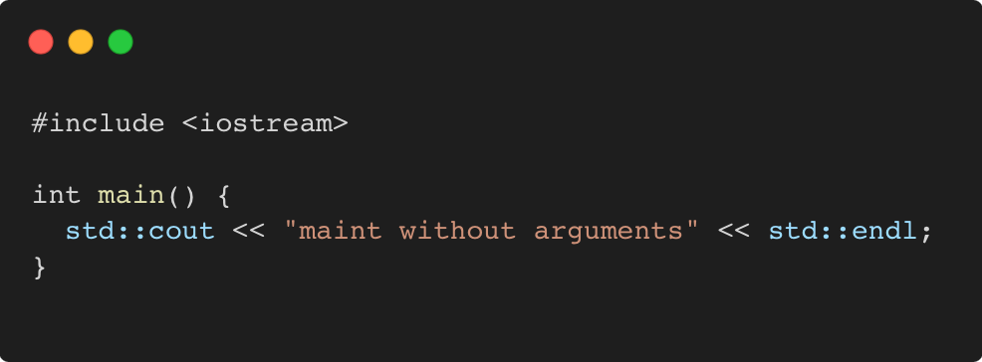
Main function
C++98
Language Basics | Hello World
Gammasoft
Modern C++ Course

Slide 15
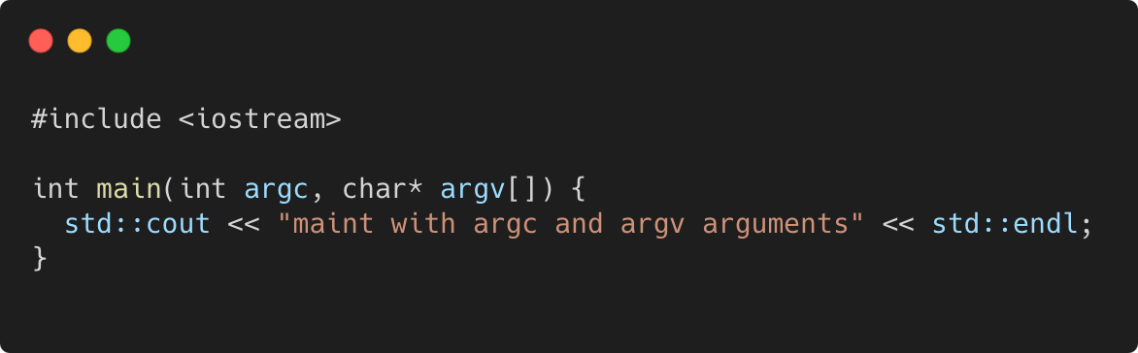
Main function
C++98
Language Basics | Hello World
Gammasoft
Modern C++ Course

Slide 16
Exercise : environment
C++98
Language Basics | Hello World
Learn how to use CMake to generate a project.
Go to exercises/environment
Look at environment.cpp and CMakeLists.txt
Compile it (make) and run the program (./environment)
Work on the tasks that you find in environment.cpp
Gammasoft
Modern C++ Course

Slide 17
Language Basics
Language Basics
Gammasoft
Modern C++ Course
Hello World
Core syntax and types
Arrays and Pointers
Scopes / namespaces
Class and enum types
References
Functions
Operators
Control structures
Headers and interfaces
auto keyword
inline keyword
Assertions

Slide 18
Language Basics
Language Basics
Gammasoft
Modern C++ Course
Hello World
Core syntax and types
Arrays and Pointers
Scopes / namespaces
Class and enum types
References
Functions
Operators
Control structures
Headers and interfaces
auto keyword
inline keyword
Assertions

Slide 19
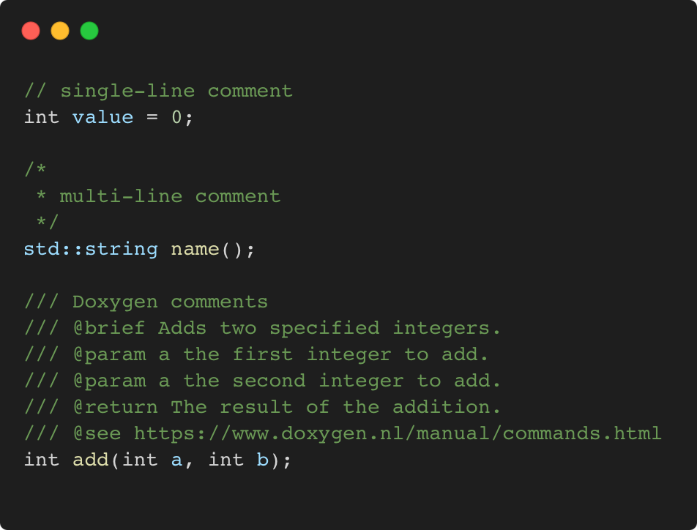
Comments
C++98
Language Basics | Core syntax and types
Gammasoft
Modern C++ Course

Slide 20
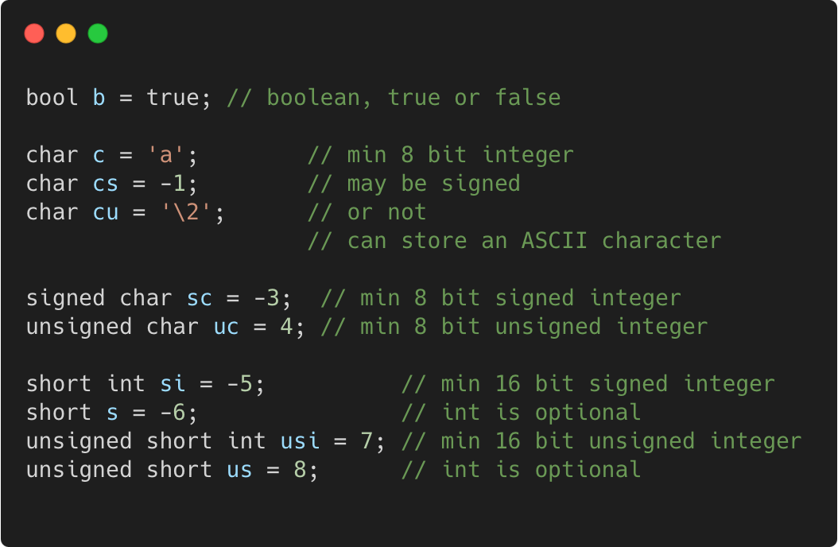
Basic types
C++98
Language Basics | Core syntax and types
Gammasoft
Modern C++ Course

Slide 21
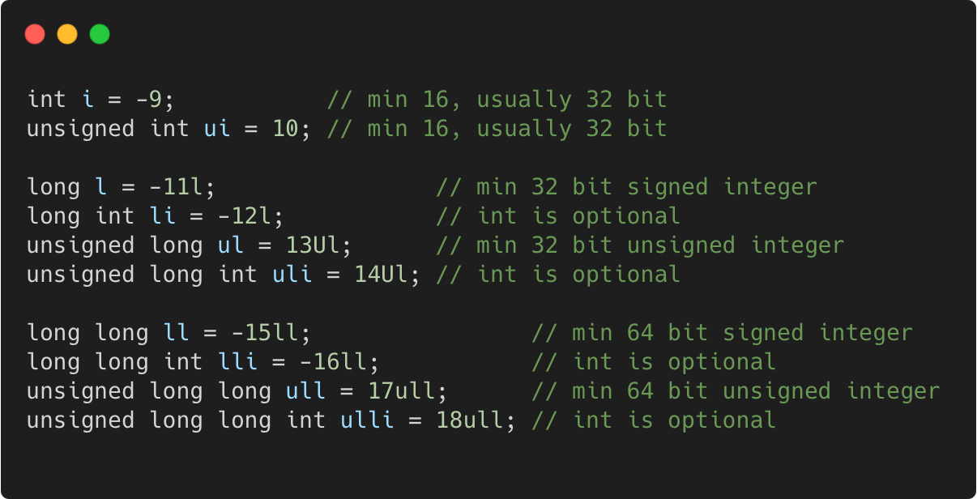
Basic types
C++98
Language Basics | Core syntax and types
Gammasoft
Modern C++ Course

Slide 22
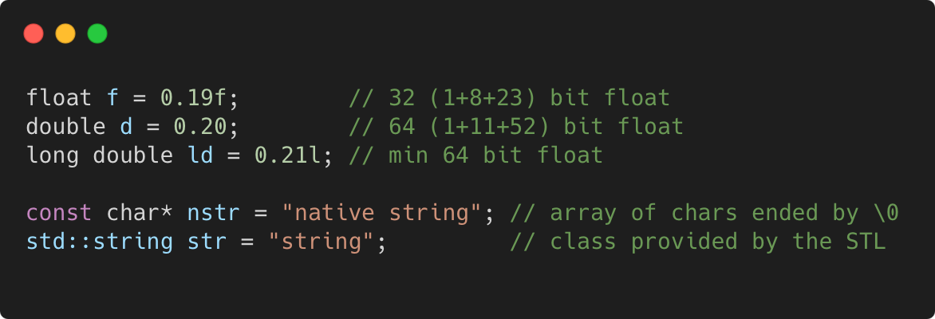
Basic types
C++98
Language Basics | Core syntax and types
Gammasoft
Modern C++ Course

Slide 23
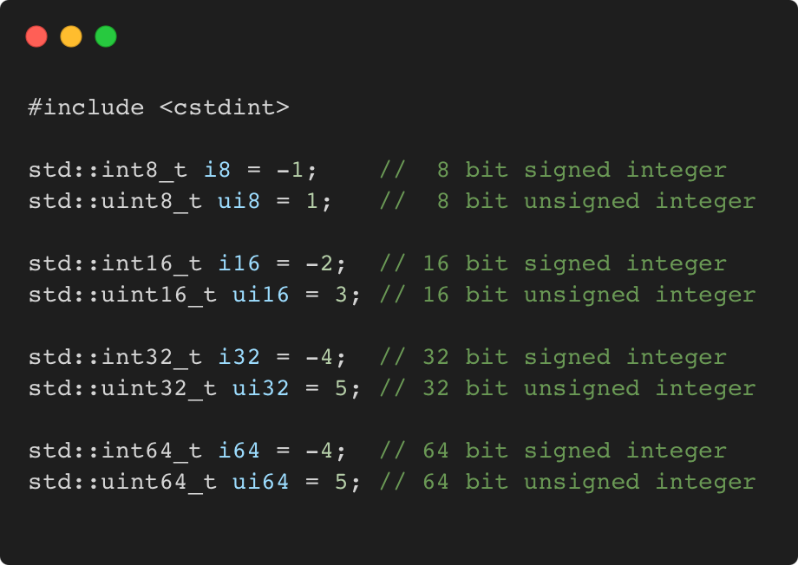
Fixed width integer types
C++11
Language Basics | Core syntax and types
Gammasoft
Modern C++ Course

Slide 24
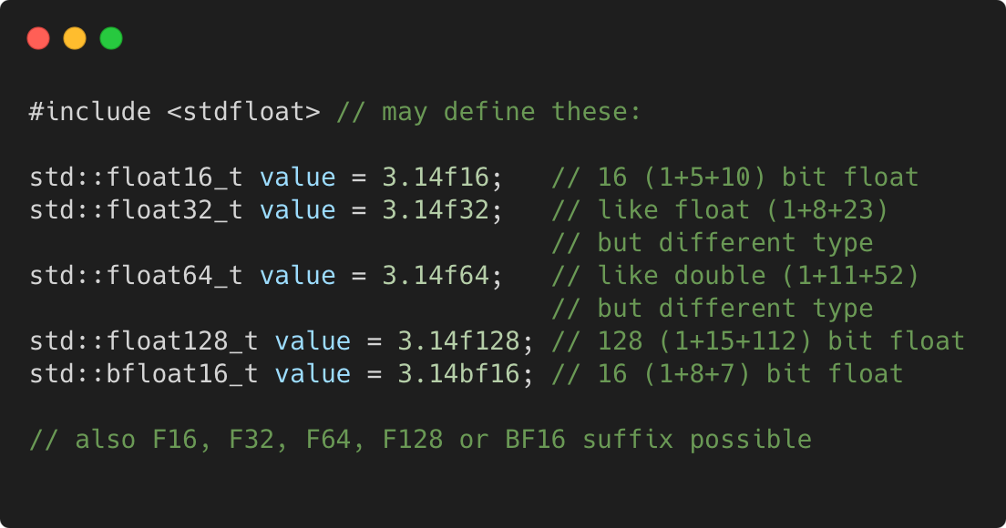
Fixed width floating-point types
C++23
Language Basics | Core syntax and types
Gammasoft
Modern C++ Course

Slide 25
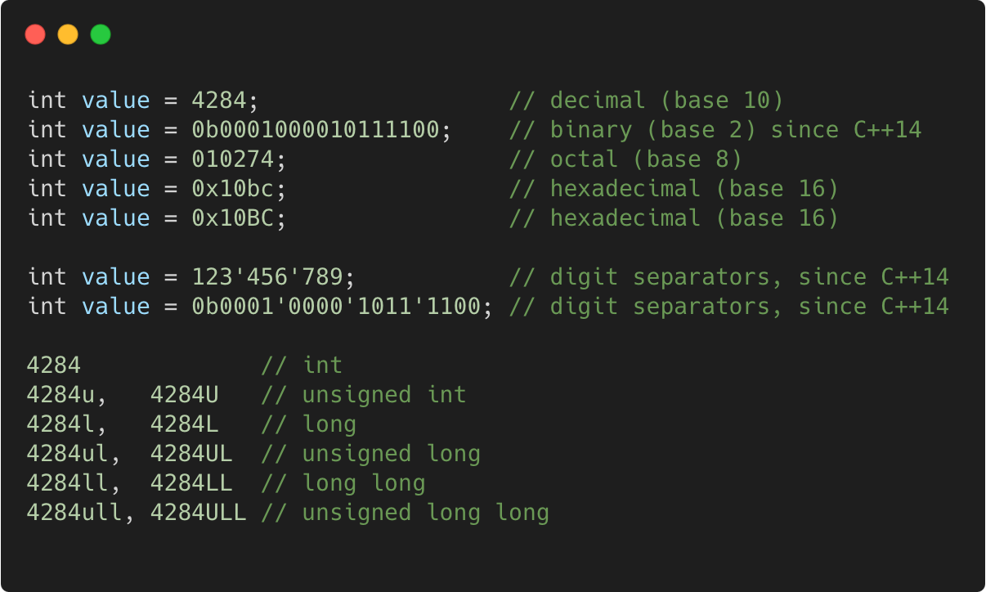
Integer literals
C++98
Language Basics | Core syntax and types
Gammasoft
Modern C++ Course

Slide 26
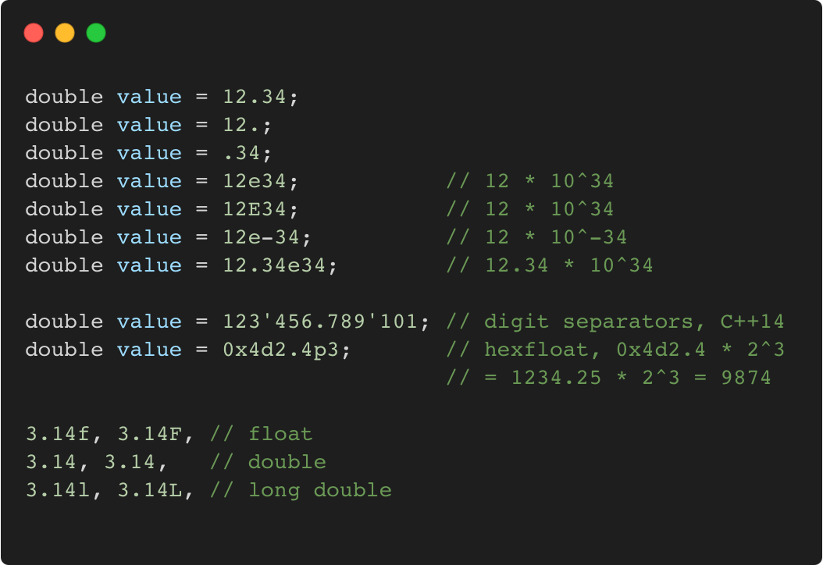
Floating-point literals
C++98
Language Basics | Core syntax and types
Gammasoft
Modern C++ Course

Slide 27
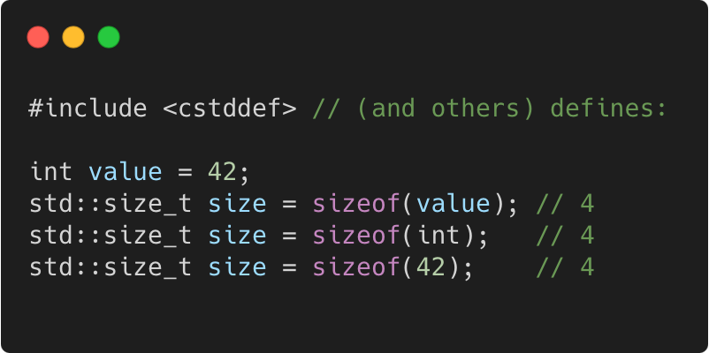
Sizeof
C++98
Language Basics | Core syntax and types
Gammasoft
Modern C++ Course

Slide 28
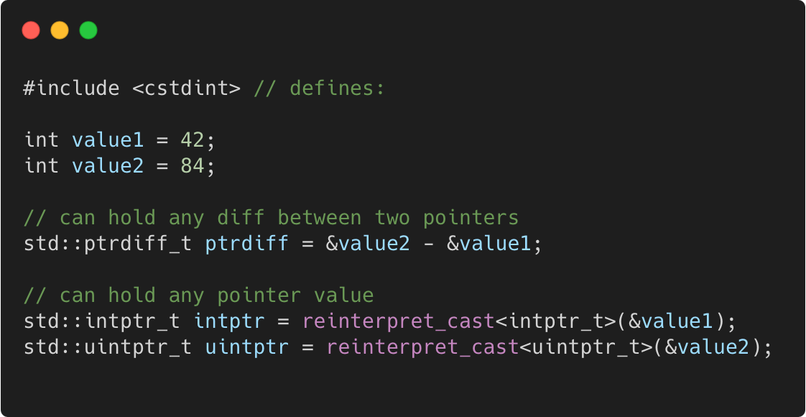
Pointer to integer
C++11
Language Basics | Core syntax and types
Gammasoft
Modern C++ Course

Slide 29
Language Basics
Language Basics
Gammasoft
Modern C++ Course
Hello World
Core syntax and types
Arrays and Pointers
Scopes / namespaces
Class and enum types
References
Functions
Operators
Control structures
Headers and interfaces
auto keyword
inline keyword
Assertions

Slide 30
Language Basics
Language Basics
Gammasoft
Modern C++ Course
Hello World
Core syntax and types
Arrays and Pointers
Scopes / namespaces
Class and enum types
References
Functions
Operators
Control structures
Headers and interfaces
auto keyword
inline keyword
Assertions

Slide 31
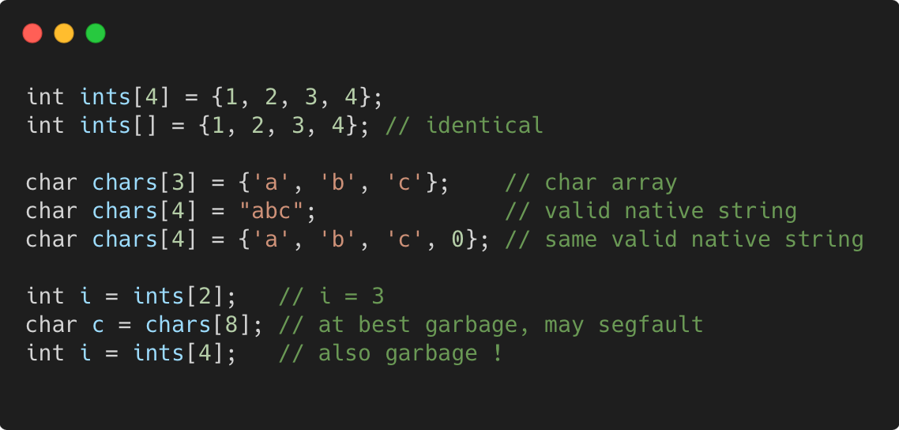
Static arrays
C++98
Language Basics | Arrays and Pointers
Gammasoft
Modern C++ Course

Slide 32
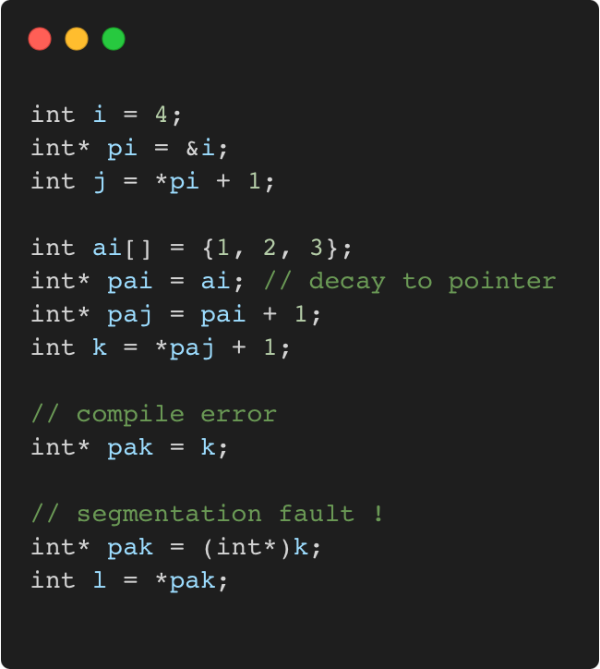
Pointers
C++98
Language Basics | Arrays and Pointers
Gammasoft
Modern C++ Course

Slide 33
Pointers
C++98
Language Basics | Arrays and Pointers
Memory layout
 | 0x3028 300
 | 0x3024
 | 0x3020 300
 | 0x301C
 | 0x3018 300
 | 0x3014
 | 0x3010 300
 | 0x300C
 | 0x3008 300
 | 0x3004
i = 4 | 0x3000 300
Gammasoft
Modern C++ Course

Slide 34
Pointers
C++98
Language Basics | Arrays and Pointers
Memory layout
 | 0x3028 300
 | 0x3024
 | 0x3020 300
 | 0x301C
 | 0x3018 300
 | 0x3014
 | 0x3010 300
 | 0x300C
 | 0x3008 300
pi = 0x3000 | 0x3004
i = 4 | 0x3000 300
Gammasoft
Modern C++ Course

Slide 35
Pointers
C++98
Language Basics | Arrays and Pointers
Memory layout
 | 0x3028 300
 | 0x3024
 | 0x3020 300
 | 0x301C
 | 0x3018 300
 | 0x3014
 | 0x3010 300
 | 0x300C
j = 5 | 0x3008 300
pi = 0x3000 | 0x3004
i = 4 | 0x3000 300
Gammasoft
Modern C++ Course

Slide 36
Pointers
C++98
Language Basics | Arrays and Pointers
Memory layout
 | 0x3028 300
 | 0x3024
 | 0x3020 300
 | 0x301C
 | 0x3018 300
ai[2] = 3 | 0x3014
ai[1] = 2 | 0x3010 300
ai[0] = 1 | 0x300C
j = 5 | 0x3008 300
pi = 0x3000 | 0x3004
i = 4 | 0x3000 300
Gammasoft
Modern C++ Course

Slide 37
Pointers
C++98
Language Basics | Arrays and Pointers
Memory layout
 | 0x3028 300
 | 0x3024
 | 0x3020 300
 | 0x301C
pai = 0x300C | 0x3018 300
ai[2] = 3 | 0x3014
ai[1] = 2 | 0x3010 300
ai[0] = 1 | 0x300C
j = 5 | 0x3008 300
pi = 0x3000 | 0x3004
i = 4 | 0x3000 300
Gammasoft
Modern C++ Course

Slide 38
Pointers
C++98
Language Basics | Arrays and Pointers
Memory layout
 | 0x3028 300
 | 0x3024
 | 0x3020 300
paj = 0x3010 | 0x301C
pai = 0x300C | 0x3018 300
ai[2] = 3 | 0x3014
ai[1] = 2 | 0x3010 300
ai[0] = 1 | 0x300C
j = 5 | 0x3008 300
pi = 0x3000 | 0x3004
i = 4 | 0x3000 300
Gammasoft
Modern C++ Course

Slide 39
Pointers
C++98
Language Basics | Arrays and Pointers
Memory layout
 | 0x3028 300
 | 0x3024
k = 3 | 0x3020 300
paj = 0x3010 | 0x301C
pai = 0x300C | 0x3018 300
ai[2] = 3 | 0x3014
ai[1] = 2 | 0x3010 300
ai[0] = 1 | 0x300C
j = 5 | 0x3008 300
pi = 0x3000 | 0x3004
i = 4 | 0x3000 300
Gammasoft
Modern C++ Course

Slide 40
Pointers
C++98
Language Basics | Arrays and Pointers
Memory layout
 | 0x3028 300
pak = 3 | 0x3024
k = 3 | 0x3020 300
paj = 0x3010 | 0x301C
pai = 0x300C | 0x3018 300
ai[2] = 3 | 0x3014
ai[1] = 2 | 0x3010 300
ai[0] = 1 | 0x300C
j = 5 | 0x3008 300
pi = 0x3000 | 0x3004
i = 4 | 0x3000 300
??
Gammasoft
Modern C++ Course

Slide 41
nullptr
C++11
Language Basics | Arrays and Pointers
if a pointer doesn’t point to anything, set it to nullptr
useful to e.g. mark the end of a linked data structure
or absence of an optional function argument (pointer)
same as setting it to 0 or NULL (before C++ 11)
triggers compilation error when assigned to integer
Gammasoft
Modern C++ Course

Slide 42
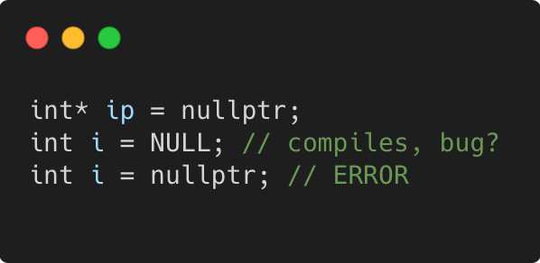
nullptr
C++11
Language Basics | Arrays and Pointers
if a pointer doesn’t point to anything, set it to nullptr
useful to e.g. mark the end of a linked data structure
or absence of an optional function argument (pointer)
same as setting it to 0 or NULL (before C++ 11)
triggers compilation error when assigned to integer
Gammasoft
Modern C++ Course

Slide 43
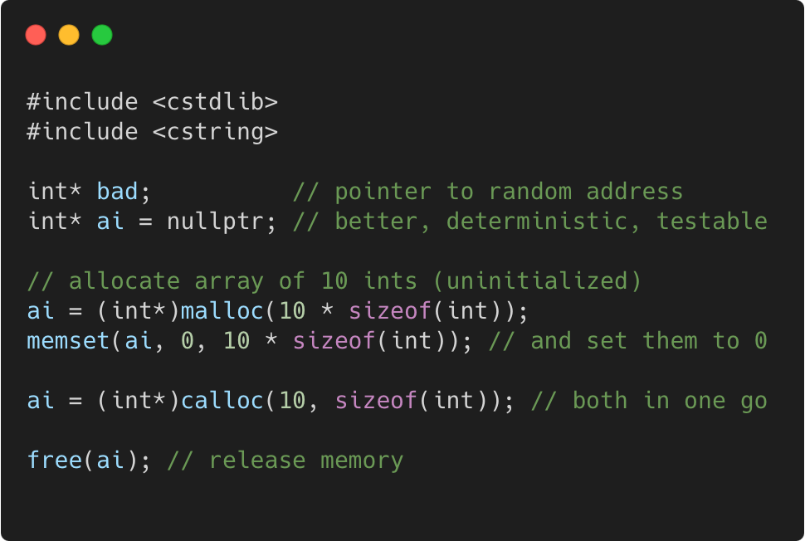
Dynamic arrays using C
C++98
Language Basics | Arrays and Pointers
Gammasoft
Modern C++ Course

Slide 44
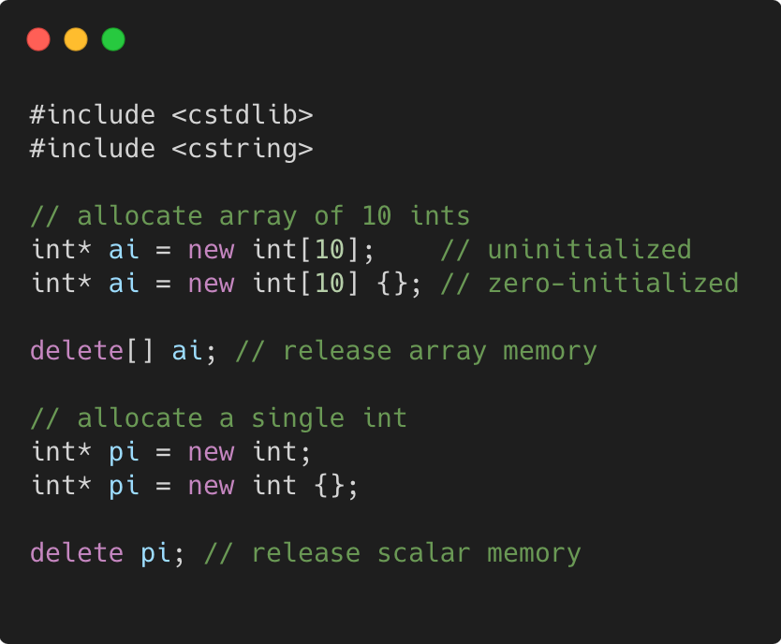
Dynamic arrays using C++
C++98
Language Basics | Arrays and Pointers
Gammasoft
Modern C++ Course

Slide 45
Language Basics
Language Basics
Gammasoft
Modern C++ Course
Hello World
Core syntax and types
Arrays and Pointers
Scopes / namespaces
Class and enum types
References
Functions
Operators
Control structures
Headers and interfaces
auto keyword
inline keyword
Assertions

Slide 46
Language Basics
Language Basics
Gammasoft
Modern C++ Course
Hello World
Core syntax and types
Arrays and Pointers
Scopes / namespaces
Class and enum types
References
Functions
Operators
Control structures
Headers and interfaces
auto keyword
inline keyword
Assertions

Slide 47
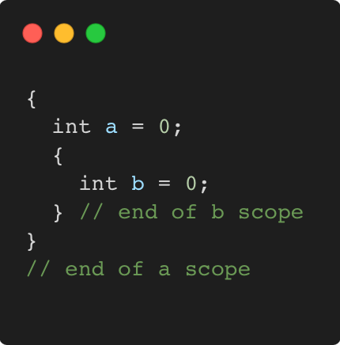
Scope
C++98
Language Basics | Scopes / namespaces
Portion of the source code where a given name is valid
Typically :
simple block of code, within {}
function, class, namespace
the global scope, i.e. translation unit (.cpp file + all includes)
Gammasoft
Modern C++ Course

Slide 48
Scope and lifetime of variables
C++98
Language Basics | Scopes / namespaces
Variables are (statically) allocated when defined
Variables are freed at the end of a scope
Gammasoft
Modern C++ Course

Slide 49
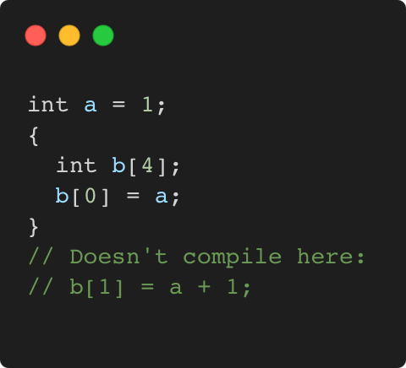
Scope and lifetime of variables
C++98
Language Basics | Scopes / namespaces
Variables are (statically) allocated when defined
Variables are freed at the end of a scope
Gammasoft
Modern C++ Course

Slide 50
Scope and lifetime of variables
C++98
Language Basics | Scopes / namespaces
Variables are (statically) allocated when defined
Variables are freed at the end of a scope
Memory layout
 | 0x3010
 | 0x300C
 | 0x3008
 | 0x3004
i = 4 | 0x3000
Gammasoft
Modern C++ Course

Slide 51
Scope and lifetime of variables
C++98
Language Basics | Scopes / namespaces
Variables are (statically) allocated when defined
Variables are freed at the end of a scope
Memory layout
b[3] = ? | 0x3010
b[2] = ? | 0x300C
b[1] = ? | 0x3008
b[0] = ? | 0x3004
i = 4 | 0x3000
Gammasoft
Modern C++ Course

Slide 52
Scope and lifetime of variables
C++98
Language Basics | Scopes / namespaces
Variables are (statically) allocated when defined
Variables are freed at the end of a scope
Memory layout
b[3] = ? | 0x3010
b[2] = ? | 0x300C
b[1] = ? | 0x3008
b[0] = 1 | 0x3004
i = 4 | 0x3000
Gammasoft
Modern C++ Course

Slide 53
Scope and lifetime of variables
C++98
Language Basics | Scopes / namespaces
Variables are (statically) allocated when defined
Variables are freed at the end of a scope
Memory layout
? | 0x3010
? | 0x300C
? | 0x3008
1 | 0x3004
i = 4 | 0x3000
Gammasoft
Modern C++ Course

Slide 54
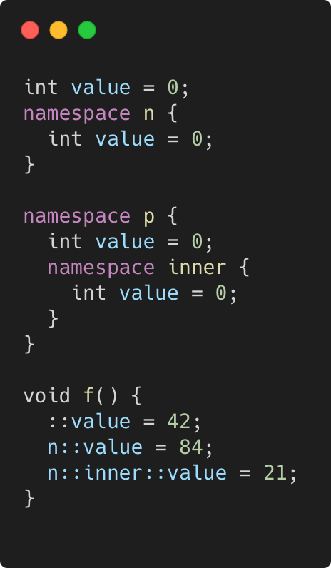
Namepaces
C++98
Language Basics | Scopes / namespaces
Namespaces allow to segment your code to avoid name clashes
They can be embedded to create hierarchies (separator is ::)
Gammasoft
Modern C++ Course

Slide 55
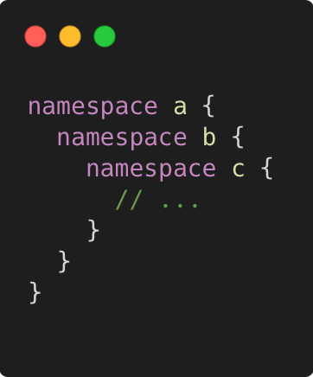
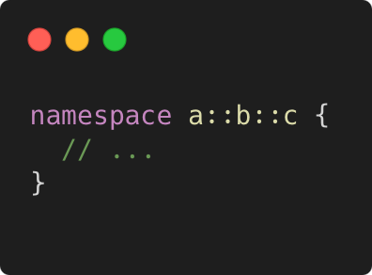
Nested namespaces
C++17
Language Basics | Scopes / namespaces
Easier way to declare nested namespaces
C++98
C++17
Gammasoft
Modern C++ Course

Slide 56
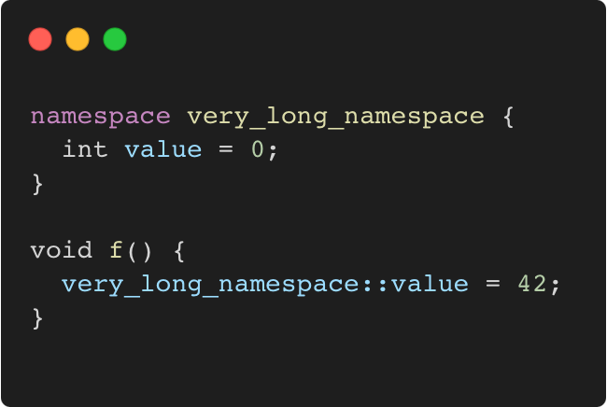
namespace alias
C++98
Language Basics | Scopes / namespaces
The namespace keyword can be use to create an alias on an other namespace.
Gammasoft
Modern C++ Course

Slide 57
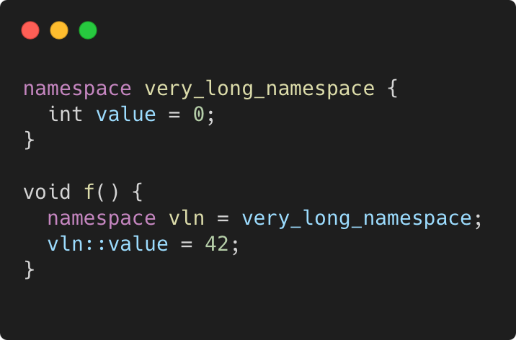
namespace alias
C++98
Language Basics | Scopes / namespaces
The namespace keyword can be use to create an alias on an other namespace.
Gammasoft
Modern C++ Course

Slide 58
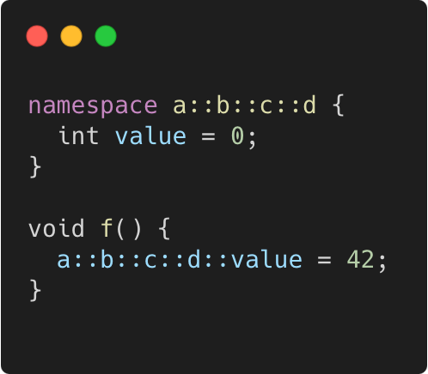
namespace alias
C++98
Language Basics | Scopes / namespaces
The namespace keyword can be use to create an alias on an other namespace.
Or on nested namespaces.
Gammasoft
Modern C++ Course

Slide 59
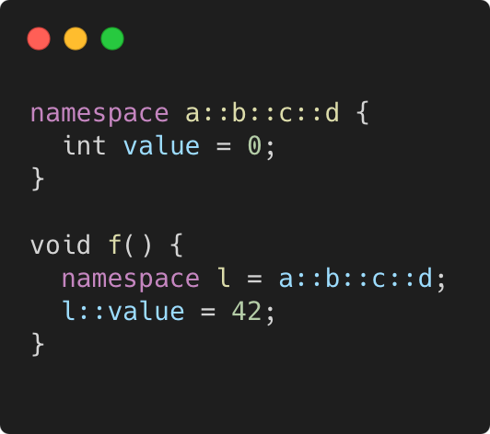
namespace alias
C++98
Language Basics | Scopes / namespaces
The namespace keyword can be use to create an alias on an other namespace.
Or on nested namespaces.
Gammasoft
Modern C++ Course

Slide 60
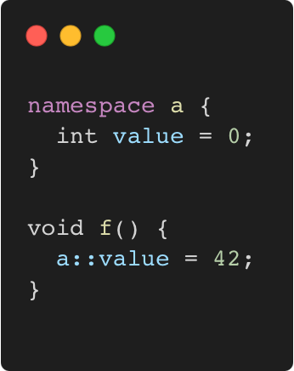
Using namespace directive
C++98
Language Basics | Scopes / namespaces
The using namespace directive make all members of the specified namespace visible in current scope.
Gammasoft
Modern C++ Course

Slide 61
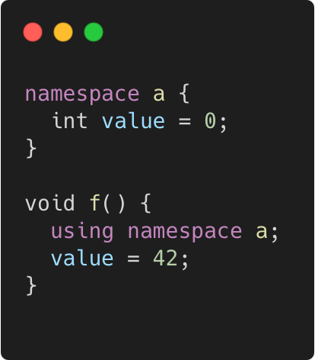
Using namespace directive
C++98
Language Basics | Scopes / namespaces
The using namespace directive make all members of the specified namespace visible in current scope.
Gammasoft
Modern C++ Course

Slide 62
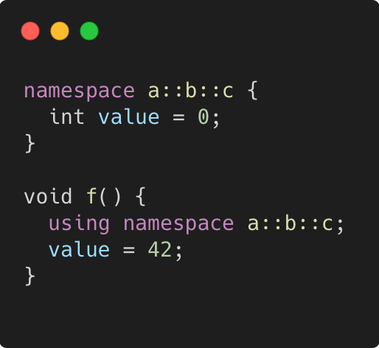
Using namespace directive
C++98
Language Basics | Scopes / namespaces
The using namespace directive make all members of the specified namespace visible in current scope.
The same for nested namespaces.
Gammasoft
Modern C++ Course

Slide 63
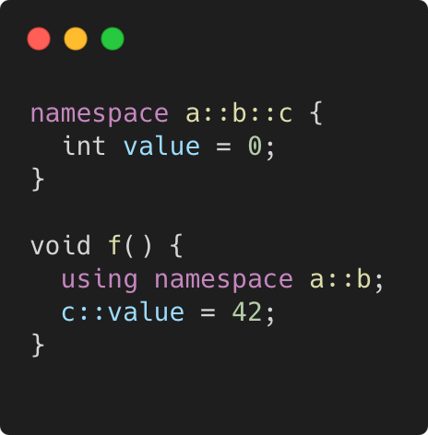
Using namespace directive
C++98
Language Basics | Scopes / namespaces
The using namespace directive make all members of the specified namespace visible in current scope.
The same for nested namespaces.
As well as for any part of the nested namespaces.
Gammasoft
Modern C++ Course

Slide 64
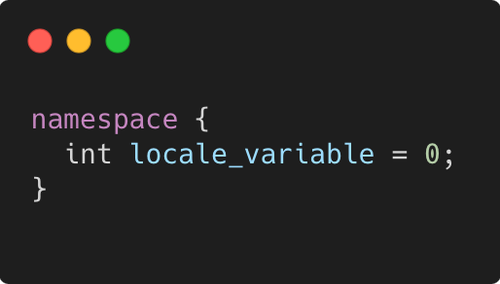
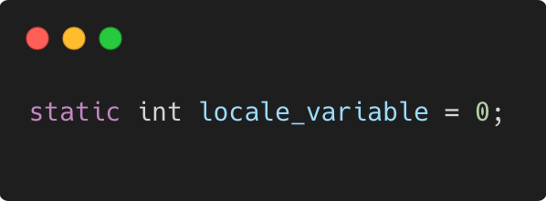
Anonymous namespace
C++98
Language Basics | Scopes / namespaces
groups a number of declarations
visible only in the current translation unit
but not reusable outside
allows much better compiler optimizations and checking
e.g. unused function warning
context dependent optimizations
equivalent
Gammasoft
Modern C++ Course

Slide 65
Language Basics
Language Basics
Gammasoft
Modern C++ Course
Hello World
Core syntax and types
Arrays and Pointers
Scopes / namespaces
Class and enum types
References
Functions
Operators
Control structures
Headers and interfaces
auto keyword
inline keyword
Assertions

Slide 66
Language Basics
Language Basics
Gammasoft
Modern C++ Course
Hello World
Core syntax and types
Arrays and Pointers
Scopes / namespaces
Class and enum types
References
Functions
Operators
Control structures
Headers and interfaces
auto keyword
inline keyword
Assertions

Slide 67
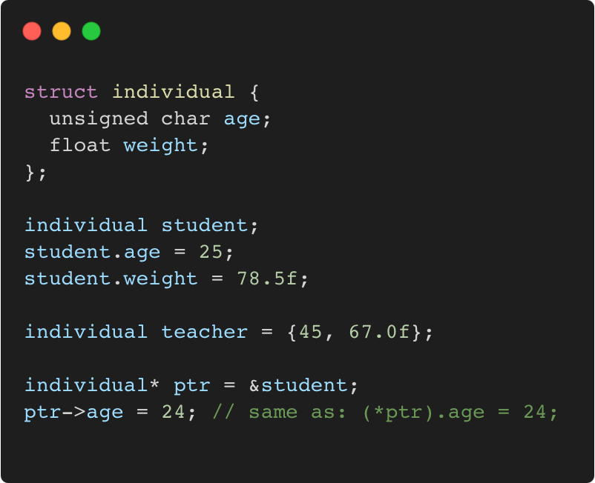
Struct
C++98
Language Basics | Class and enum types
“members” grouped together under one name
Gammasoft
Modern C++ Course

Slide 68
Struct
C++98
Language Basics | Class and enum types
“members” grouped together under one name
Memory layout
 |  |  |  | 0x3010
 |  |  |  | 0x300C
 |  |  |  | 0x3008
 |  |  |  | 0x3004
 |  |  |  | 0x3000
Gammasoft
Modern C++ Course

Slide 69
Struct
C++98
Language Basics | Class and enum types
“members” grouped together under one name
Memory layout
 |  |  |  | 0x3010
 |  |  |  | 0x300C
 |  |  |  | 0x3008
? | ? | ? | ? | 0x3004
? | ? | ? | ? | 0x3000
{
Student
Gammasoft
Modern C++ Course

Slide 70
Struct
C++98
Language Basics | Class and enum types
“members” grouped together under one name
Memory layout
 |  |  |  | 0x3010
 |  |  |  | 0x300C
 |  |  |  | 0x3008
? | ? | ? | ? | 0x3004
25 | ? | ? | ? | 0x3000
{
Student
Gammasoft
Modern C++ Course

Slide 71
Struct
C++98
Language Basics | Class and enum types
“members” grouped together under one name
Memory layout
 |  |  |  | 0x3010
 |  |  |  | 0x300C
 |  |  |  | 0x3008
 |  |  |  | 0x3004
25 | ? | ? | ? | 0x3000
{
78.5
Student
Gammasoft
Modern C++ Course

Slide 72
Struct
C++98
Language Basics | Class and enum types
“members” grouped together under one name
Memory layout
 |  |  |  | 0x3010
 |  |  |  | 0x300C
45 | ? | ? | ? | 0x3008
 |  |  |  | 0x3004
25 | ? | ? | ? | 0x3000
{
67.0
Teacher
{
78.5
Student
Gammasoft
Modern C++ Course

Slide 73
Struct
C++98
Language Basics | Class and enum types
“members” grouped together under one name
Memory layout
 |  |  |  | 0x3010
 |  |  |  | 0x300C
45 | ? | ? | ? | 0x3008
 |  |  |  | 0x3004
25 | ? | ? | ? | 0x3000
0x3000
{
67.0
Teacher
{
78.5
Student
Gammasoft
Modern C++ Course

Slide 74
Struct
C++98
Language Basics | Class and enum types
“members” grouped together under one name
Memory layout
 |  |  |  | 0x3010
 |  |  |  | 0x300C
45 | ? | ? | ? | 0x3008
 |  |  |  | 0x3004
24 | ? | ? | ? | 0x3000
0x3000
{
67.0
Teacher
{
78.5
Student
Gammasoft
Modern C++ Course

Slide 75
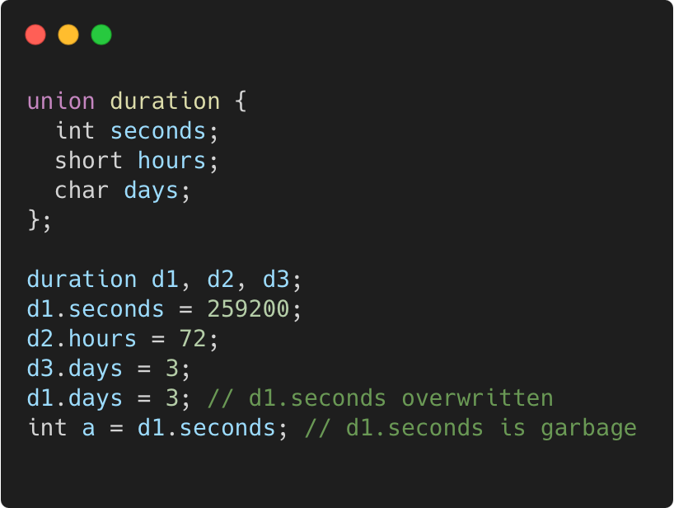
Union
C++98
Language Basics | Class and enum types
“members” packed together at same memory location
Gammasoft
Modern C++ Course

Slide 76
Union
C++98
Language Basics | Class and enum types
“members” packed together at same memory location
Memory layout
 |  |  |  | 0x300C
 |  |  |  | 0x3008
 |  |  |  | 0x3004
 |  |  |  | 0x3000
Gammasoft
Modern C++ Course

Slide 77
Union
C++98
Language Basics | Class and enum types
“members” packed together at same memory location
Memory layout
 |  |  |  | 0x300C
? | ? | ? | ? | 0x3008
? | ? | ? | ? | 0x3004
? | ? | ? | ? | 0x3000
Gammasoft
Modern C++ Course

Slide 78
Union
C++98
Language Basics | Class and enum types
“members” packed together at same memory location
Memory layout
 |  |  |  | 0x300C
? | ? | ? | ? | 0x3008
? | ? | ? | ? | 0x3004
 |  |  |  | 0x3000
259200
Gammasoft
Modern C++ Course

Slide 79
Union
C++98
Language Basics | Class and enum types
“members” packed together at same memory location
Memory layout
 |  |  |  | 0x300C
? | ? | ? | ? | 0x3008
 |  | ? | ? | 0x3004
 |  |  |  | 0x3000
72
259200
Gammasoft
Modern C++ Course

Slide 80
Union
C++98
Language Basics | Class and enum types
“members” packed together at same memory location
Memory layout
 |  |  |  | 0x300C
3 | ? | ? | ? | 0x3008
 |  | ? | ? | 0x3004
 |  |  |  | 0x3000
72
259200
Gammasoft
Modern C++ Course

Slide 81
Union
C++98
Language Basics | Class and enum types
“members” packed together at same memory location
Memory layout
 |  |  |  | 0x300C
3 | ? | ? | ? | 0x3008
 |  | ? | ? | 0x3004
3 | ? | ? | ? | 0x3000
72
Gammasoft
Modern C++ Course

Slide 82
Union
C++98
Language Basics | Class and enum types
“members” packed together at same memory location
Memory layout
? | ? | ? | ? | 0x300C
3 | ? | ? | ? | 0x3008
 |  | ? | ? | 0x3004
3 | ? | ? | ? | 0x3000
72
Gammasoft
Modern C++ Course

Slide 83
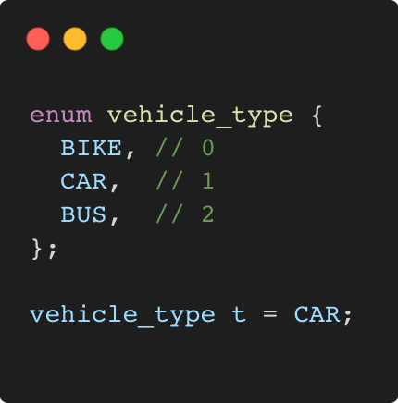
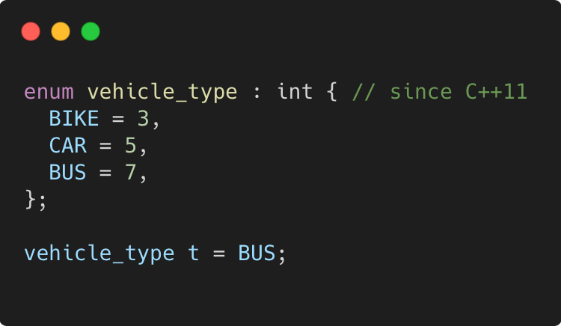
Enum
C++98
Language Basics | Class and enum types
use to declare a list of related constants (enumerators)
has an underlying integral type
enumerator names leak into enclosing scope
Gammasoft
Modern C++ Course

Slide 84
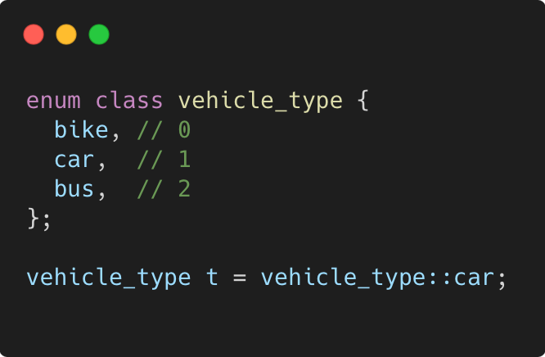
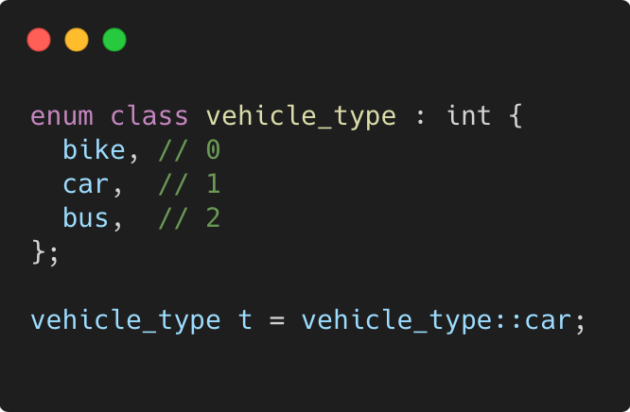
Enum class
C++11
Language Basics | Class and enum types
scopes enumerator names, avoids name clashes
strong typing, no automatic conversion to int
Gammasoft
Modern C++ Course

Slide 85
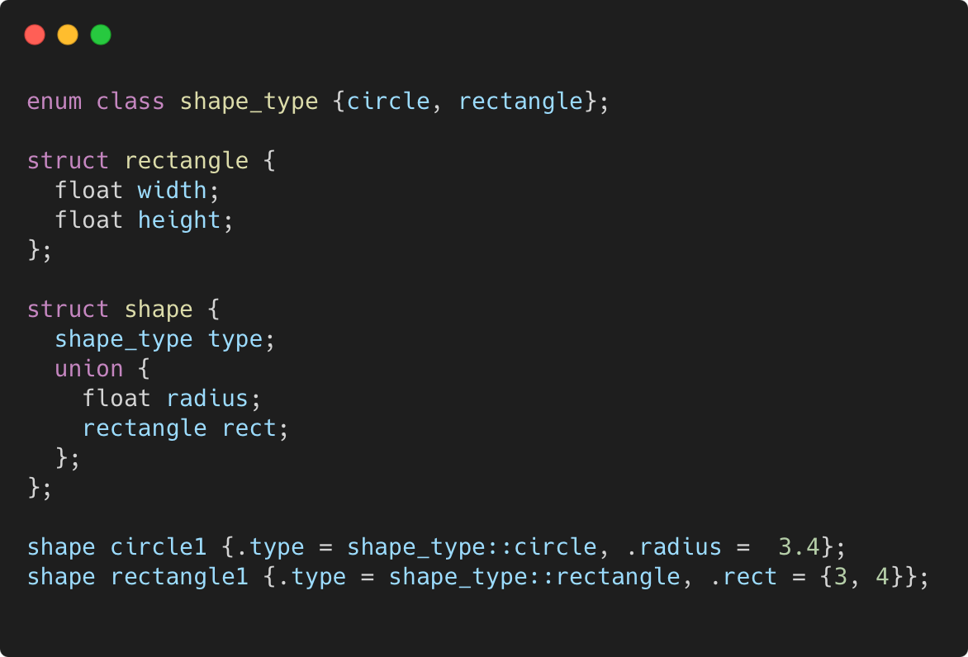
More concrete example
C++11
Language Basics | Class and enum types
Gammasoft
Modern C++ Course

Slide 86
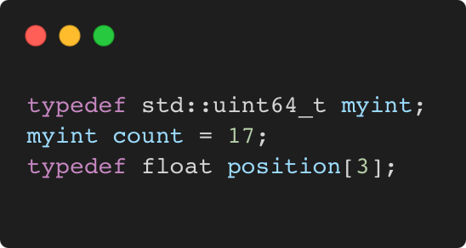
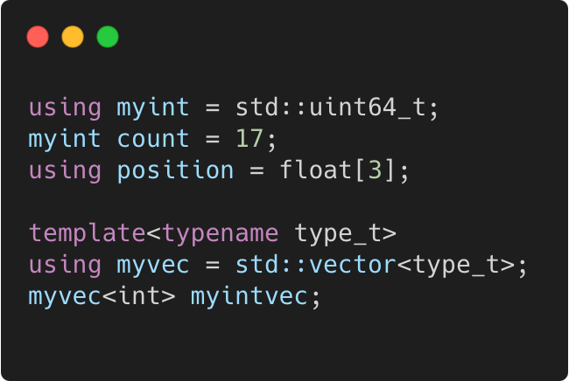
typedef and using
C++98 / C++11
Language Basics | Class and enum types
C++98
C++11
Gammasoft
Modern C++ Course

Slide 87
Language Basics
Language Basics
Gammasoft
Modern C++ Course
Hello World
Core syntax and types
Arrays and Pointers
Scopes / namespaces
Class and enum types
References
Functions
Operators
Control structures
Headers and interfaces
auto keyword
inline keyword
Assertions

Slide 88
Language Basics
Language Basics
Gammasoft
Modern C++ Course
Hello World
Core syntax and types
Arrays and Pointers
Scopes / namespaces
Class and enum types
References
Functions
Operators
Control structures
Headers and interfaces
auto keyword
inline keyword
Assertions

Slide 89
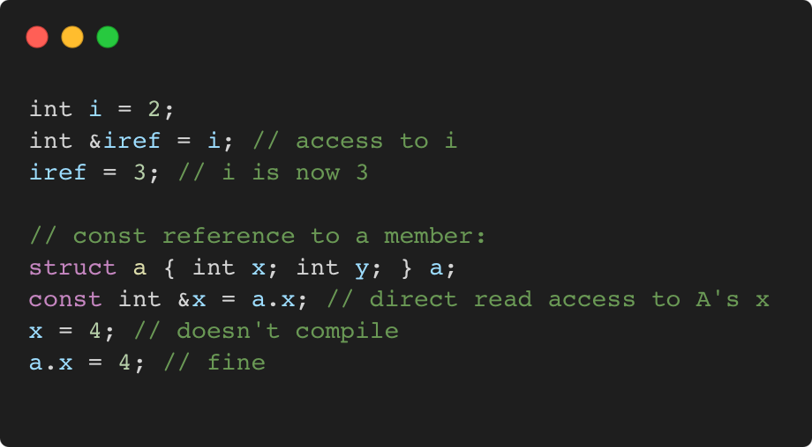
References
C++98
Language Basics | References
References allow for direct access to another object
They can be used as shortcuts / better readability
They can be declared const to allow only read access
Gammasoft
Modern C++ Course

Slide 90
References vs pointers
C++98
Language Basics | References
Natural syntax
Cannot be null
Must be assigned when defined, cannot be reassigned
Prefer using references instead of pointers
Mark references const to prevent modification
Gammasoft
Modern C++ Course

Slide 91
Language Basics
Language Basics
Gammasoft
Modern C++ Course
Hello World
Core syntax and types
Arrays and Pointers
Scopes / namespaces
Class and enum types
References
Functions
Operators
Control structures
Headers and interfaces
auto keyword
inline keyword
Assertions

Slide 92
Language Basics
Language Basics
Gammasoft
Modern C++ Course
Hello World
Core syntax and types
Arrays and Pointers
Scopes / namespaces
Class and enum types
References
Functions
Operators
Control structures
Headers and interfaces
auto keyword
inline keyword
Assertions

Slide 93
Functions
C++98
Language Basics | Functions
Gammasoft
Modern C++ Course

Slide 94
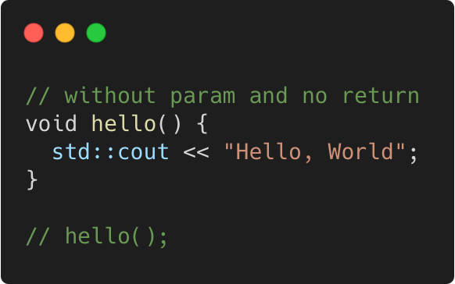
Functions
C++98
Language Basics | Functions
Gammasoft
Modern C++ Course

Slide 95
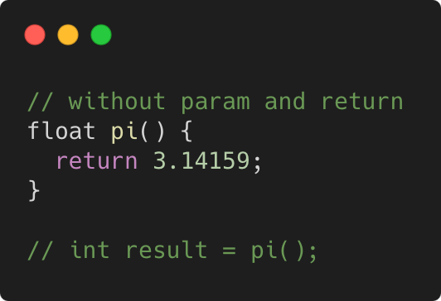
Functions
C++98
Language Basics | Functions
Gammasoft
Modern C++ Course

Slide 96

Functions
C++98
Language Basics | Functions
Gammasoft
Modern C++ Course

Slide 97

Functions
C++98
Language Basics | Functions
Gammasoft
Modern C++ Course

Slide 98

Functions
C++98
Language Basics | Functions
Gammasoft
Modern C++ Course

Slide 99

Functions
C++98
Language Basics | Functions
Gammasoft
Modern C++ Course

Slide 100

Functions
C++98
Language Basics | Functions
Gammasoft
Modern C++ Course

Slide 101

Functions
C++98
Language Basics | Functions
Gammasoft
Modern C++ Course

Slide 102

Parameter are passed by value
C++98
Language Basics | Functions
Gammasoft
Modern C++ Course

Slide 103
Parameter are passed by value
C++98
Language Basics | Functions
Memory layout
 | 0x31E0
 | 0x3190
 | 0x3140
 | 0x30F0
 | 0x30A0
 | 0x3050
 | 0x3000
Gammasoft
Modern C++ Course

Slide 104
Parameter are passed by value
C++98
Language Basics | Functions
Memory layout
 | 0x31E0
 | 0x3190
 | 0x3140
 | 0x30F0
sn | 0x30A0
... | 0x3050
s1 | 0x3000
{
s
Gammasoft
Modern C++ Course

Slide 105
Parameter are passed by value
C++98
Language Basics | Functions
Memory layout
{
 | 0x31E0
pn | 0x3190
... | 0x3140
p1 | 0x30F0
sn | 0x30A0
... | 0x3050
s1 | 0x3000
p
{
s
Gammasoft
Modern C++ Course

Slide 106
Parameter are passed by value
C++98
Language Basics | Functions
Memory layout
 | 0x31E0
 | 0x3190
 | 0x3140
q = 0x3000 | 0x30F0
sn | 0x30A0
... | 0x3050
s1 | 0x3000
{
s
Gammasoft
Modern C++ Course

Slide 107

Pass by value or reference ?
C++98
Language Basics | Functions
Gammasoft
Modern C++ Course

Slide 108
Pass by value or reference ?
C++98
Language Basics | Functions
Memory layout
 | 0x3008
 | 0x3004
 | 0x3000
Gammasoft
Modern C++ Course

Slide 109
Pass by value or reference ?
C++98
Language Basics | Functions
Memory layout
 | 0x3008
 | 0x3004
s.a = 1 | 0x3000
Gammasoft
Modern C++ Course

Slide 110
Pass by value or reference ?
C++98
Language Basics | Functions
Memory layout
 | 0x3008
p.a = 1 | 0x3004
s.a = 1 | 0x3000
Gammasoft
Modern C++ Course

Slide 111
Pass by value or reference ?
C++98
Language Basics | Functions
Memory layout
 | 0x3008
p.a = 2 | 0x3004
s.a = 1 | 0x3000
Gammasoft
Modern C++ Course

Slide 112
Pass by value or reference ?
C++98
Language Basics | Functions
Memory layout
 | 0x3008
 | 0x3004
s.a = 1 | 0x3000
Gammasoft
Modern C++ Course

Slide 113
Pass by value or reference ?
C++98
Language Basics | Functions
Memory layout
 | 0x3008
q = 0x3000 | 0x3004
s.a = 1 | 0x3000
Gammasoft
Modern C++ Course

Slide 114
Pass by value or reference ?
C++98
Language Basics | Functions
Memory layout
 | 0x3008
q = 0x3000 | 0x3004
s.a = 2 | 0x3000
Gammasoft
Modern C++ Course

Slide 115
Pass by value or reference ?
C++98
Language Basics | Functions
Memory layout
 | 0x3008
 | 0x3004
s.a = 2 | 0x3000
Gammasoft
Modern C++ Course

Slide 116

Different ways to pass arguments to a function
C++98
Language Basics | Functions
By default, arguments are passed by value (= copy) => good for small types, e.g. numbers
Use references for parameters to avoid copies => good for large types, e.g. objects
Use const for safety and readability whenever possible
Gammasoft
Modern C++ Course

Slide 117

Overloading
C++98
Language Basics | Functions
We can have multiple functions with the same name
Must have different parameter lists
A different return type alone is not allowed
Form a so-called “overload set”
Default arguments can cause ambiguities
Gammasoft
Modern C++ Course

Slide 118
Exercise : functions
C++98
Language Basics | Functions
Familiarise yourself with pass by value / pass by reference.
Go to exercises/functions
Look at functions.cpp
Compile it (make) and run the program (./functions)
Work on the tasks that you find in functions.cpp
Gammasoft
Modern C++ Course

Slide 119

Good practices
C++98
Language Basics | Functions
Write readable functions
Keep functions short
Do one logical thing (single-responsibility principle)
Use expressive names
Document non-trivial functions
Gammasoft
Modern C++ Course

Slide 120

Good practices
C++98
Language Basics | Functions
Don’t! Everything in one long function
Gammasoft
Modern C++ Course

Slide 121
Language Basics
Language Basics
Gammasoft
Modern C++ Course
Hello World
Core syntax and types
Arrays and Pointers
Scopes / namespaces
Class and enum types
References
Functions
Operators
Control structures
Headers and interfaces
auto keyword
inline keyword
Assertions

Slide 122
Language Basics
Language Basics
Gammasoft
Modern C++ Course
Hello World
Core syntax and types
Arrays and Pointers
Scopes / namespaces
Class and enum types
References
Functions
Operators
Control structures
Headers and interfaces
auto keyword
inline keyword
Assertions

Slide 123

Binary and Assignment Operators
C++98
Language Basics | Operators
Gammasoft
Modern C++ Course

Slide 124

Increment / Decrement Operators
C++98
Language Basics | Operators
Gammasoft
Modern C++ Course

Slide 125

Bitwise and Assignment Operators
C++98
Language Basics | Operators
Gammasoft
Modern C++ Course

Slide 126

Logical Operators
C++98
Language Basics | Operators
Gammasoft
Modern C++ Course

Slide 127

Comparison Operators
C++98
Language Basics | Operators
Gammasoft
Modern C++ Course

Slide 128

Operator Precedence
C++98
Language Basics | Operators
Avoid writing a line of operators as in the example on the right
It's better to decompose the expression
and to use parentheses
Details can be found on cppreference
Gammasoft
Modern C++ Course

Slide 129
Language Basics
Language Basics
Gammasoft
Modern C++ Course
Hello World
Core syntax and types
Arrays and Pointers
Scopes / namespaces
Class and enum types
References
Functions
Operators
Control structures
Headers and interfaces
auto keyword
inline keyword
Assertions

Slide 130
Language Basics
Language Basics
Gammasoft
Modern C++ Course
Hello World
Core syntax and types
Arrays and Pointers
Scopes / namespaces
Class and enum types
References
Functions
Operators
Control structures
Headers and interfaces
auto keyword
inline keyword
Assertions

Slide 131
Language Basics
Language Basics
Gammasoft
Modern C++ Course
Hello World
Core syntax and types
Arrays and Pointers
Scopes / namespaces
Class and enum types
References
Functions
Operators
Control structures
Headers and interfaces
auto keyword
inline keyword
Assertions

Slide 132
Language Basics
Language Basics
Gammasoft
Modern C++ Course
Hello World
Core syntax and types
Arrays and Pointers
Scopes / namespaces
Class and enum types
References
Functions
Operators
Control structures
Headers and interfaces
auto keyword
inline keyword
Assertions

Slide 133
Language Basics
Language Basics
Gammasoft
Modern C++ Course
Hello World
Core syntax and types
Arrays and Pointers
Scopes / namespaces
Class and enum types
References
Functions
Operators
Control structures
Headers and interfaces
auto keyword
inline keyword
Assertions

Slide 134
Language Basics
Language Basics
Gammasoft
Modern C++ Course
Hello World
Core syntax and types
Arrays and Pointers
Scopes / namespaces
Class and enum types
References
Functions
Operators
Control structures
Headers and interfaces
auto keyword
inline keyword
Assertions

Slide 135
Language Basics
Language Basics
Gammasoft
Modern C++ Course
Hello World
Core syntax and types
Arrays and Pointers
Scopes / namespaces
Class and enum types
References
Functions
Operators
Control structures
Headers and interfaces
auto keyword
inline keyword
Assertions

Slide 136
Language Basics
Language Basics
Gammasoft
Modern C++ Course
Hello World
Core syntax and types
Arrays and Pointers
Scopes / namespaces
Class and enum types
References
Functions
Operators
Control structures
Headers and interfaces
auto keyword
inline keyword
Assertions

Slide 137
Language Basics
Language Basics
Gammasoft
Modern C++ Course
Hello World
Core syntax and types
Arrays and Pointers
Scopes / namespaces
Class and enum types
References
Functions
Operators
Control structures
Headers and interfaces
auto keyword
inline keyword
Assertions

Slide 138
Language Basics
Language Basics
Gammasoft
Modern C++ Course
Hello World
Core syntax and types
Arrays and Pointers
Scopes / namespaces
Class and enum types
References
Functions
Operators
Control structures
Headers and interfaces
auto keyword
inline keyword
Assertions

Slide 139
Language Basics
Language Basics
Gammasoft
Modern C++ Course
Hello World
Core syntax and types
Arrays and Pointers
Scopes / namespaces
Class and enum types
References
Functions
Operators
Control structures
Headers and interfaces
auto keyword
inline keyword
Assertions

Slide 140
Language Basics
Language Basics
Gammasoft
Modern C++ Course
Hello World
Core syntax and types
Arrays and Pointers
Scopes / namespaces
Class and enum types
References
Functions
Operators
Control structures
Headers and interfaces
auto keyword
inline keyword
Assertions

Slide 141
Language Basics
Language Basics
Gammasoft
Modern C++ Course
Hello World
Core syntax and types
Arrays and Pointers
Scopes / namespaces
Class and enum types
References
Functions
Operators
Control structures
Headers and interfaces
auto keyword
inline keyword
Assertions

Slide 142
Outline
Introduction
Language Basics
Object Oriented Programming (OOP)
Core Modern C++
Modern C++ Expert
Advanced Programming
Gammasoft
Modern C++ Course

Slide 143
End
Gammasoft
Modern C++ Course

