Slide 1


Modern C++ Course
Gammasoft

Slide 2

Who am I ?
Gammasoft
Gammasoft aims to make c++ fun again.
About
Gammasoft is the nickname of Yves Fiumefreddo.
More than thirty years of passion for high technology especially in development (c++, c#, objective-c, ...).
Object-oriented programming is more than a mindset.
more info see my GitHub : https://github.com/gammasoft71
Gammasoft
Modern C++ Course

Slide 3
Outline
Introduction
Language Basics
Object Oriented Programming (OOP)
Core Modern C++
Modern C++ Expert
Advanced Programming
Gammasoft
Modern C++ Course

Slide 4
Outline
Introduction
Language Basics
Object Oriented Programming (OOP)
Core Modern C++
Modern C++ Expert
Advanced Programming
Gammasoft
Modern C++ Course

Slide 5
Outline
Introduction
Language Basics
Object Oriented Programming (OOP)
Core Modern C++
Modern C++ Expert
Advanced Programming
Gammasoft
Modern C++ Course

Slide 6
Outline
Introduction
Language Basics
Object Oriented Programming (OOP)
Core Modern C++
Modern C++ Expert
Advanced Programming
Gammasoft
Modern C++ Course

Slide 7
Objects Oriented Programming (OOP)
Objects Oriented Programming
Gammasoft
Modern C++ Course
Objects and classes
Inheritance
Constructors / Destructors
Static members
Allocating objects
Advanced Object Oriented
Type casing
Operator overloading
Function objects
Name Lookups

Slide 8
Objects Oriented Programming (OOP)
Objects Oriented Programming
Gammasoft
Modern C++ Course
Objects and classes
Inheritance
Constructors / Destructors
Static members
Allocating objects
Advanced Object Oriented
Type casing
Operator overloading
Function objects
Name Lookups

Slide 9
Classes (or “user-defined types”)
C++98
Object Oriented Programming | Objects and classes
structs on steroids
with inheritance
with access control
including methods (aka. member functions)
Gammasoft
Modern C++ Course

Slide 10
Objects
C++98
Object Oriented Programming | Objects and classes
instances of classes
Gammasoft
Modern C++ Course

Slide 11
A class encapsulates state and behavior
of “something”
C++98
Object Oriented Programming | Objects and classes
shows an interface
provides its implementation
status, properties
possible interactions
construction and destruction
Gammasoft
Modern C++ Course

Slide 12
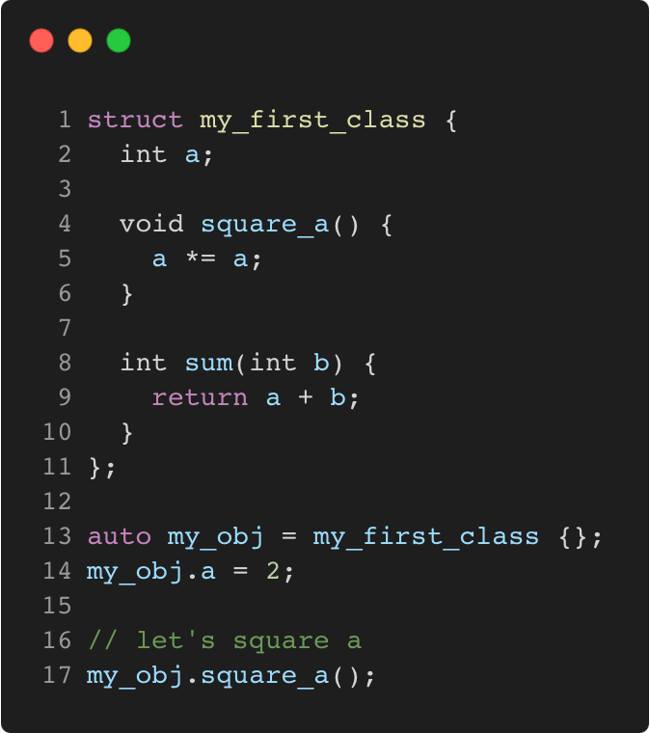
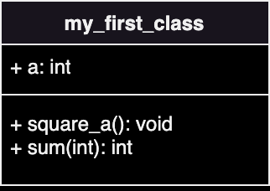
My first class
C++11
Object Oriented Programming | Objects and classes
Gammasoft
Modern C++ Course

Slide 13
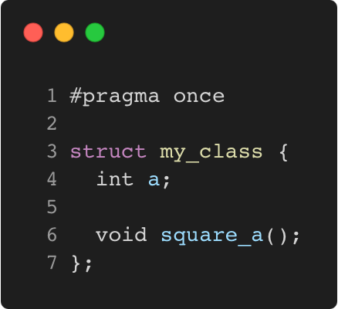
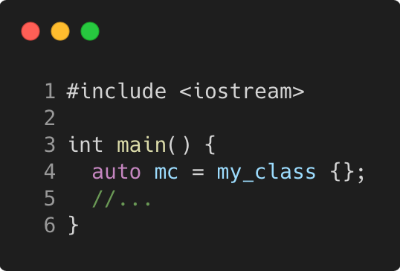
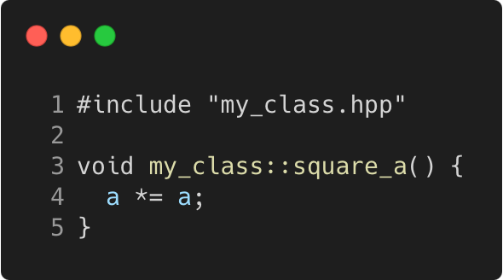
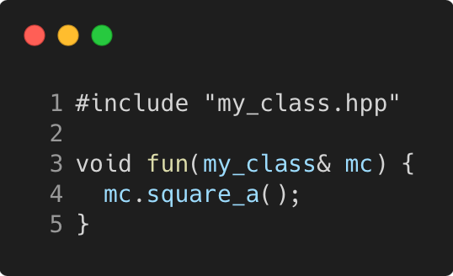
Separating the interface
C++11
Object Oriented Programming | Objects and classes
Header: my_class.hpp
User 1: main.cpp
Implementation: my_class.cpp
User 2: fun.cpp
Gammasoft
Modern C++ Course

Slide 14
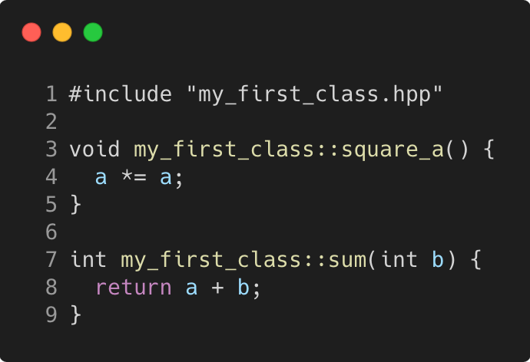
Implementing methods
C++98
Object Oriented Programming | Objects and classes
Good practice
usually in .cpp, outside of class declaration
using the class name as “namespace”
short member functions can be in the header
some functions (templates, constexpr) must be in the header
Gammasoft
Modern C++ Course

Slide 15
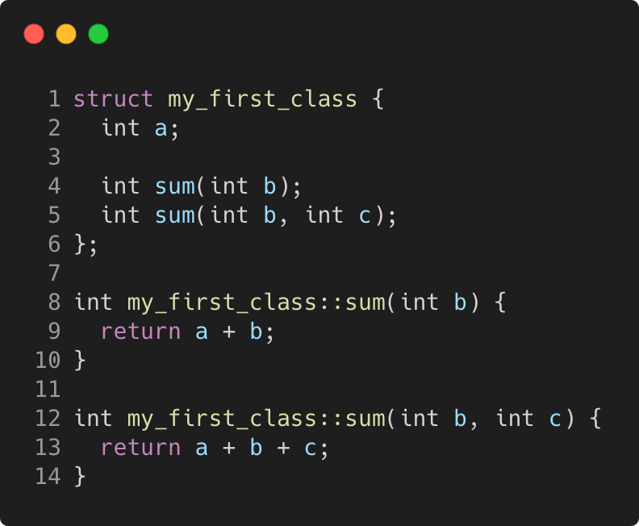
Method overloading
C++98
Object Oriented Programming | Objects and classes
The rules in C++
overloading is authorized and welcome
signature is part of the method identity
but not the return type
Gammasoft
Modern C++ Course

Slide 16
Objects Oriented Programming (OOP)
Objects Oriented Programming
Gammasoft
Modern C++ Course
Objects and classes
Inheritance
Constructors / Destructors
Static members
Allocating objects
Advanced Object Oriented
Type casing
Operator overloading
Function objects
Name Lookups

Slide 17
Objects Oriented Programming (OOP)
Objects Oriented Programming
Gammasoft
Modern C++ Course
Objects and classes
Inheritance
Constructors / Destructors
Static members
Allocating objects
Advanced Object Oriented
Type casing
Operator overloading
Function objects
Name Lookups

Slide 18
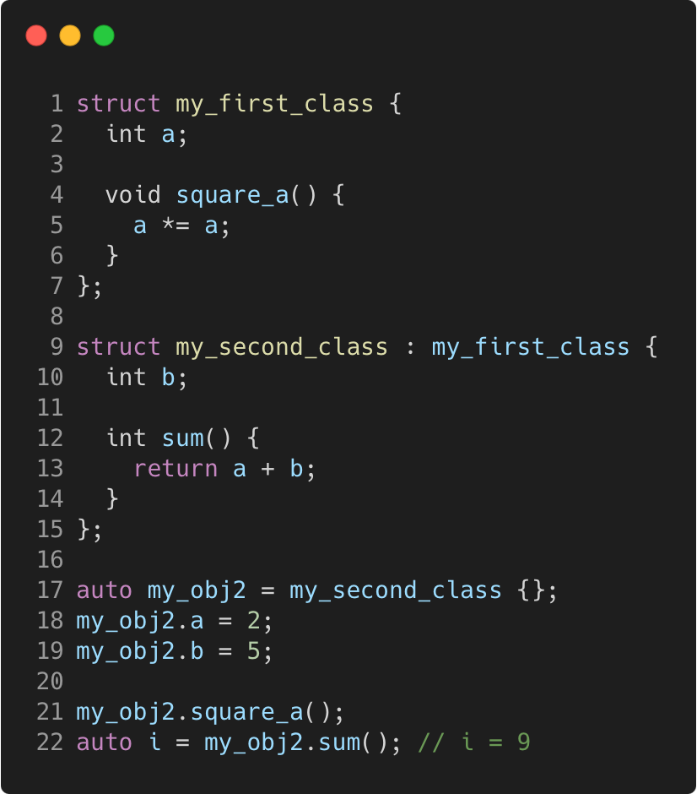
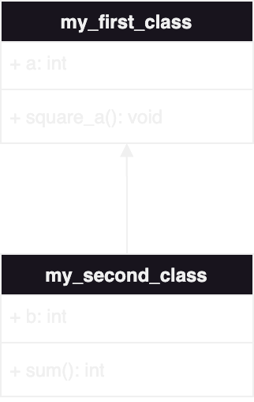
First inheritance
C++11
Object Oriented Programming | Inheritance
Gammasoft
Modern C++ Course

Slide 19
First inheritance
C++11
Object Oriented Programming | Inheritance
Memory layout
 | 0x3010
 | 0x300C
 | 0x3008
 | 0x3004
 | 0x3000
Gammasoft
Modern C++ Course

Slide 20
First inheritance
C++11
Object Oriented Programming | Inheritance
Memory layout
 | 0x3010
 | 0x300C
 | 0x3008
b = ? | 0x3004
a = ? | 0x3000
{
my_obj2
Gammasoft
Modern C++ Course

Slide 21
First inheritance
C++11
Object Oriented Programming | Inheritance
Memory layout
 | 0x3010
 | 0x300C
 | 0x3008
b = ? | 0x3004
a = 2 | 0x3000
{
my_obj2
Gammasoft
Modern C++ Course

Slide 22
First inheritance
C++11
Object Oriented Programming | Inheritance
Memory layout
 | 0x3010
 | 0x300C
 | 0x3008
b = 5 | 0x3004
a = 2 | 0x3000
{
my_obj2
Gammasoft
Modern C++ Course

Slide 23
First inheritance
C++11
Object Oriented Programming | Inheritance
Memory layout
 | 0x3010
 | 0x300C
 | 0x3008
b = 5 | 0x3004
a = 4 | 0x3000
{
my_obj2
Gammasoft
Modern C++ Course

Slide 24
First inheritance
C++11
Object Oriented Programming | Inheritance
Memory layout
 | 0x3010
 | 0x300C
i = 9 | 0x3008
b = 5 | 0x3004
a = 4 | 0x3000
{
my_obj2
Gammasoft
Modern C++ Course

Slide 25
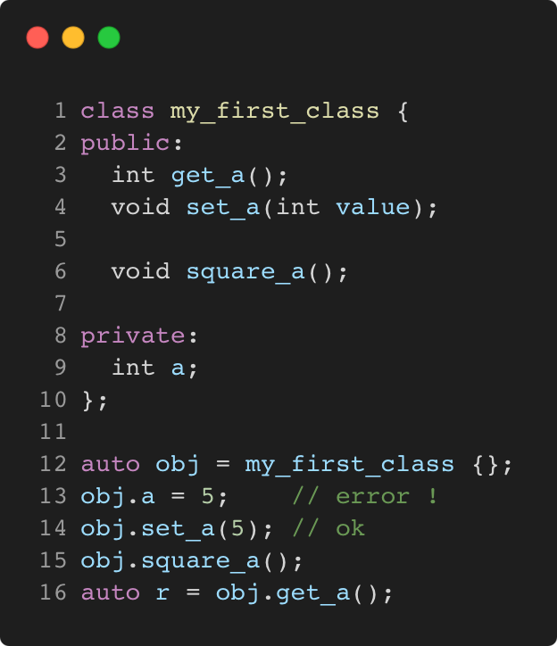
Managing access to class members
C++11
Object Oriented Programming | Inheritance
public / private keywords
private allows access only within the class
public allows access from anywhere
The default for class is private
The default for struct is public
Gammasoft
Modern C++ Course

Slide 26
Managing access to class members
C++11
Object Oriented Programming | Inheritance
public / private keywords
private allows access only within the class
public allows access from anywhere
The default for class is private
The default for struct is public
This break my_second_class !
Gammasoft
Modern C++ Course

Slide 27
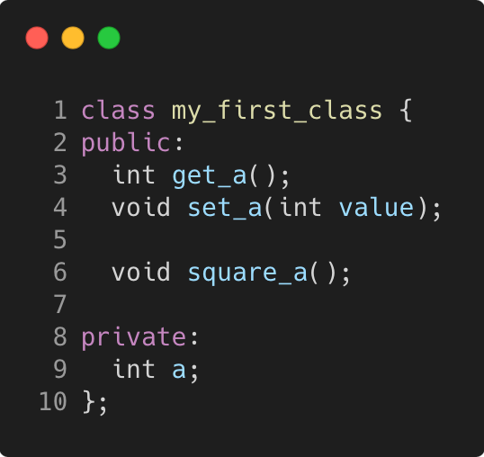
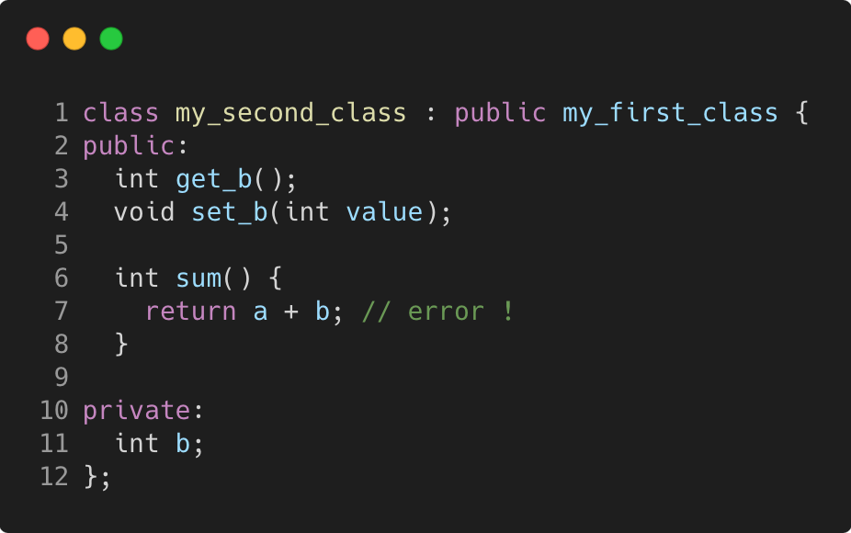
a is not accessible in the sum function
C++98
Object Oriented Programming | Inheritance
Gammasoft
Modern C++ Course

Slide 28
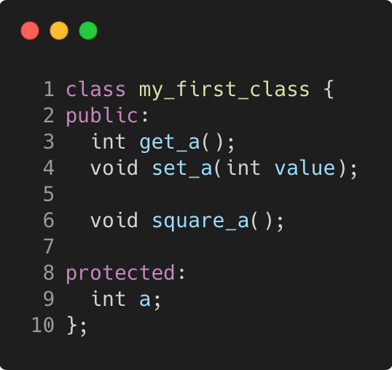
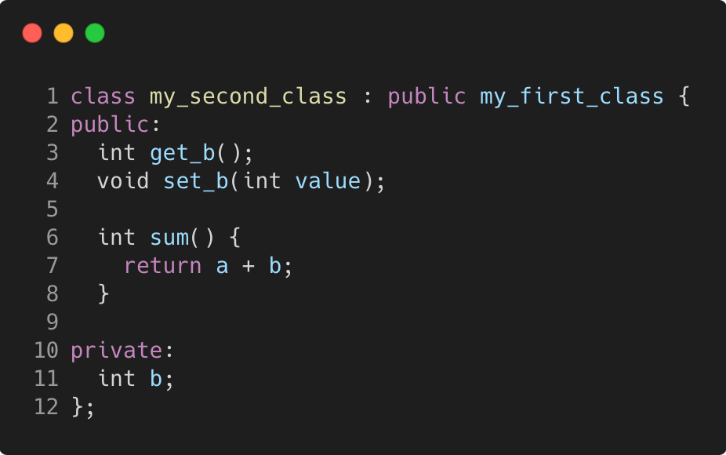
Solution is protected keyword
C++98
Object Oriented Programming | Inheritance
Gammasoft
Modern C++ Course

Slide 29
Inheritance can be public, protected
or private
C++98
Object Oriented Programming | Inheritance
It influences the privacy of inherited members for external code.
The code of the class itself is not affected
public privacy of inherited members remains unchanged
protected inherited public members are seen as protected
private all inherited members are seen as private. This is the default for classes if nothing is specified
Gammasoft
Modern C++ Course

Slide 30
Inheritance can be public, protected
or private
C++98
Object Oriented Programming | Inheritance
Net result for external code
only public members of public inheritance are accessible
Net result for code in derived classes
only public and protected members of public and protected
parents are accessible
Gammasoft
Modern C++ Course

Slide 31
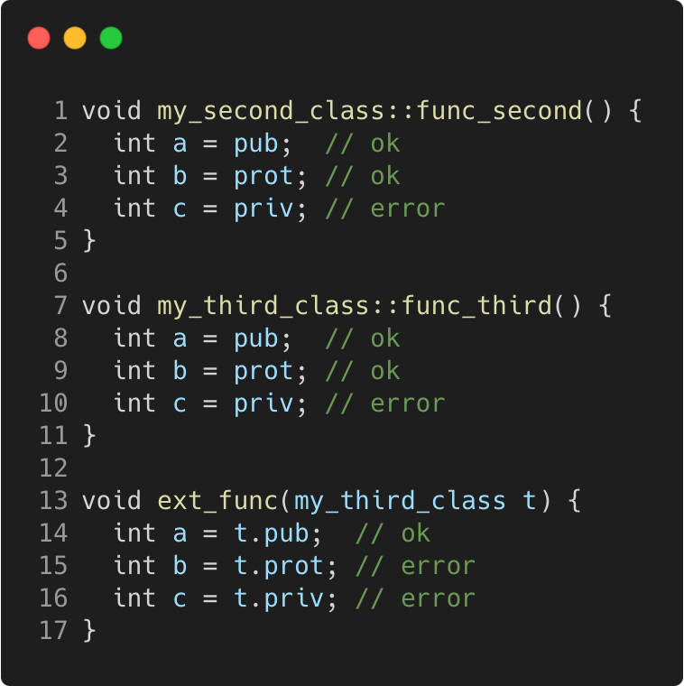
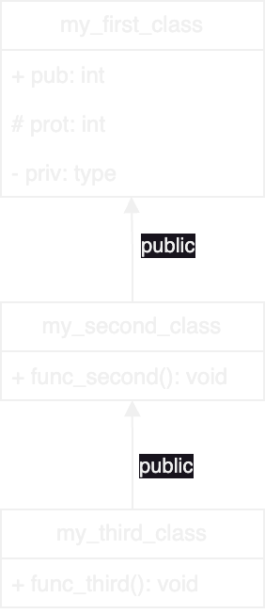
Managing inheritance privacy - public
C++98
Object Oriented Programming | Inheritance
Gammasoft
Modern C++ Course

Slide 32
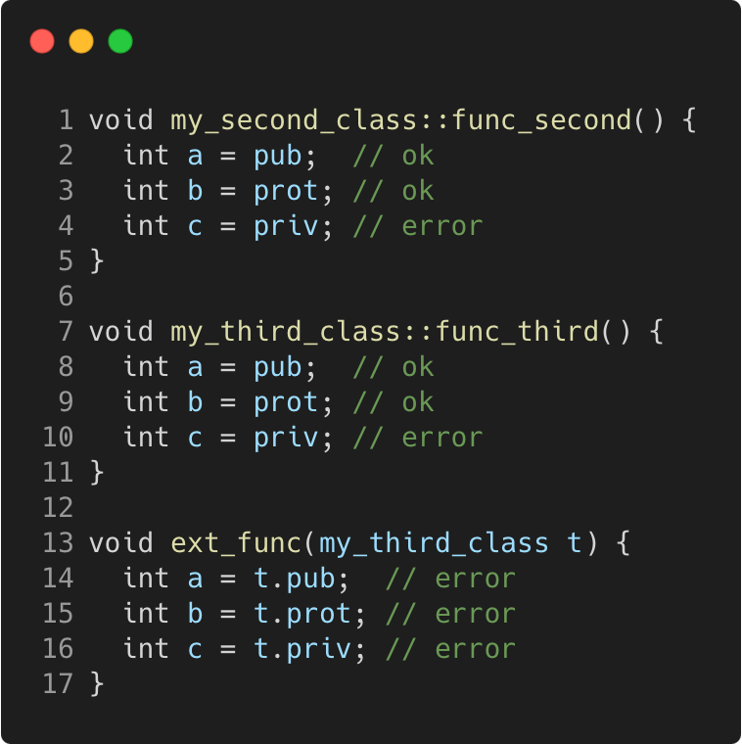
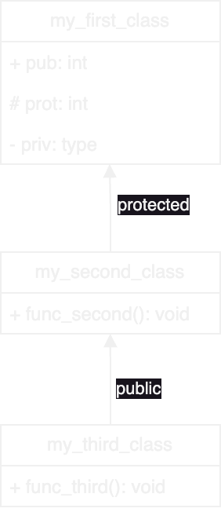
Managing inheritance privacy - protected
C++98
Object Oriented Programming | Inheritance
Gammasoft
Modern C++ Course

Slide 33
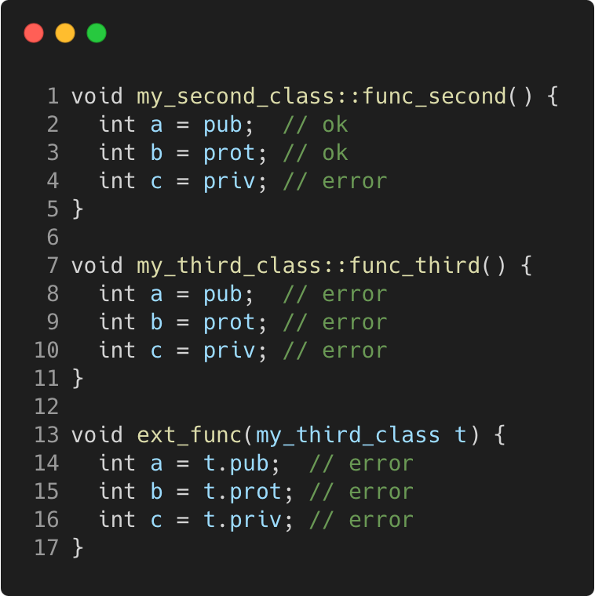
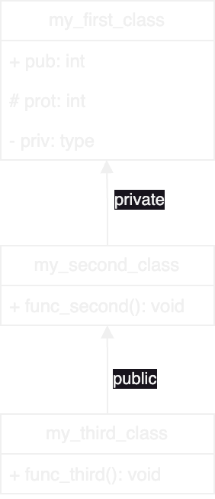
Managing inheritance privacy - private
C++98
Object Oriented Programming | Inheritance
Gammasoft
Modern C++ Course

Slide 34
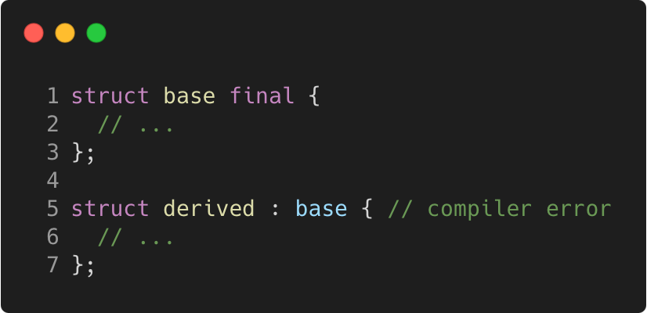
Final class
C++11
Object Oriented Programming | Inheritance
Idea
make sure you cannot inherit from a given class
by declaring it final
Gammasoft
Modern C++ Course

Slide 35
Objects Oriented Programming (OOP)
Objects Oriented Programming
Gammasoft
Modern C++ Course
Objects and classes
Inheritance
Constructors / Destructors
Static members
Allocating objects
Advanced Object Oriented
Type casing
Operator overloading
Function objects
Name Lookups

Slide 36
Objects Oriented Programming (OOP)
Objects Oriented Programming
Gammasoft
Modern C++ Course
Objects and classes
Inheritance
Constructors / Destructors
Static members
Allocating objects
Advanced Object Oriented
Type casing
Operator overloading
Function objects
Name Lookups

Slide 37
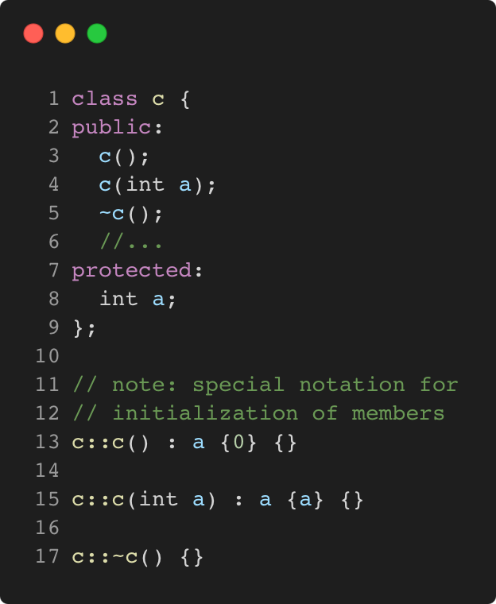
Class constructors and destructors
C++11
Object Oriented Programming | Constructors / Destructors
Concept
special functions called when building/destroying an object
a class can have several constructors, but only one destructor
the constructors have the same name as the class
same for the destructor with a leading ~
Gammasoft
Modern C++ Course

Slide 38
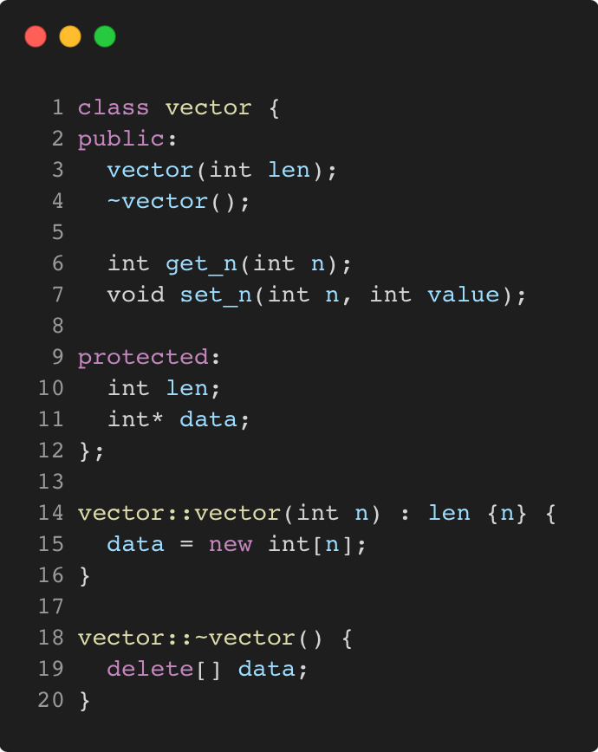
Class constructors and destructors
C++11
Object Oriented Programming | Constructors / Destructors
Gammasoft
Modern C++ Course

Slide 39
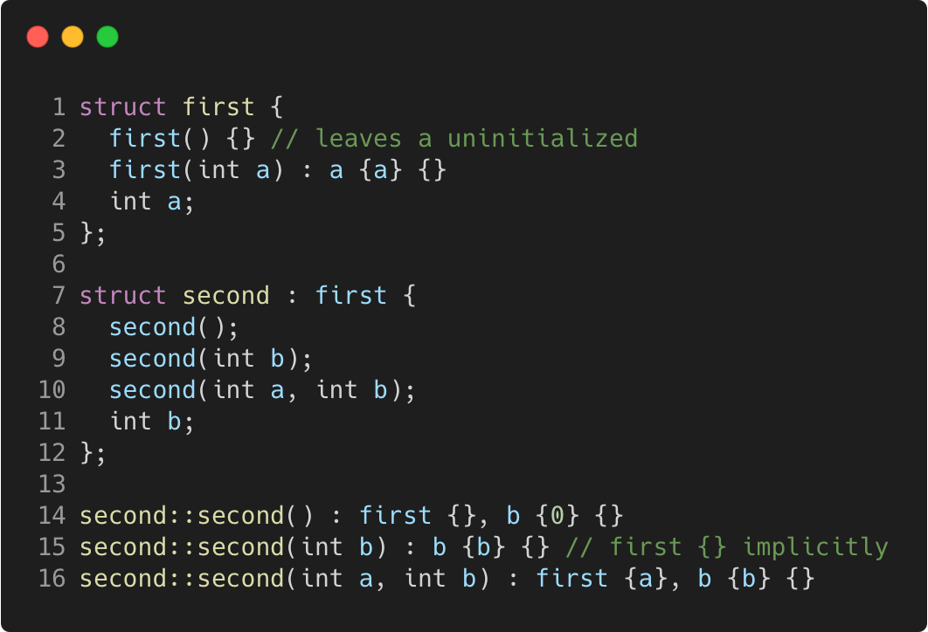
Constructors and inheritance
C++11
Object Oriented Programming | Constructors / Destructors
Gammasoft
Modern C++ Course

Slide 40
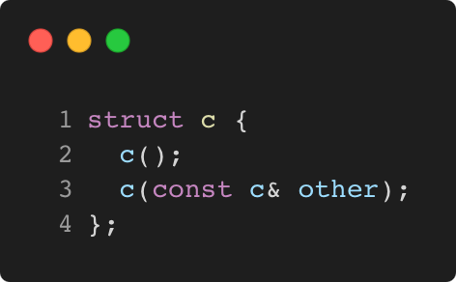
Copy constructor
C++11
Object Oriented Programming | Constructors / Destructors
Concept
special constructor called for replicating an object
takes a single parameter of type const & to class
provided by the compiler if not declared by the user
Gammasoft
Modern C++ Course

Slide 41
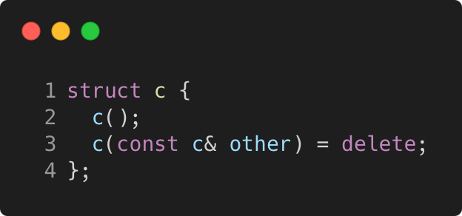
Copy constructor
C++11
Object Oriented Programming | Constructors / Destructors
Concept
special constructor called for replicating an object
takes a single parameter of type const & to class
provided by the compiler if not declared by the user
in order to forbid copy, use = delete (or private copy constructor with no implementation in C++ 98)
Gammasoft
Modern C++ Course

Slide 42
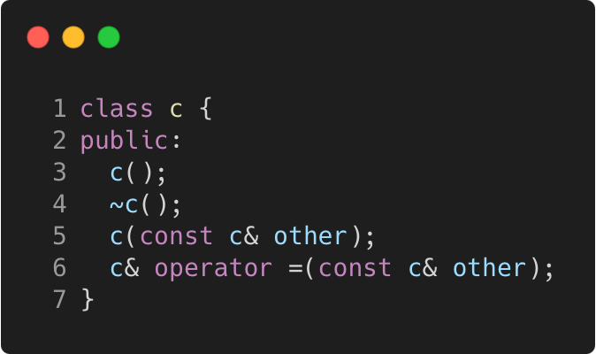
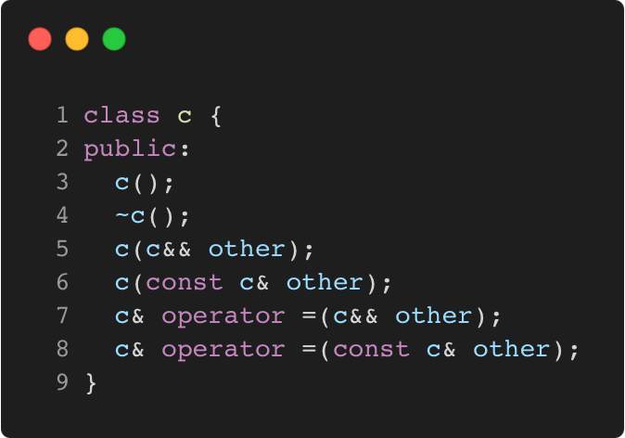
Good practice
C++11
Object Oriented Programming | Constructors / Destructors
The rule of 3/5 (C++ 98/11) - cppreference
if a class needs a custom destructor, a copy/move constructor or a copy/move assignment operator, it should have all three/five.
Gammasoft
Modern C++ Course

Slide 43
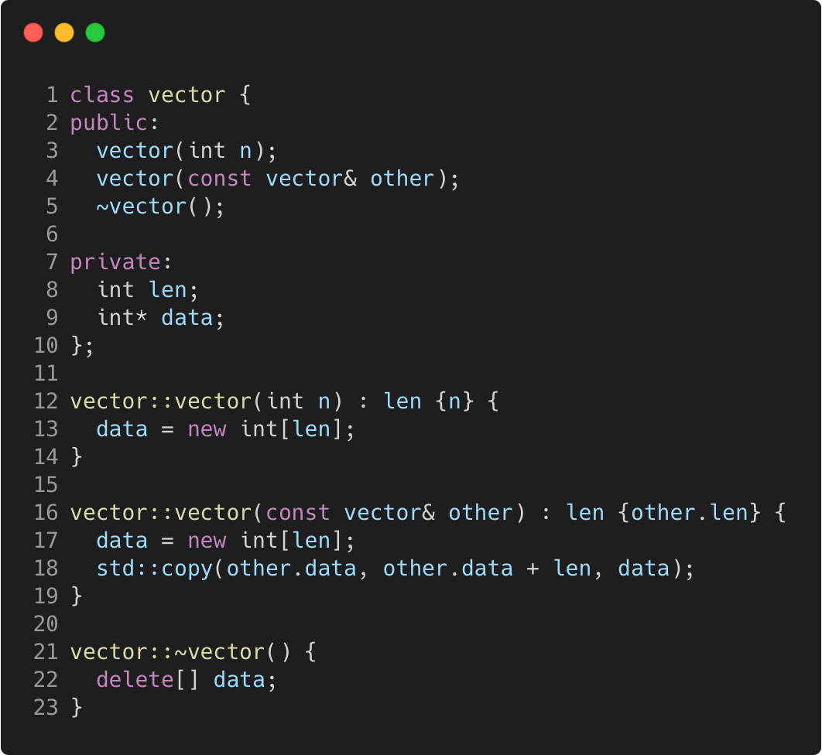
Copy constructor
C++11
Object Oriented Programming | Constructors / Destructors
Gammasoft
Modern C++ Course

Slide 44
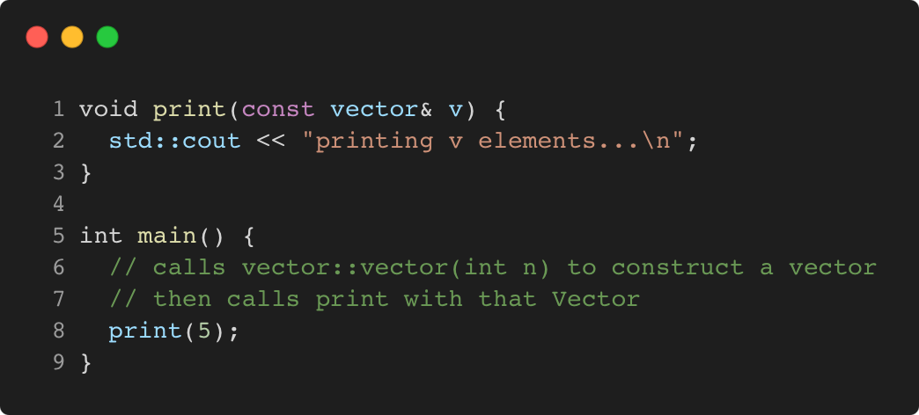
Explicit unary constructor
C++98
Object Oriented Programming | Constructors / Destructors
Concept
A constructor with a single non-default parameter can be used
by the compiler for an implicit conversion.
Gammasoft
Modern C++ Course

Slide 45
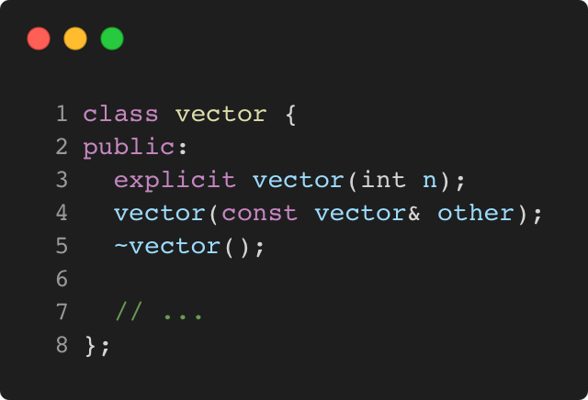
Explicit unary constructor
C++98
Object Oriented Programming | Constructors / Destructors
Concept
The keyword explicit forbids such implicit conversions.
It is recommended to use it systematically, except in special cases.
Gammasoft
Modern C++ Course

Slide 46
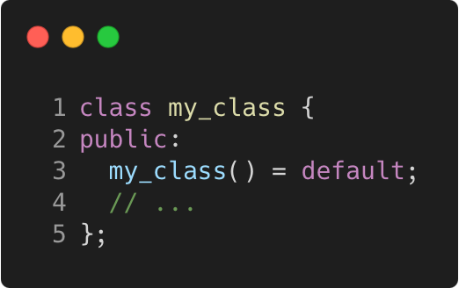
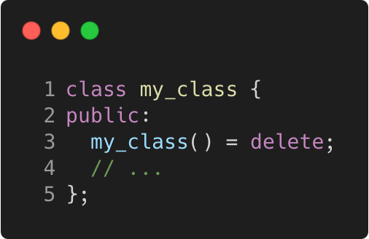
Defaulted constructor
C++11
Object Oriented Programming | Constructors / Destructors
Idea
avoid empty default constructors like class_name() {}
declare them as = default
Details
without a user-defined constructor, a default one is provided
any user-defined constructor disables the default one
but the default one can be requested explicitly
rule can be more subtle depending on data members
Gammasoft
Modern C++ Course

Slide 47
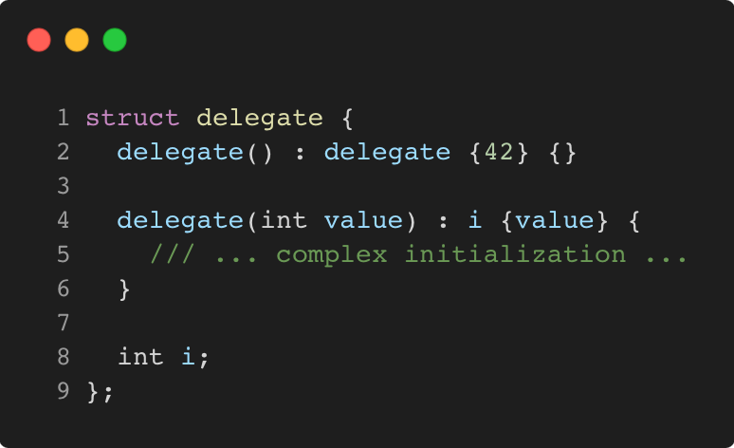
Delegating constructor
C++11
Object Oriented Programming | Constructors / Destructors
Idea
avoid replication of code in several constructors
by delegating to another constructor, in the initialization list
Gammasoft
Modern C++ Course

Slide 48
Objects Oriented Programming (OOP)
Objects Oriented Programming
Gammasoft
Modern C++ Course
Objects and classes
Inheritance
Constructors / Destructors
Static members
Allocating objects
Advanced Object Oriented
Type casing
Operator overloading
Function objects
Name Lookups

Slide 49
Objects Oriented Programming (OOP)
Objects Oriented Programming
Gammasoft
Modern C++ Course
Objects and classes
Inheritance
Constructors / Destructors
Static members
Allocating objects
Advanced Object Oriented
Type casing
Operator overloading
Function objects
Name Lookups

Slide 50
C++98
Object Oriented Programming | Static members
Gammasoft
Modern C++ Course

Slide 51
Objects Oriented Programming (OOP)
Objects Oriented Programming
Gammasoft
Modern C++ Course
Objects and classes
Inheritance
Constructors / Destructors
Static members
Allocating objects
Advanced Object Oriented
Type casing
Operator overloading
Function objects
Name Lookups

Slide 52
Objects Oriented Programming (OOP)
Objects Oriented Programming
Gammasoft
Modern C++ Course
Objects and classes
Inheritance
Constructors / Destructors
Static members
Allocating objects
Advanced Object Oriented
Type casing
Operator overloading
Function objects
Name Lookups

Slide 53
C++98
Object Oriented Programming | Allocating objects
Gammasoft
Modern C++ Course

Slide 54
Objects Oriented Programming (OOP)
Objects Oriented Programming
Gammasoft
Modern C++ Course
Objects and classes
Inheritance
Constructors / Destructors
Static members
Allocating objects
Advanced Object Oriented
Type casing
Operator overloading
Function objects
Name Lookups

Slide 55
Objects Oriented Programming (OOP)
Objects Oriented Programming
Gammasoft
Modern C++ Course
Objects and classes
Inheritance
Constructors / Destructors
Static members
Allocating objects
Advanced Object Oriented
Type casing
Operator overloading
Function objects
Name Lookups

Slide 56
C++98
Object Oriented Programming | Advanced Object Oriented
Gammasoft
Modern C++ Course

Slide 57
Objects Oriented Programming (OOP)
Objects Oriented Programming
Gammasoft
Modern C++ Course
Objects and classes
Inheritance
Constructors / Destructors
Static members
Allocating objects
Advanced Object Oriented
Type casing
Operator overloading
Function objects
Name Lookups

Slide 58
Objects Oriented Programming (OOP)
Objects Oriented Programming
Gammasoft
Modern C++ Course
Objects and classes
Inheritance
Constructors / Destructors
Static members
Allocating objects
Advanced Object Oriented
Type casing
Operator overloading
Function objects
Name Lookups

Slide 59
C++98
Object Oriented Programming | Type casing
Gammasoft
Modern C++ Course

Slide 60
Objects Oriented Programming (OOP)
Objects Oriented Programming
Gammasoft
Modern C++ Course
Objects and classes
Inheritance
Constructors / Destructors
Static members
Allocating objects
Advanced Object Oriented
Type casing
Operator overloading
Function objects
Name Lookups

Slide 61
Objects Oriented Programming (OOP)
Objects Oriented Programming
Gammasoft
Modern C++ Course
Objects and classes
Inheritance
Constructors / Destructors
Static members
Allocating objects
Advanced Object Oriented
Type casing
Operator overloading
Function objects
Name Lookups

Slide 62
C++98
Object Oriented Programming | Operator overloading
Gammasoft
Modern C++ Course

Slide 63
Objects Oriented Programming (OOP)
Objects Oriented Programming
Gammasoft
Modern C++ Course
Objects and classes
Inheritance
Constructors / Destructors
Static members
Allocating objects
Advanced Object Oriented
Type casing
Operator overloading
Function objects
Name Lookups

Slide 64
Objects Oriented Programming (OOP)
Objects Oriented Programming
Gammasoft
Modern C++ Course
Objects and classes
Inheritance
Constructors / Destructors
Static members
Allocating objects
Advanced Object Oriented
Type casing
Operator overloading
Function objects
Name Lookups

Slide 65
C++98
Object Oriented Programming | Function objects
Gammasoft
Modern C++ Course

Slide 66
Objects Oriented Programming (OOP)
Objects Oriented Programming
Gammasoft
Modern C++ Course
Objects and classes
Inheritance
Constructors / Destructors
Static members
Allocating objects
Advanced Object Oriented
Type casing
Operator overloading
Function objects
Name Lookups

Slide 67
Objects Oriented Programming (OOP)
Objects Oriented Programming
Gammasoft
Modern C++ Course
Objects and classes
Inheritance
Constructors / Destructors
Static members
Allocating objects
Advanced Object Oriented
Type casing
Operator overloading
Function objects
Name Lookups

Slide 68
C++98
Object Oriented Programming | Name Lookups
Gammasoft
Modern C++ Course

Slide 69
Objects Oriented Programming (OOP)
Objects Oriented Programming
Gammasoft
Modern C++ Course
Objects and classes
Inheritance
Constructors / Destructors
Static members
Allocating objects
Advanced Object Oriented
Type casing
Operator overloading
Function objects
Name Lookups

Slide 70
Objects Oriented Programming (OOP)
Objects Oriented Programming
Gammasoft
Modern C++ Course
Objects and classes
Inheritance
Constructors / Destructors
Static members
Allocating objects
Advanced Object Oriented
Type casing
Operator overloading
Function objects
Name Lookups

Slide 71
Outline
Introduction
Language Basics
Object Oriented Programming (OOP)
Core Modern C++
Modern C++ Expert
Advanced Programming
Gammasoft
Modern C++ Course

Slide 72
End
Gammasoft
Modern C++ Course

