Slide 1
Case Study: 10
Dashboard for Business Insights
GamyaShree.V

Slide 2
Scenario:
GTS needs an interactive dashboard to track job applications, hires, payments, and training enrollments.
Tasks:
● Aggregate data from different sources.
● Design visualizations to track key business metrics.
● Implement a BI dashboard using Power BI/Tableau.

Slide 3
Approach
Used ETL approach with python and power bi
Extract the Data
Transform the Data
Load the Data
Visualizations
Why?
Because this approach helps to clean the data better and handle large datasets using Python which makes it smoother and seamless for power Bi to load the cleaned data. Hence, this provide accurate and better visuals

Slide 4
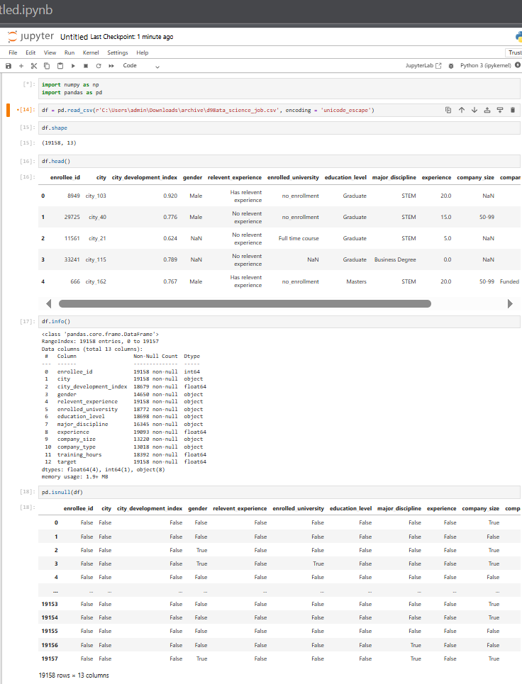
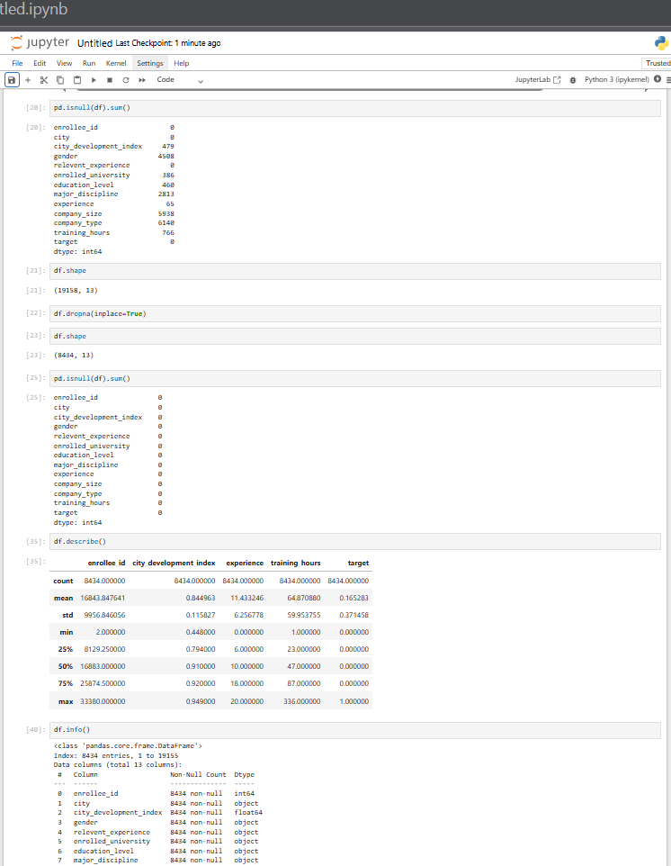
Data cleaning :
Data is cleaned using the python

Slide 5
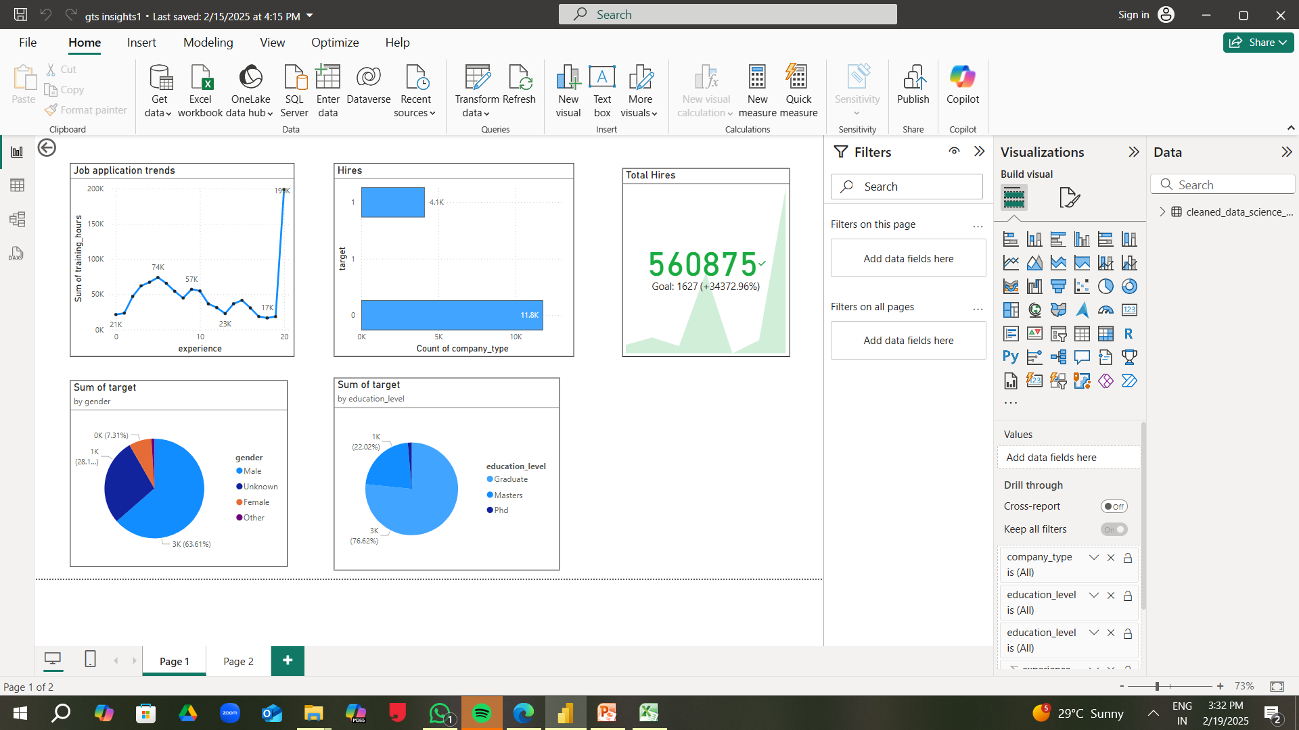
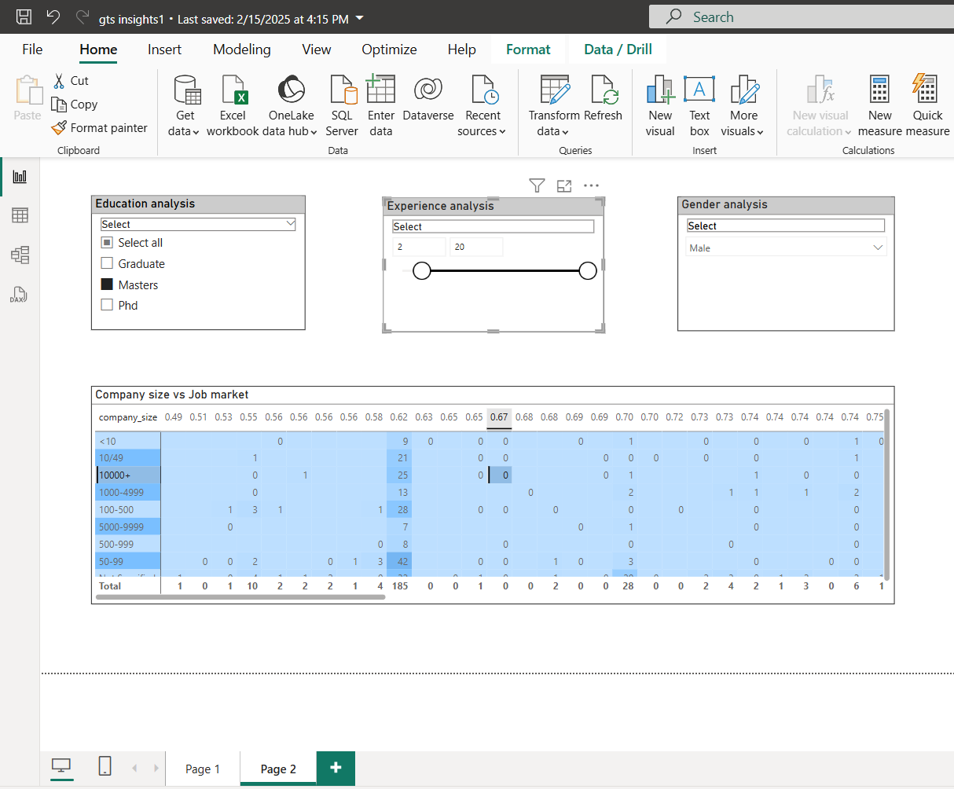
Visualization:
Created Key Visuals using Power Bi

