Slide 1
Automatics Vehicle Licence Plate Recognation
150208058
Gamze YILMAZ

Slide 2
Contents
Methodology
Pre-processed image
Segmentation of the image
Binarization of the pre-processed image
Calculation of intensities by rows
Crop the image
Location and extraction of the licence plate
Morphological transformations
Edge detection
Image convulsion
Calculation and extraction of regions
Removal of the licence plate
5. References

Slide 3
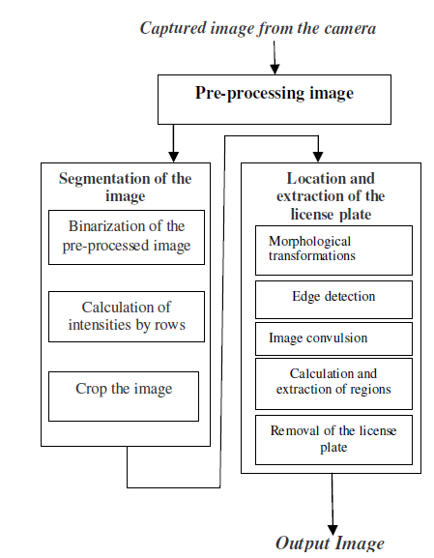
1. Methodology

Slide 4
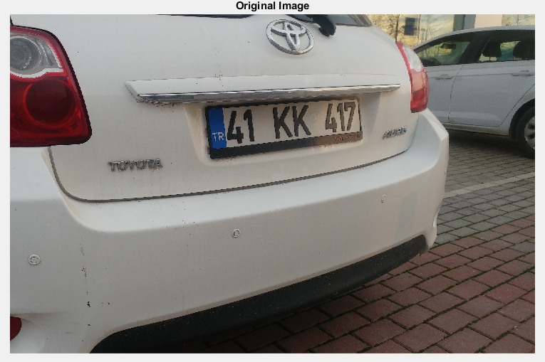

Slide 5
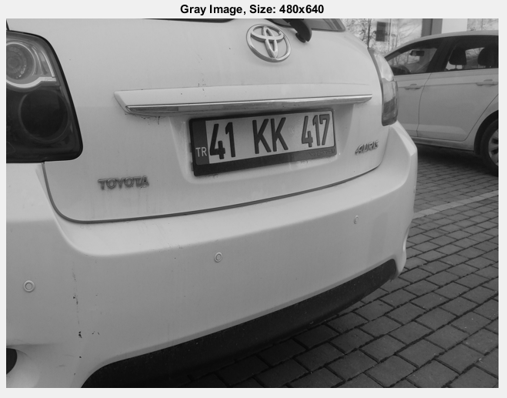
2. Pre-Processed Image
In this case, the image is scaled to a size of 480 × 640. Then, we proceed to the conversion of the image grayscale.

Slide 6
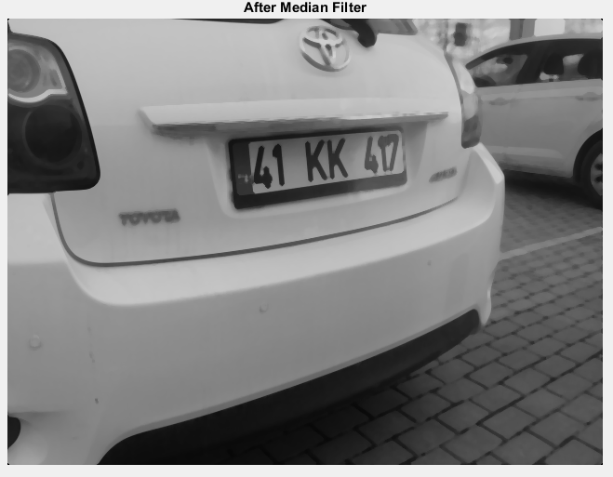
The result of this process is an image with less noise and greater smoothing.

Slide 7
3. Segmentation of the image 3.1 Binarization of the pre-processed image
A process of binarization is applied to the resulting image of the pre-processing in order to detect its edges. In this case, the image is processed using the Canny algorithm. This algorithm is based on the theory of first derivative operators and is especially useful since, in addition to extracting edges, it closes the contours avoiding possible ruptures.

Slide 8
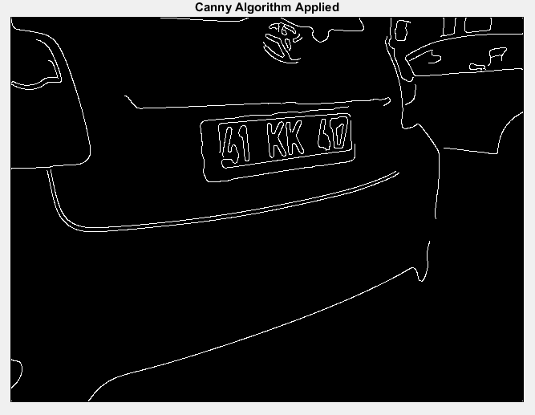

Slide 9
3.2 Calculation of intensities by rows
For each row, its value will be increased by 1 (starting from 0) as long as we meet some of the following patterns in their pixels: (0, 0, 1) or (1, 0, 1).
The idea is to penalize those areas with continuous borders or without borders and favors those
rows with discontinuous edges, a pattern that will follow
the numbers of a license plate.

Slide 10
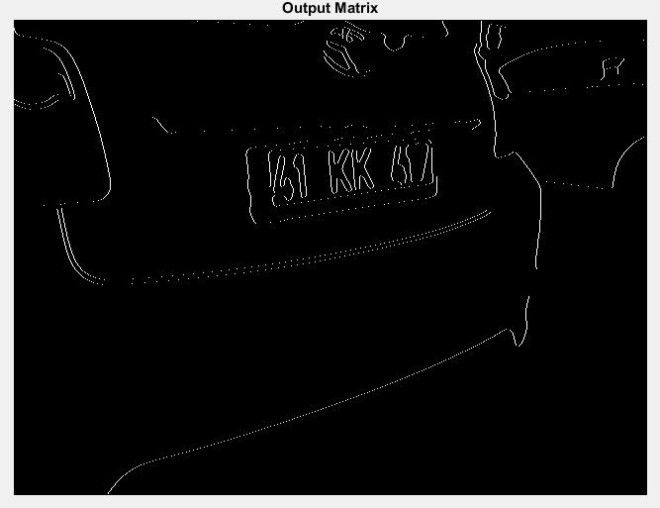

Slide 11
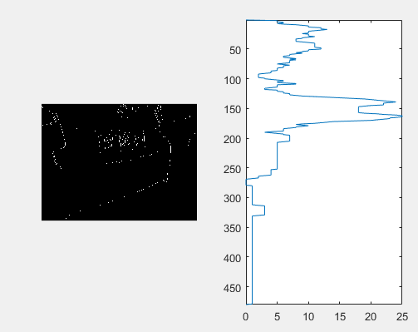

Slide 12
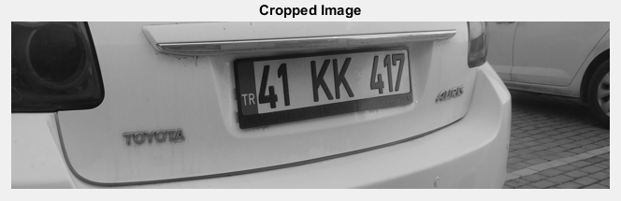
3.3 Crop the image

Slide 13
4. Location and extraction of the licence plate
4.1 Morphological transformations
4.2 Edge detection
4.3 Image convulsion
4.4 Calculation and extraction of regions
4.5 Removal of the licence plate

Slide 14
4.1 Morphological transformations
We’ll perform a series of morphological transformations in the image.
These transformations will allow us to soften the edges of the different regions of the image (specifically the region of the license plate), separate the different regions and facilitate their computation.

Slide 15
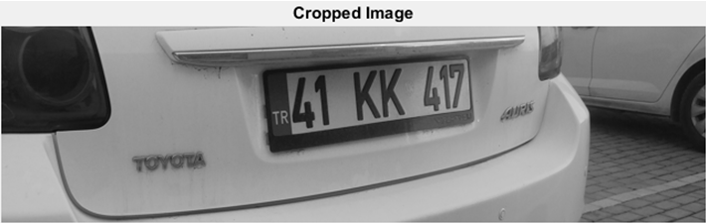
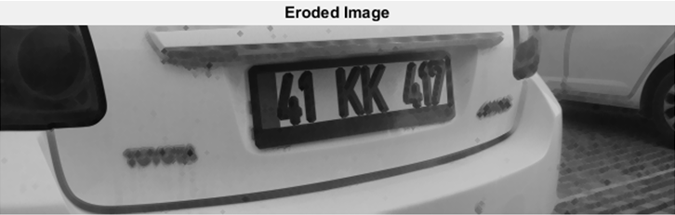
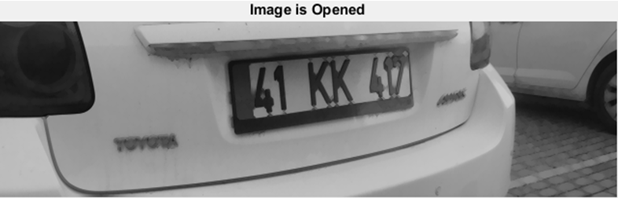

Slide 16
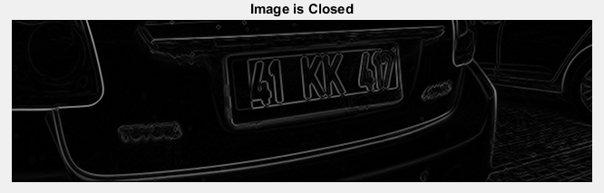

Slide 17
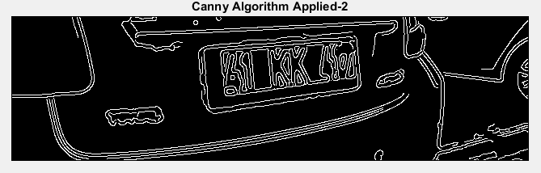
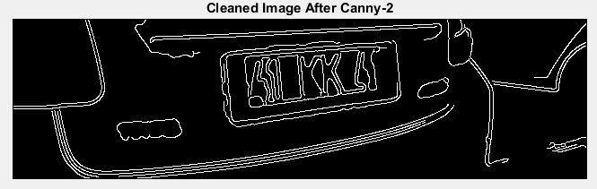
4.2 Edge detection

Slide 18
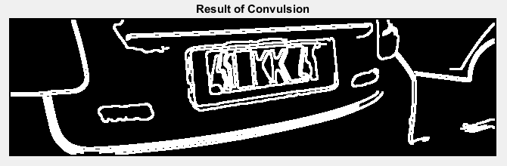
4.3 Image convulsion
In order to facilitate the detection of the regions, a convulsion process is performed in the binarized image.
This will serve to soften the image and reduce the number of connected
convulsion components.
The following filter applied to the binary image
msk=[0 0 0 0 0; 0 1 1 1 0; 0 1 1 1 0; 0 1 1 1 0; 0 0 0 0 0]

Slide 19
4.4 Calculation and extraction of regions
The process consists of several steps:
We label the connected regions. In our case, we
also indicate that the connected regions must
have at least 8 connected objects.
2. The second step is to fill in the connected
regions.
3. Finally, the regions are identified.

Slide 20
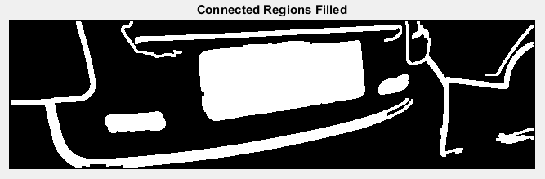

Slide 21
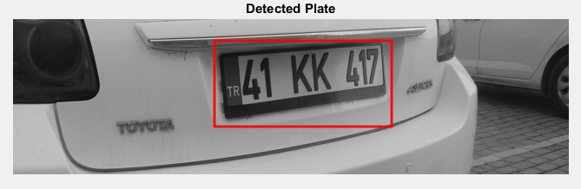
4.5 Removal of the licence plate

Slide 22
5. References
[1] www.IJCSN.org
[2] https://www.mathworks.com/matlabcentral/fileexchange/
[3] http://ijcsn.org/IJCSN-2017/6-6/Automatics-Vehicle-License-Plate-Recognition-using-MATLAB.pdf

