Slide 1

The Virtues of Conflict : Analysing Modern Concurrency
Ganesh Narayanaswamy‚ Saurabh Joshi and Daniel Kroening

Slide 2
A Tale in Three Parts: Problem, Semantics and Analysis
C programs with assertions
Weak
Memory
Semantics
Static Analysis
True Concurrency
BMC &
SAT Solvers
WALCYRIE

Slide 3
Problem
C programs with assertions
Weak
Memory

Slide 4
Weak Memory Consistency
Modern processors relax the textual, total program order
Reordering of memory operations improve the performance dramatically
Accounts for 10 to 40% of the performance
We will focus on TSO & PSO
Sequential Consistency (SC): textual, total, unrelaxed program order
But such reorderings lead to…
State space explosion
Highly unintuitive language interactions
Non-deterministic, subtle bugs

Slide 5

Total Store Order : TSO
Total Store order (TSO) : R/W relaxation

Slide 6


An Example : TSO
A `Naïve’ view
x86’s view
x = 0; y = 0
Wx
Wx
T1:
x = 1
a = y
T2:
y = 1
b = x
$$⊆$$
Wy
Wy
Wx
Wx
Wx
Ry
Wy
Rx
✗
assert(a==1|| b==1)
Ry
Ry
Preserved Program Order (PPO) = Textual Program Order that is preserved

Slide 7

Partial Store Order : PSO
Partial Store order (PSO) : R/W, W/W relaxation

Slide 8

Our intermediate form
x = 0; y = 0
Wx
T1:
x = 1
a = y
T2:
y = 1
b = x
Wy
TSO
Wx
Ry
Wy
Rx
assert(a==1|| b==1)
Concurrent SSA Events : Wx, Ry … Guards : guard(Wx)
Happens before/PPO : Potential matches :

Slide 9
Semantics
C programs with assertions
Weak
Memory
Semantics
True
Concurrency

Slide 10












What is concurrency?
conflict
SAT!
(declarative)
$$⟦a||b⟧ ≜ ¬\left(a<b\right)∧¬\left(a\#b\right)∗$$
$$a$$
$$b$$
truly concurrent semantics
happens-before
$$?$$
$$⟦a||b⟧ =$$
induitively: Partial Order Reduction
.
choice
$$a$$
$$b$$
(enumerative)
$$⟦a||b⟧ ≜a.b | b.a$$
$$|$$
interleaving semantics
$$b$$
$$a$$
sequencing
.
*symmetries assumed

Slide 11



A tale of conflicts…
Trace Equivalence
is often not sufficient
a
a
a
a
a
$$||$$
$$||$$
b
c
c
b
c
c
X
Z
Y
Z
Event structures: integrate conflict & dependence
Branching/Conflict
Matters!
conflict
$⟦a||b⟧ ≜ ¬\left(a<b\right)∧¬\left(a\#b\right)$
Posets: program is a set of posets
happens-before

Slide 12



Our Semantics
General Event Structures based semantics
From Preserved Program Order (PPO), Potential Matches ($M$), and path conditions (guards).
Conflict-aware : path conditions; $e_{1}\# e_{2}⇔ guard\left(e_{1}\right)∧guard\left(e_{2}\right)= ⊥$
Compositional
Per thread Event structures, $Γ_{i}$
⨡$M$
$$⟦P⟧ ≜Γ_{P}=( Γ_{1}×Γ_{2}⋯{×Γ}_{n})$$

Slide 13
Analysis
C programs with assertions
Weak
Memory
Semantics
Static Analysis
True
Concurrency
BMC &
SAT Solvers

Slide 14
BMC & SAT Solvers
Bounded Model Checking
Takes program and an integer k
Depth bound exploration of state space up to k unwindings
Can account for all behaviors up to k
CBMC – C99 Standard
Structures/unions, variable/function pointers, malloc/free, pthreads…
Symbolic representation of the unrolled program
Propositional, fed to the SAT solver to find solutions
Modern SAT solvers can handle diverse, realistic problem instances
HW/SW verification, equivalence/model checking, planning/scheduling

Slide 15
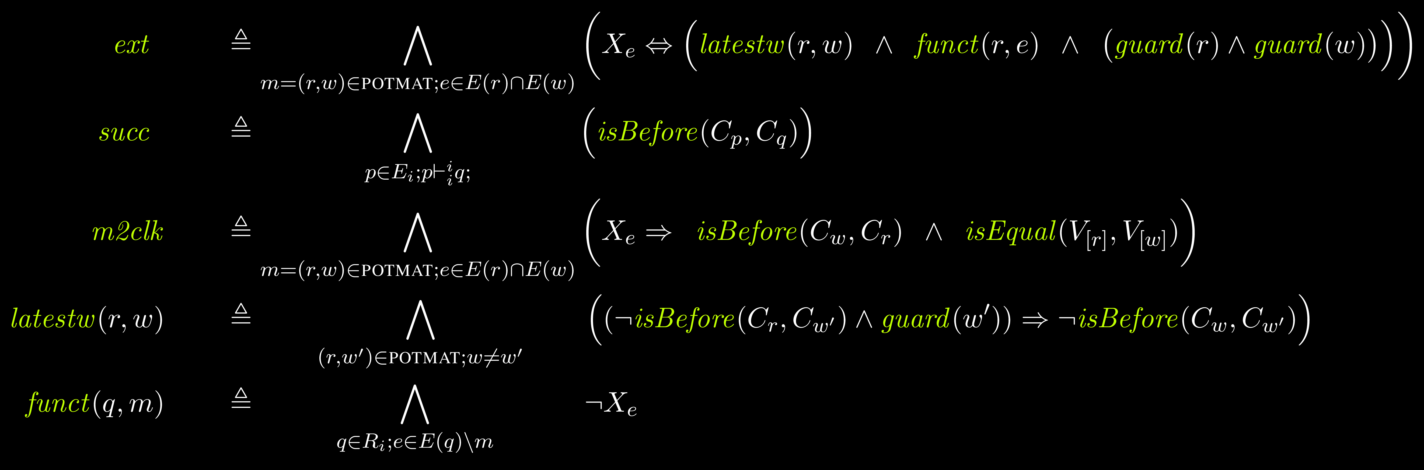
Our Encoding

Slide 16
WALCYRIE
Weak
Memory
True
Concurrency
BMC &
SAT Solvers
WALCYRIE

Slide 17
walcyrie
input C program
Concurrent SSA
goto-symex
Build IR
happens before
potential matches
guards
MiniSAT
Encoding
Counter-example
Boolean Formula

Slide 18
Evaluation
WALCYRIE vs. CBMC-PO
CBMC-PO is based on Partial Orders
Conflict unaware: Semantics of the program is a set of partial orders
WALCYRIE is conflict aware
Benchmarks
Litmus Tests
4000+ small programs that exhibit subtle weak memory behaviors
Verified under 10 secs
SVCOMP ’15
600+ collection of real-world, and realistic code fragments drawn from diverse program domains, from kernel to drivers to database engines.

Slide 19
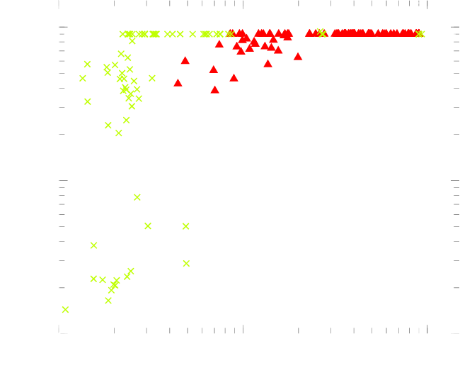
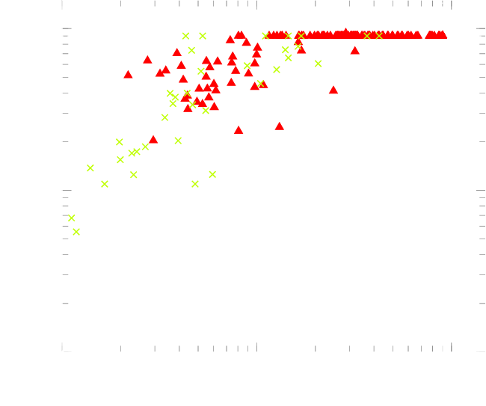

SVCOMP’15 Verification Times : TSO & PSO
TSO
PSO
$×$ UNSAT
SAT

Slide 20
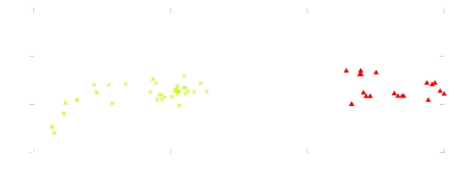
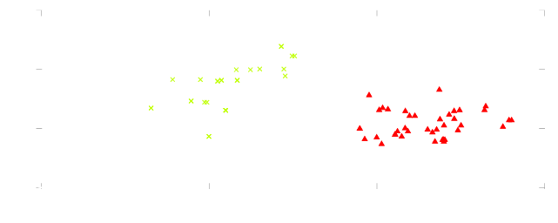



$ρ=\frac{Propagations}{`Conflicts`}$ : TSO & PSO
While(1)
{
Decide : Select some unassigned variable and assign it a value.
Deduce : Infer values of other variables by propagation, and detect `conflicts’
Resolve : learn and back track
}
SAT: higher $ρ$ values
UNSAT: lower $ρ$ values
TSO
PSO

Slide 21

Take Home
True Concurrency: declarative
Conflict Awareness: expressive & efficient
SAT Solvers/Symbolic Methods: effective
Category Theory: unifying
https://github.com/gan237/walcyrie

Slide 22











Unified big picture
$$π_{1}$$
$$π_{2}$$
$$A$$
$A×B$
$$B$$
Objects: Threads, Processes
Morphisms: ‘matches’
$f:Reads→Writes$
$f:Recv→Sends$
$f :Unlock→Locks$
$f :push→pop$
….
Different morphisms yield different categories, but the construction remains the same!
$$!$$
$$f_{1}$$
$$f_{2}$$
$A_{1}×B_{1}$
⨡$M$
$$⟦P⟧ ≜Γ_{P}=( Γ_{1}×Γ_{2}⋯{×Γ}_{n})$$

