Slide 1
DENSITY BASED SMART TRAFFIC CONTROL SYSTEM
PRESENTED BY:
D. GANESH (19TK1A0528)
A. SRINATH (19TK1A0510)
T. PALLAVI (19TK1A05A2)

Slide 2
CONTENT
3
Introduction
4
System Analysis
System Design
6
Modules
11
Conclusion
14

Slide 3
Abstract
3
As the problem of urban traffic congestion intensifies, there is a pressing need for the introduction of advanced technology and equipment to improve the state-of-the-art of traffic control.

Slide 4
Introduction
Some of the works have proposed to allocate time based solely on the density of traffic. But this may be disadvantageous for those who are in lanes that have less frequency of traffic.
In recent years, image processing has shown promising outcomes in acquiring real time traffic information using CCTV footage installed along the traffic light.

Slide 5
System Analysis & Design

Slide 6
System Analysis
Existing System
Different techniques had been proposed, such as infra-red-light sensor, induction loop etc. to acquire traffic date which had their fair share of demerits.
Proposed System
A system to control the traffic by measuring the real-time vehicle density using canny edge detection with digital image processing is proposed.
This imposing traffic control system offers significant improvement in response time, vehicle management, automation, reliability and overall efficiency over the existing systems. ​

Slide 7
System Requirements
Hardware Requirements
System : Pentium IV 2.4 GHz.
Hard Disk : 40 GB.
Floppy Drive : 1.44 Mb.
Monitor : 15 VGA Color.
Mouse : Logitech.
Ram : 512 Mb.
Software Requirements
Operating System : Windows
Coding Language : Python 3.7 ​

Slide 8
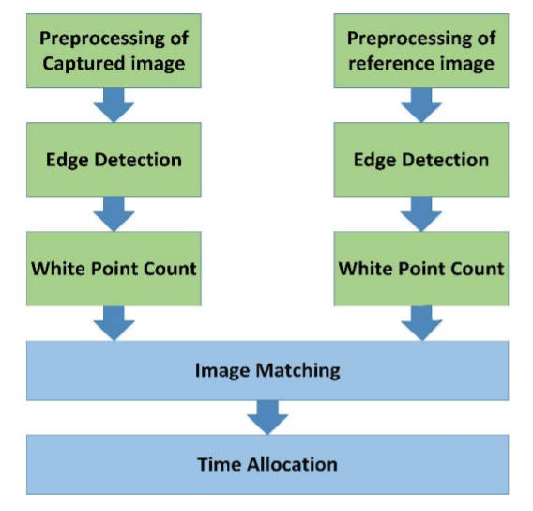
System Architecture

Slide 9
MODULES
Upload Traffic Image
Run EML Algorithm
Image Pre-processing Using Canny Edge Detection
Calculate Green Signal Time Allocation
EML Predict Time
White Pixel Count

Slide 10
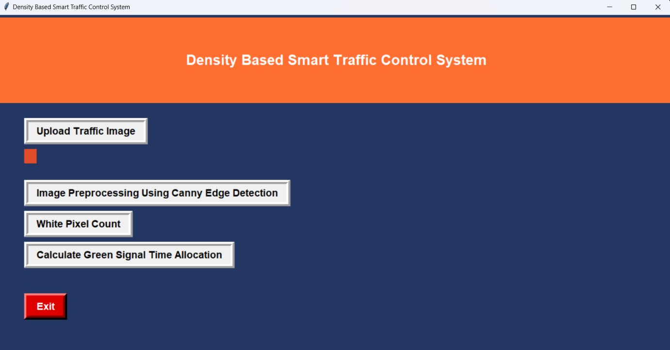
GUI Interface

Slide 11
Conclusion
A smart traffic control system availing image processing as an instrument for measuring the density has been proposed.
Besides explaining the limitations of current near obsolete traffic control system, the advantages of proposed traffic control system have been demonstrated.
​

Slide 12
Thank you

