Slide 1


Phishing Website Detection
Under the guidance of
Kavya G
Assistant Professor
TEAM MEMBERS
321910307015 – G. Mahendra Reddy
321910307004 – B. Harsha Vardhan Reddy
321910307039 – A. Jagadeesh
321910307059 – K. Balu Reddy
1

Slide 2
CONTENTS
Abstract
Introduction
Literature Survey
Exiting System
Proposed System
Architecture
Conclusion
Reference
2

Slide 3
Abstract
Phishing is a common attack on credulous people by making them to disclose their unique information using counterfeit websites
Phishers use the websites which are visually and semantically similar to those real websites.
As technology continues to grow, phishing techniques started to progress rapidly and this needs to be prevented by using anti-phishing mechanisms to detect phishing. Machine learning is a powerful tool used to strive against phishing attacks.
In this project we will create a model where the we will enter the URL in our List and the algorithm will tell whether the URL is good or bad.
When a new URL is entered, it checks the list and detects whether it’s a bad website or not. In addition, the model learns about the data set of the URLs that are enter.
3

Slide 4
Introduction
Nowadays Phishing becomes a main area of concern for security researchers because it is not difficult to create the fake website which looks so close to Good website.
Experts can identify fake websites but not all the users can identify the fake website and such users become the victim of phishing attack.
Main aim of the attacker is to steal banks account credentials.
Phishing attacks are becoming successful because lack of user awareness. .Since phishing attack exploits the weaknesses found in users, it is very difficult to mitigate them but it is very important to enhance phishing detection techniques.
Phishing may be a style of broad extortion that happens
once a pernicious web site act sort of a real one memory that the last word objective to accumulate unstable info, as an example, passwords, account focal points, or MasterCard numbers.
4

Slide 5
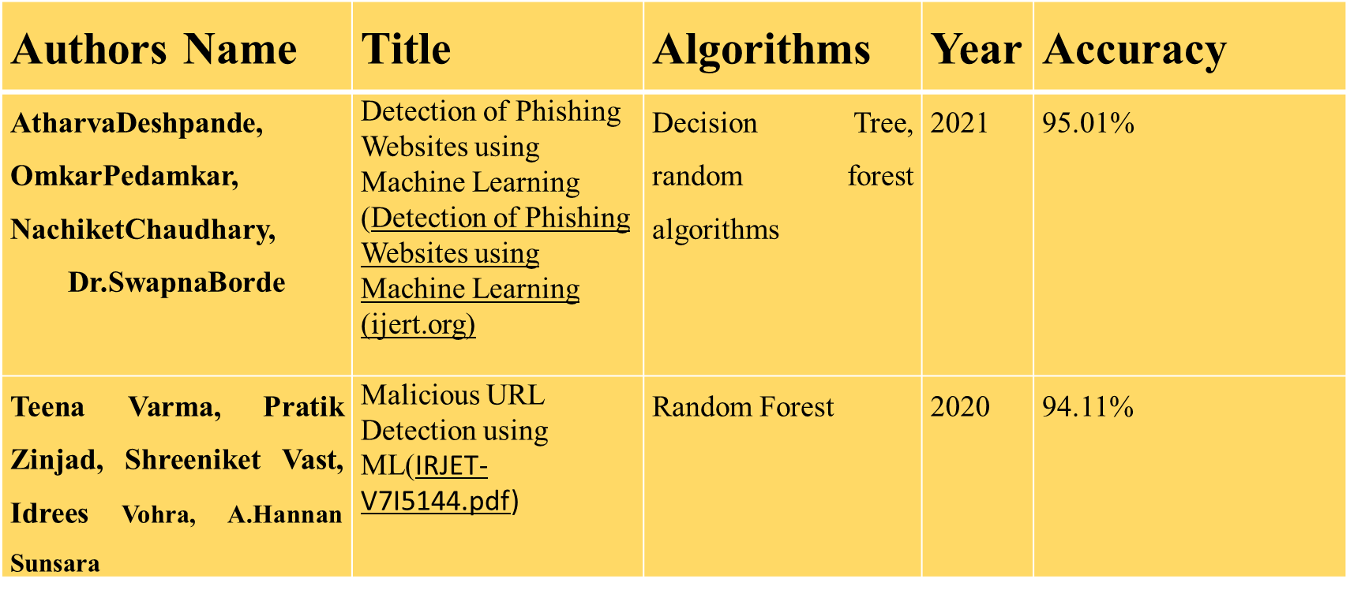
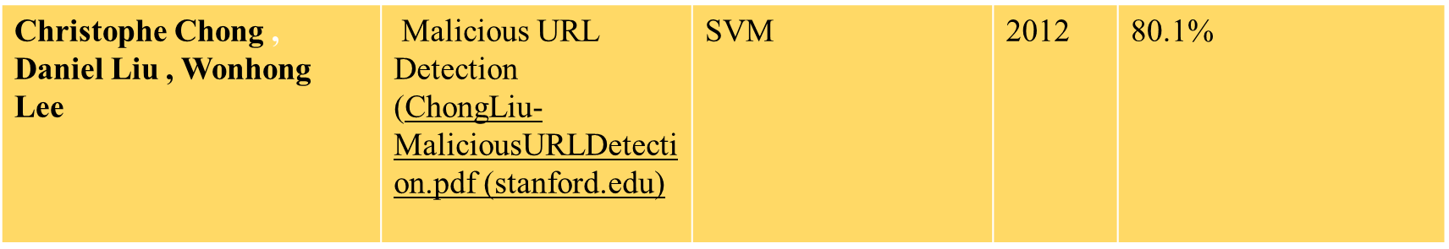
Literature Survey
5

Slide 6
Exiting System
Decision Tree , Random Forest, – 95.01% Random Forest – 94.11% SVM -80.1%
Disadvantages
Time Complexity is high
Less Accuracy
6

Slide 7
Proposed System
Our main objective is to detect fraudulent websites and reduce the cybercrime and data extraction by these sites.
Under this project, using machine learning, we will train our model to the data set containing the features of the malicious websites.
Once the system is trained using the machine learning and Logistic regression Algorithm, we will be in a position to analyse any URL and detect if it is an authentic website or not. At this point, we can take the input from the users, in the form of URL and analyse through the different features of that website. We will then test this URL and display whether the URL is Good or Bad.
We chose the model with least time complexity and highest accuracy.
7

Slide 8
Features for Predicting URL
IP Address
URL length
@ Symbol in URL
‘//’ in URL
Number of domains and subdomains
Use of HTTPS
8

Slide 9







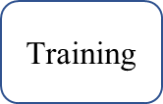




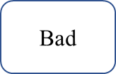

Architecture
9

Slide 10
Logistic Regression Algorithm
Logistic regression is one of the most popular Machine Learning algorithms, which comes under the Supervised Learning technique. It is used for predicting the categorical dependent variable using a given set of independent variables.
Logistic regression predicts the output of a categorical dependent variable. Therefore the outcome must be a categorical or discrete value. It can be either Yes or No, 0 or 1, true or False etc.
This is a Logistic Regression algorithm that we will use to train our model. This algorithm will enable our model to understand patterns and relationships in our dataset. The model will gain useful knowledge, which it will use to make predictions.
10

Slide 11
CONCLUSIONS
1) STAY INFORMED
Learn about new phishing techniques that are being
developed to avoid falling prey to one.
2) THINK BEFORE YOU CLICK
Never click on hyperlinks without examining the
hidden URL.
11

Slide 12
REFERENCES
"MALICIOUS URL DETECTION WITH MACHINE LEARNING | by Jayant Gadge |IEE" Phishing Sites Detection Based on C4.5 Decision Tree Algorithm | IEEE Conference Publication | IEEE Xplore
"Malicious URL Detection using M" IRJET-V7I5144.pdf
Detecting Malicious URL using Machine Learning | Engineering Education (EngEd) Program | Section
(PDF) Phishing Website Detection Based on URL (researchgate.net)
Phishing Website Detection Based on Machine Learning Algorithm | IEEE Conference Publication | IEEE Xplore
12

Slide 13


Thank you!
13

