Slide 1
ONLINE BUS TICKET BOOKING SYSTEM
GANAPATHI VIGNESH S
SAP ID:51897494

Slide 2
INTRODUCTION
The main objective of the Java Project on Bus Booking System is to manage the details of Operators, Customer, Ticket Booking.
It manages all the information about Bus Ticket Booking. The project is totally built at administrative end and thus only the administrator is guaranteed the access.
The purpose of the project is to build an application program to reduce the manual work for managing the Operators, Bus, Customer.

Slide 3
PATHWAY
ADMIN USER
ADD BUS DASHBOARD
DELETE BUS SIGNUP
EDIT BUS BOOK TICKET
LOGOUT LOGOUT

Slide 4
TECHNOLOGY USED
JAVA(SPRING MVC,HIBERNATE)
HTML, CSS
JAVASCRIPT
MYSQL
JSP PAGES

Slide 5
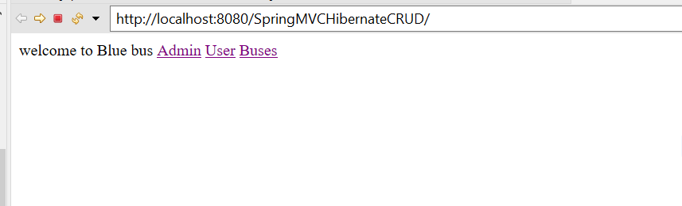
HOME PAGE

Slide 6
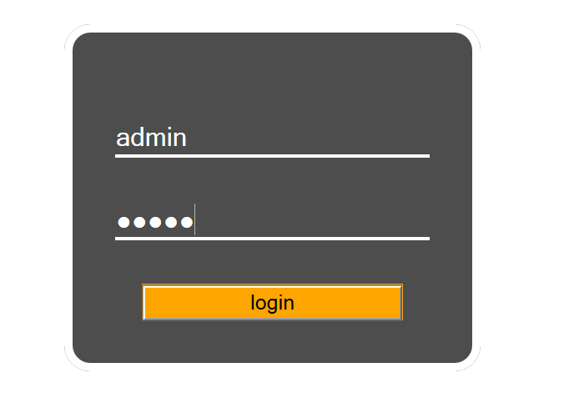
ADMIN LOGIN

Slide 7
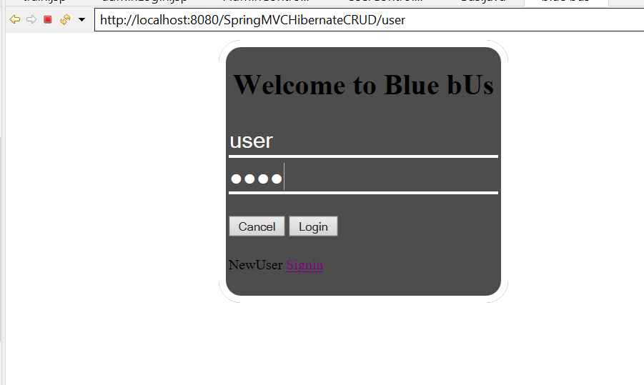
USER LOGIN

Slide 8
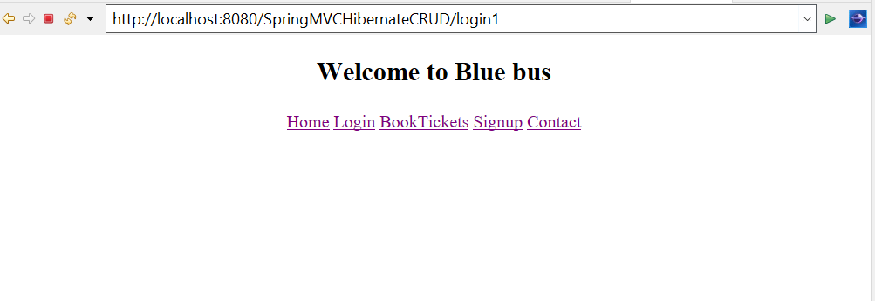
USER HOME

Slide 9
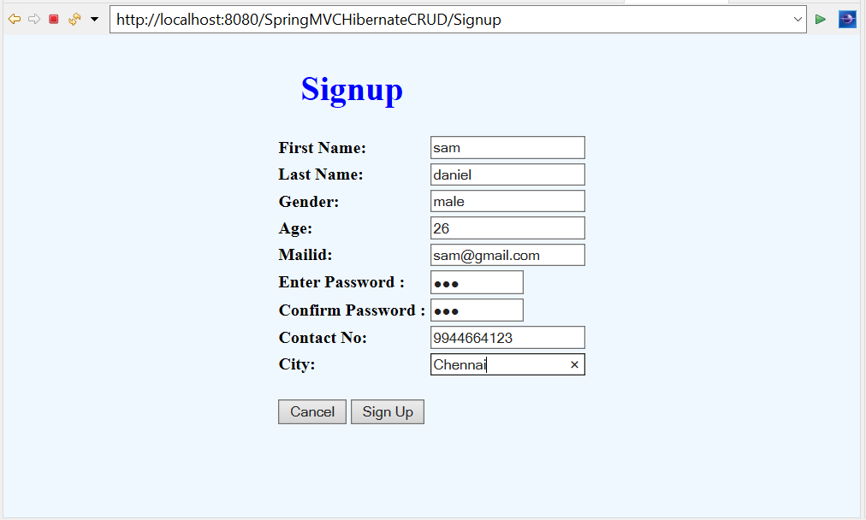
SIGNUP

Slide 10
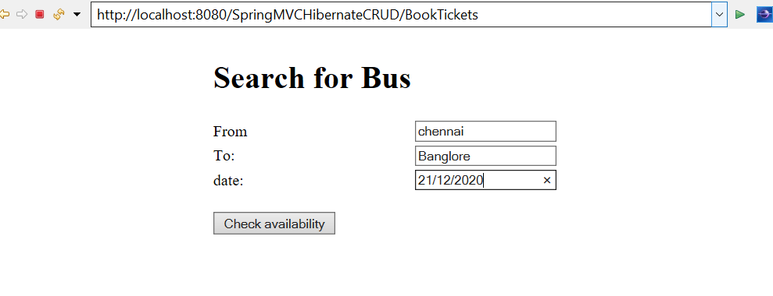
SEARCH BUS

Slide 11
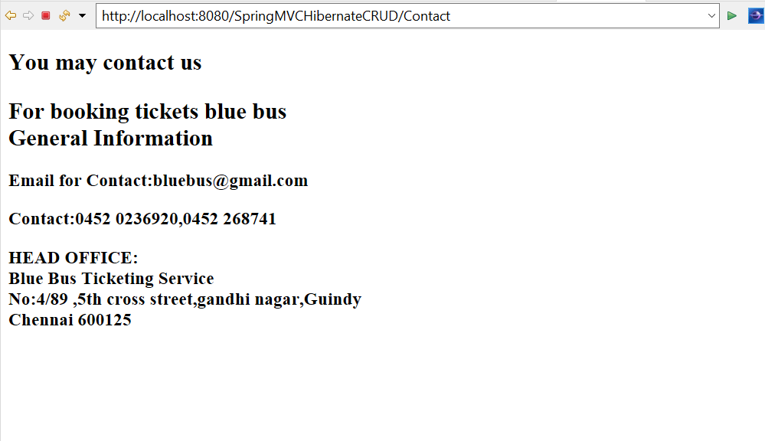
CONTACT US

Slide 12
EXPECTED OUTCOMES
THIS APPLICATION CONNECTS PASSENGERS WITH THE BUS OPERATORS AND VICE VERSA
USING THIS ,PASSENGERS CAN BOOK NUMBER OF TICKETS WHENEVER THEY WANT AND CAN CANCEL THEM.
ADMINS CAN ALTER THE BUS DETAILS BASED ON THEIR ROUTE,DAY OF OPERATION,AND TIME.

