Slide 1
Parkinson’s Disease Detection
Team Details:
Ganapuram Ramya(21EG505823)
G.Yashwanth(21EG505827)
A.Nagaraju(21EG505803)
Project Supervisor
Name: Ms A.Durga Bhavani
Designation: Assistant Professor

Slide 2
Introduction
Parkinson's disease (PD), the second most common neurodegenerative illness following Alzheimer's disease, profoundly affects the nervous system. In India alone, more than 1 million people grapple with this condition each year. PD results from the loss of crucial brain cells responsible for dopamine production, leading to a gradual onset of symptoms. These symptoms encompass both motor issues, such as tremors and gait disturbances, and a range of non-motor challenges, including sleep disturbances, loss of smell, and cognitive difficulties. Parkinson's disease thus presents a complex and multifaceted health concern.

Slide 3
Literature
Author(s) | Method | Advantages | Disadvantages
Tapan Kumar , Pradyumn Sharma(2021) | Random forest, Decision tree | bagging classifier is also over-fitted, with a training accuracy of 98.5% | The problem of over-fitting as seen in a few models is also resulting due to a small dataset.
Nasif Wasek Fahim, Samik Ahmed Eshti,Khadiza Akter Nura(2019) | XGBoost Algorithm | XGBoost can solve real-world scale problems using a minimal amount of resources. | It is giving less accuracy than compared to others.
Anastasia Moshkova, Andrey Samorodov, Natalia Voinova, AlexanderVolkov (2020) | kNN, SVM, Decision Tree (DT), Random Forest (RF) | Signals were obtained with 3D Leap Motion sensor. | 3 motion parameters required speed, amplitude, frequency.

Slide 4
Literature
Author(s) | Method | Advantages | Disadvantages
Khadiza Akter Nura(2019) | Decision Tree Classifier | Less number of data preparation steps and highly versatile algorithm | Some changes in the data can dramatically change the predictions and doesn’t consider how the recent decision will affect the next few stages of splitting
Nupur Prakash, Pradyumn Sharma(2022) | Convolutional Neural Networks (CNN),knn,svm | By using this flask application and train & test data it will get better accuracy | Lots of Training data is required and overfitting

Slide 5
Problem Statement
The problem at hand is the increasing prevalence of Parkinson's disease (PD) in India, affecting over 1 million individuals annually. PD, the second most common neurodegenerative disorder after Alzheimer's, leads to a loss of brain cells responsible for dopamine production. Addressing this complex and multifaceted health concern is essential to enhance the quality of life for those living with PD in India.
Objective
To give the better treatment by early detection by using this project and to get good accuracy than the previous existing ones.

Slide 6
Proposed Method
Our proposed system is Parkinson’s Disease Detection for the people who are suffering from the symptoms like Parkinson’s Disease .
Our proposed system can give better accuracy by using the flask in previous only ML model is trained and get the accuracy but now we are using CNN and flask to get accuracy.
Our proposed system can do voice based prediction also. Thus our system is more robust in nature.

Slide 7
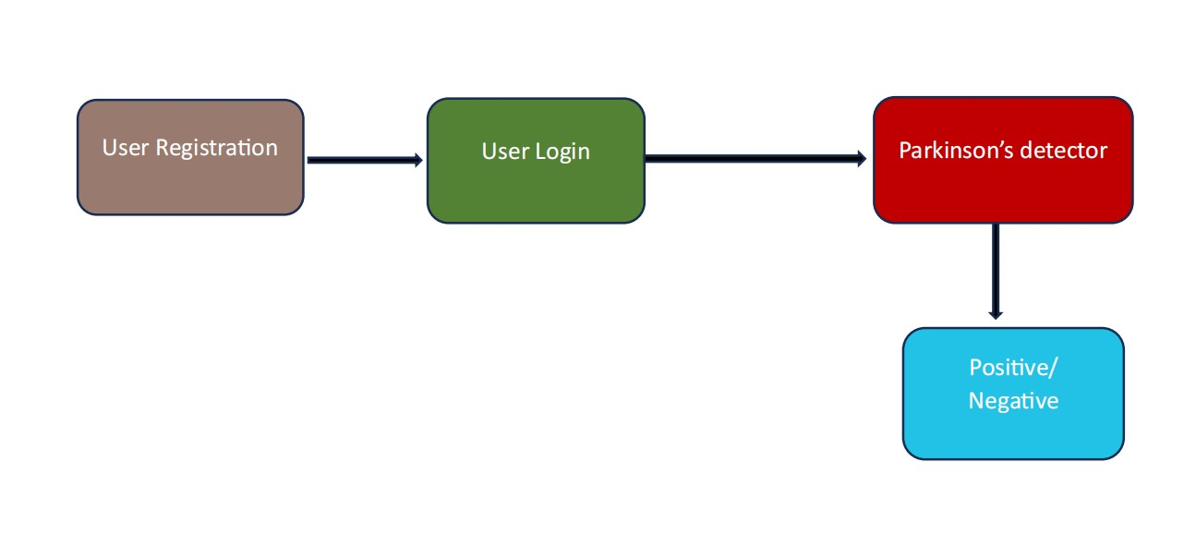
Proposed Method

Slide 8
Project status
S. No | Functionality | Status (Completed /in-progress/Not started)
1 | Data Collection and preparation | Completed
2 | Creating a model and processing the data | Completed
3 | Training the model | In progress
4 | Parkinson’s Disease Detection By extra features | In progress
Note: Submit Form 1,2 and 3

Slide 9
References
Comparison of Machine learning models for Parkinson’s Disease prediction
https://ieeexplore.ieee.org/document/9298033
Parkinson Disease Detection: Using XGBoost Algorithm to Detect Early Onset Parkinson Disease https://www.researchgate.net/publication/354835987
Parkinson’s Disease Detection by Using Machine Learning Algorithms and Hand Movement Signal from LeapMotion Sensor
https://ieeexplore.ieee.org/document/9087433
Comparison of Machine learning models for Parkinson’s Disease prediction https://ieeexplore.ieee.org/document/9142988
Parkinson’s Disease Detection By Flask application https://ieeexplore.ieee.org/document/9298033

