Slide 1
Parkinson’s Disease Detection
Team Details:
Ganapuram Ramya(21EG505823)
G.Yashwanth(21EG505827)
A.Nagaraju(21EG505803)
Project Supervisor
Name: Mrs A.Durga Bhavani
Designation: Assistant Professor

Slide 2
Introduction
Parkinson's disease (PD), the second most common neurodegenerative illness following Alzheimer's disease, profoundly affects the nervous system. In India alone, more than 1 million people grapple with this condition each year. PD results from the loss of crucial brain cells responsible for dopamine production, leading to a gradual onset of symptoms. These symptoms encompass both motor issues, such as tremors and gait disturbances, and a range of non-motor challenges, including sleep disturbances, loss of smell, and cognitive difficulties. Parkinson's disease thus presents a complex and multifaceted health concern.

Slide 3
Problem Statement
This project addresses late-stage Parkinson's disease diagnoses by using advanced deep learning to create a user-friendly application for early detection through symptoms, aiming for more effective and timely medical intervention.

Slide 4
Proposed Method
Data Collection:
Gather a dataset of medical and clinical data, including patient records, medical imaging (if available), and other relevant information. This dataset should include information on both patients with Parkinson's disease and healthy individuals for comparison.
Feature Engineering:
Extract relevant features from the data that are indicative of Parkinson's disease. Features may include demographic information, clinical test results, voice recordings, and more.
Deployment:
Develop a user-friendly web application that allows individuals to input their symptom information. The deep learning model should be integrated into this application.

Slide 5
Experiment Environment
Operating system: Windows
IDE : VS Code
Libraries : Flask
Flask: Flask is used for parkinson disease detection applications due to its lightweight and flexible nature, making it ideal for building web-based interfaces to showcase and interact with machine learning or deep learning models that classify parkinson diseases, enabling easy deployment and accessibility for users.
Programming Languages: Python 3.10

Slide 6
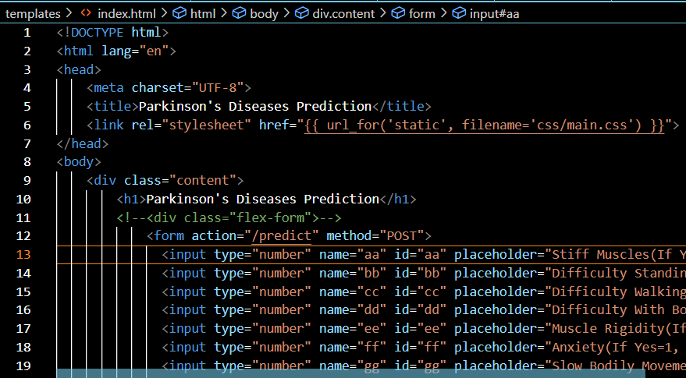
Experiment Screen shorts

Slide 7
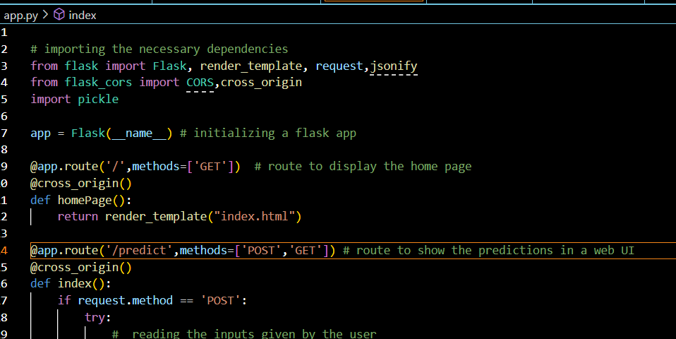
Experiment Screen shorts

Slide 8
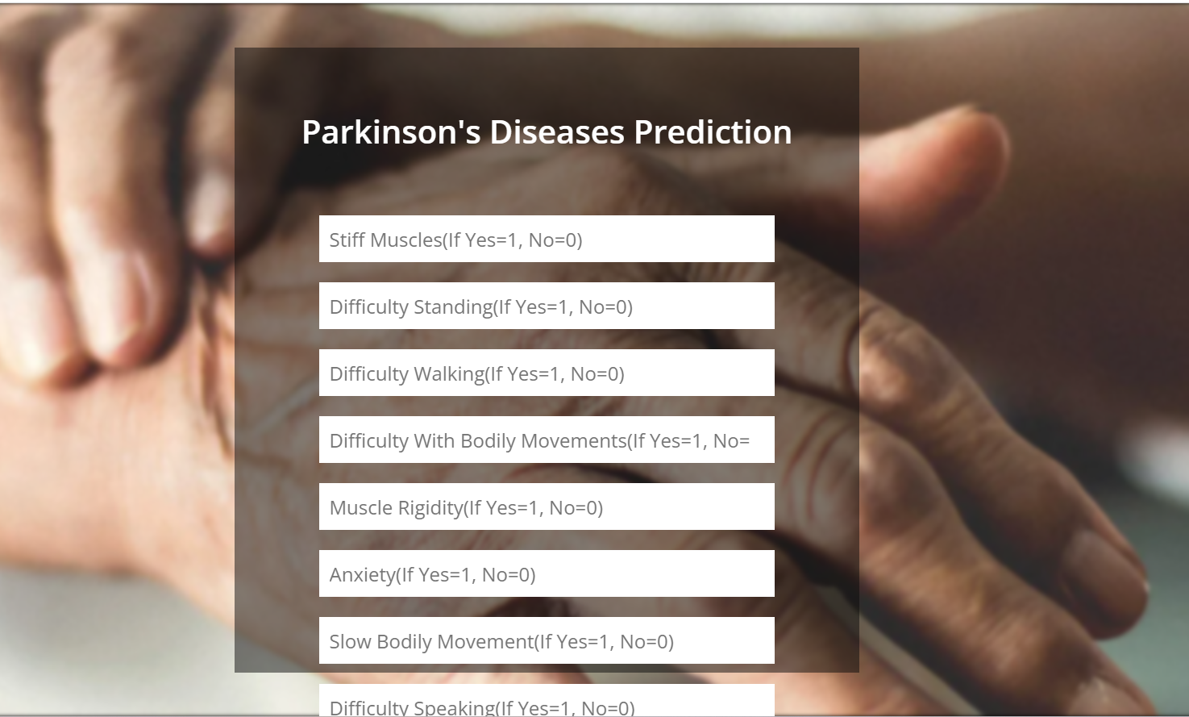
Experiment Results

Slide 9
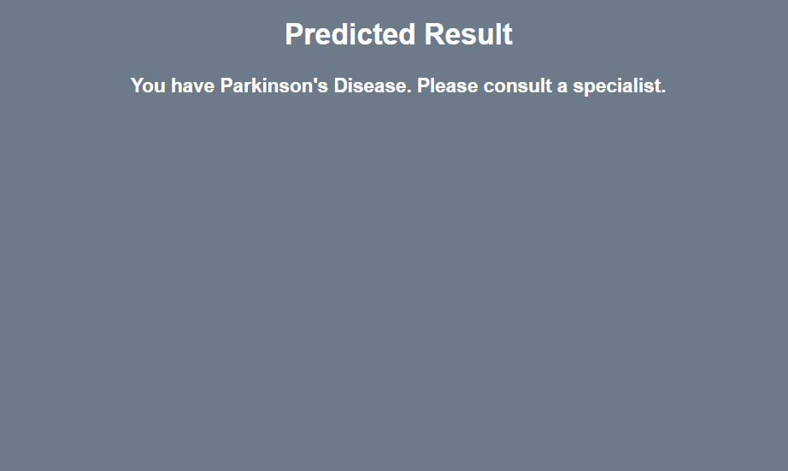
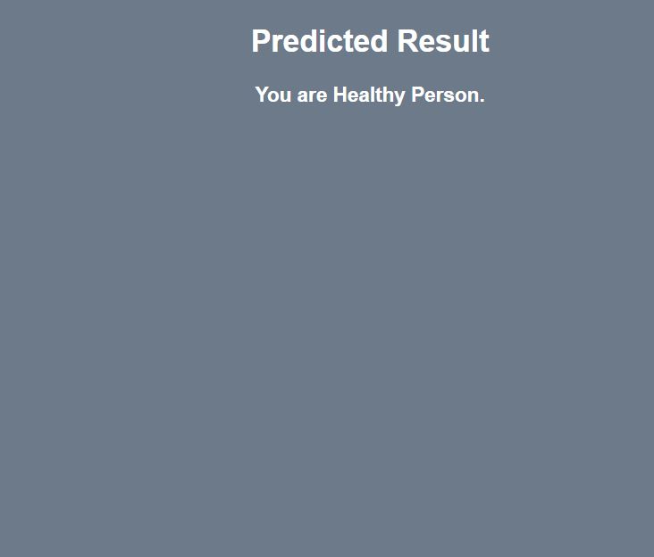
Finding
By giving input it is predicting whether a person has parkinson disease or not

Slide 10
Justification
1.What are parameters improved by your method?
Vissulaization
2. why your parameter values improved?
Time
Security

