Slide 1

PROJECT TITLE -
SEASONAL AGRICULTURE PERFORMANCE ANALYSIS
Student Name- Ganasri B
College Name- EGS Pillay Engineering college
AICTE STU ID : (STU681d7d7f84e0a1746763135)

Slide 2

PROBLEM STATEMENT
Agricultural activities are influenced by seasonal variations in environmental conditions, farming practices, resource availability and market conditions. As a result, agricultural performance may differ from one season to another. However, raw agricultural data does not clearly explain how agricultural performance changes across seasons or what patterns can be observed in different seasonal conditions. The problem is to analyze the given agricultural dataset and investigate seasonal differences in agricultural performance by identifying meaningful patterns, trends, relationships and variations within the available data.

Slide 3
PROJECT DESCRIPTION Overview: EDA on 4,000 farm records to evaluate crop performance, operational costs, and profitability across Kharif, Rabi, and Zaid seasons. Data Processing: Cleaned dataset (imputed missing rainfall & yield values) and calculated net profit using Python (Pandas, Seaborn). Key Findings: Kharif: Most profitable season (Avg. Profit: ₹1,78,914) due to optimal monsoon rainfall. Rabi: Stable secondary harvest (Avg. Profit: ₹87,689) with moderate production. Zaid: Faces seasonal losses (Avg. Loss: -₹24,804) driven by extreme summer heat and heavy irrigation costs. Outcome: Delivers data-driven crop selection strategies to minimize off-season farm losses.

Slide 4

WHO ARE THE END USERS?
Farmers & Practitioners: To make data-driven seasonal crop and resource choices.
Agricultural Planners & Policy Makers: To optimize regional water allocation and subsidies.
Researchers & Analysts: To study climate impact on productivity.
Government Stakeholders: For food security planning and crop insurance strategies.
Students & Educators: As an analytical benchmark for agricultural data analytics.

Slide 5

Technology Used
Python: Primary programming language for data manipulation and statistical modeling.
Pandas & NumPy: For data cleaning, feature engineering, missing value imputation, and seasonal aggregations.
Matplotlib & Seaborn: For generating analytical charts, heatmaps, and distribution plots.
Jupyter Notebook: Development environment used to document the end-to-end data pipeline.

Slide 6
RESULTS
Dataset Understanding & Preparation
• Explored agricultural activities across seasons
• Identified relevant environmental, production, resource and economic variables
• Cleaned and prepared data for analysis

Slide 7
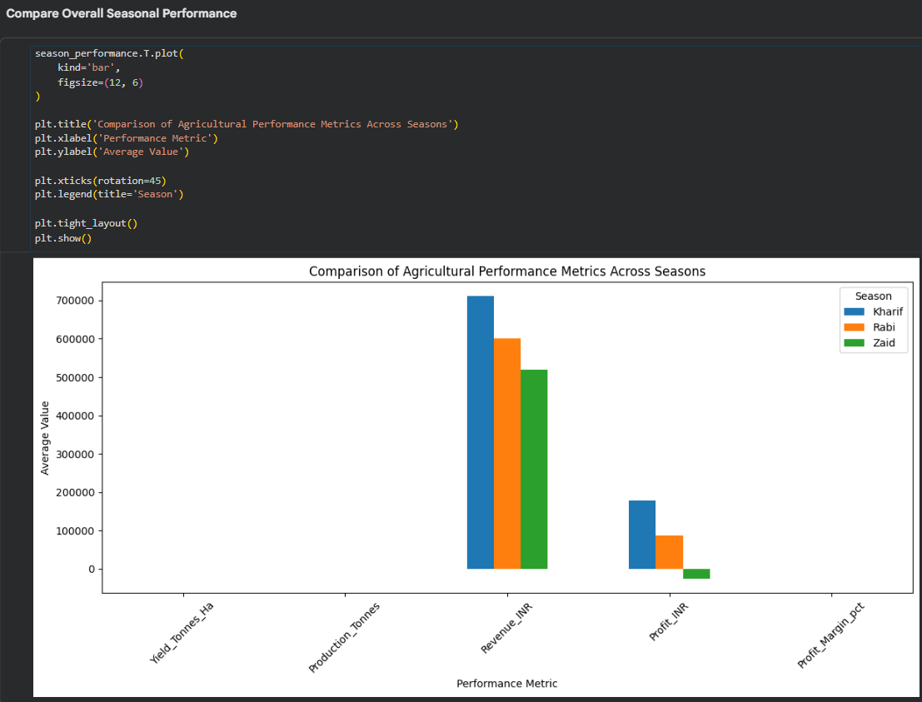
RESULTS
Seasonal Performance Analysis

Slide 8
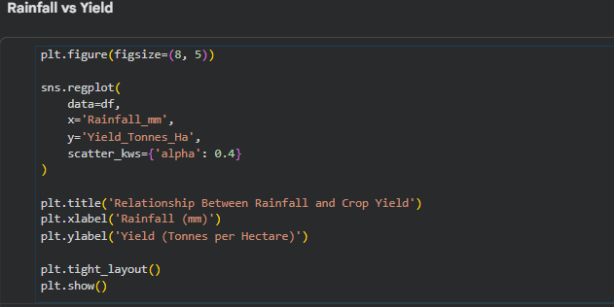
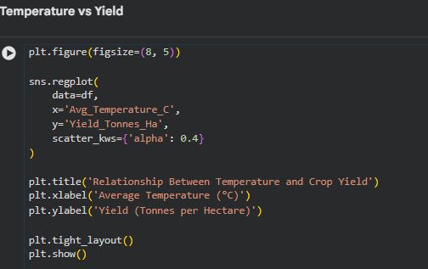
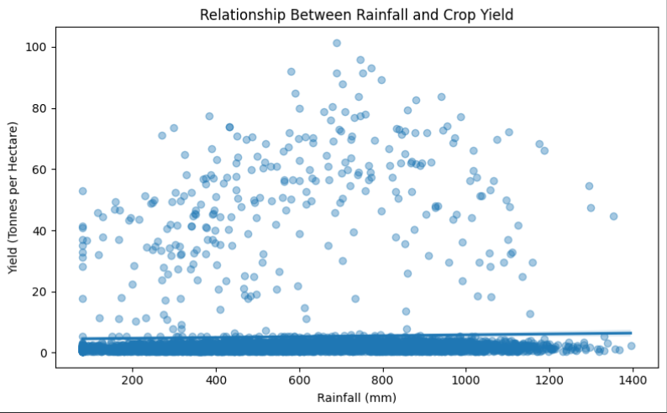
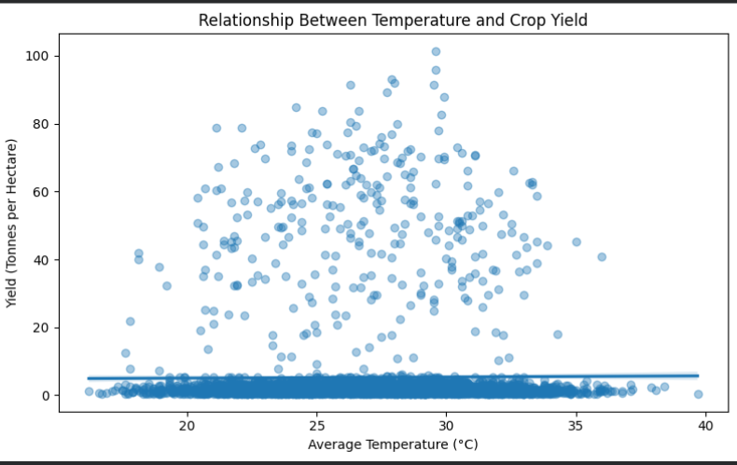
RESULTS

Slide 9
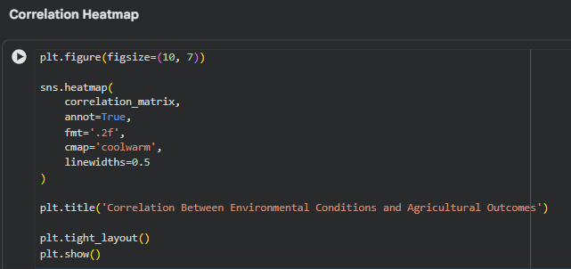
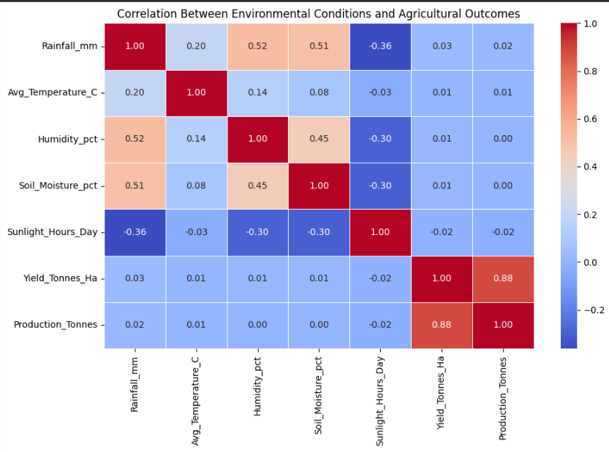
RESULTS

Slide 10
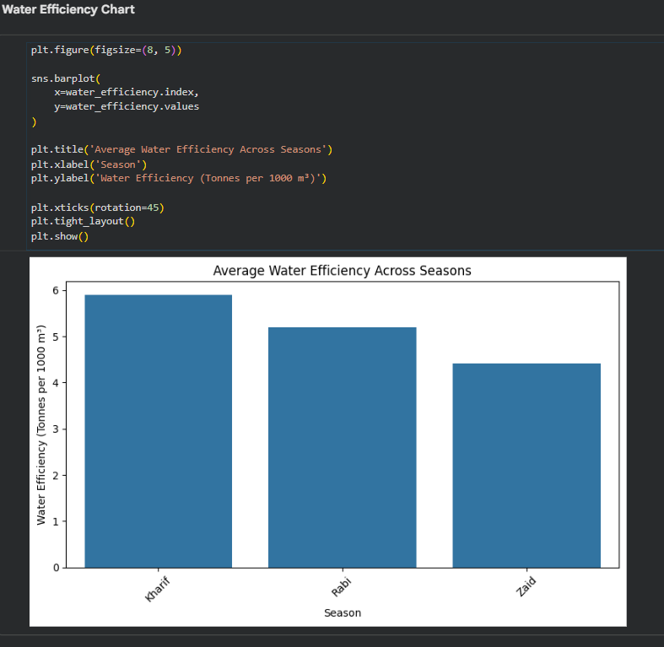
RESULTS

Slide 11
FUTURE SCOPE
Extend analysis across larger, multi-year historical datasets to model climate change impacts.
Integrate real-time satellite imagery and daily weather time-series data.
Develop Machine Learning predictive models (e.g., Random Forest/XGBoost) for crop yield estimation.
Build interactive Streamlit/Dash web application dashboards for agricultural stakeholders.

Slide 12
GITHUB LINK
https://github.com/ganasri-b/seasonal_agriculture_performance.git

Slide 13
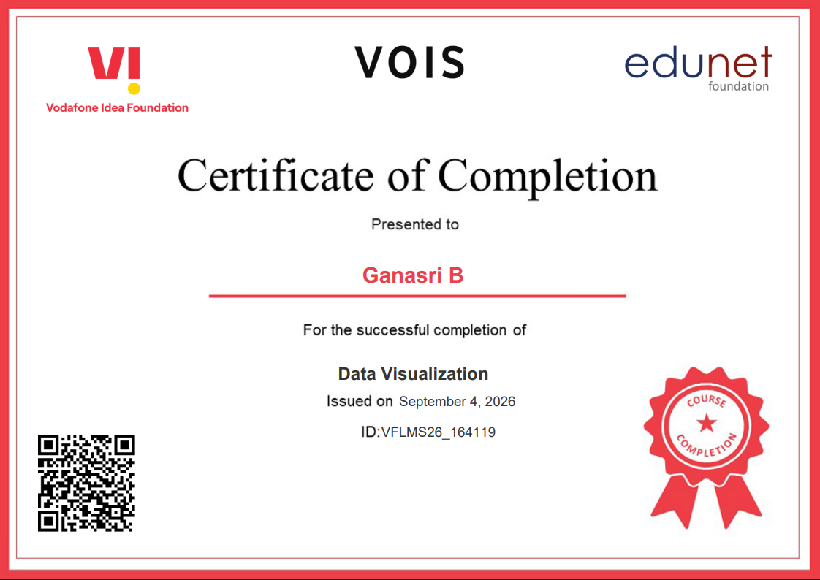
VOIS Course completion certificate - Course name- Data Visualization

Slide 14
Thank you
.

