Slide 1
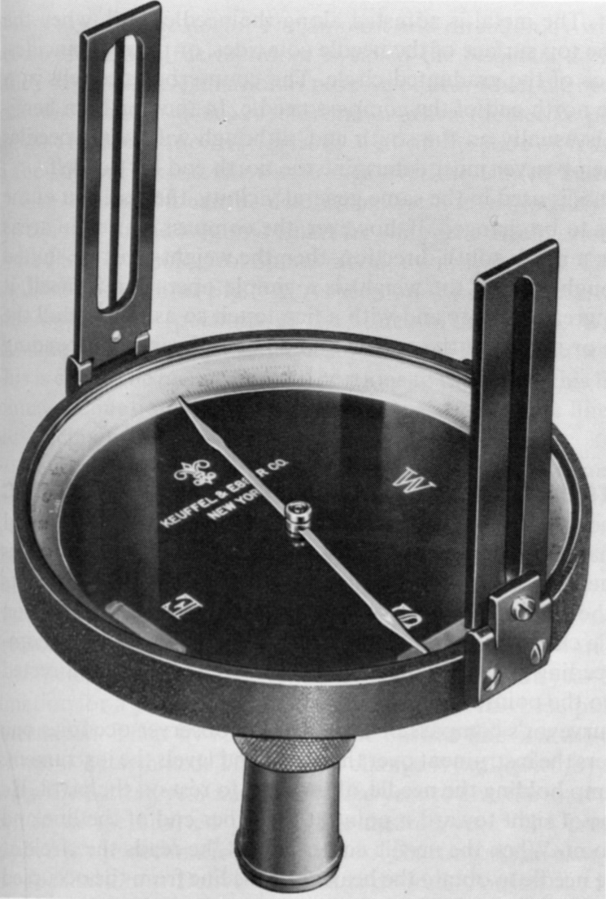
Surveyors Compass
Box with center point
Magnetized Needle
Lift needle
Blade Sights
Level tubes
Base
Jacob’s staff
Tripod

Slide 2
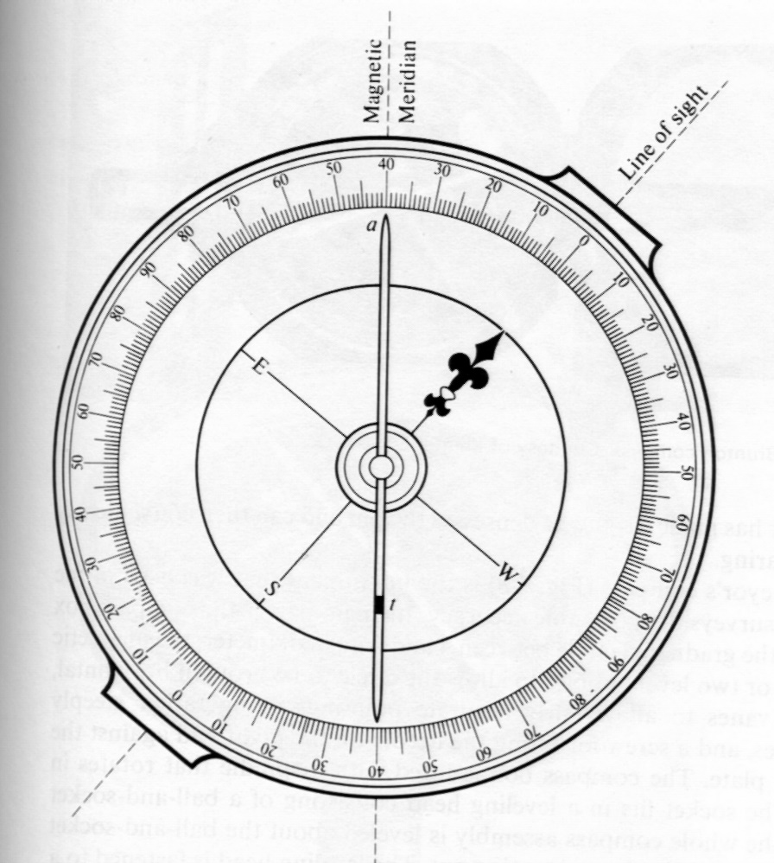
Magnetic Compasses
Magnetized Needle
Points North
Dips down
Wire wrap
Compass Rose is backwards
Local Attraction

Slide 3
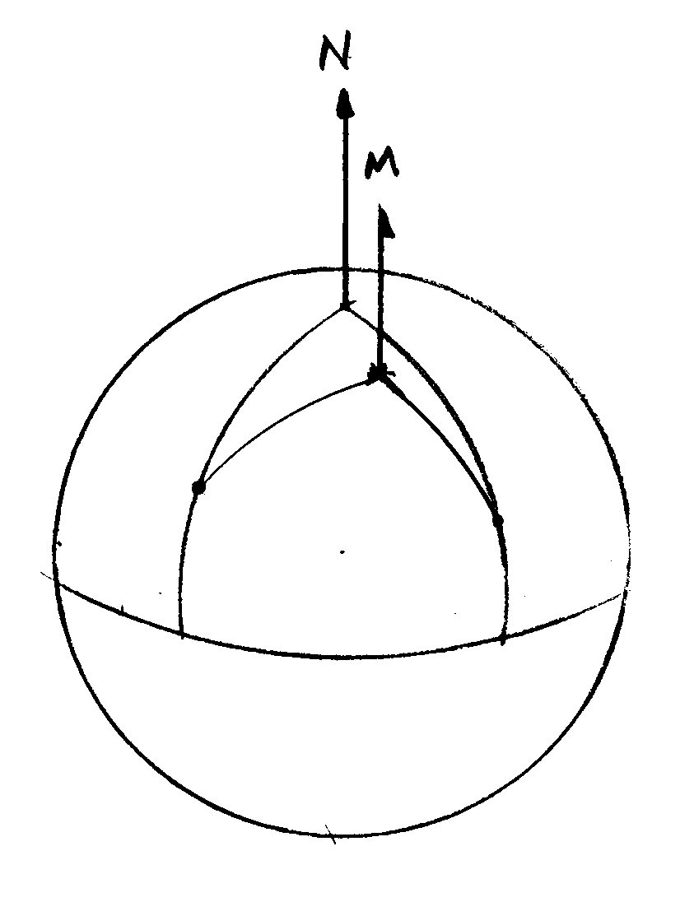
Magnetic Declination
Longitude – true North
Magnetic North not true
Angular difference – magnetic declination
Varies by place – E or W
Varies with time

Slide 4
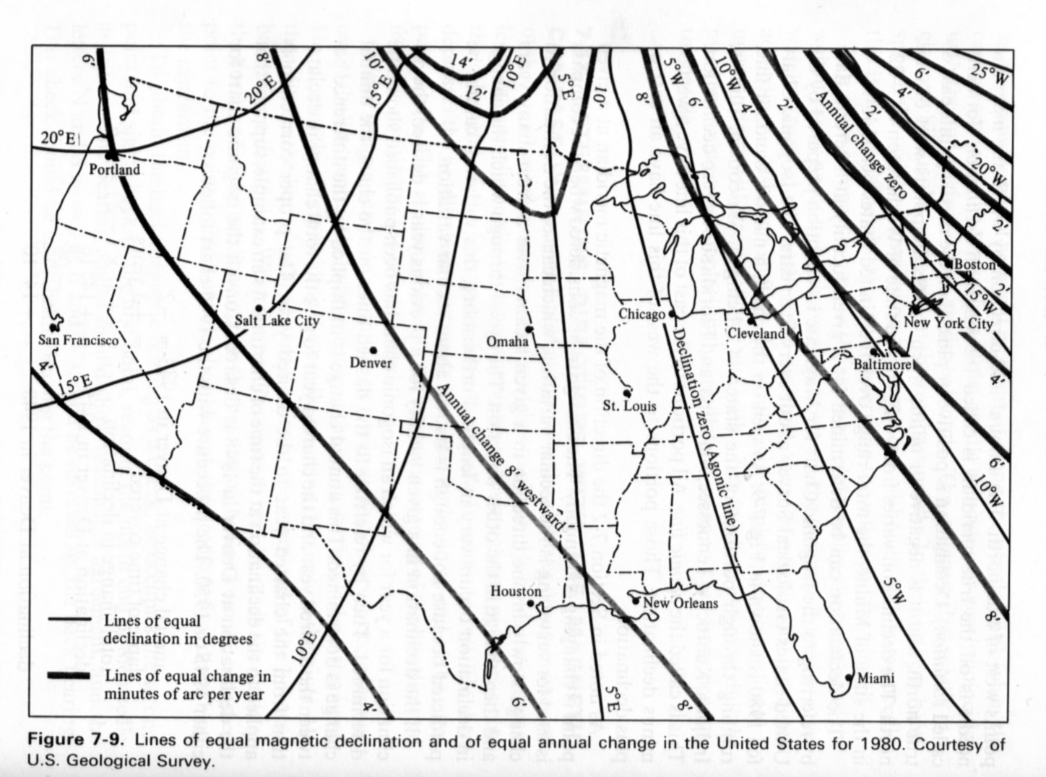
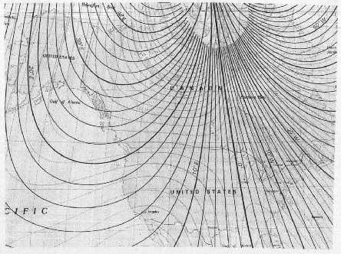
Isogonal Map
Agonic Line
East Declination
West Declination
Annual Drift
Map Date

Slide 5

Declination in Moorhead
In 1980
7° E
Drifting 10’ W/year
Now
Assume E = (+)
7° + (-10’/yr)(24 yr) = 3°00’
Use most current map available

Slide 6
Declination Calc’s
Old survey in Moorhead sets line AB
Decl then = 11°15’ E
N
M
Mag Bearing AB = S38°22’E
Find True direction now
Convert to Azimuth
Mag Az = 141°38’
True = Mag + Decl
True Az = 141°38’ + 11°15’ = 152°53’

Slide 7
Problem 9-28
1890 Survey
Decl = 7°00’ E (+)
N
M
M
Mag Az = 134°30’
True = Mag + Decl
True Az = 134°30’ + 7°00’ = 141°30’
Mag Az Now
Decl Now = 3°30’ W (-)
Mag = True – Decl
Mag Az = 141°30’ – (-3°30’) = 145°00’

