Slide 1


SOUND SENSOR
Final Project
Ganbold Biligsaikhan 6712000075

Slide 2
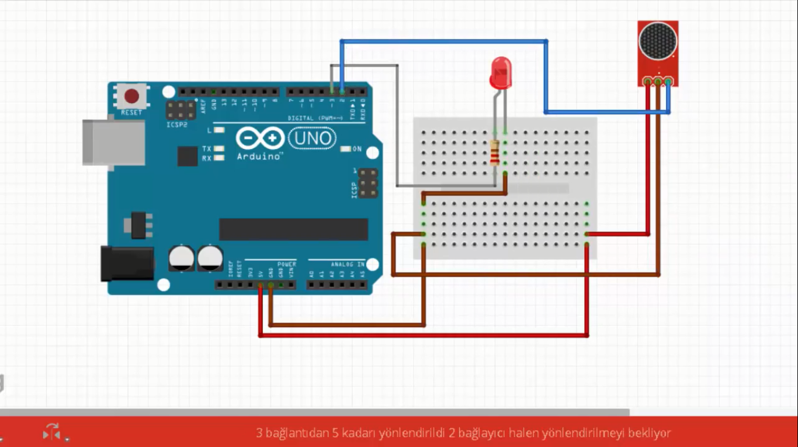
How Does it work?

Slide 3
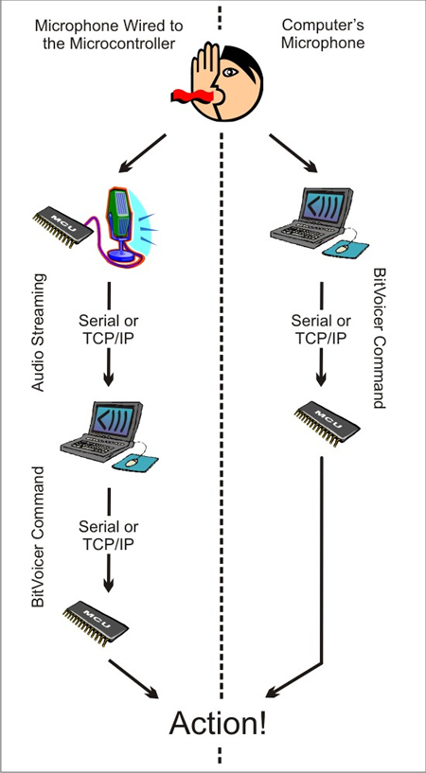
BitVoicer + Arduino
Smart Light

Slide 4
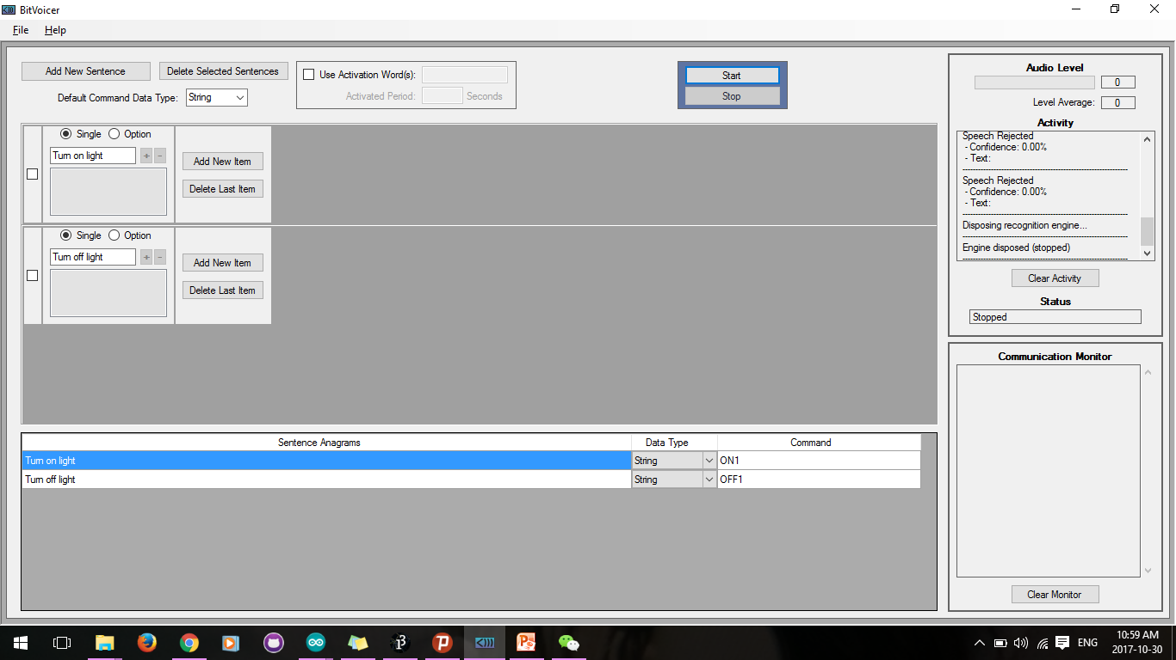

Slide 5

Ganbold Biligsaikhan

Slide 6
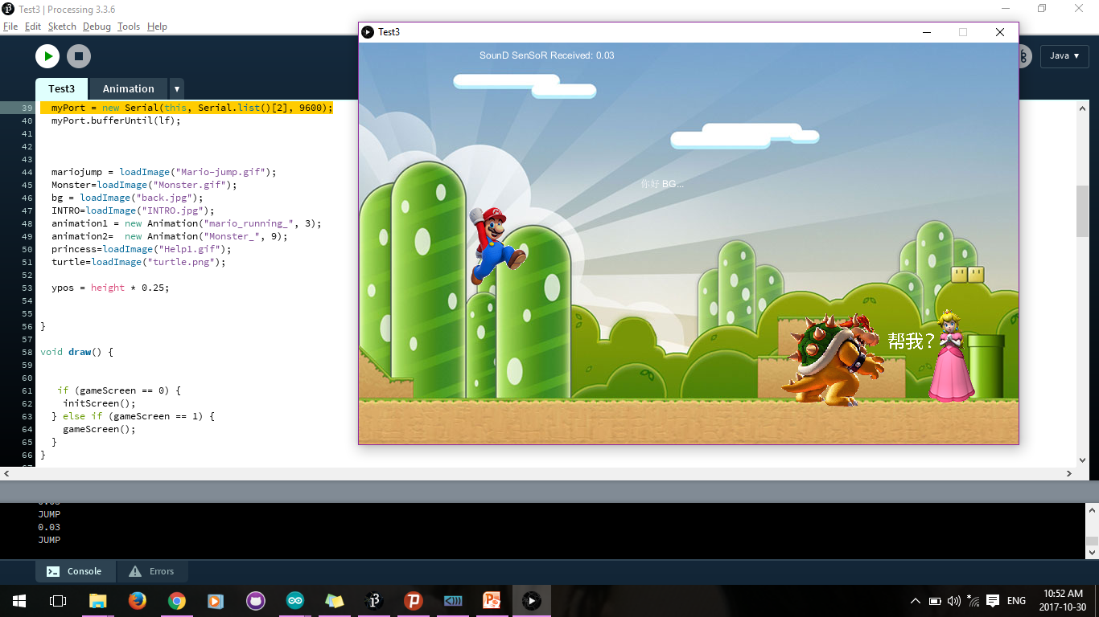

Slide 7
Баярлалаа!

