Slide 1
Any kind of shapes recognition
Jacek Ganszczyk Piotr Kałucki

Slide 2
assumptions
Supervised neural network
No specified size of a dataset
Dataset made of black and white pixels

Slide 3

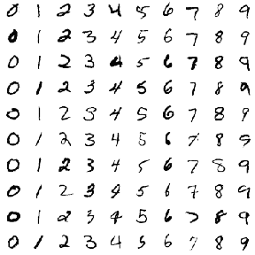
datasets

Slide 4
Results
Result given by the neural network will show the % match with drawn stuff

Slide 5
Thanks for your attention!!!

