Slide 1
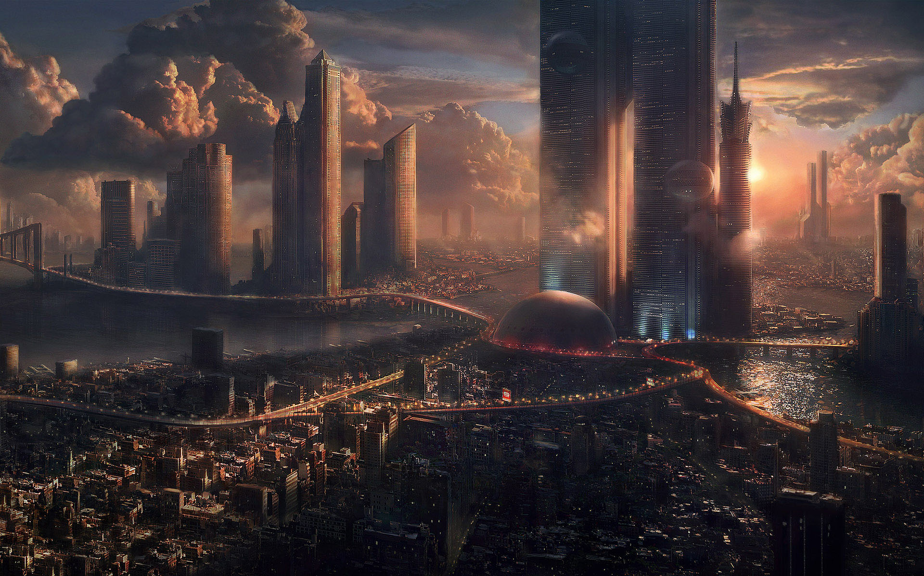
Interplanetary Smart City (IPSC)

Slide 2




Physical Asset Trade
Atomicity

Slide 3


Digital Asset Trade on the Internet
Bob
1
1
3
3
Cameron
Alice

Slide 4
IPSC Data Exchange Requirements
Secure – strong cryptography
Robust – decentralised
Scalable – P2P and microservices
Accountable – temper prove log
Space Aware – Organisation structures
No trusted third party – private blockchain technology

Slide 5
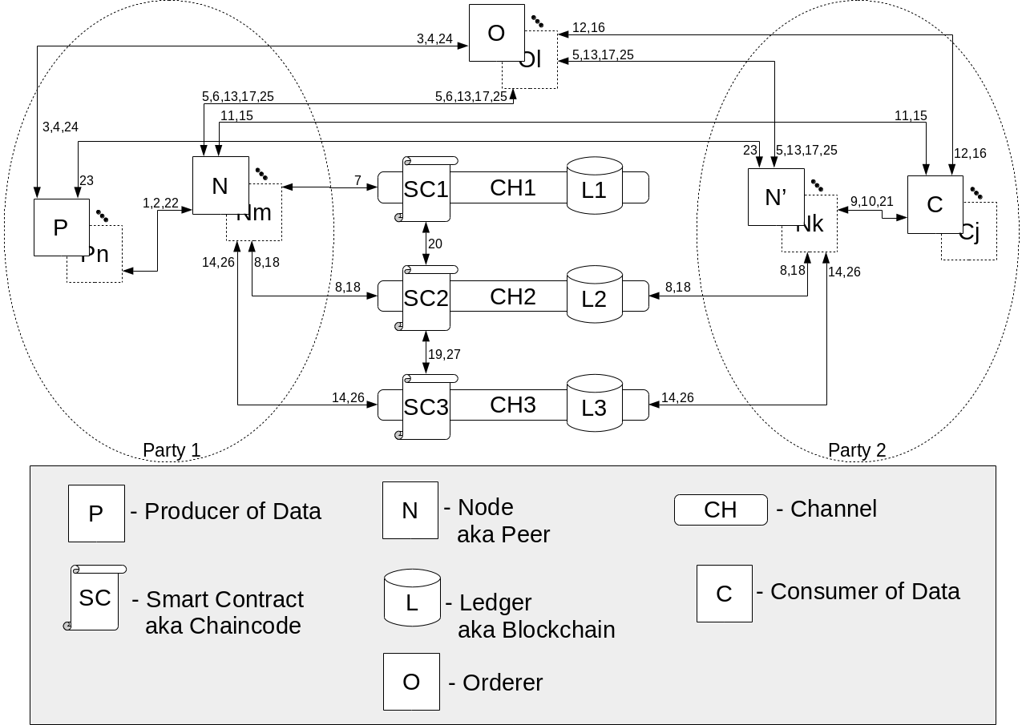
IPSC Architecture

Slide 6
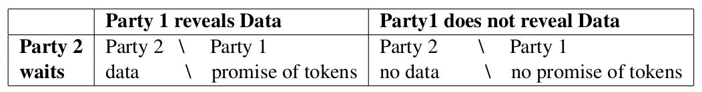
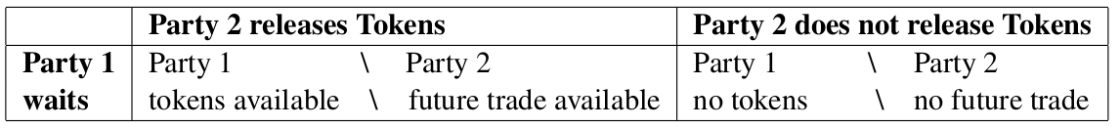
Game Theoretical Analysis

Slide 7
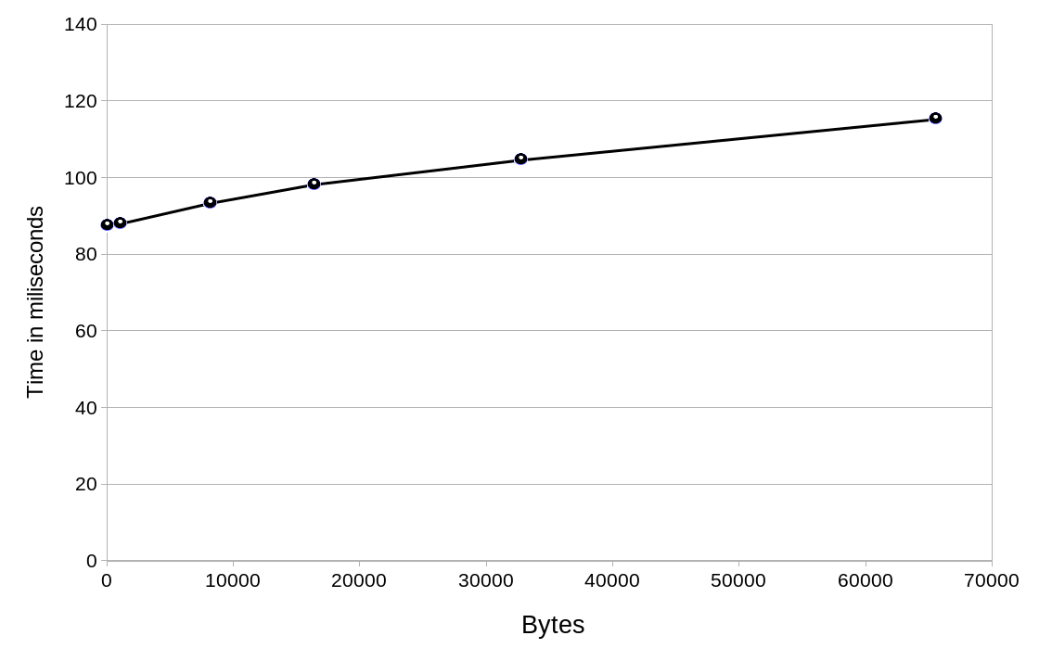
Statistical Performance Analysis

Slide 8
Testing
chaincode_data.go – 84.6%
chaincode_tokens.go – 71.2%
chaincode_ad.go – 66.3%
Unit Tests + Scenarios

