Slide 1
Final model: ~ Diagnosis + Age + Sex

Slide 2
MDS before regressing out covariates
0
-50
Sex
F
M
PC2
-100
Diagnosis
Control
Autism
-150
-200
0
PC1
100

Slide 4
No GO enrichment

Slide 5

GSEA
spliceosomal tri-snRNP complex assembly
mRNA trans splicing, via spliceosome
mRNA trans splicing, SL addition
formation of quadruple SL/U4/U5/U6 snRNP
negative regulation of inclusion body assembly
regulation of cellular response to heat
positive regulation of potassium ion transmembrane transport
membrane repolarization during cardiac muscle cell action potential
p.adjust
spliceosomal snRNP assembly
membrane repolarization during action potential
negative regulation of tumor necrosis factor production
0.9581733
regulation of T cell proliferation
negative regulation of interferon-gamma production
urate metabolic process
interferon-gamma production
regulation of T-helper 1 type immune response
positive regulation of T cell proliferation
T cell proliferation
C4-dicarboxylate transport
T-helper 1 type immune response
-2
-1
0
1
2
NES

Slide 6
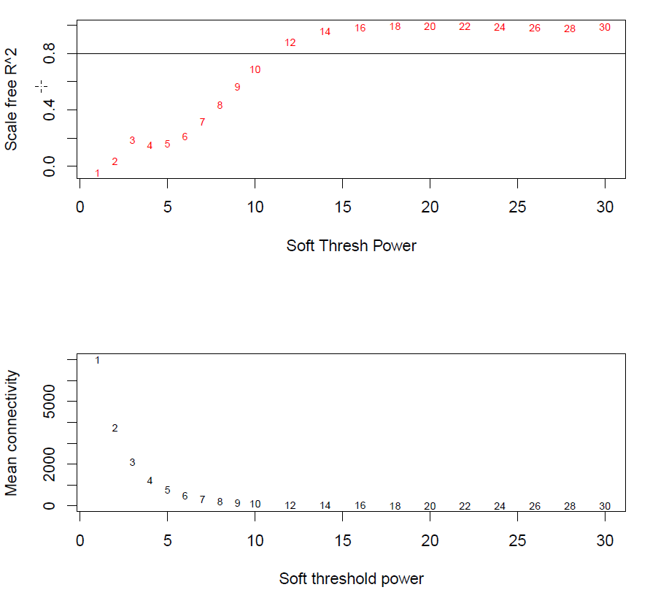
Power = 12

Slide 7
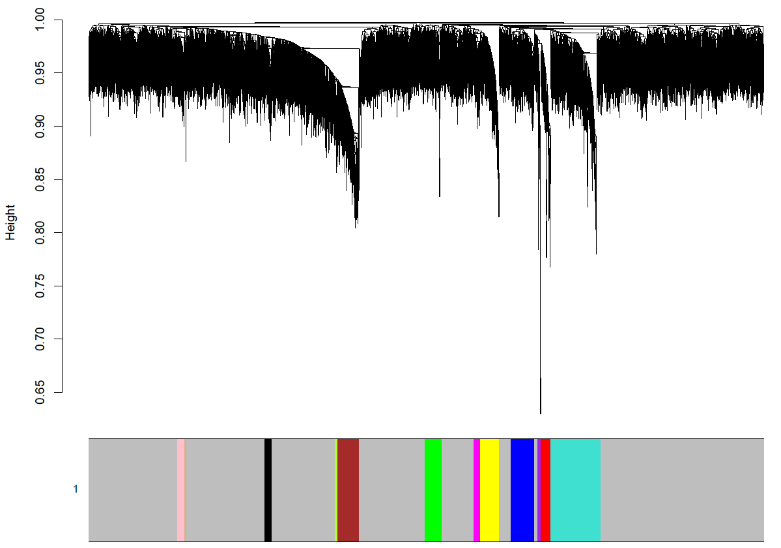
deepSplit = 0; minModSize = 40

Slide 8

Module-Trait Association
-log10FDR
Autism
0
turquoise
blue
brown
yellow
green
red
black
pink
magenta
purple
greenyellow
tan

Slide 9
Second attempt with more covariates

Slide 10

seqPC10
seqPC9
seqPC8
seqPC7
seqPC6
seqPC5
correlation
seqPC4
seqPC3
0.75
covariate
0.50
seqPC2
0.25
seqPC1
0.00
PositionOnSequencingPlate
RNAseqPool
Sex
Age
Diagnosis
PC1
PC2
PC3
PC4
PC5
exPC
PC6
PC7
PC8
PC9
PC10

Slide 11
Final model: ~ Diagnosis + Age + Sex + seqPC1 + seqPC2

Slide 12
MDS before regressing out covariates
0
-50
Sex
F
M
PC2
-100
Diagnosis
Autism
Control
-150
-200
0
PC1
100

Slide 13
MDS after first 2 seqPCs were regressed out
150
100
50
Sex
F
M
PC2
0
Diagnosis
Control
Autism
-50
-100
0
PC1
100
200

Slide 15
GO enrichment
cytokine-mediated signaling pathway
positive regulation of cell proliferation
cell surface
phospholipid binding
cellular response to oxygen-containing compound
transmembrane signaling receptor activity
protein maturation
intrinsic component of plasma membrane
enzyme linked receptor protein signaling pathway
-1
0
1
Signed -log10(FDR)

Slide 16
Power = 22

Slide 17
deepSplit = 2;
minModSize = 40

Slide 18

-log10FDR
Autism
-0.3
0.0
-0.5
blue
yellow
green
red
black
pink
purple
tan
cyan
grey60
white
violet
-1.0
turquoise
brown
magenta
salmon
lightcyan
lightgreen
royalblue
darkred
darkgrey
orange
skyblue
sienna3
skyblue3
greenyellow
midnightblue
lightyellow
darkgreen
darkorange
steelblue
darkmagenta
yellowgreen
darkturquoise
saddlebrown
paleturquoise
darkolivegreen
-1.5

Slide 19
Module 15 (midnightblue)
Module-Trait Association
Eigengene Expression
GABA.subcluster7
Cell-Type Enrichment
0.0
GABA.subcluster6
GABA.subcluster5
GABA.subcluster4
GABA.subcluster3
GABA.subcluster2
GABA.subcluster1
exPFC.subcluster8
exPFC.subcluster7
exPFC.subcluster6
0.25
exPFC.subcluster5
-0.1
exPFC.subcluster4
exPFC.subcluster3
exPFC.subcluster2
exPFC.subcluster1
END
NSC
MG
OPC
Dataset
ODC2
Group
ODC1
Goldman
Linear Regression Beta
ASC2
-0.2
0.00
ASC1
Habib
Eigengene
Control
exDG
Zeisel
Autism
GABA2
GABA1
Zhang
exCA3
exCA1
exPFC2
exPFC1
perivascular_macrophage
monocytes
-0.3
peritoneal_macrophage
-0.25
astrocytes_ependymal
endothelial.mural
microglia
oligodendrocytes
pyramidal.CA1
pyramidal.SS
interneurons
Endothelial
Microglia
*
Oligodendrocyte
-0.4
Astrocyte
Autism
-0.50
Neuron
0
5
10
15
Age
log10fdr
Functional Enrichment
Hub Genes Network
symporter activity
KDELC2
CCNL2
ENTPD1
intrinsic component of plasma membrane
NPIPB5
LPIN2
D-aspartate transport
ATP1B2
GABBR1
D-aspartate import across plasma membrane
GPR56
SLC15A2
L-glutamate import across plasma membrane
KIF21B
SLC1A2
SLC1A3
BCAN
PAMR1
L-glutamate import
CLU
NOTCH2
Proximal tubule bicarbonate reclamation
PREX2
GPR98
C1orf61
glutamate secretion
SMG7
EDNRB
G-protein coupled receptor signaling pathway
SLC4A4
microglial cell proliferation
ACSL6
ITSN1
DOK6
0
1
2
3
-log10(p.value)

