Slide 1
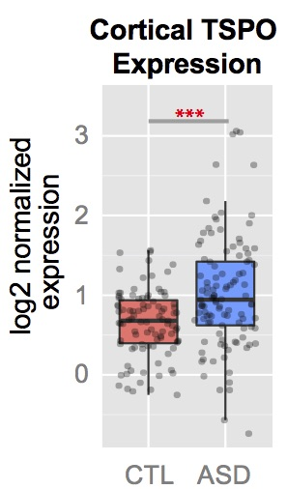
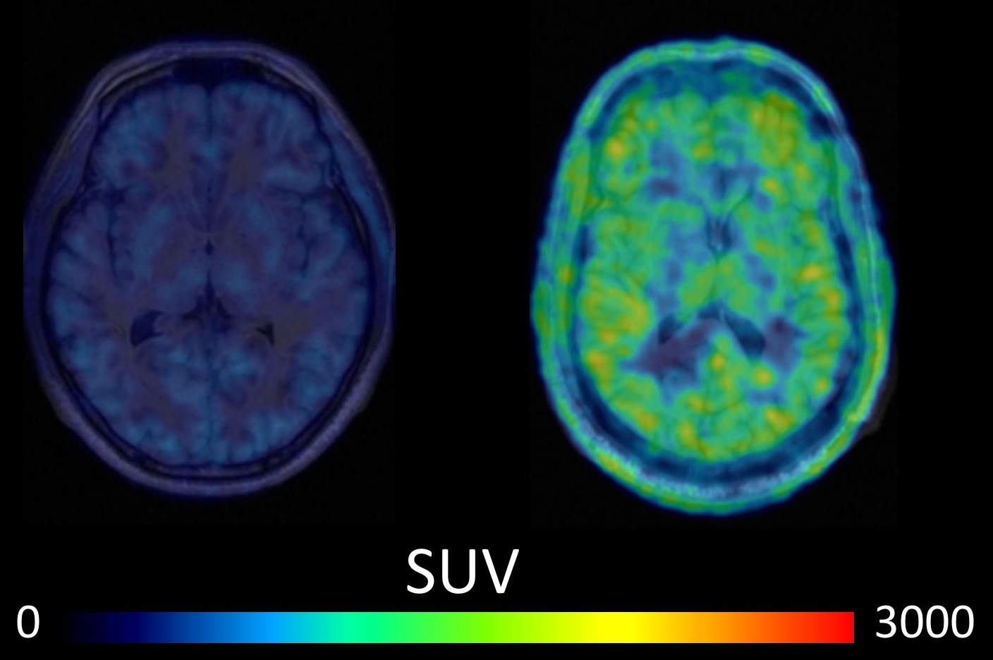
AIM1
AIM2: 12 week open-label minocycline trial
100 mg / day
200 mg / day
N=15, Adults with ASD
Baseline
Weeks 2,4
Week 6
Weeks 8,10
Week 12
Clinical Screen Genotype
TSPO PET
Blood Sample
Cog Battery
TSPO PET
Blood Sample
Cog Battery
Recruit
Enroll
Clinic/ Monitor
Cog Battery
Blood Sample
Clinic/ Monitor
N=15, Matched controls
AIM3: Cognitive, behavioral, clinical outcome measures
Cognition (MATRICS), CGI-I, CGI-S, Anxiety & Depression

