Slide 1

EXECUTIVE BRIEFING • ANALYTICS EXPERIENCE
From Food Waste Data to
Operational Intelligence
PlateSight Analytics Tab: Turning automated waste records into operational visibility, financial understanding, and actionable interventions.
PREPARED FOR
Dolphin Group of Hotels
Ramoji Film City, Hyderabad
(Sitara • Sahara • Tara • Eureka)
SCOPE & FOCUS
Analytics Experience
Centralized Web Management Portal
ai.platesight.in/analytics
PREPARED BY & DATE
PlateSight Intelligence
Gandhaar Joshi, Co-Founder
October 2026 Executive Review
Notes:
SPEAKER NARRATIVE:
Good morning, leadership team of Dolphin Group of Hotels and Ramoji Film City. In our previous demonstrations, we walked through the physical monitoring station—our edge cameras, certified weighing load cells, and kitchen-facing touchscreen.
Today, we are setting physical hardware aside to focus exclusively on the management layer: the PlateSight Analytics Tab. Our core conviction is that food waste data only becomes valuable when it delivers operational visibility, financial understanding, and measurable opportunities for kitchen intervention.
TRANSITION:
Let us examine how data flows from hotel operations into this central platform, and how multiple input streams combine into a single authoritative management workflow.
CAVEAT & CONTEXT:
The views and screenshots presented today reflect the live implementation at ai.platesight.in/analytics as captured on 9 October 2026. The interface is actively evolving as part of our pilot engagement to align perfectly with Dolphin Group's specific operational workflows.

Slide 2
02 / WORKFLOW & INGESTION
One Analytical Workflow Can Bring Multiple Sources Together
PlateSight consolidates automated hardware logging, existing kitchen spreadsheets, and manual audits into a single pipeline.
THREE DATA PILLARS
THE CENTRAL DATA PIPELINE
Multi-Stream Data Harmonization
From Raw Logs to Executive Action
01 • AI Vision & Load-Cell Stations
Edge-computed plate and tray logs provide instant food segmentation and certified kilogram weights without manual kitchen logging.
02 • Kitchen Excel Sheets & ERP
Automated ingestion of daily kitchen production, pickup, and wastage reports (e.g. Sahara & Sitara daily logs) to establish historical baselines.
03 • Managerial & Audit Overrides
Authorized supervisor portal to input guaranteed banquet Pax, menu metadata, and food-safety disposition flags.
Step 1: Standardization & Unit Normalization
Normalizes diverse kitchen units (kg, portions, pans) and maps raw food labels to standardized hotel master recipes.
Step 2: Relational Aggregation
Organizes records by property (Sitara, Sahara), meal shift (Lunch, Dinner), and service format (Buffet, Banquet).
Step 3: Rules Engine & Variance Triggers
Compares prepared vs consumed vs discarded against historical benchmarks to detect waste anomalies.
Step 4: Executive Dashboards & Action Cards
Surfaces instant financial valuation and actionable batch-size adjustment recommendations.
Data Governance: Historical spreadsheets bootstrap intelligence immediately, ensuring baseline visibility prior to physical station rollout.
PlateSight
AI-Powered Food Waste Monitoring — Prepared for Dolphin Group of Hotels
2 / 12
Notes:
SPEAKER NARRATIVE:
A common misconception in food waste initiatives is that everything must wait for 20 physical scanning machines to be installed across all banquet kitchens. That is not how PlateSight works.
PlateSight is built on a hybrid data ingestion model. We recognize that Dolphin Hotels already maintains valuable kitchen logs—such as the Sahara and Sitara daily production, pickup, and wastage Excel sheets. Our platform ingests these historical records directly, applies standardized recipe mapping, and aggregates them into our central intelligence engine.
TRANSITION:
Now let us see what leadership actually sees once this data is processed. Let us move to the executive overview and top-level KPI ribbon.
CAVEAT:
While spreadsheet ingestion bootstraps immediate baseline visibility, real-time edge hardware provides higher granularity and image-verified audit trails. Both feed the same unified data schema.

Slide 3

03 / EXECUTIVE KPIS
Start With the Full Food-Waste Picture
Top-level KPI cards establish executive visibility across total preparation, consumption, waste, cost, and guest volume.
Current interface snapshot: Top-level operational KPI cards (ai.platesight.in/analytics) • Values shown represent current platform demonstration data.
VOLUME & INTAKE
COST & BUFFER DRIFT
RESOURCE RECOVERY
Prepared vs. Consumed
Financial Valuation & Drift
Leftover Segregation
• Total Food Prepared: Establishes total kitchen production volume entering service.
• Consumption Rate: Measures true guest intake (e.g. 74.8% intake, 546g/guest).
• Waste % & g/PAX: Normalizes discard volume against changing banquet group sizes.
• Total Waste Cost: Maps discard kilograms directly to hotel ingredient cost sheets.
• Waste Cost / Guest: Isolates per-cover margin erosion for banquet pricing review.
• Prepared vs Planned: Quantifies kitchen buffer inflation against contracted pax.
• Kitchen vs Buffet Split: Differentiates unserved pan holding from buffet table returns.
• Diverted / Reused Food: Tracks safe culinary repurposing under hotel food-safety SOPs.
• Clean Separation: Strictly avoids counting clean leftovers as unrecoverable waste.
PlateSight
AI-Powered Food Waste Monitoring — Prepared for Dolphin Group of Hotels
3 / 12
Notes:
SPEAKER NARRATIVE:
When an executive chef or general manager opens PlateSight, the first view they encounter is this top-level KPI ribbon. It answers six fundamental operational questions in five seconds:
1. How much food entered the operation? (Total Food Prepared)
2. How much was actually eaten by guests? (Consumption Rate and grams per guest)
3. How much was discarded, and what percentage of production did that represent?
4. What did that discard cost the hotel in rupee ingredient value?
5. How much clean surplus was held, and how much was safely repurposed?
6. Did the kitchen over-buffer preparation relative to planned banquet attendance?
TRANSITION:
Notice that we distinguish between leftovers, safe reuse, and true waste. Let us examine the exact culinary lifecycle flow in Slide 4 to understand why this distinction is critical for chef credibility.
CAVEAT:
The figures shown on this card represent the live demonstration snapshot. In live deployment, these metrics update continuously based on verified weighments and uploaded shift reports.

Slide 4
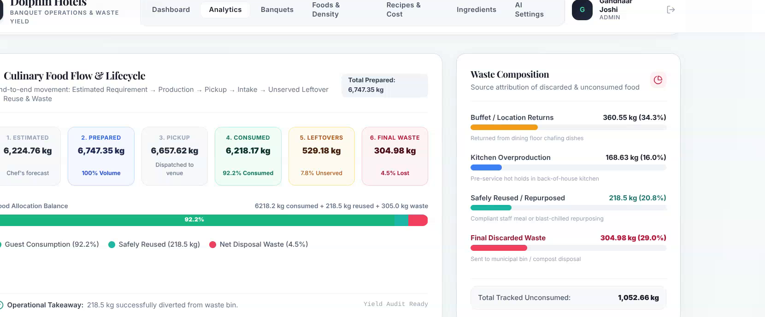
04 / CULINARY LIFECYCLE
Understand Where Food Goes Before Calling It Waste
Tracking food through distinct operational stages prevents misattributing kitchen holding, buffet returns, or safe reuse as landfill waste.
LIFECYCLE MASS-BALANCE
End-to-End Kitchen Journey
• Estimated Requirement: Forecasted volume based on banquet PAX & per-head specs.
• Kitchen Production: Actual cooked food output dispatched from central hot kitchens.
• Service Intake: Food picked up and consumed by banquet and restaurant guests.
• Surplus Disposition: Separation into unserved leftovers vs plate scrapings.
Current interface snapshot: Culinary Food Flow & Waste Composition panel.
WASTE COMPOSITION
CULINARY MASS BALANCE
Crucial Operational Categorization
• Mass-Balance Ledger: Total Prepared = Consumed + Cold-Chain Leftovers + Final Discard.
• Cold-Chain Preservation: Safe unserved holding is tracked separately under HACCP temp logs.
• Culinary Credibility: Sous chefs audit disposition before final service sign-off.
• Buffet Returns: Unserved hot/cold chafing dishes under temperature control.
• Safely Reused: Rapid-chilled items repurposed under hotel food-safety SOPs.
• Final Discard: Contaminated plate scrapings and post-service spoilage.
• Rigorous Rule: Reused food is strictly separated and NEVER double-counted as waste.
PlateSight
AI-Powered Food Waste Monitoring — Prepared for Dolphin Group of Hotels
4 / 12
Notes:
SPEAKER NARRATIVE:
In commercial kitchens, nothing creates resistance faster than accusing a culinary team of 'wasting food' when they have simply prepared food that was held cleanly and safely repurposed.
PlateSight solves this through strict mass-balance accounting. As shown in this panel, we follow food from Estimated Requirement to Cooked Production, through Service Pickup, into Consumption. Unconsumed food splits into two distinct operational categories:
1. Safe Leftovers (unserved pans held under temperature control in the kitchen).
2. Final Discarded Waste (table plate scrapings and contaminated returns).
TRANSITION:
Once this lifecycle data is captured, how do we alert the kitchen to take action? Slide 5 presents the Operational Intelligence and AI Action Plan.
CAVEAT:
Safely reused items require logging under hotel temperature-control SOPs. The current interface reflects these categories, supporting verifiable separation between reuse and waste.

Slide 5
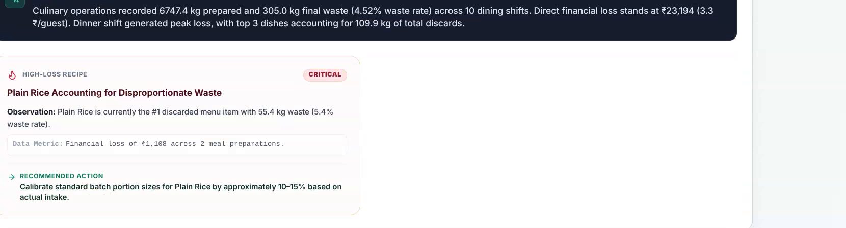
05 / OPERATIONAL INTELLIGENCE
A Signal Is the Start of an Investigation
Rules-driven intelligence translates operational anomalies into targeted kitchen inquiries, not unverified root-cause accusations.
THE 5-STEP ACTION FRAMEWORK
How Observations Become Results
• 1. Metric Signal: Identifies anomaly (e.g. Dinner buffet waste >30%).
• 2. Data Indication: Isolates specific recipe drift (e.g. Plain Rice over-batching).
• 3. Investigation: Sous chef inspects pan replenishment timing & headcounts.
• 4. Kitchen Action: Implement staged batch cooking (50% base + 25% + 25%).
• 5. Verification: Measure waste reduction across next 5 comparable dinner services.
Current interface snapshot: Operational Intelligence & Action Plan cards with priority filters.
LIVE ACTION CARD SAMPLES
Direct Recommendations Generated in Dashboard
• [CRITICAL] Plain Rice Batch Size: Cut dinner buffet primary batch by 25% (Sahara Kitchen). Estimated impact: -14 kg/day.
• [ATTENTION] Sambar Replenishment: Switch to 2-stage half-pan holding in final 45 mins. Estimated impact: -8 kg/day.
• [PERFORMING WELL] Bread & Bakery Station: Waste index < 3.2% across last 7 consecutive services.
TRIAGE & TRANSPARENCY
Rules-Driven, Not Black-Box
• Priority Triage: Filter by Critical, Attention, Performing Well, and Information.
• Deterministic Logic: Actions are based on hotel-configured rules, not hallucinated AI claims.
PlateSight
AI-Powered Food Waste Monitoring — Prepared for Dolphin Group of Hotels
5 / 12
Notes:
SPEAKER NARRATIVE:
Data without action is overhead. Slide 5 shows the 'Operational Intelligence & AI Action Plan' section. Notice how action cards are organized by status filters: Critical, Attention, Performing Well, and Information.
Each card follows a rigorous 5-step operational framework:
1. Signal: Identifies the trigger condition.
2. Indication: Pinpoints what the data shows.
3. Investigation: Guides the sous chef where to look.
4. Action: Recommends an immediate kitchen adjustment.
5. Verification: Defines how success will be measured in upcoming services.
TRANSITION:
Next, how do we track whether these interventions work over time? Slide 6 examines Daily Operational Trends.
CAVEAT:
We explicitly clarify that these recommendations are rules-driven observations based on deterministic hotel parameters. We do not claim an autonomous AI robot is running the kitchen; rather, it is an executive decision-support system.

Slide 6
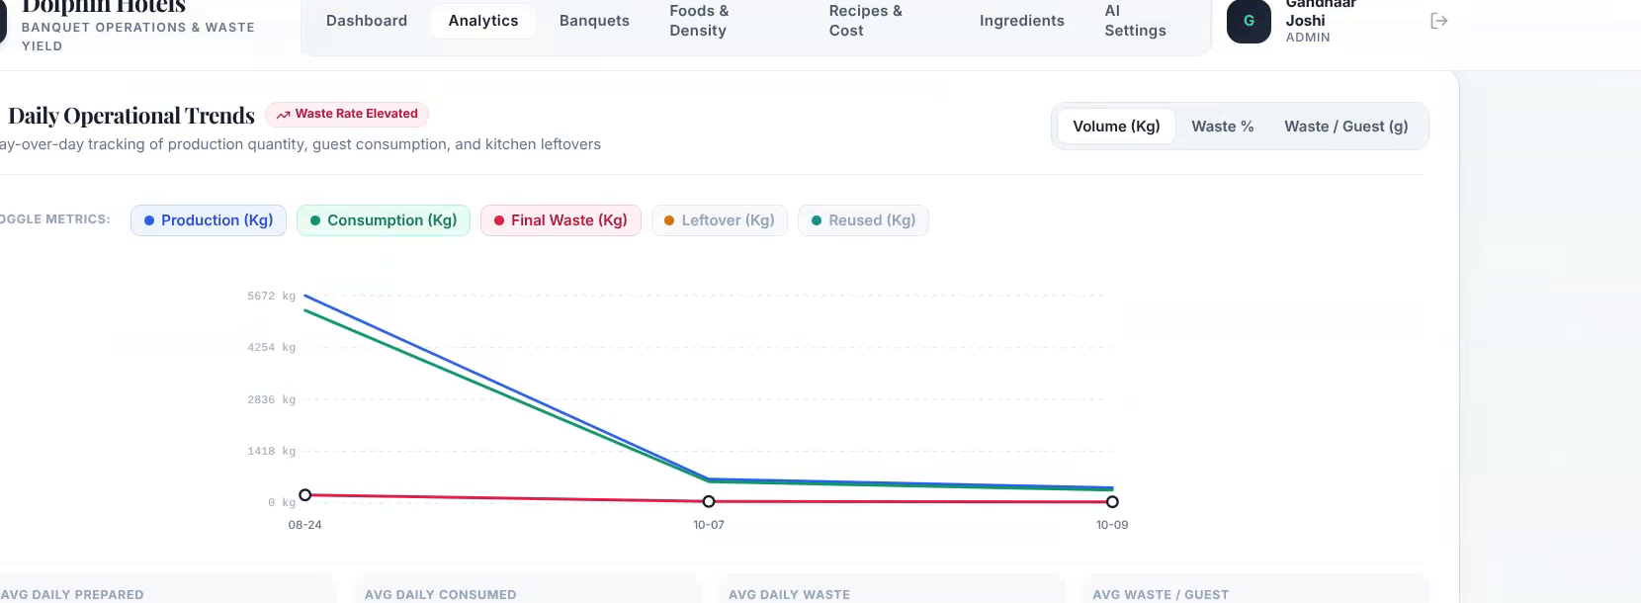
06 / TREND ANALYSIS
Separate Total Volume From Performance Rates
Day-over-day tracking reveals whether rising waste stems from operational inefficiency or simply higher guest volume.
DUAL-AXIS EVALUATION
Why Normalization Matters
• Gross Kilograms (kg): Indicates total handling volume and physical disposal load.
• Waste Percentage (%): Measures kitchen batch accuracy relative to total cooked volume.
• Grams per Guest (g/PAX): The gold standard hospitality benchmark. Evaluates whether 50kg waste came from 200 guests (crisis) or 2,000 guests (highly efficient).
Current interface snapshot: Daily Operational Trends (Volume, Waste %, Waste/Guest).
NORMALIZED BENCHMARKING
MULTI-STREAM TOGGLES
Grams-Per-Guest (g/PAX) Target Metrics
Tracking Cross-Stream Dynamics
• Gross Volume vs True Rate: 100kg waste with 2,000 PAX (50g/guest) is far more efficient than 30kg waste with 100 PAX (300g/guest).
• Target Hospitality Benchmark: <80g/PAX for multi-dish banquet buffets; <45g/PAX for business luncheons.
• Metric Toggles: Seamlessly switch views between Production, Consumption, Final Waste, Leftover, and Reused.
• Management Insight: Verifies whether waste reduction is driven by leaner cooking batches or improved leftover recovery.
• Rolling Averages: Computes daily average production and grams per guest to smooth out weekend banquet fluctuations.
PlateSight
AI-Powered Food Waste Monitoring — Prepared for Dolphin Group of Hotels
6 / 12
Notes:
SPEAKER NARRATIVE:
In hospitality analytics, gross numbers can deceive. Consider a wedding banquet at Sahara with 1,500 guests that generates 100 kilograms of food waste. That sounds alarming—until you calculate the per-guest rate: only 66 grams per person, which is exceptionally lean.
Conversely, a small executive conference of 80 guests generating 30 kilograms represents an unacceptable 375 grams per guest.
Slide 6 shows how PlateSight's Daily Trends view allows leadership to toggle between gross kilograms, waste percentage, and normalized grams per guest (g/PAX).
TRANSITION:
Now let us break this down further: where does this waste actually happen? Slide 7 examines Meal Shifts and Service Types.
CAVEAT:
Accurate guest count (PAX) data is essential for reliable per-guest calculations. Our system syncs PAX from banquet event orders or supervisor inputs.

Slide 7
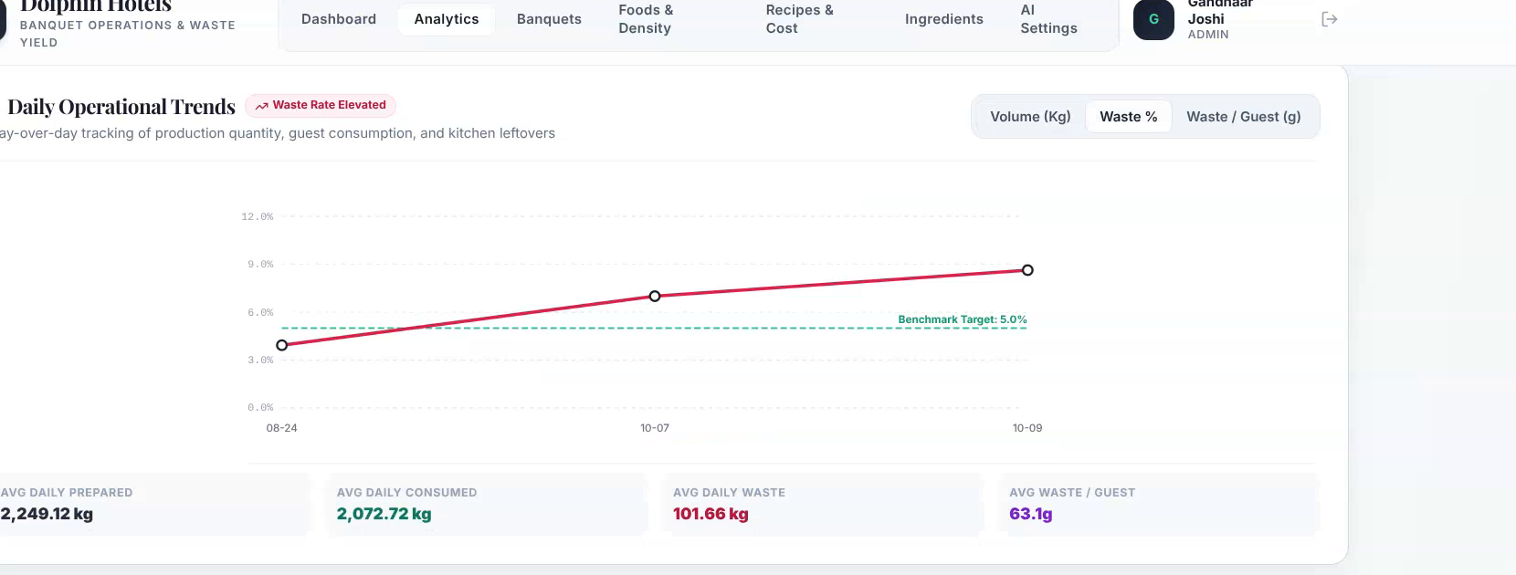
07 / OPERATING CONTEXT
Find Out Which Operating Context Needs Attention
Grouping performance by meal shift and service format pinpoints structural operational differences across banquet and outlet operations.
SHIFT PROFILES
Session-Wise Dynamics
• Breakfast: Standardized pickups, high predictability, low waste intensity.
• Lunch: High turnover, compact service window, moderate buffet recovery.
• Dinner: Consistently highest waste intensity due to prolonged service holding and late-buffet presentation requirements.
• Snacks / Hi-Tea: Variable pickup; sensitive to precise conference timing.
Current interface snapshot: Session-wise Breakdown & Service Type Operational Yield.
SERVICE YIELD
OPERATIONAL SHIFT AUDIT
Key Session Yield Observations
Buffet vs Banquet vs À la Carte
• Dinner Shift Disproportion: Dinner accounts for over 58% of aggregate daily waste due to late-buffet presentation requirements.
• Buffet Pan Tapering SOP: Implementing half-pan replenishment in the final 45 minutes saves ~15–20% without impacting guest satisfaction.
• Buffets: Suffer from 'full pan' visual presentation pressure until closing.
• Banquets: High volume, fixed menus, contractual over-buffering against guarantees.
• À la Carte: On-demand preparation delivers tightest margins and lowest waste (~3–5%).
• Targeted Action: Interventions focus specifically where 85%+ of waste occurs: Buffets & Banquets.
PlateSight
AI-Powered Food Waste Monitoring — Prepared for Dolphin Group of Hotels
7 / 12
Notes:
SPEAKER NARRATIVE:
Telling an executive chef to 'cut waste by 10%' across all kitchens is ineffective and demoralizing. Kitchen teams need surgical operational targets.
Slide 7 breaks down performance by Meal Shift and Service Format. Across commercial hotel data—including Dolphin's own properties—Dinner Buffet consistently exhibits the highest waste intensity. Why? Because hotel hospitality standards demand that chafing dishes look full and inviting even for late-arriving guests at 10:30 PM.
By contrasting Buffets, Banquets, and À la Carte, PlateSight helps management focus batch-reduction playbooks precisely where the waste is concentrated: the final 45 minutes of dinner buffet replenishment.
TRANSITION:
How does this manifest in specific functions? Slide 8 explores Banquet & Event Performance.
CAVEAT:
Service type classifications must be tagged consistently in kitchen event orders (BEOs) to ensure clear attribution between banquet functions and restaurant buffets.

Slide 8
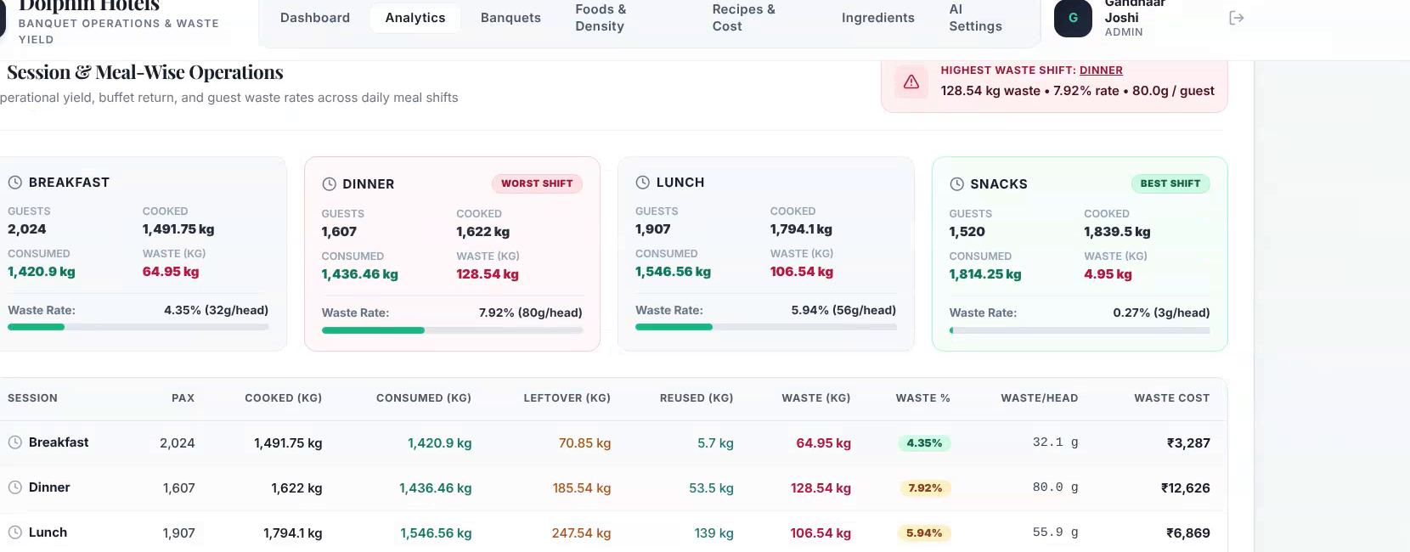
08 / BANQUET & EVENT INTELLIGENCE
Review One Event, Then Compare Like-for-Like Events
Granular function records enable event-by-event post-mortems while building historical benchmarks across event categories.
EVENT AUDIT MATRIX
Comprehensive Function Auditing
• Event Metadata: Function Name, Hall (Sitara, Sahara), Date, and Guaranteed PAX.
• Volume Reconciliation: Estimated Requirement vs Actual Cooked vs Consumed kilograms.
• Disposition Tracking: Leftovers recovered, safely reused, and final discarded kilograms.
• Financial Impact: Total Waste Cost (₹) and Cost per PAX.
• Compliance Status: Automated status pill (Compliant, Review, Critical) via configurable thresholds.
Current interface snapshot: Banquet Event Performance Table with configurable thresholds.
FUNCTION AUDIT CRITERIA
EVENT BENCHMARKING
Automated BEO Threshold Triggers
Like-for-Like Event Analysis
• Guaranteed vs Actual Variance: Instantly flags events where guest turnout deviated by >15% from contract guarantee.
• Margin Protection: Prevents unfair attribution of client no-shows to kitchen overproduction.
• Event Type Segmentation: Compare lavish wedding banquets against corporate seminars of identical PAX.
• Menu Complexity Impact: Evaluate whether 10-course buffets generate 40% more waste than 6-course formats.
• Sales Feedback Loop: Feeds actual PAX eating patterns directly back into banquet sales contracts.
PlateSight
AI-Powered Food Waste Monitoring — Prepared for Dolphin Group of Hotels
8 / 12
Notes:
SPEAKER NARRATIVE:
Banquets represent the highest-margin and highest-risk sector of hotel F&B. When an event experiences heavy food waste, who is responsible? Is it kitchen over-preparation, or did the client guarantee 500 PAX while only 320 showed up?
Slide 8 demonstrates our Banquet Event Performance table. For every single function, we capture the guaranteed PAX, estimated requirements, cooked kilograms, actual consumed volume, leftovers, and final waste cost.
Furthermore, management can click 'Configure Thresholds' to set acceptable waste tolerances based on event scale. This creates an objective, data-backed bridge between banquet sales coordinators and executive chefs.
TRANSITION:
Now let us zoom into the culinary specifics. Which dishes generate this waste, and when does it spike? Slide 9 presents Dish Rankings and Shift Heatmaps.
CAVEAT:
Event records require matching Banquet Event Order (BEO) numbers with kitchen production sheets to achieve full automated reconciliation.

Slide 9
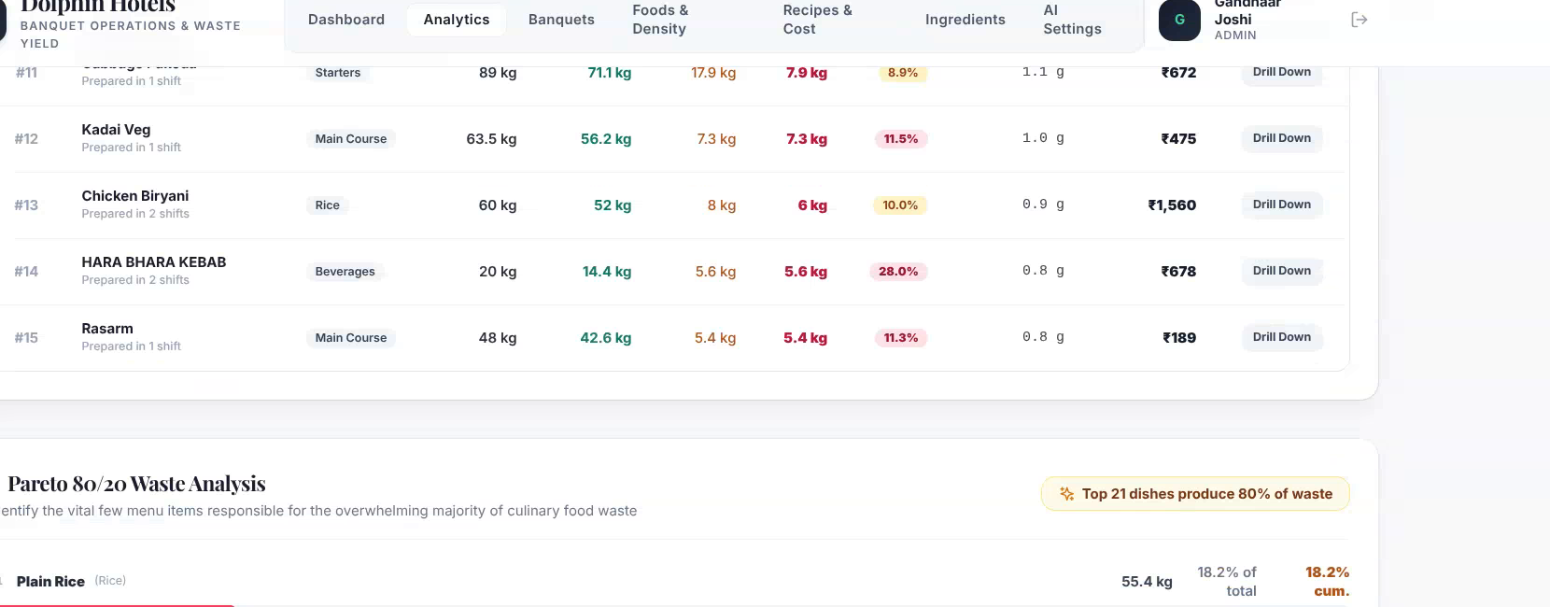
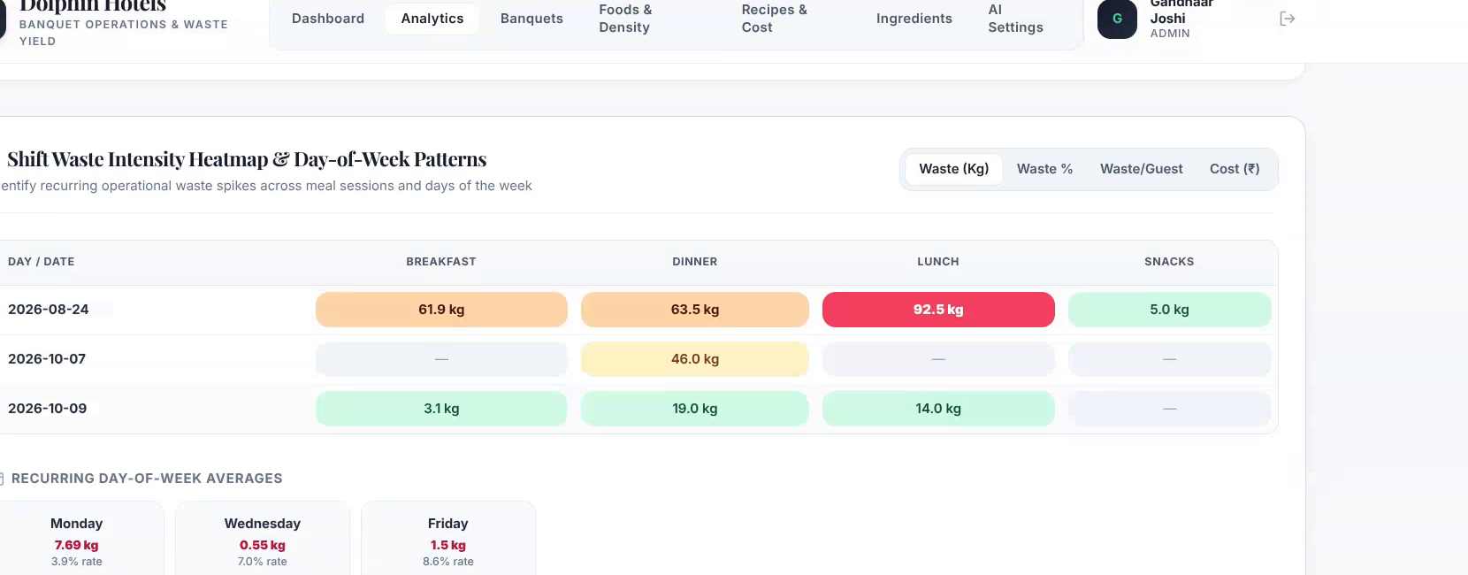
09 / DISH & TIME INTELLIGENCE
Move From Total Waste to the Specific Dishes and Periods Behind It
Combining item-level Pareto rankings with temporal heatmaps directs culinary focus to the high-impact recipes and recurring shift windows.
Current UI: Dish-level waste ranking & Pareto distribution.
Current UI: Shift waste intensity heatmap by day-of-week.
PARETO DISTRIBUTION
TEMPORAL CLUSTERING
Top-Waste Dish Concentration
Heatmap Shift Intensity
• The 80/20 Rule: In Indian hotel banquets, 4–5 core staple recipes consistently generate over 70% of total discarded weight (Plain Rice, Sambar, Rasam, Dal, Biryani).
• Actionable Priority: Eliminating overproduction on just these 4 items solves the vast majority of volume and disposal expense.
• Visual Shift Intensity: Color gradient maps high-loss hotspots across Date × Meal Session (Waste kg, %, Cost ₹).
• Day-of-Week Recurring Patterns: Immediately highlights structural variances—such as heavy Sunday night banquet spikes versus compliant Tuesday lunch services.
PlateSight
AI-Powered Food Waste Monitoring — Prepared for Dolphin Group of Hotels
9 / 12
Notes:
SPEAKER NARRATIVE:
Slide 9 answers the two most actionable questions in culinary operations: 'WHAT is being wasted?' and 'WHEN is it being wasted?'
On the left, the Dish Ranking view applies Pareto analysis. Across hundreds of hotel buffet records, we find that chefs do not have a 50-dish waste problem. They have a 4-dish waste problem: Plain Rice, Sambar, Rasam, and Dal. Because these items are inexpensive per kilogram, kitchen prep teams batch cook them in massive 50kg pots without disciplined pacing.
On the right, the Shift Intensity Heatmap cross-references meal sessions against days of the week. Management instantly sees whether waste clusters around Sunday night wedding buffets or Friday conference luncheons.
TRANSITION:
What does this waste actually mean in rupees and profit margins? Slide 10 presents our Financial Valuation and Savings Simulator.
CAVEAT:
Ranking accuracy depends on consistent dish categorization. Recipes with minor naming variations (e.g., 'Plain Rice' vs 'Steamed Rice') are unified during data standardization.

Slide 10
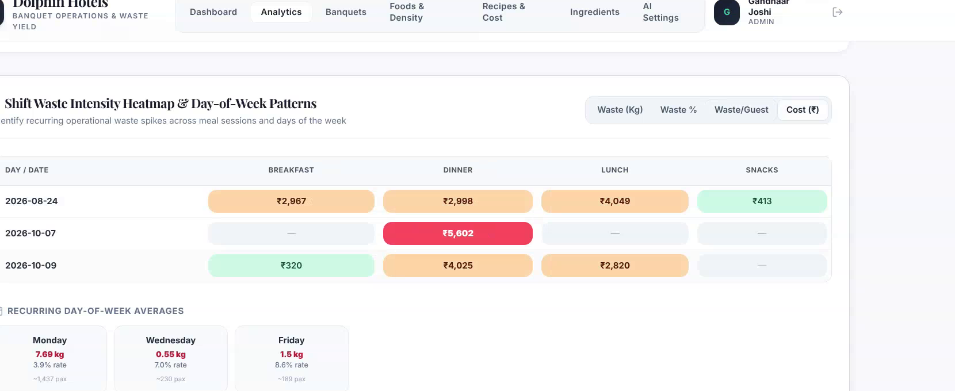
10 / FINANCIAL IMPACT
Turn a Recorded Quantity Into a Transparent Financial Scenario
Distinguishing verified ingredient cost records from hypothetical reduction scenarios provides finance with a disciplined business case.
VERIFIED SAHARA BASELINE (24 AUG 2026)
Single-Dish Case Study: Plain Rice
Recorded Source Log (24.08.26):
• Lunch Discarded: 26.2 kg (1,722 PAX)
• Dinner Discarded: 29.2 kg (752 PAX)
• Combined Daily Waste: 55.4 kg
• Source Sheet Rate: ~₹20/kg (raw base)
• Recorded Daily Cost: ₹1,108 / day
Illustrative Fully Loaded Cost (₹40/kg):
• Full Cooked Cost: ₹40/kg (ingredients + labor + gas)
• Daily Baseline Cost: 55.4kg × ₹40 = ₹2,216 / day
• 50% Reduction Target: 27.7kg = ₹1,108 / day saved
• 30-Day Potential Savings: ₹33,240 / month
(On Plain Rice alone at a single property!)
Current interface snapshot: Savings Simulator & Financial Impact Engine.
SIMULATOR METHODOLOGY
Scenario Modeling Principles
WHAT-IF REDUCTION SIMULATOR
• Dynamic Target Sensitivity: Interactive slider tests 5% to 50% waste curtailment scenarios in real time.
• ERP Cost Integration: Cost per kg automatically derives from master storeroom ingredient rate contracts.
• Direct EBITDA Impact: 100% of avoided food waste expense flows directly to hotel net margin.
Interactive Management Scenarios (Monthly Impact)
• -10% Reduction: ₹6,648 / mo potential savings (Conservative batch re-timing).
• -20% Reduction: ₹13,296 / mo potential savings (Moderate, 2-stage pan replenishments).
• -30% Reduction: ₹19,944 / mo potential savings (Optimized, live sensor-triggered refills).
• Note: Illustrative potential savings based on ₹40/kg fully loaded cost model to guide executive targets.
PlateSight
AI-Powered Food Waste Monitoring — Prepared for Dolphin Group of Hotels
10 / 12
Notes:
SPEAKER NARRATIVE:
Let us now examine the real financial opportunity using Dolphin's own audited operational data.
In the Sahara daily production report for 24 August 2026, lunch recorded 26.2 kg of Plain Rice waste across 1,722 guests. Dinner recorded 29.2 kg across 752 guests. Combined, that is 55.4 kilograms of Plain Rice discarded in a single 24-hour period.
In the hotel's raw spreadsheet, this is booked at ~₹20/kg raw rice base rate, yielding ₹1,108 in recorded cost.
However, as every F&B director knows, cooked rice does not cost ₹20/kg. When you factor in RO water, cooking gas, kitchen labor, and preparation overhead, fully loaded cooked rice costs approximately ₹40/kg.
At ₹40/kg:
• 55.4 kg × ₹40 = ₹2,216 per day in cooked food loss.
• A realistic 50% waste reduction saves 27.7 kg per day = ₹1,108 saved every day.
• Over 30 days, that represents ₹33,240 in recovered margin every month—on a single staple dish at a single property!
TRANSITION:
How does executive leadership verify that these figures are real and tamper-resistant? Slide 11 explores Trust, Audit Controls, and Multi-Property Rollout.
CAVEAT:
We distinguish recorded source spreadsheet costs (~₹20/kg raw ingredient base) from illustrative fully loaded operational costs (assumed ₹40/kg). The simulator models potential savings to guide hotel operational target-setting.

Slide 11
11 / GOVERNANCE & INTEGRATION
Reliable Decisions Depend on Consistent Records
Centralized analytics require strict data hygiene, transparent calculation definitions, and unified multi-property controls.
AUDIT INTEGRITY
MULTI-PROPERTY ROLLOUT
ROLE-BASED GOVERNANCE
Human-in-the-Loop Controls
Dolphin Property Portfolio
Tailored Stakeholder Views
• Photo Evidence: Every hardware scan captures a high-resolution image record for verification and chef dispute resolution.
• Manager Override: Authorized supervisors can review and adjust dish classifications, PAX counts, or waste reasons via secure modal.
• Immutable Log: Every weight transaction is timestamped and secured against unauthorized alteration or retroactive editing.
• Tamper Resistance: Eliminates adversarial gaming and ensures finance can rely on data integrity.
• Unified Data Schema: Single dashboard filters effortlessly across Sitara Luxury, Sahara Banquets, Tara, and Eureka.
• Cross-Kitchen Benchmarking: Compares grams-per-guest efficiency across kitchen brigades cooking identical menu specifications.
• Centralized Oversight: Headquarters view for Ramoji Film City executive leadership to monitor portfolio-wide trends.
• Scalable Architecture: Start with a pilot station at Sahara and scale seamlessly to Sitara and Tara.
• Executive / GM: High-level monthly savings, sustainability metrics, and property scorecards.
• F&B Controller / Finance: Recipe variance, ingredient wastage costs, inventory drift, and procurement alignment.
• Executive & Sous Chefs: Shift action cards, batch timing recommendations, and item-level waste rankings.
• Kitchen Stewards: Simple, language-agnostic color-coded station confirmations.
PlateSight
AI-Powered Food Waste Monitoring — Prepared for Dolphin Group of Hotels
11 / 12
Notes:
SPEAKER NARRATIVE:
For an analytics platform to succeed in enterprise hospitality, two stakeholder groups must trust it completely: the finance controller and the culinary team.
If chefs feel the system is an inaccurate surveillance tool, they will bypass it. If finance suspects the numbers are unverified, they will not use it for costing.
Slide 11 addresses governance directly:
1. Audit Integrity: Every scan stores high-resolution image evidence. Sous chefs have full rights to audit and override dish tags with recorded rationale.
2. Multi-Property Rollout: The architecture is built for Ramoji Film City's full portfolio—Sitara Luxury Hotel, Sahara Banquets, Tara, and Eureka. Management can benchmark kitchen efficiency under identical menu standards.
3. Role-Based Views: The GM sees executive margin impact; the F&B controller audits ingredient variance; the head chef receives actionable batch timing recommendations.
TRANSITION:
Let us conclude with the continuous improvement loop and our structured pilot roadmap. Slide 12.
CAVEAT:
Role-based permissions and multi-property user access controls are configured during pilot onboarding in collaboration with Dolphin IT and F&B leadership.

Slide 12
CONTINUOUS IMPROVEMENT • PILOT NEXT STEPS
Measure. Investigate. Adjust. Measure Again.
The PlateSight analytics continuous improvement loop for Dolphin Group of Hotels.
THE 4-STAGE PILOT ROADMAP
Structured 60-Day Pilot Milestones
Phase 1: Baseline Recording (Weeks 1–2)
Deploy automated monitoring & ingest daily Excel logs. Capture true, unadjusted operational baseline across lunch and dinner buffets.
Phase 2: Recipe & Cost Mapping (Weeks 3–4)
Map Dolphin Group ingredient master rate sheets into the costing engine to establish authoritative rupee valuations.
Phase 3: Targeted Batch Interventions (Weeks 5–6)
Implement action card recommendations on top 3 high-waste items (Plain Rice, Sambar) with staged pan replenishment.
Phase 4: Financial Validation & Review (Weeks 7–8)
Measure post-intervention waste reduction and audit validated rupee savings with hotel GM and finance leadership.
PlateSight Intelligence
Building a smarter, more measurable approach to banquet food waste.
Web Portal: ai.platesight.in/analytics
Email Contact: gandhaar.joshi@platesight.in
Presenter: Gandhaar Joshi, Co-Founder
Partner Property: Dolphin Group of Hotels • Ramoji Film City
PlateSight
AI-Powered Food Waste Monitoring — Prepared for Dolphin Group of Hotels
12 / 12
Notes:
SPEAKER NARRATIVE:
Food waste in hospitality operations has historically been treated as an unavoidable cost of doing business. With PlateSight, it becomes a controlled, measurable operational variable.
Our philosophy is simple: Measure. Investigate. Adjust. Measure Again.
We propose a structured, 60-day pilot engagement with Dolphin Group of Hotels:
• In Weeks 1 and 2, we establish an unadjusted baseline without interfering with kitchen operations.
• In Weeks 3 and 4, we integrate Dolphin's exact ingredient costs and master recipe rates.
• In Weeks 5 and 6, we implement simple staged batch interventions on the top 3 high-waste items (Plain Rice, Sambar).
• In Weeks 7 and 8, we audit the verified rupee savings together with executive leadership and finance.
Thank you for your partnership and vision in making hospitality operations smarter and more sustainable.
TRANSITION:
We now invite Mr. Ramoji Rao's leadership team, General Managers, and the Executive Culinary Directors to discuss pilot venue selection (Sahara vs Sitara), baseline scheduling, and opening the floor for questions.
CAVEAT:
Implementation timeline assumes timely access to daily banquet event orders (BEOs), daily store requisition rate cards, and kitchen cooperation during initial baseline logging. Physical edge stations require standard single-phase 230V power and local Wi-Fi / 4G coverage at the stewarding wash-up area.

