Slide 1
AI Banquet Food Waste & Cost Analytics
Dolphin Hotels & Ramoji Pilot: Optical Waste Recognition Platform
1/3
THE CHALLENGE
Hospitality Waste Blindspot
• 15% to 25% of prepared banquet food in Indian luxury hotels ends up in surplus waste.
• Traditional paper logs and floor weighing create severe kitchen bottlenecks during peak event turnaround.
• Zero itemized visibility: Chefs lack dish-specific data on which banquet items see highest post-event loss.
THE INNOVATION
Zero-Friction Optical AI
• Instant computer vision scanning: Kitchen staff simply point a camera or upload a chafing dish photo.
• Specialized YOLO Indian Food Neural Network: Recognizes 31 traditional menu items with high-precision bounding boxes.
• Seamless staff verification workflow: Automatic classification with rapid 1-click audit override.
BUSINESS VALUE
Protecting Culinary Margins
• Reduces daily kitchen audit time from 30+ minutes of manual scale tracking to under 3 seconds per dish.
• Enables data-driven portion sizing for recurring weddings, corporate conventions, and festive banquets.
• Supports ESG sustainability reporting and zero-landfill culinary compliance targets.

Slide 2
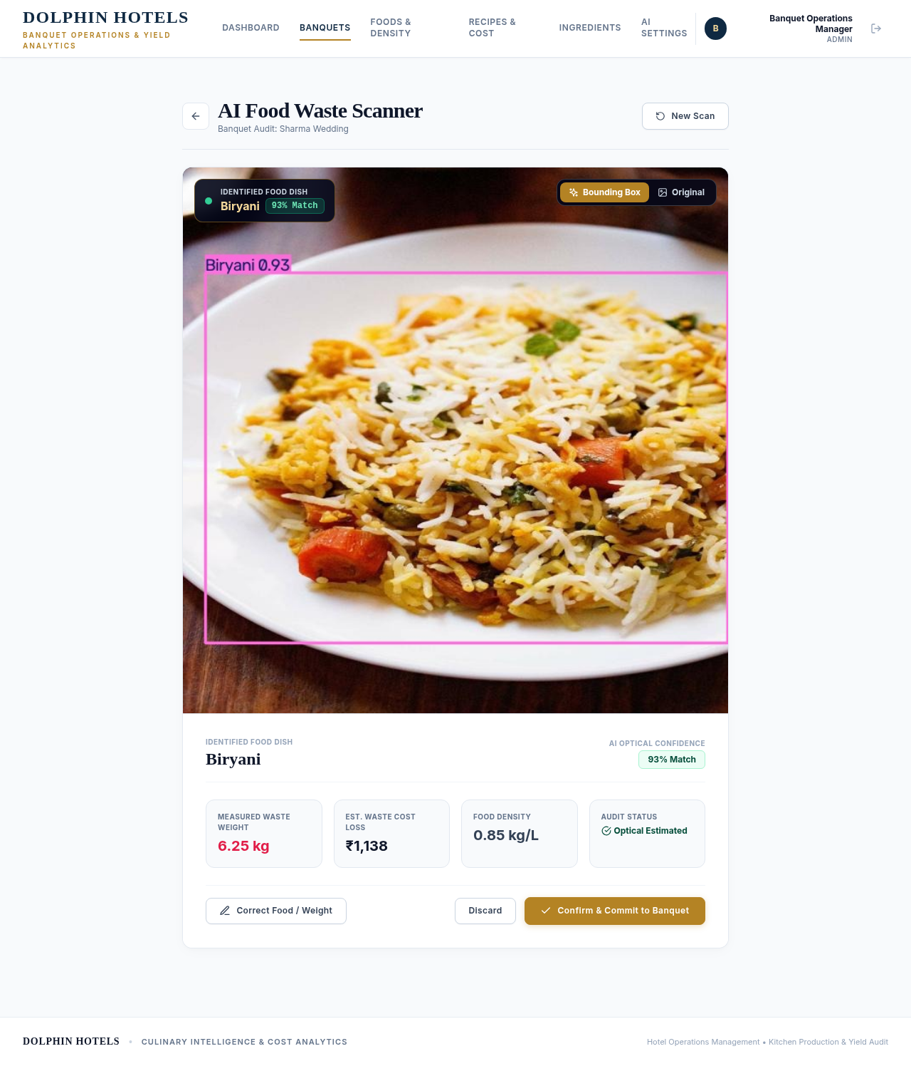
Computer Vision Engine: Real-Time YOLO Inference
Custom 31-Class Indian Food Segmentation & Optical Classification (best.pt)
2/3
MODEL ARCHITECTURE & PERFORMANCE
Custom YOLO Indian Food Vision
• Culinary Classes: 31 Indian items (Biryani, Rajma, Palak Paneer, Dal, Dosa, Poha, Sweets).
• Augmentation Pipeline: Mosaic (1.0) & Mixup (0.25) to simulate overlapping buffet chafing pans.
• GPU Inference Speed: ~11.2 ms per frame on NVIDIA GeForce RTX 4060 hardware.
• Multi-Input Ingestion: Dedicated real-time webcam feed with live HUD + Drag-and-Drop photo upload.
• Visual Verification: Automated bounding box overlay + instant confidence match badge.

Slide 3
Operational Workflow & Business Impact
Closing the Feedback Loop from Banquet Floor to Culinary Planning
3/3
PHASE 1
Kitchen Scan Capture
• Staff scans dish leftovers at tray clearance station.
• Two intuitive modes: Live webcam stream or high-res smartphone photo upload.
• Zero training required for floor stewards and culinary audit staff.
PHASE 2
Neural Classification
• YOLO extracts bounding coordinates and cross-references banquet menu hints.
• High-confidence match badge rendered directly on the dish preview.
• One-click audit correction allows instant menu override if dish is ambiguous.
PHASE 3
Executive Intelligence
• Automatic commitment to Event Banquet Waste Ledger.
• Direct recipe intelligence: highlights consistently over-prepared menu items.
• Scalable to multi-property luxury hotel chains (Dolphin Hotels / Ramoji Film City).

