Slide 1
AMAZON

Slide 2
CONTENTS
INTRODUCTION
VISION, MISSION AND VALUES
PRODUCTS AND SERVICES
SWOT ANALYSIS
BUSINESS STRATEGIES
MARKET ANALYSIS
CONCLUSION

Slide 3
INTRODUCTION
Amazon was founded by Jeff Bezos in July 1994.
Opened its virtual doors on the WWW in July 1995.
Started as online marketplace for books.
Surpassed walmart as most valuable retailer.

Slide 4
VISION, MISSION & VALUES

Slide 5
PRODUCTS AND SERVICES

Slide 6
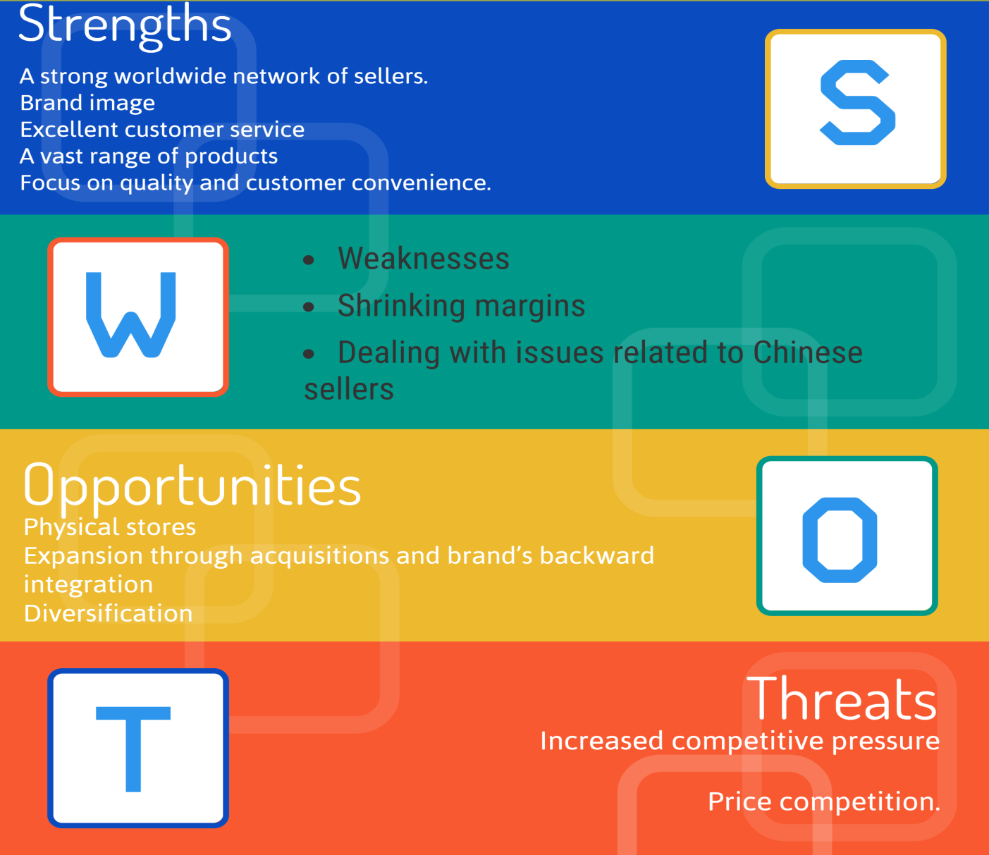
SWOT ANALYSIS

Slide 7
BUSINESS STRATEGIES
Know the customer
Maximize data
Be innovative
Create a comprehensive CRM strategy
Increase customer retention

Slide 8
MARKET VALUES

