Slide 1
(Permanently Affiliated to University of Mumbai)
SMART DIGITAL ALARM CLOCK
SHAMIKA DEASI -513
DEEPSHIKHA DUBEY -515
DRISHTI GANDHI -518

Slide 2
(Permanently Affiliated to University of Mumbai)
ABSTRACT:
> A Digital clock generally a device that help us to know the accurate current time.
> The main purpose of smart digital clock is to comprises a an alarm system which is represented in digitalized way.
The clock would be capable of displaying the temperature and also consist of a buzzer that starts to ring when clock reaches its set time.

Slide 3
(Permanently Affiliated to University of Mumbai)
INTRODUCTION:
The Arduino based Real Time Clock is a smart digital clock to display real time using a RTC IC DS1307 which works on I2C protocol. Real time clock means it runs even after power failure. When power is reonnected ,it displays the real time irrespective to the time and duration it was in off state .Also we have used 16*2 LCD module to display the time in(hour ,minute ,seconds,date,month,year,temperature) format. An alarm option is also added and we can set up the alarm time.

Slide 4
(Permanently Affiliated to University of Mumbai)
SOFTWARE:
ARDUINO IDE
HARDWARE:
BREADBOARD
REAL TIME CLOCK(RTC)
ARDUINO
LCD I2C
BLUETOOTH
BUZZER
MALE TO MALE WIRE
MALE TO FEMALE WIRE

Slide 5
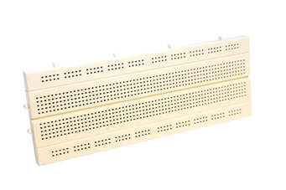
(Permanently Affiliated to University of Mumbai)
ARDUINO IDE
1. BREADBOARD

Slide 6
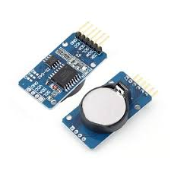
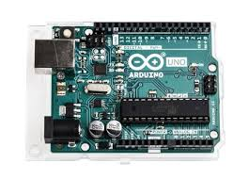
(Permanently Affiliated to University of Mumbai)
2. REAL TIME CLOCK(RTC)
3. ARDUINO

Slide 7
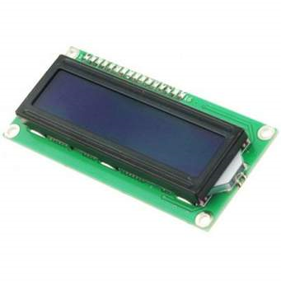
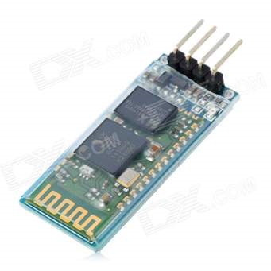
(Permanently Affiliated to University of Mumbai)
4, LCD I2C
5. BLUETOOTH

Slide 8
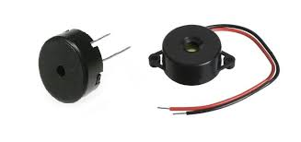
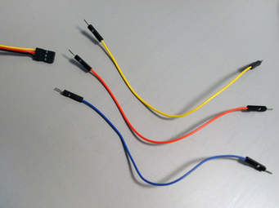
(Permanently Affiliated to University of Mumbai)
6.BUZZER
7. MALE TO MALE WIRE

Slide 9
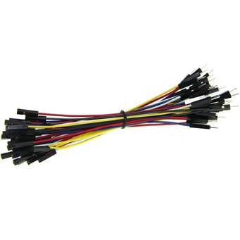
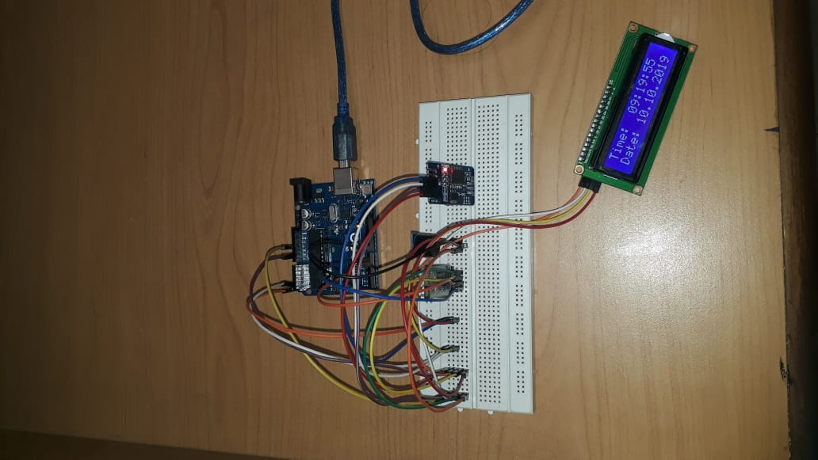
(Permanently Affiliated to University of Mumbai)
8. MALE TO FEMALE WIE

Slide 10
(Permanently Affiliated to University of Mumbai)
WORKING :
Bluetooth with Arduino
Connect GND with any GND of arduino
Connect Rx pin with Tx of arduino
Connect Tx pin with Rx of arduino
LCD I2C with Arduino
Connect GND with GND of arduino
Connect VCC with 5V
Connect SDA with A4
Connct SCL with A5

Slide 11
(Permanently Affiliated to University of Mumbai)
Buzzer with Arduino:
Connect GND with GND of arduino
Connect supply wire with 9 pin of arduino
Connect VCC with 5V

Slide 12
(Permanently Affiliated to University of Mumbai)

